Slide 1
Lecture 5:
Spatial Mapping with CRNS
Trenton Franz
Assoc. Professor of Hydrogeophysics
School of Natural Resources
Faculty Fellow at the Daugherty Water for Food Global Institute
University of Nebraska-Lincoln

Slide 2
Overview
Why we need spatial data for agriculture
Design of spatial surveys
1D transect examples and case study in Spain
2D examples at watershed and field scale

Slide 3
Measurements of Soil Moisture
TDR Sensor Array
Satellite Remote Sensing
Mobile TDR & EM
1 year
1 month
1 day
Airborne Remote Sensing
1 hour
1 minute
Cosmic-ray Probe and Rover
1 m
100 m
10 km
1000 km
Adapted from Robinson (2008)

Slide 4
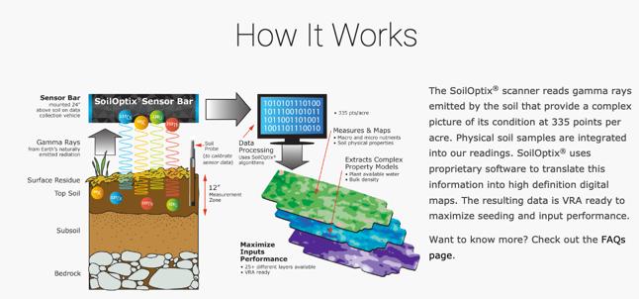
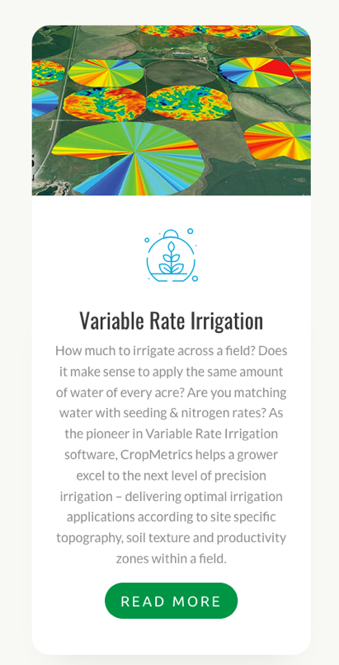
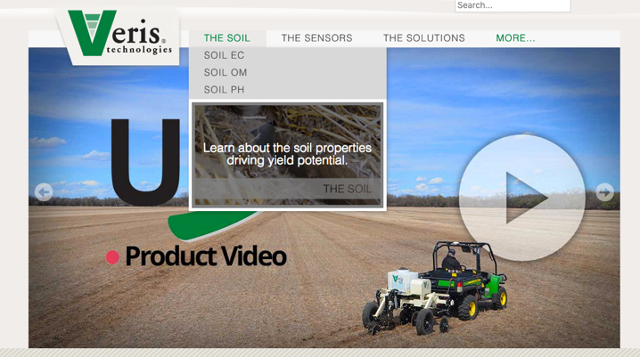
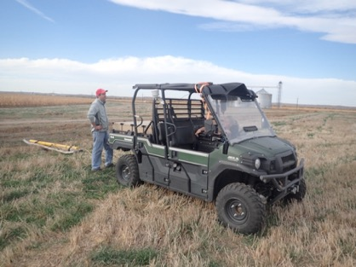
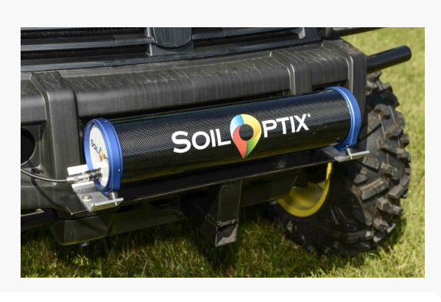
Examples of Geophysical Sensors in Use Today
CropMetrics/CropX
Use Dualem to map soil electrical Conductivity to make prescription maps (water, planting, nitrogen)
SoilOptix
Use gamma ray detector and soil cores to make soil physical and chemical property maps
Veris
Use electrical resistivity and visible light to map soil physical and chemical properties
Photos taken from company websites. Other companies include Trimble and SmartFirmer

Slide 5
Goals For Using Hydrogeophysical Tools
Improve understanding of how agroecosystem functions by better spatiotemporal observations and predictions of soil state, flux, and nutrient transport
  Water, energy and biogeochemical cycles

Slide 6
Goals For Using Hydrogeophysical Tools
Improve understanding of how agroecosystem functions by better spatiotemporal observations and predictions of soil state, flux, and nutrient transport
  Water, energy and biogeochemical cycles
Improve spatial understanding of agronomic inputs, outputs, and changes in storage to better define profitability zones and thus impact decision making
  Return on investment

Slide 7
Goals For Using Hydrogeophysical Tools
Improve understanding of how agroecosystem functions by better spatiotemporal observations and predictions of soil state, flux, and nutrient transport
  Water, energy and biogeochemical cycles
Improve spatial understanding of agronomic inputs, outputs, and changes in storage to better define profitability zones and thus impact decision making
  Return on investment
Add to or replace “Deep Knowledge” gained by history of producer/land manager
  Deep knowledge

Slide 8
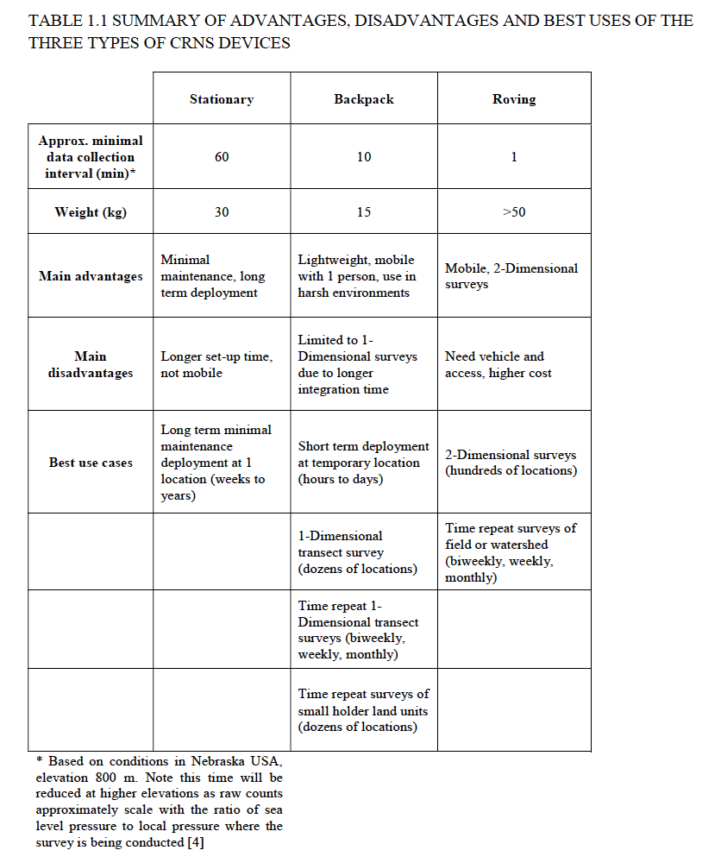
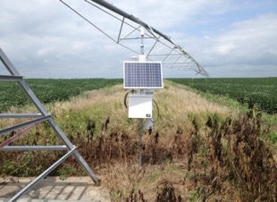
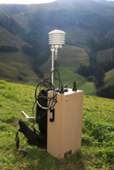
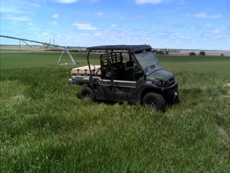
Summary Table
TECDOC 1845

Slide 9
Design of Detectors and Experiments

Slide 10
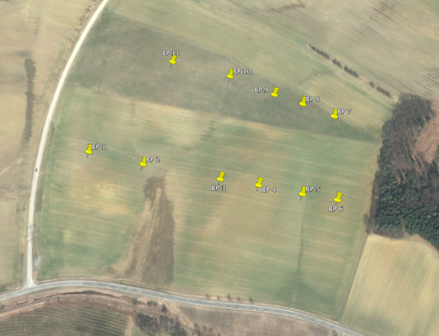
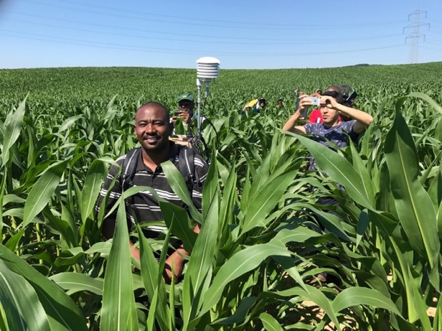
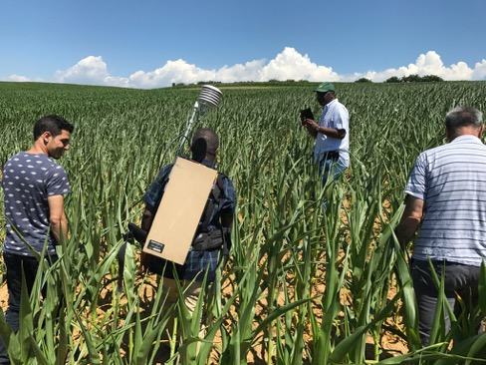
1-D Surveys in Austria

Slide 11
2-D Survey Best Practices
Minimum of ~400 raw counts for each data point
Minimum of 60 data points in sampling area
Sampling time less than 4 hrs
Geostatistics and smoothing algorithms can improve and sharpen images

Slide 12
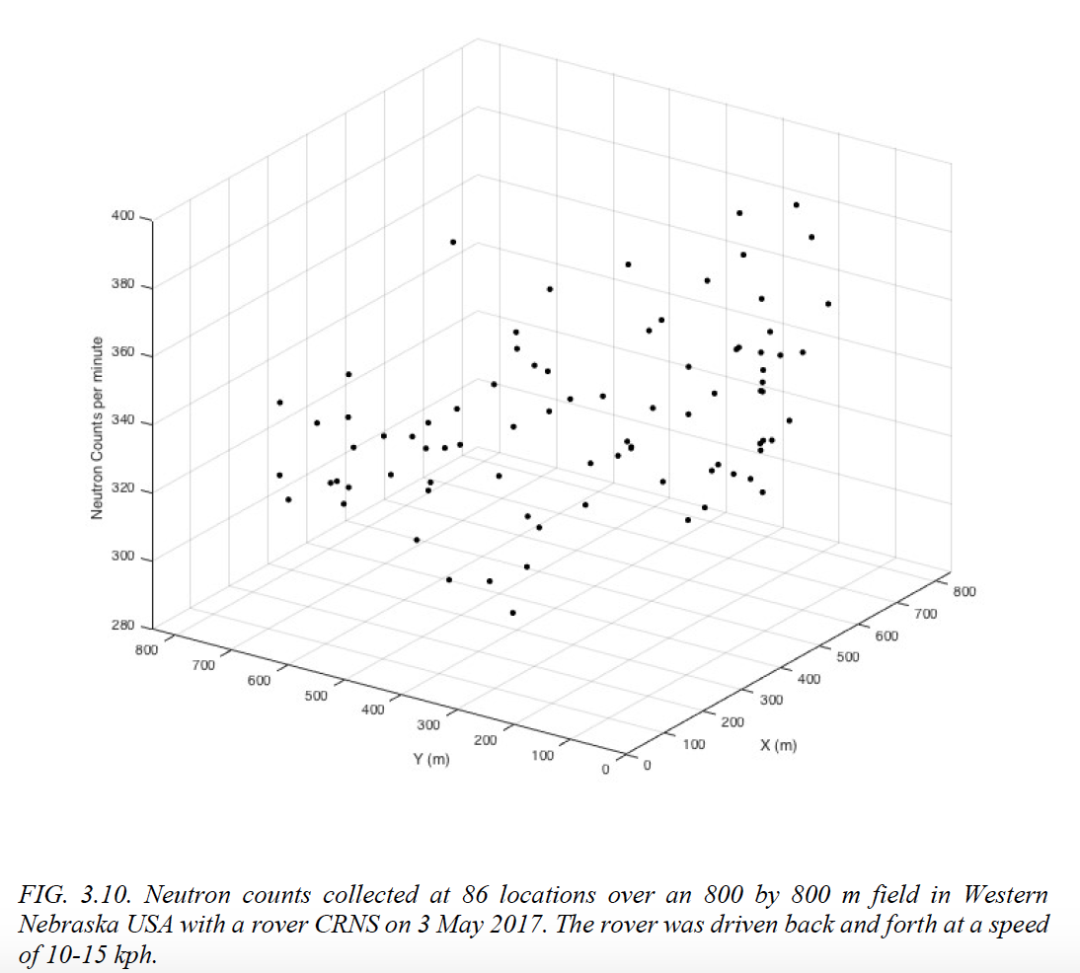
2-D Surveys

Slide 13
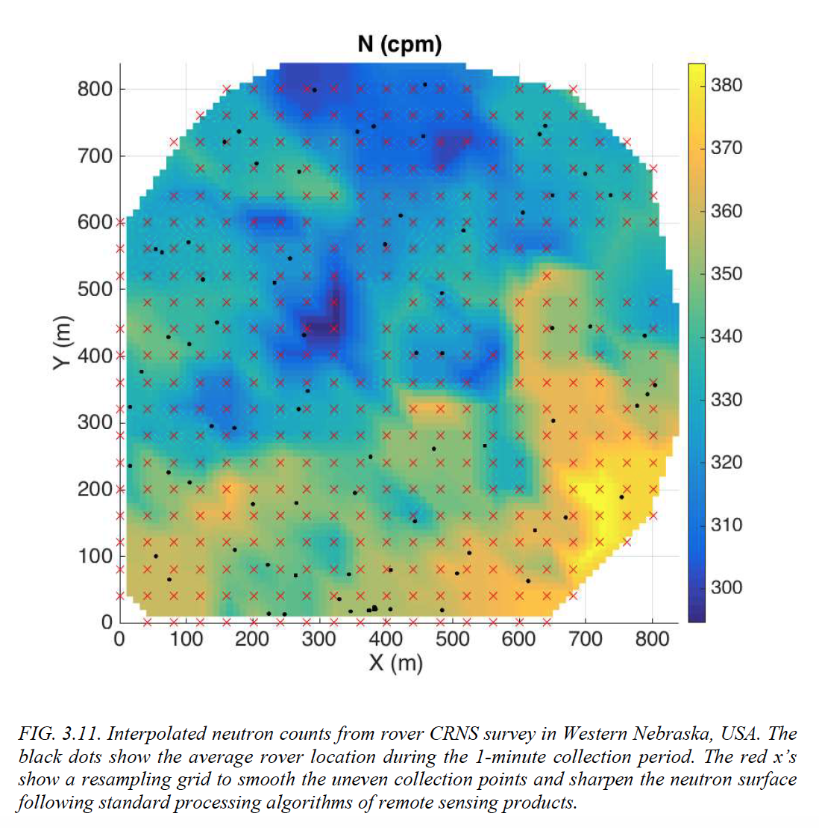
2-D Surveys

Slide 14
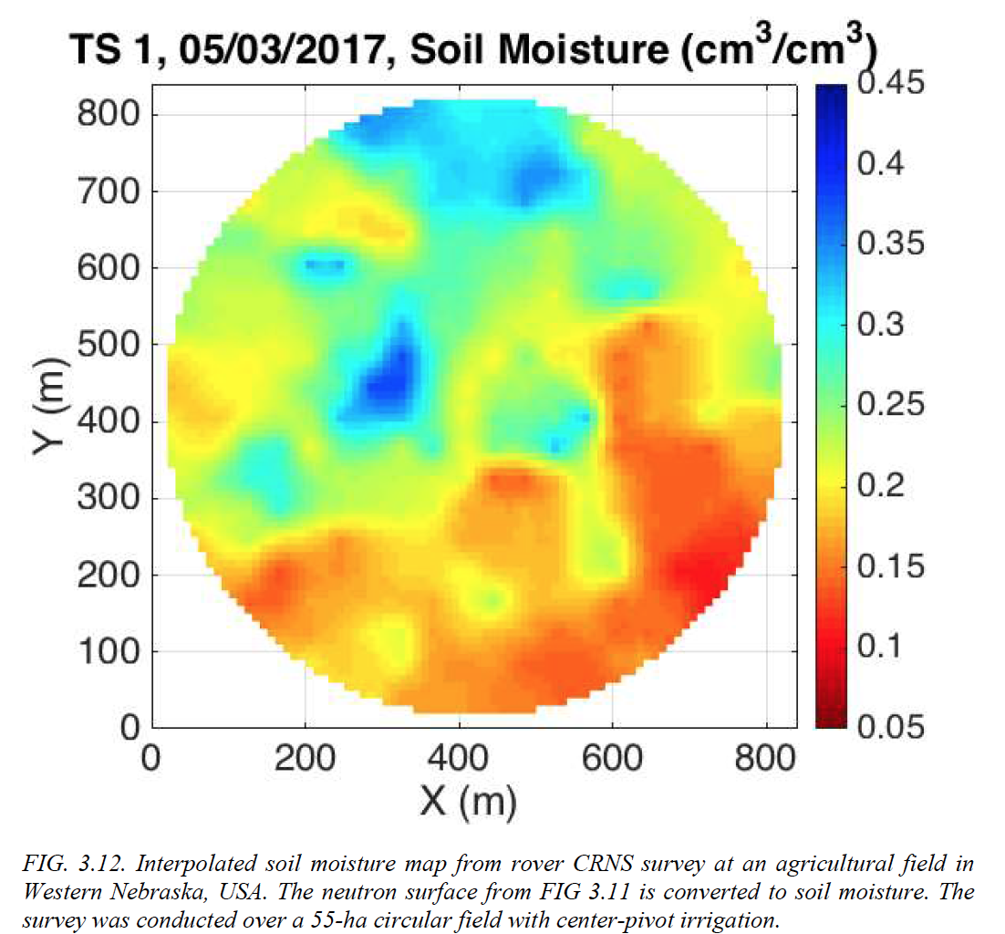
Overview

Slide 15
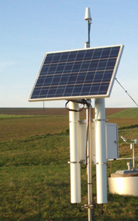
Cross Calibration

Slide 16
CRNS Backpack Surveys At Established Research Sites To Enhance Science

Slide 17
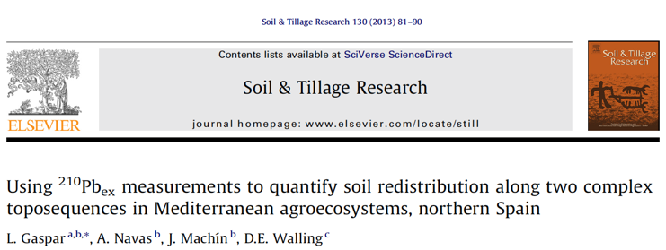
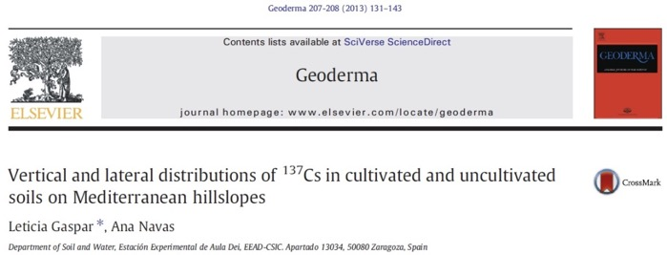
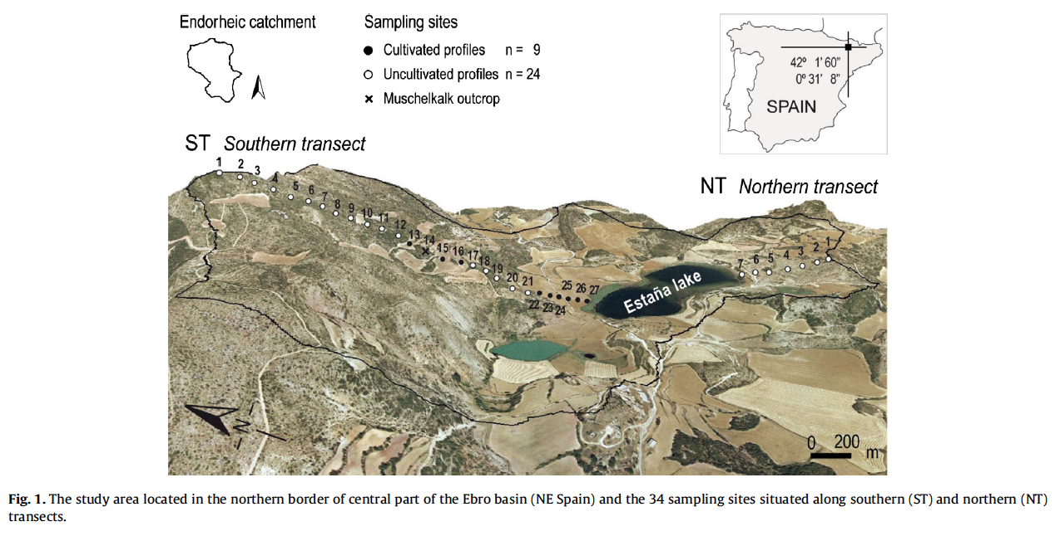
Spain CRNS Backpack Surveys At Established Site
In collaboration with A. Navas, L. Gaspar Ferrer, I. Lizaga Villuendas

Slide 18
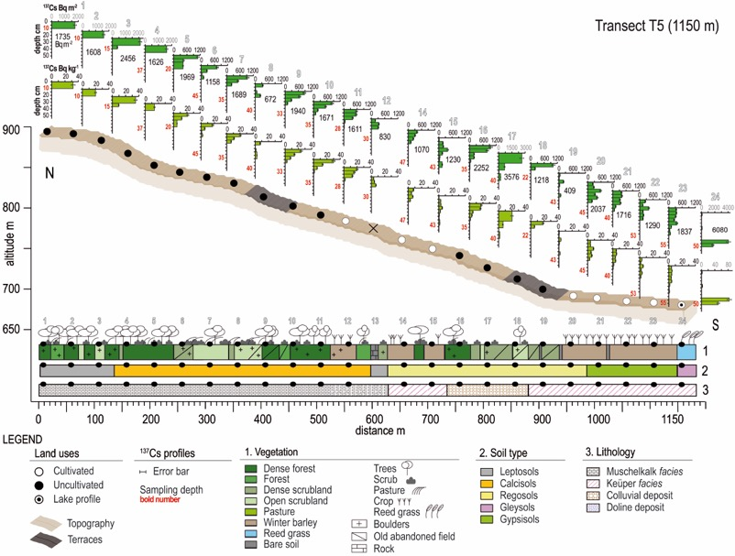
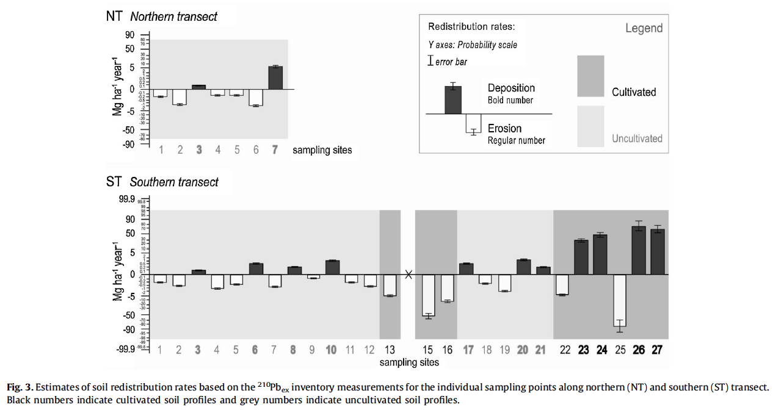
Spain CRNS Backpack Surveys
In collaboration with A. Navas, L. Gaspar Ferrer, I. Lizaga Villuendas

Slide 19
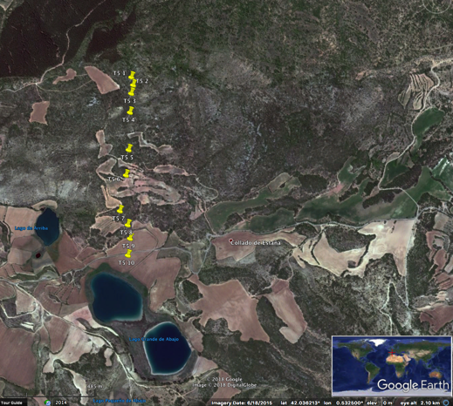
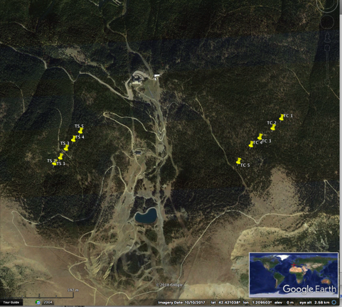
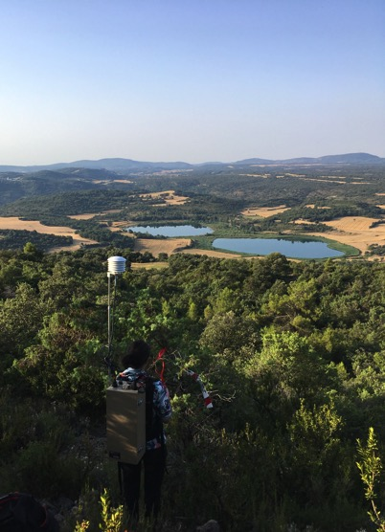
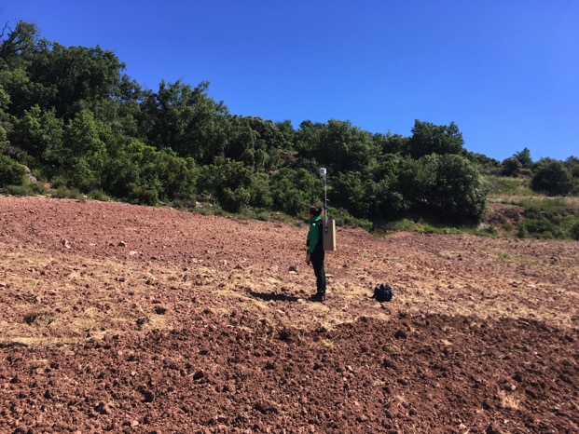
Spain CRNS Backpack Surveys
3 Study sites in Eastern Spain (T5, TC, TS) with 7, 6, and 5 surveys in wet and dry conditions
In collaboration with A. Navas, L. Gaspar Ferrer, I. Lizaga Villuendas

Slide 20
Spain CRNS Backpack Surveys
In collaboration with A. Navas, L. Gaspar Ferrer, I. Lizaga Villuendas

Slide 21
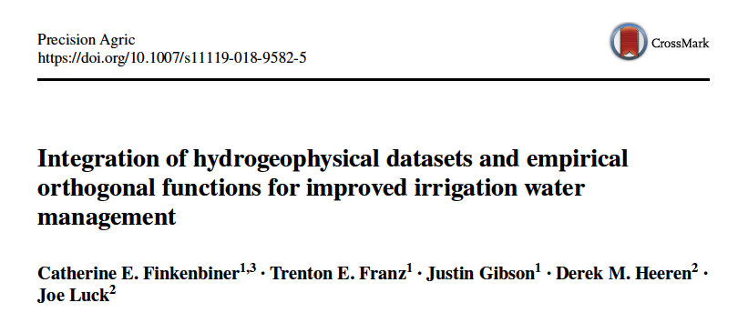
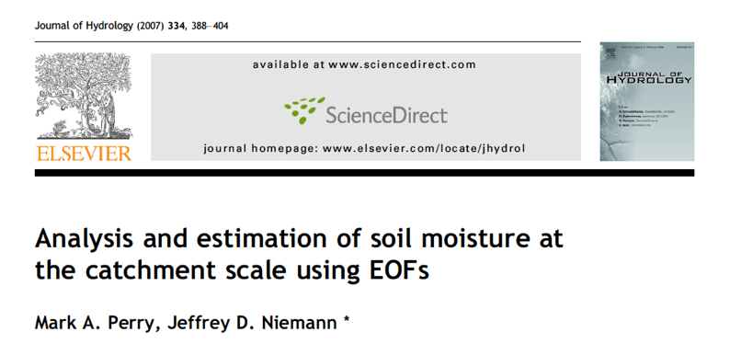
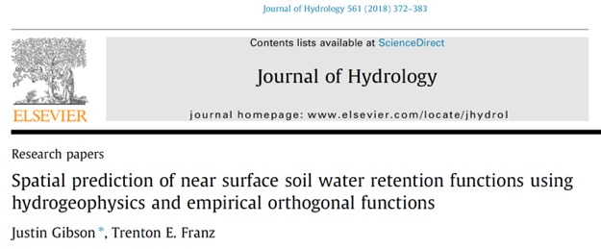
Use EOF framework to seperate spatial and temporal soil moisture anomalies
  Spatial loadings map (EOFs) can be used to group sites of “like” soil moisture states
  Spatial moments of point sensors can be used to describe temporal varying component (ECs)
  Combine reduced number of spatial (EOFs) and time varying loadings (EC) to reconstruct spatial patterns across space and time

Slide 22
Spain CRNS Backpack Surveys
93% of Spatial SM Variability contained in 1st EOF/PCA axis
Relative Wet
Transect Average
Relative Dry
In collaboration with A. Navas, L. Gaspar Ferrer, I. Lizaga Villuendas

Slide 23
Spain CRNS Backpack Surveys
In collaboration with A. Navas, L. Gaspar Ferrer, I. Lizaga Villuendas

Slide 24
Mobile CNRS to detect mesoscale patterns of soil moisture in agricultural regions of Nebraska
Franz et al. 2015 GRL

Slide 25
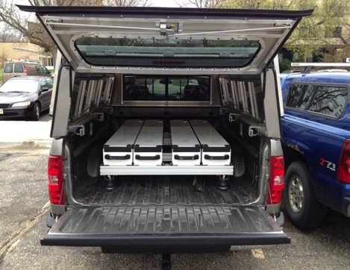
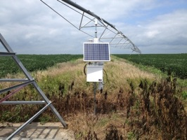
Space-time Mapping of Soil Moisture
Deployed 3 stationary CRS sensors recording hourly soil moisture in irrigated maize, soybean and rainfed maize/soybean near Waco, NE.
Used roving CRS to make daily soil moisture maps every week over a 12x12 km grid with 1.6 km spacing between May and September 2014.
Goal to make continuous soil moisture estimates at individual quarter section level (~0.8 km) using statistical methods
Study Area and Layout of Sensors
Roving Sensor
Stationary Sensor
12 km

Slide 26
Roving CRS Results

Slide 27
CRS and Rover Validation

Slide 28
Statistical Properties

Slide 29
Correlation Between Probes
RMSE = 0.0122 cm³/cm³

Slide 30
Correlation Between Probes
4 km
Split 12 km domain into 9 4x4 km subdomains

Slide 31
Correlation Between Probes
4 km

Slide 32
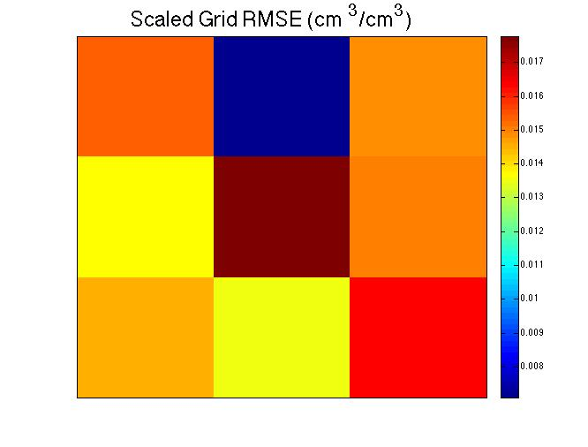
Correlation Between Probes
4 km

Slide 33
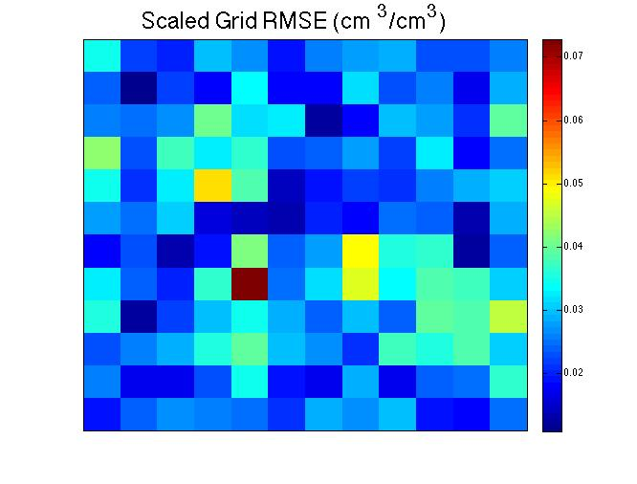
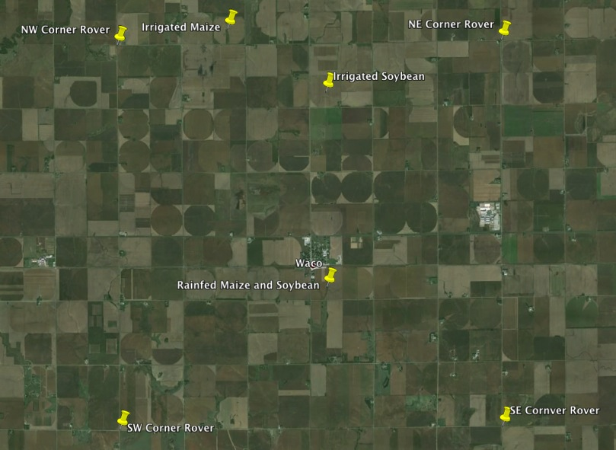
Correlation Between Probes
Split 12 km domain into 144 quarter section subdomains
0.8 km

Slide 34
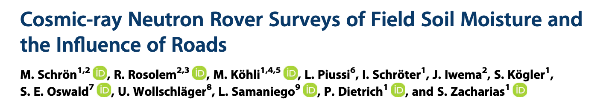
Built Up Environment

Slide 35
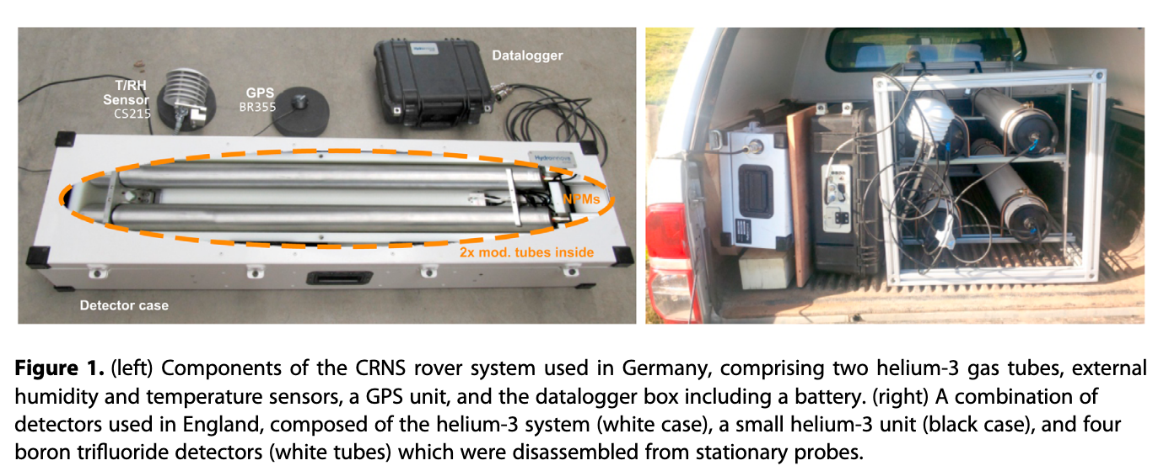
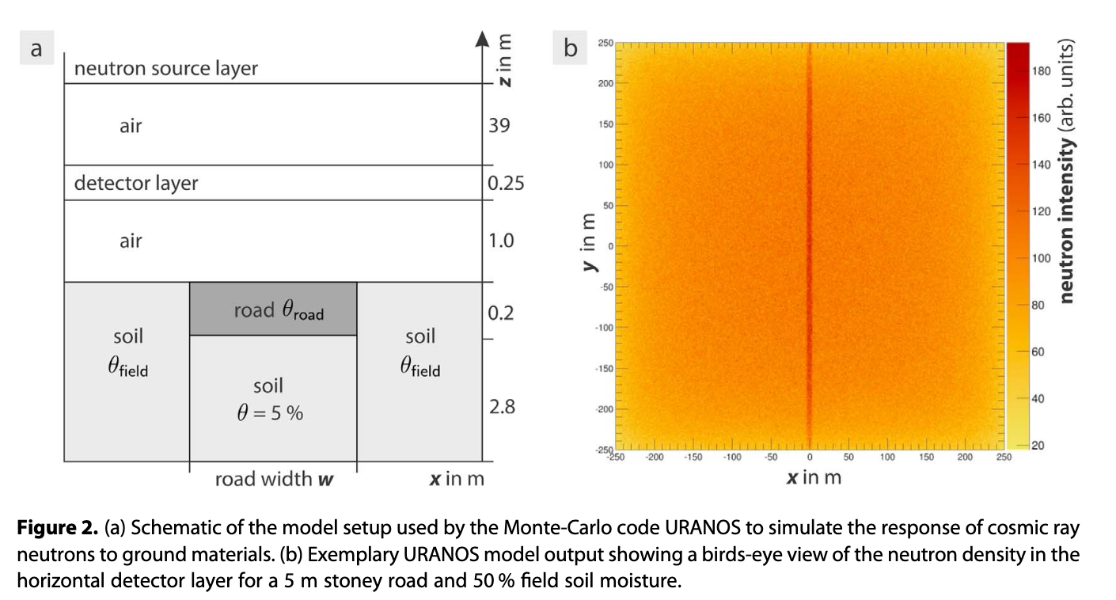

Slide 36
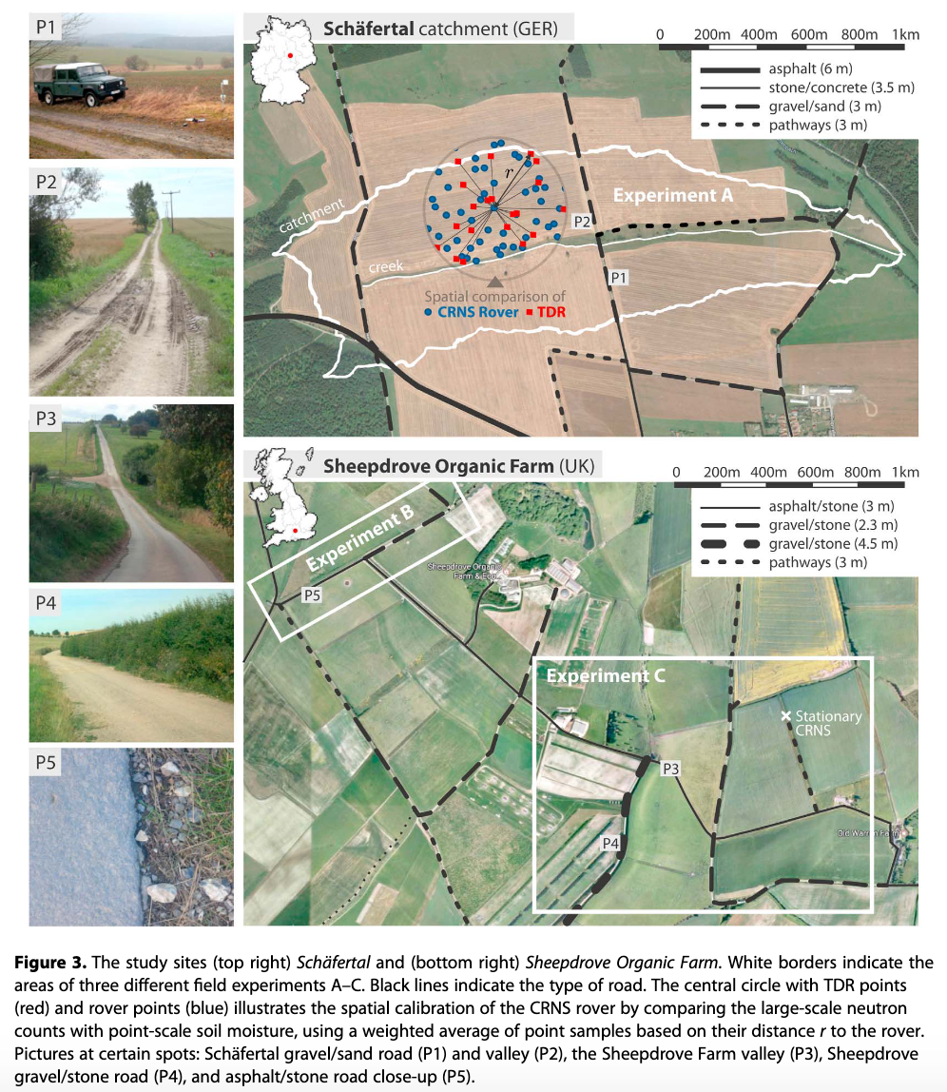
Built Up Environment

Slide 37
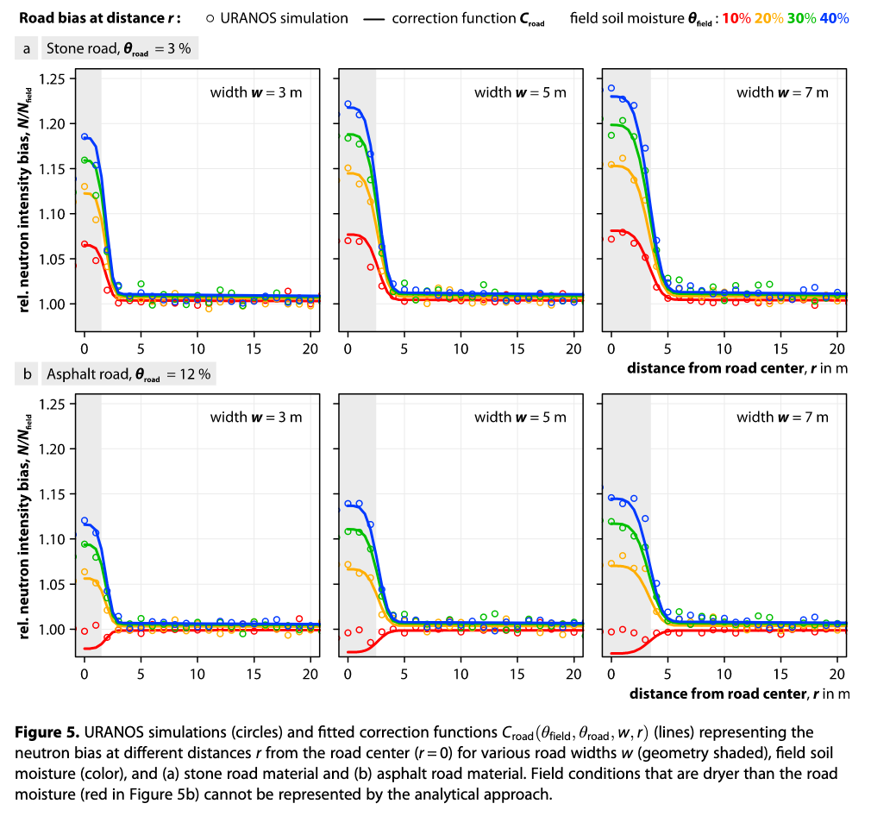
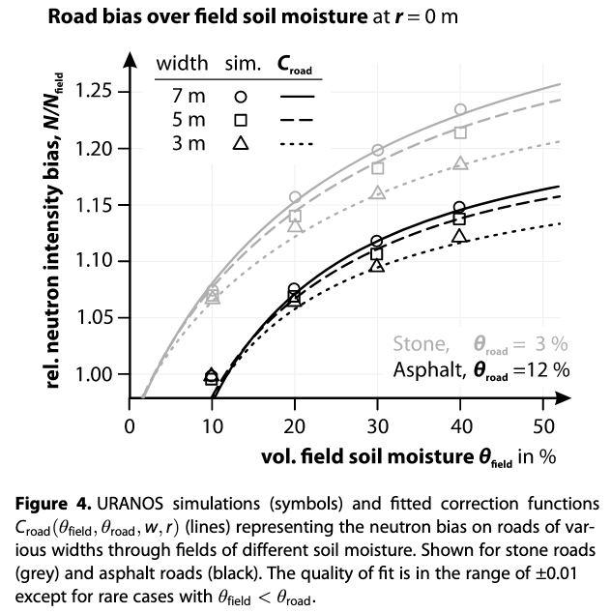
Built Up Environment

Slide 38
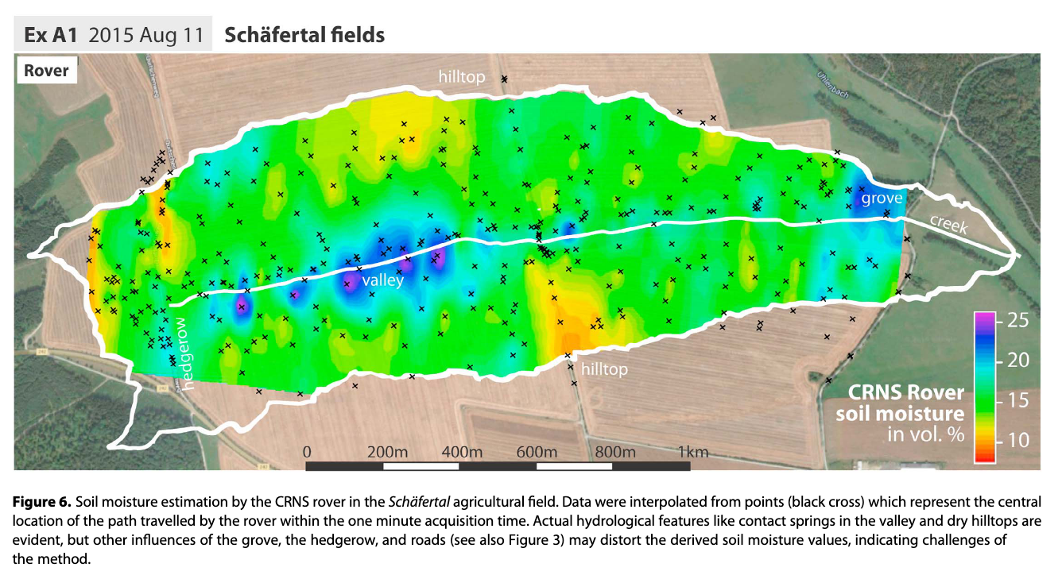
Built Up Environment

Slide 39
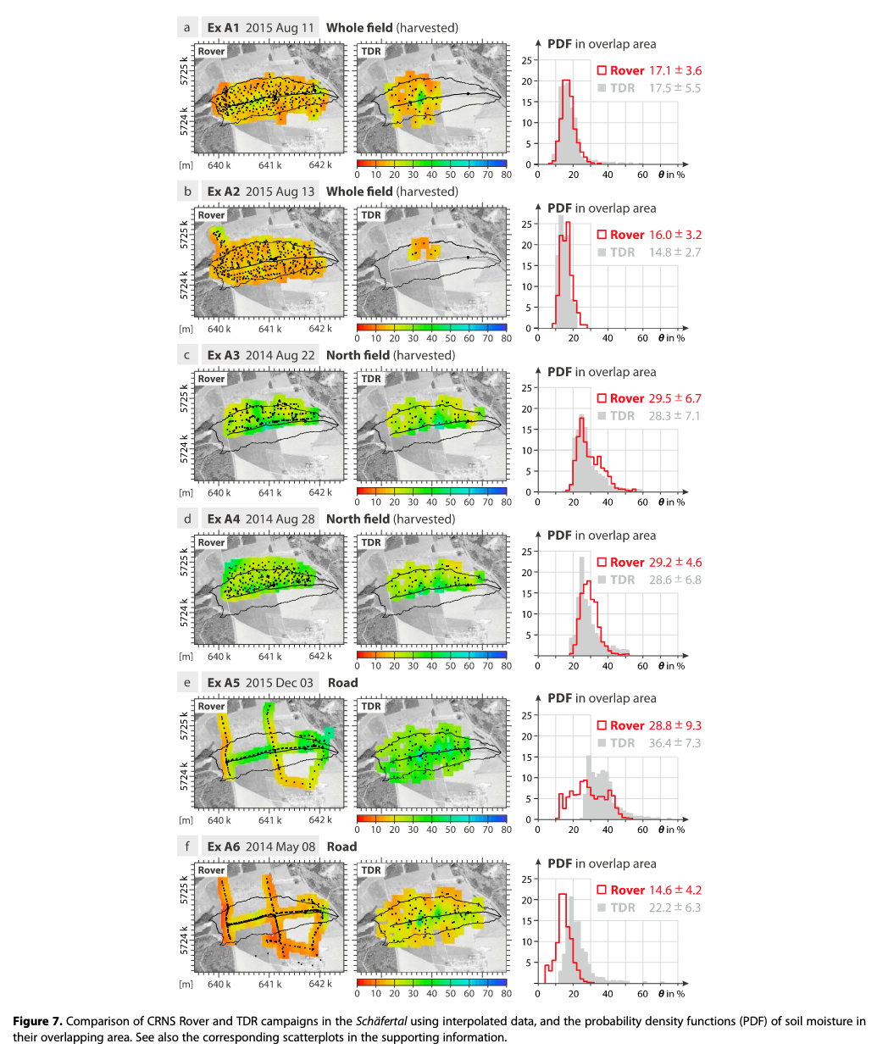
Built Up Environment

Slide 40
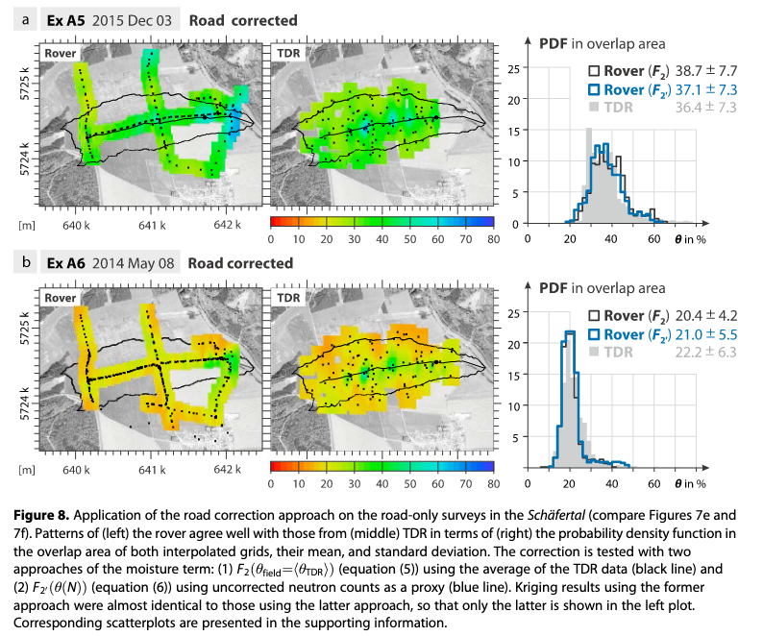
Built Up Environment

Slide 41
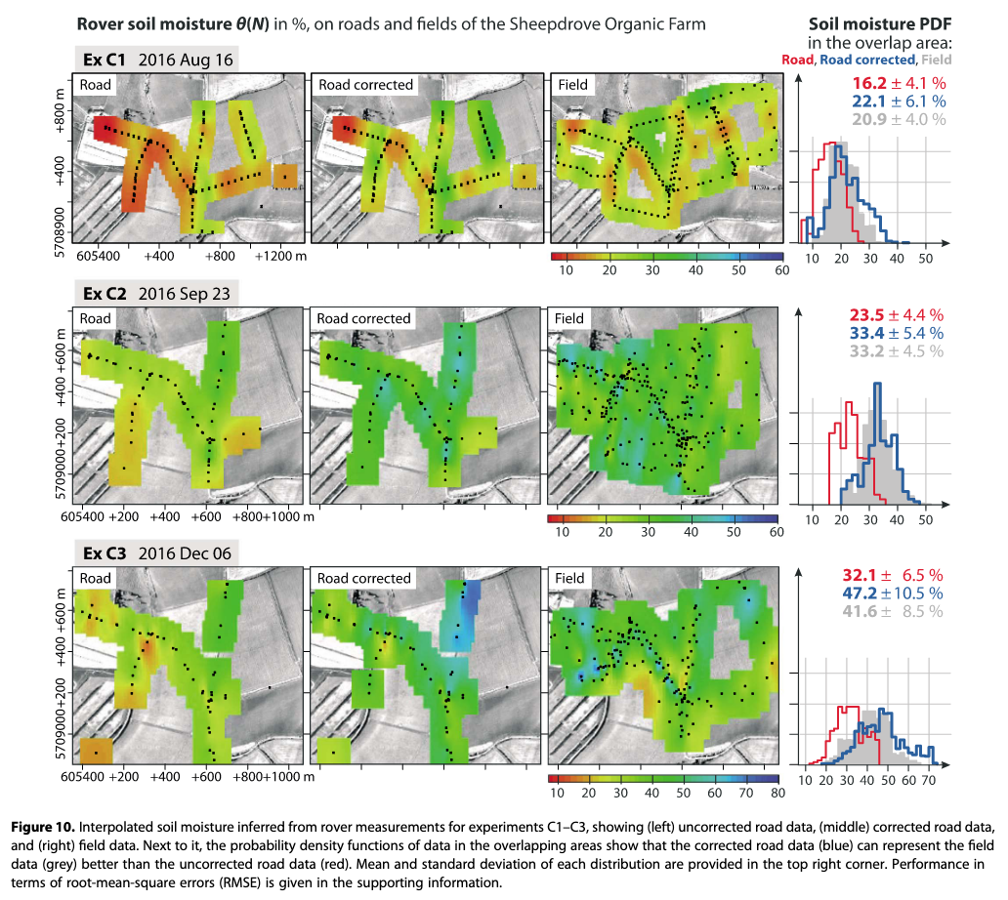
Built Up Environment

Slide 42
Use of mobile CRNS in agriculture

Slide 43
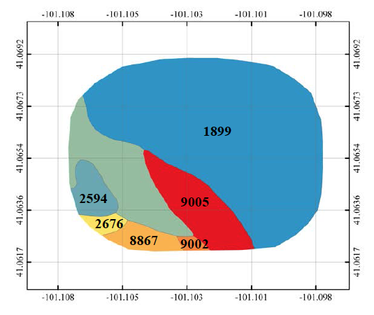
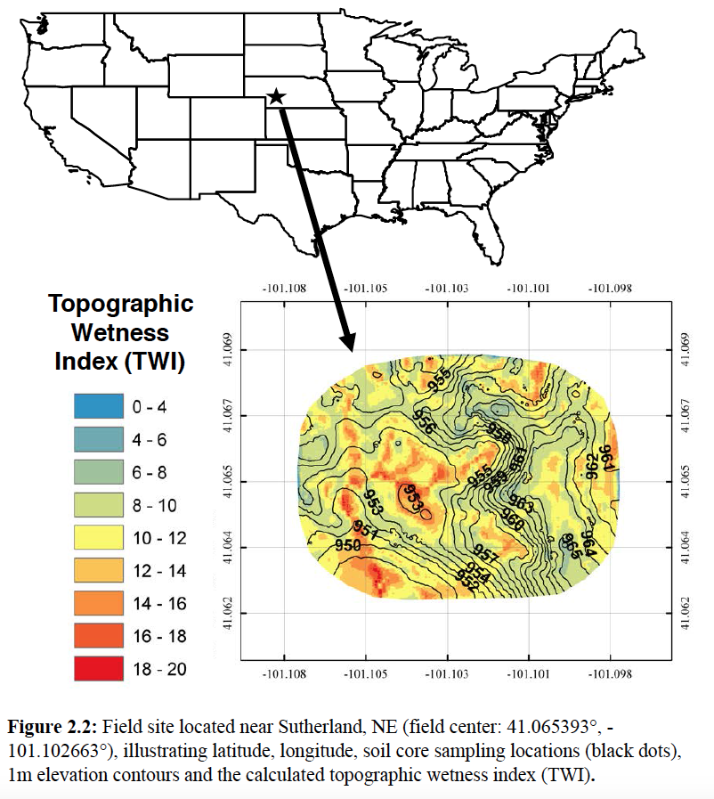
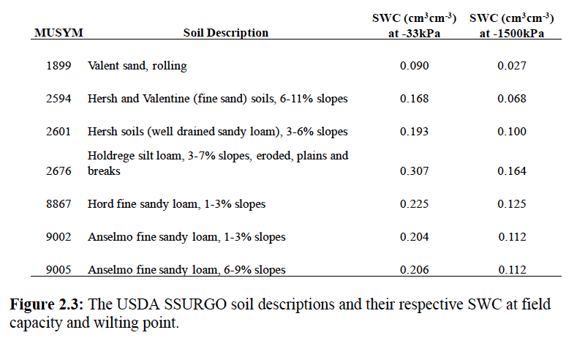
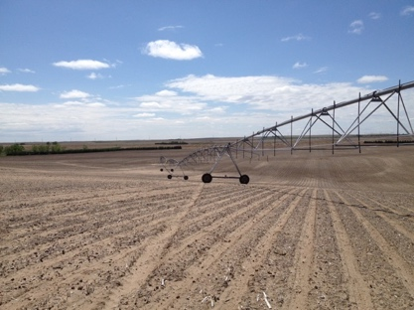
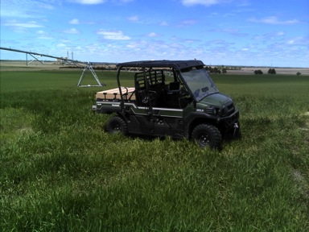
Study Site
Paulman Farms located near Sutherland, NE
Center-pivot irrigated corn
Notes:
Our field site is located at Paulman Farms near Sutherland, NE. It is a center pivot irrigated corn field with ~60ft elevation increase as you travel from west to east. The field is predominantly sand with some sandy loams, and silt loams. The top 30cm of the SSURGO soil database were averaged to approximate field capacity for the field. The field capacity estimates are summarized in the table.

Slide 44
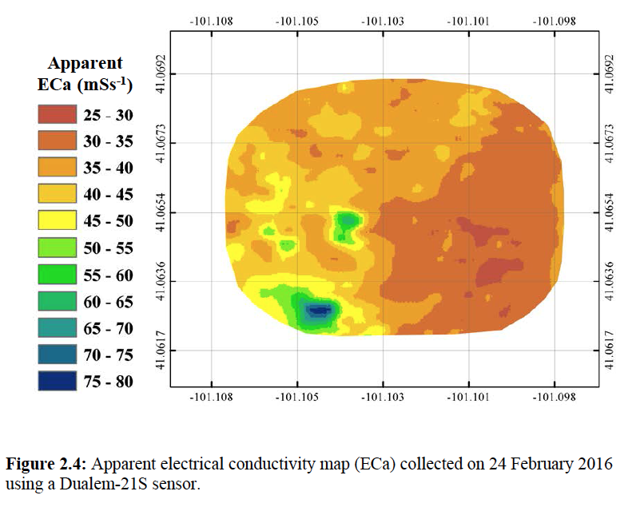
Hydrogeophysical Mapping

Slide 45

Multivariate Statistical Techniques
Use EOF framework to seperate spatial and temporal soil moisture anomalies
  Spatial loadings map can be used to select monitoring sites of “like” soil moisture states
  Fixed CRNP or point sensors can be used to describe temporal varying component
  Combine spatial and time varying loadings to reconstruct spatial image
V*E = L*E

Slide 46
EOF Example
Spatial Loadings
EV | Explained Spatial Variance
1 | 90.5%
2 | 4.3%
3 | 1.6%
4 | 1.2%
5 | 1.0%
6 | 0.8%
7 | 0.6%

Slide 47
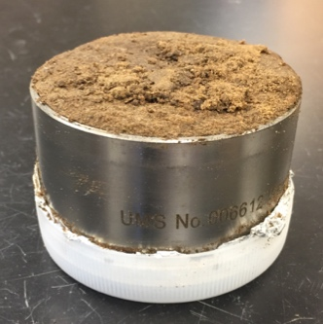




Soil Sampling
Collected 31 undisturbed soil cores at 20cm depth
Sample locations chosen based on SSURGO soil boundaries, EOFs, and EM surveys
Samples were placed in a cooler in the field and then stored in a freezer at the lab
SSURGO
EOF1
EOF2
ECa
Notes:
We collected 31 undisturbed soil cores at a 20cm soil depth. The sample locations were chosen based on SSURGO soil boundaries, EOFs and EM surveys. Our goal was to select sample locations from a range of values from each map. Samples were placed in a cooler in the field and then stored in a freezer at the lab until they were analyized.

Slide 48



Calculating Field Capacity/ Wilting Point
Decagon HYPROP
Records mass change and change in tension
Notes:
We used a Decagon HYPROP to create water retention curves to approximate field capacity for our soil samples.
Wet sample to saturation
Remove air from DI water in tensiometer
Insert tensiometer in soil core and record mass change and change in tension as soil dries
Estimate Field Capacity at -6 kPa and -33kPa

Slide 49

Soil Water Retention Curve Generated by HYPROP Software
Field Capacity
Available water
Wilting Point
Notes:
This is an example of one of the soil water retention curves created using the decagon HYPROP software. After I stopped running the sample, I oven dried it and weighed it to calculate it’s bulk density and porosity. Since the sample started at saturation, we assumed the water content at the start of the experiment was equal to porosity. We fit our data using the van Genuchten model. Field capacity water content estimates were calculated at 6kPa and 33kPa.

Slide 50

Notes:
The binned mean values could be used for zone averaged irrigation management. P-value

Slide 51



Spatial Products Useful for Irrigators
Notes:
Here is a new field capacity product I created for our field site. This product can be used to make prescription irrigation maps for the field that better characterize the soil spatial heterogeneity within the field.
Wetness Index! SSURGO with FC values

Slide 52
CRNP mapping + EOF is best environmental covariate predictor of lab derived soil properties
Economically viable (?) for high value crops or areas with severe water allocation
Notes:
Here is a new field capacity product I created for our field site. This product can be used to make prescription irrigation maps for the field that better characterize the soil spatial heterogeneity within the field.
Wetness Index! SSURGO with FC values

Slide 53

WNIP Summary
How good are existing datasets (i.e. SSURGO + ROSETTA) at predicting soil hydraulic properties?
What are the best environmental covariates?
Gibson 2017
Notes:
Here is a new field capacity product I created for our field site. This product can be used to make prescription irrigation maps for the field that better characterize the soil spatial heterogeneity within the field.
Wetness Index! SSURGO with FC values

Slide 54


WNIP Summary
Gibson 2017
Notes:
Here is a new field capacity product I created for our field site. This product can be used to make prescription irrigation maps for the field that better characterize the soil spatial heterogeneity within the field.
Wetness Index! SSURGO with FC values

Slide 55


WNIP Summary
Gibson 2017
Notes:
Here is a new field capacity product I created for our field site. This product can be used to make prescription irrigation maps for the field that better characterize the soil spatial heterogeneity within the field.
Wetness Index! SSURGO with FC values

Slide 56


WNIP Summary
Gibson 2017 in prep.
Notes:
Here is a new field capacity product I created for our field site. This product can be used to make prescription irrigation maps for the field that better characterize the soil spatial heterogeneity within the field.
Wetness Index! SSURGO with FC values

Slide 57
WNIP Summary
Only need ~5-7 lab samples to describe spatial properties at unmeasured sites
  ~90% reduction compared to 2.5 acre grid sampling over 160 acres
  Sites selected based on time-lapse hydrogeophysics and elevation
Gibson 2017 in prep.
Notes:
Here is a new field capacity product I created for our field site. This product can be used to make prescription irrigation maps for the field that better characterize the soil spatial heterogeneity within the field.
Wetness Index! SSURGO with FC values

Slide 58
WNIP Summary
Only need ~5-7 lab samples to describe spatial properties at unmeasured sites
  ~90% reduction compared to 2.5 acre grid sampling over 160 acres
  Sites selected based on time-lapse hydrogeophysics and elevation
Sampling + hydrogeo reduces SSURGO/ROSETTA uncertainty by 40-90% in bd and n
  Marginal improvement for alpha and Ksat (mean value but limited spatial information)
Gibson 2017 in prep.
Notes:
Here is a new field capacity product I created for our field site. This product can be used to make prescription irrigation maps for the field that better characterize the soil spatial heterogeneity within the field.
Wetness Index! SSURGO with FC values

Slide 59
Strategies Moving Forward
Collect 4+ hydrogeophysical maps at different SWC (medium to dry conditions)
  Use self driving car, existing farm equipment to reduce costs?
Notes:
Here is a new field capacity product I created for our field site. This product can be used to make prescription irrigation maps for the field that better characterize the soil spatial heterogeneity within the field.
Wetness Index! SSURGO with FC values

Slide 60
Strategies Moving Forward
Collect 4+ hydrogeophysical maps at different SWC (medium to dry conditions)
  Use self driving car, existing farm equipment to reduce costs?
Use hydrogeophysical EOFs and elevation to select 5-7 sampling locations per 160 acres (90% reduction in samples)
  EOF additional spatial dataset uncorrelated to satellite imagery (CRNP=10⁻¹² m and EMI=10⁵ m vs. 10⁻⁷ to 10⁻⁵ m for visible, NIR, IR)
  Novel data discriminator in AI or deep learning algorithms?
Notes:
Here is a new field capacity product I created for our field site. This product can be used to make prescription irrigation maps for the field that better characterize the soil spatial heterogeneity within the field.
Wetness Index! SSURGO with FC values

Slide 61
Strategies Moving Forward
Collect 4+ hydrogeophysical maps at different SWC (medium to dry conditions)
  Use self driving car, existing farm equipment to reduce costs?
Use hydrogeophysical EOFs and elevation to select 5-7 sampling locations per 160 acres (90% reduction in samples)
  EOF additional spatial dataset uncorrelated to satellite imagery (CRNP=10⁻¹² m and EMI=10⁵ m vs. 10⁻⁷ to 10⁻⁵ m for visible, NIR, IR)
  Novel data discriminator in AI or deep learning algorithms?
Regress soil lab cores with EOFs and elevation layers to generate useful spatial products agnostic of geometry
  Producer management zones
Notes:
Here is a new field capacity product I created for our field site. This product can be used to make prescription irrigation maps for the field that better characterize the soil spatial heterogeneity within the field.
Wetness Index! SSURGO with FC values

Slide 62
Strategies Moving Forward
Collect 4+ hydrogeophysical maps at different SWC (medium to dry conditions)
  Use self driving car, existing farm equipment to reduce costs?
Use hydrogeophysical EOFs and elevation to select 5-7 sampling locations per 160 acres (90% reduction in samples)
  EOF additional spatial dataset uncorrelated to satellite imagery (CRNP=10⁻¹² m and EMI=10⁵ m vs. 10⁻⁷ to 10⁻⁵ m for visible, NIR, IR)
  Novel data discriminator in AI or deep learning algorithms?
Regress soil lab cores with EOFs and elevation layers to generate useful spatial products agnostic of geometry
  Producer management zones
Combine hydrogeophysics at medium to dry field conditions with hyperspectral data (UAS, aircraft, satellites) during wet to very wet field conditions to complete soil hydraulic picture
  The light will show you the way
Notes:
Here is a new field capacity product I created for our field site. This product can be used to make prescription irrigation maps for the field that better characterize the soil spatial heterogeneity within the field.
Wetness Index! SSURGO with FC values

Slide 63
Summary
Discussed spatial sampling design for 1 and 2D surveys
Example of regional scale soil moisture in agricultural areas of NE
Looked at correction factor for dry bias of roads of CRNS for studies in Germany and UK
Example of in field mapping for agricultural applications by better defining soil hydraulic properties

Slide 64
Key References
Finkenbiner, C. E., T. E. Franz, J. Gibson, D. M. Heeren, and J. Luck (2019), Integration of
hydrogeophysical datasets and empirical orthogonal functions for improved irrigation water management, Precis. Agric., 20(1), 78-100. doi:10.1007/s11119-018-9582-5.
Franz, T. E., T. Wang, W. Avery, C. Finkenbiner, and L. Brocca (2015), Combined analysis of soilmoisture measurements from roving and fixed cosmic ray neutron probes for multiscale real-time monitoring, Geophysical Research Letters, 42, 3389–3396. doi:10.1002/2015GL063963.
Gibson, J., and T. E. Franz (2018), Spatial prediction of near surface soil water retention functions using hydrogeophysics and empirical orthogonal functions, Journal of Hydrology, 561, 372-383. doi:10.1016/j.jhydrol.2018.03.046.

