Slide 1

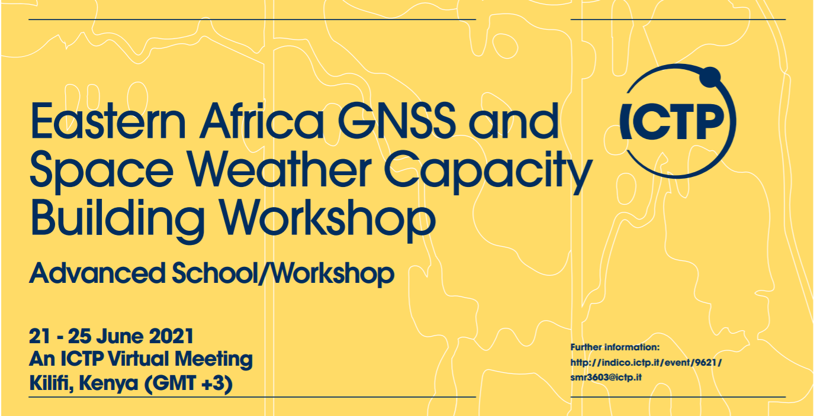
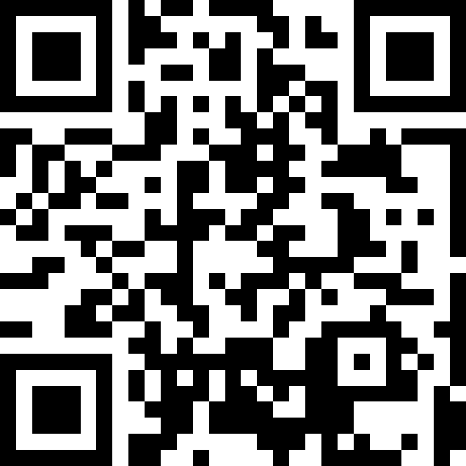
Low latitude ionosphere - Ionospheric scintillations (ground based climatology)
Luca Spogli
luca.spogli@ingv.it

Slide 2
Low latitude ionosphere - Ionospheric scintillations (ground based climatology)

Slide 3


Questions to be addressed
What are the pro’s and con’s
of a climatological picture?
What are the main physical phenomena behind
Scintillation and TEC gradients occurrence?
What are the sectors of the low-latitude ionosphere more exposed to scintillation?
What are the main features of the
low-latitude ionosphere highlighted by climatology?
What’s the meaning of a ionospheric scintillation climatology and what’s the difference with the (ionospheric) weather
What are the main results of the recent studies?
How to cook a good
scintillation climatology?
What’s the role of the external drivers in modulating the scintillation occurrence?

Slide 4

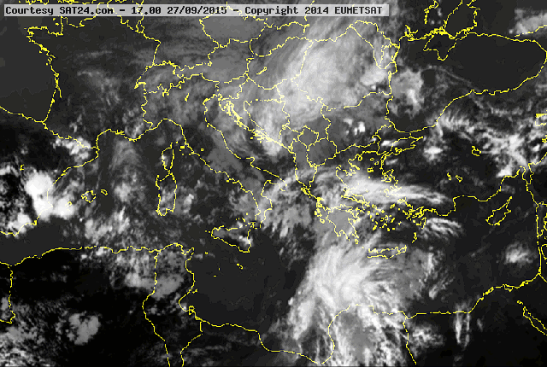
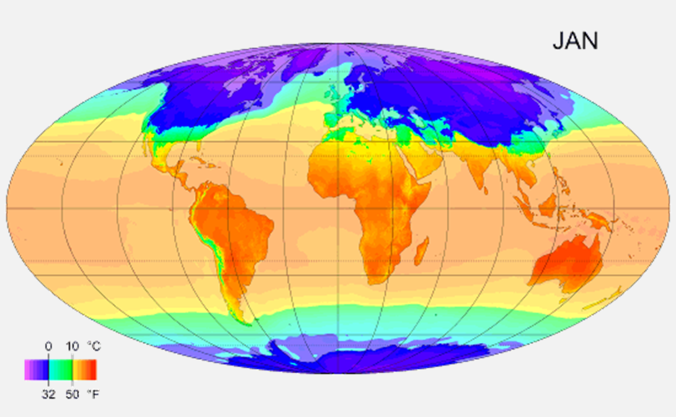
Weather vs. Climate
Weather, state of the atmosphere at a particular place during a short period of time.
Climate, conditions of the atmosphere at a particular location over a long period of time; it is the long-term summation of the atmospheric elements (and their variations) that, over short time periods, constitute weather.
Lower Atmosphere

Slide 5
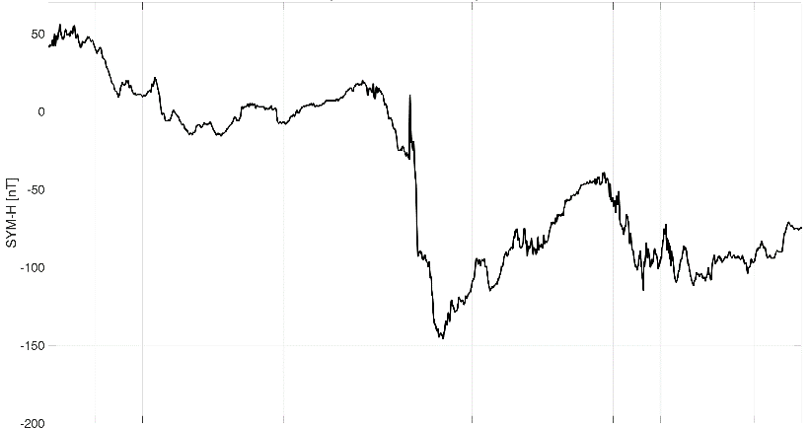
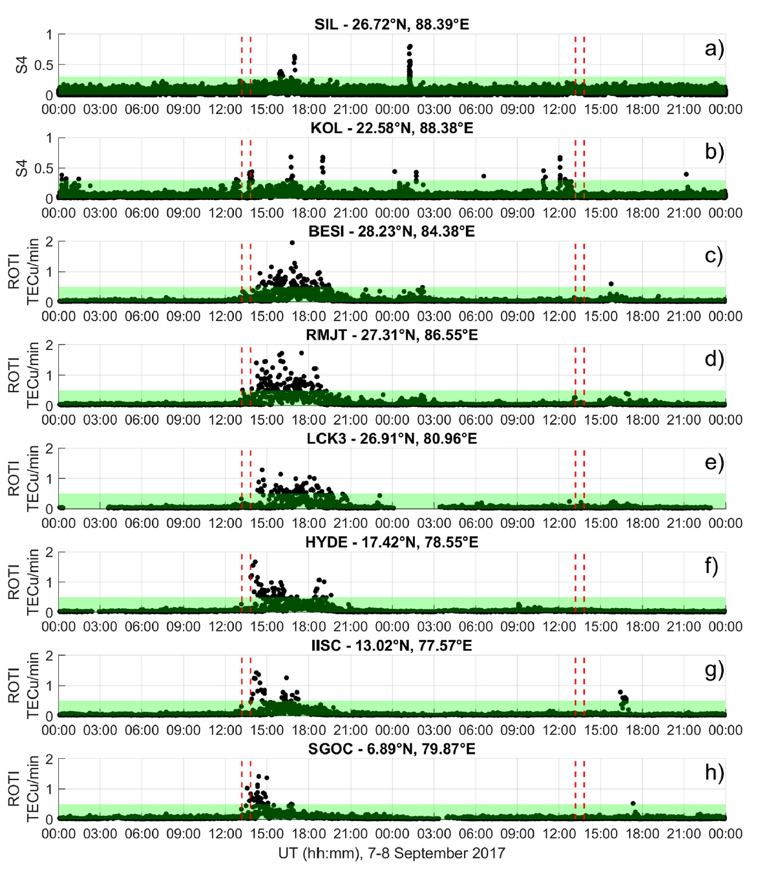
Weather vs. Climate
Weather
In general, weather relates to case events, allows studying the conditions of geospace in terms of selected and interesting quantities
This allows to identify possible correlations among physical parameters involved in the investigated phenomena by taking a snapshot in specific time interval.
Upper Atmosphere

Slide 6
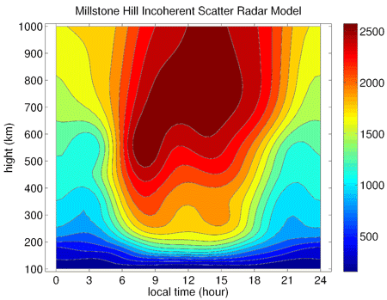
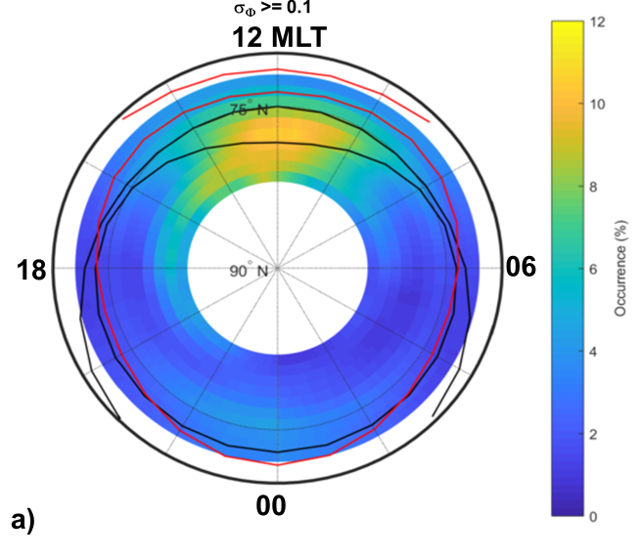
Weather vs. Climate
Climate
Ionospheric Climatology: Studies of ionospheric climatology address general, synthetic, averaged and large spatial scale ionospheric features, in contrast to specific ionospheric and space weather events.
Ionospheric Scintillation Climatology: To assess the general recurrent features of the ionospheric irregularities dynamics and temporal evolution on long data series, trying to catch eventual correspondences with scintillation occurrence. (Alfonsi et al., Radio Science 2011).
Plasma temperature climatology
Probability of phase fluctuations over Svalbard
Upper Atmosphere

Slide 7
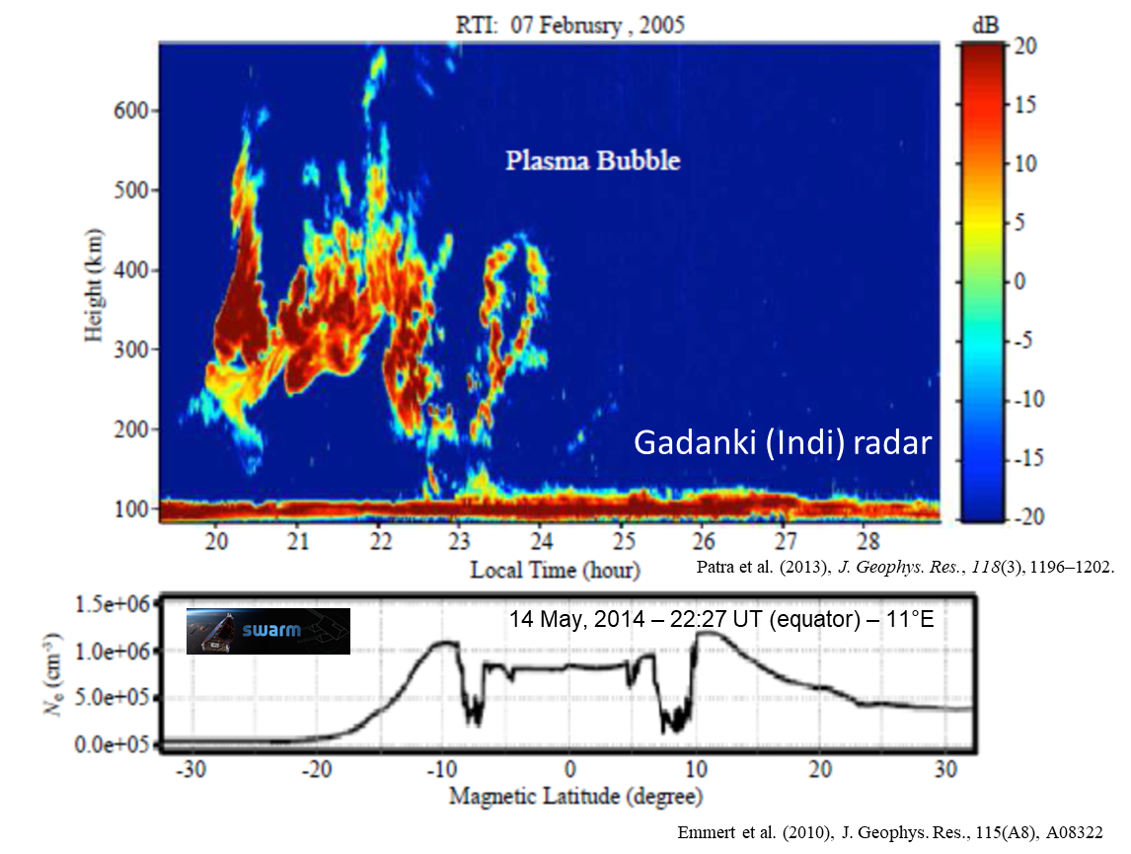
What are the sectors of the low-latitude ionosphere more exposed to scintillation?
Ionospheric scintillation on GNSS signals at low latitudes is triggered by the presence of Equatorial Plasma Bubbles (EPBs)
The formation of the EPBs is driven by the ExB electrodynamics
Controlling factors:
(1) Plasma density perturbation (wave structure in the east–west direction) at F region bottomside for seeding
the R–T instability,
(2) the equatorial vertical plasma drift and F layer height
(3) the field-line-integrated conductivity controlling the growth rate of the R–T instability
$P_{scint}={P_{EPB}× P_{growth}= P}_{seed}×$ $P_{inst}× P_{growth}$
Probability of perturbation seeding
Probability of formation of R-T instability
Probability that the growth rate is such to lead to small scale irregularities formation

Slide 8
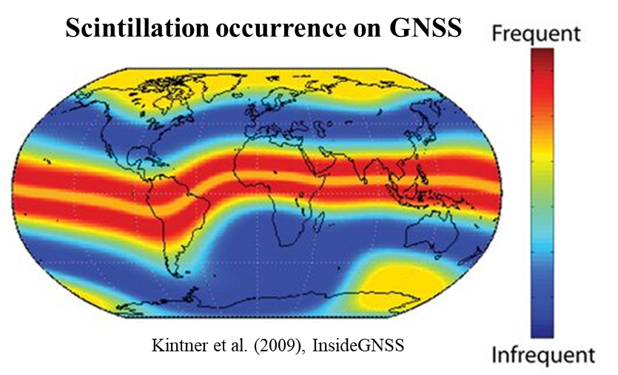
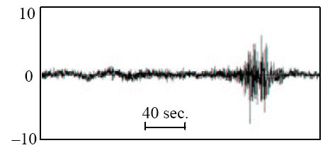
What are the sectors of the low-latitude ionosphere more exposed to scintillation?
Ionospheric scintillation on GNSS signals at low latitudes is due to the diffraction induced by the presence of small-scale irregularities
(d < d_{Fresnel} ~ O(few 100’s m)) embedded in post-sunset (and post-midnight) EPBs
Scintillation threatens the performances of GNSS-reliant services requiring high-precision positioning
The corruption due to ionospheric irregularities on GNSS signals is still challenging to be modelled and mitigated
Day-to-day variability → variation of the EPB formation probability and mapping location during quiet conditions
Inhibition/Enhancement of small scale irregularities formation during active periods (Prompt Penetrating Electric Fields and Disturbance Dynamo Electric Fields)
Daytime scintillation: unlikely, but not negligible. Mechanisms not fully understood (likely linked to sporadic-E appearance).
Scintillation
Reduced accuracy of positioning
Loss of lock with the satellite

Slide 9
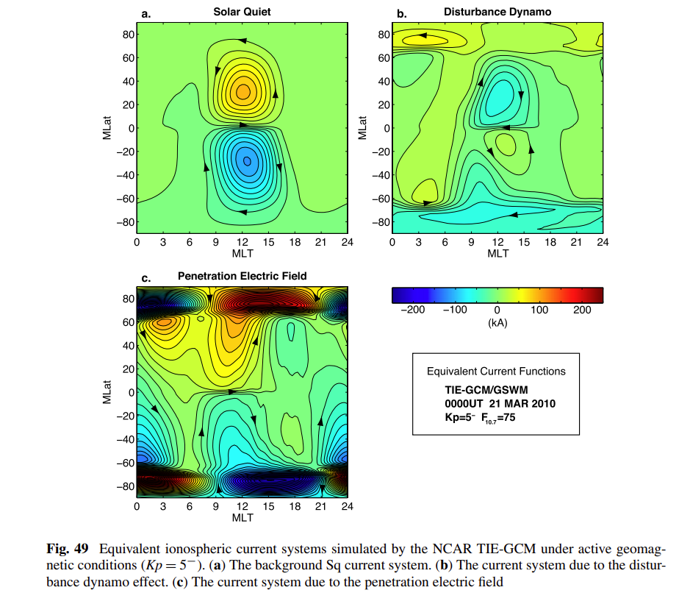
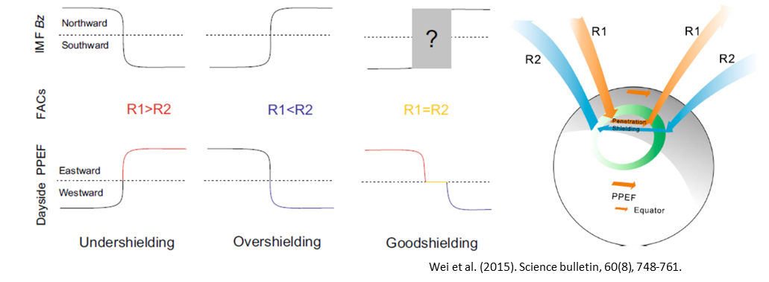
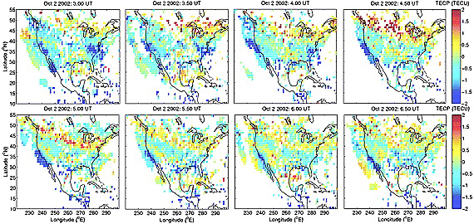
What’s the role of the external drivers in modulating the scintillation occurrence?
In case of a geoffective Space Weather event
Equatorial zonal electric field E, eastward in dayside and westward in nightside, is modified and the mechanisms ruling out the formation of small-scale irregularities is altered.
Prompt Penetration Electric Fields (PPEF)
Penetration of Electric Field from Interplanetary Electric Field.
Prompt effect, perturbations in the zonal electric field for shorter durations of about 30 min to 2 h
Involved parameter/index: IMF-Bz, IEF-Ey
Disturbance Dynamo Electric Fields (DDEF)
Cross-equatorial winds due to thermospheric changes induced by heating at high latitude (often with LSTID).
Delayed effect, non-uniform time delays at different latitudes and lasts for few hours to more than a day
Involved parameter/index: AE, Joule heating
Yamazaki, Y., & Maute, A. (2017). Space Science Reviews.

Slide 10
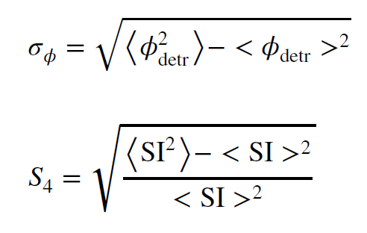
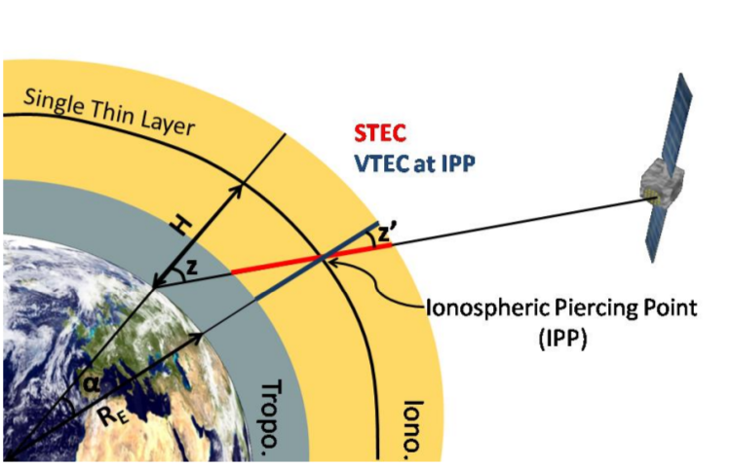
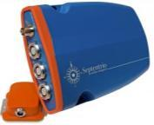

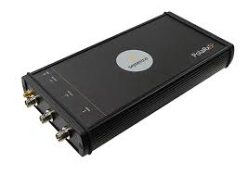
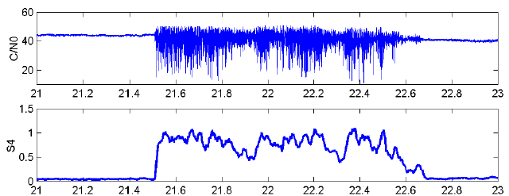
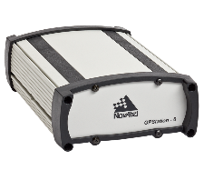
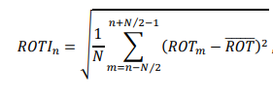
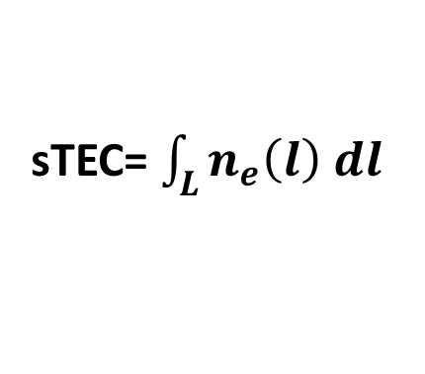
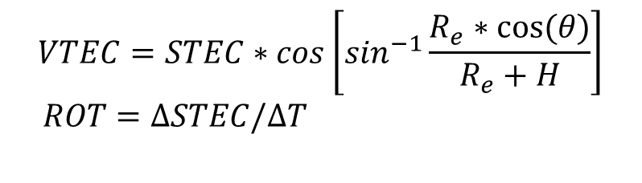
How to measure scintillation
Total Electron Content
Scintillation is measured by statistical indices:
phase scintillation index (σ_{Φ})
amplitude scintillation index (S4)
Ionospheric Scintillation Monitor Receivers:
Low noise phase measurements
Stable clock
Provide indices every 1 minute starting from 50/100 Hz (20/10 ms) data
Larger values of the indices correspond to increased fading of the signal (increased carrier to noise ratio)
sTEC= $\int_{L}{n_{e}\left(l\right) dl}$
$$VTEC=STEC∗cos\left[\sin^{−1}\frac{R_{e}∗cos⁡(θ)}{R_{e}+H}\right]$$
$ROT=∆STEC/∆T$

Slide 11
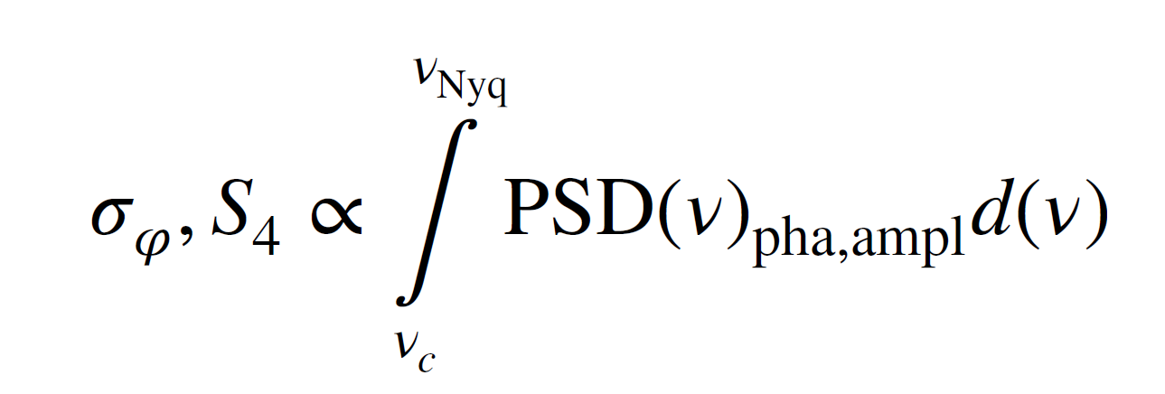
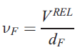
What is scintillation?
Phase
Phase “fluctuations”:
2 mechanisms:
-diffraction (small-scale irregularities)
-refraction (all scale range and scaling with 1/f)
Stochastic and deterministic effects
Amplitude
Log(PSD)
Amplitude scintillation:
1 mechanism:
diffraction triggered by small-scale irregularities
Stochastic effect
Not suitable at high-latitudes
ν_{F}: Fresnel’s Frequency
V^{REL}: relative velocity ray-path-ionosphere
d_{F}=sqrt(2*λ*h_{IPP})
0.1 Hz
ν_{cutoff}=ν_{Fresnel}
ν_{Nyquist}
Log(ν)

Slide 12
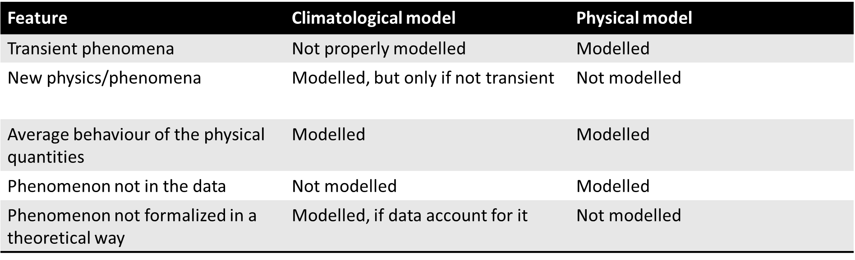
What we can actually understand with scintillation climatology
Semi-empirical models are often a good compromise

Slide 13
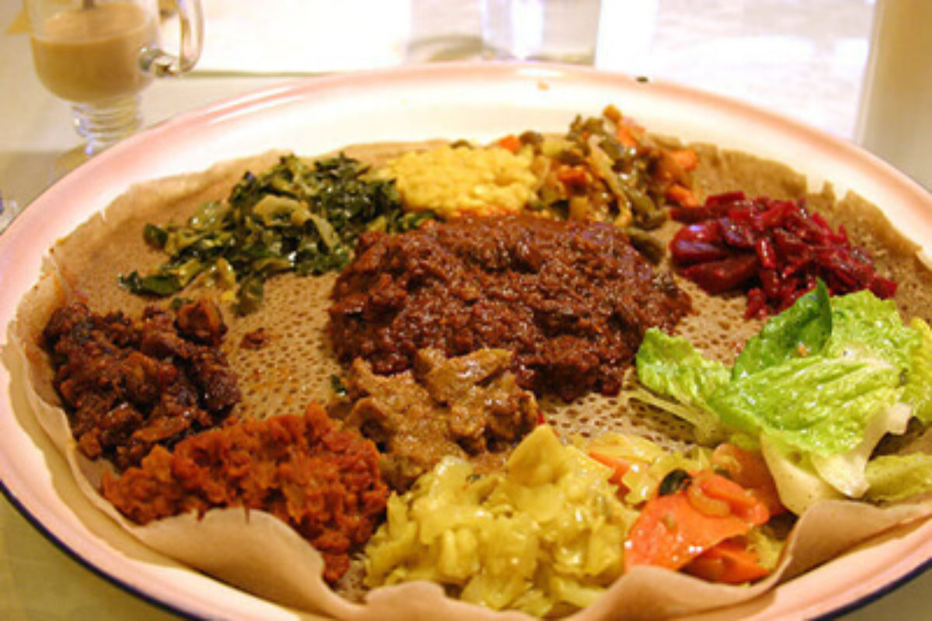
How to cook a good scintillation climatology
Ingredients:
Suitable Network(s) of ISMR’s
If not available, geodetic receivers offer proxies
A big bunch of good scintillation data
The longer, the better
Data quality, selection and integration is an issue
Clear ideas about the phenomenon you want to model
System of coordinates
Cut/Thresholds on investigated parameters
Physical assumptions
Companion sets of parameters to sort your climatology
Geomagnetic activity indices
Solar activity indices
Solar Wind parameters
Auroral indices
…

Slide 14
Ground Based Scintillation Climatology
GBSC is used in:
Spogli et al., 2009, Ann. Geophys.
Alfonsi et al., 2011, Radio Science
Spogli et al., 2013, Annals of Geophysics
Spogli et al, 2013, JASTP
Cesaroni et al., 2015, JSWSC
D’Angelo et al., 2015, ASR
Spogli et al., 2016, JGR
Alfonsi et al., 2017, ASR
Povero et al., 2017, Navigation
Alfonsi et al., 2018, IEEE-TGRS
De Franceschi et al., 2019, SciRep
Maps of ionospheric scintillation and TEC derived parameters
  Mean value and standard deviation
  Occurrence above user-defined thresholds
of the main parameters measured by modern GNSS receivers for scintillation
Mainly Scintillation indices (S₄ and σ_{Φ}) and TEC derived parameters (sTEC, vTEC, ROT), but also receiver behaviour parameters such as C/n, Standard Deviation of the Code Carrier, Loss of Lock events.
System of reference: Geographic and geomagnetic coordinates, Universal and Magnetic Local Times*, Azimuth, Elevation
Different geomagnetic conditions can be selected (Kp, IMF, Dst, R12, AU/AL/AE/AO)
Homemade at INGV
Developed for: PolaRx(5)S, Station6, GSV4004, SCINTMON, Javad receivers, geodetic receivers (TEC and Scintillation proxies)
*Expressed@ the IPP

Slide 15
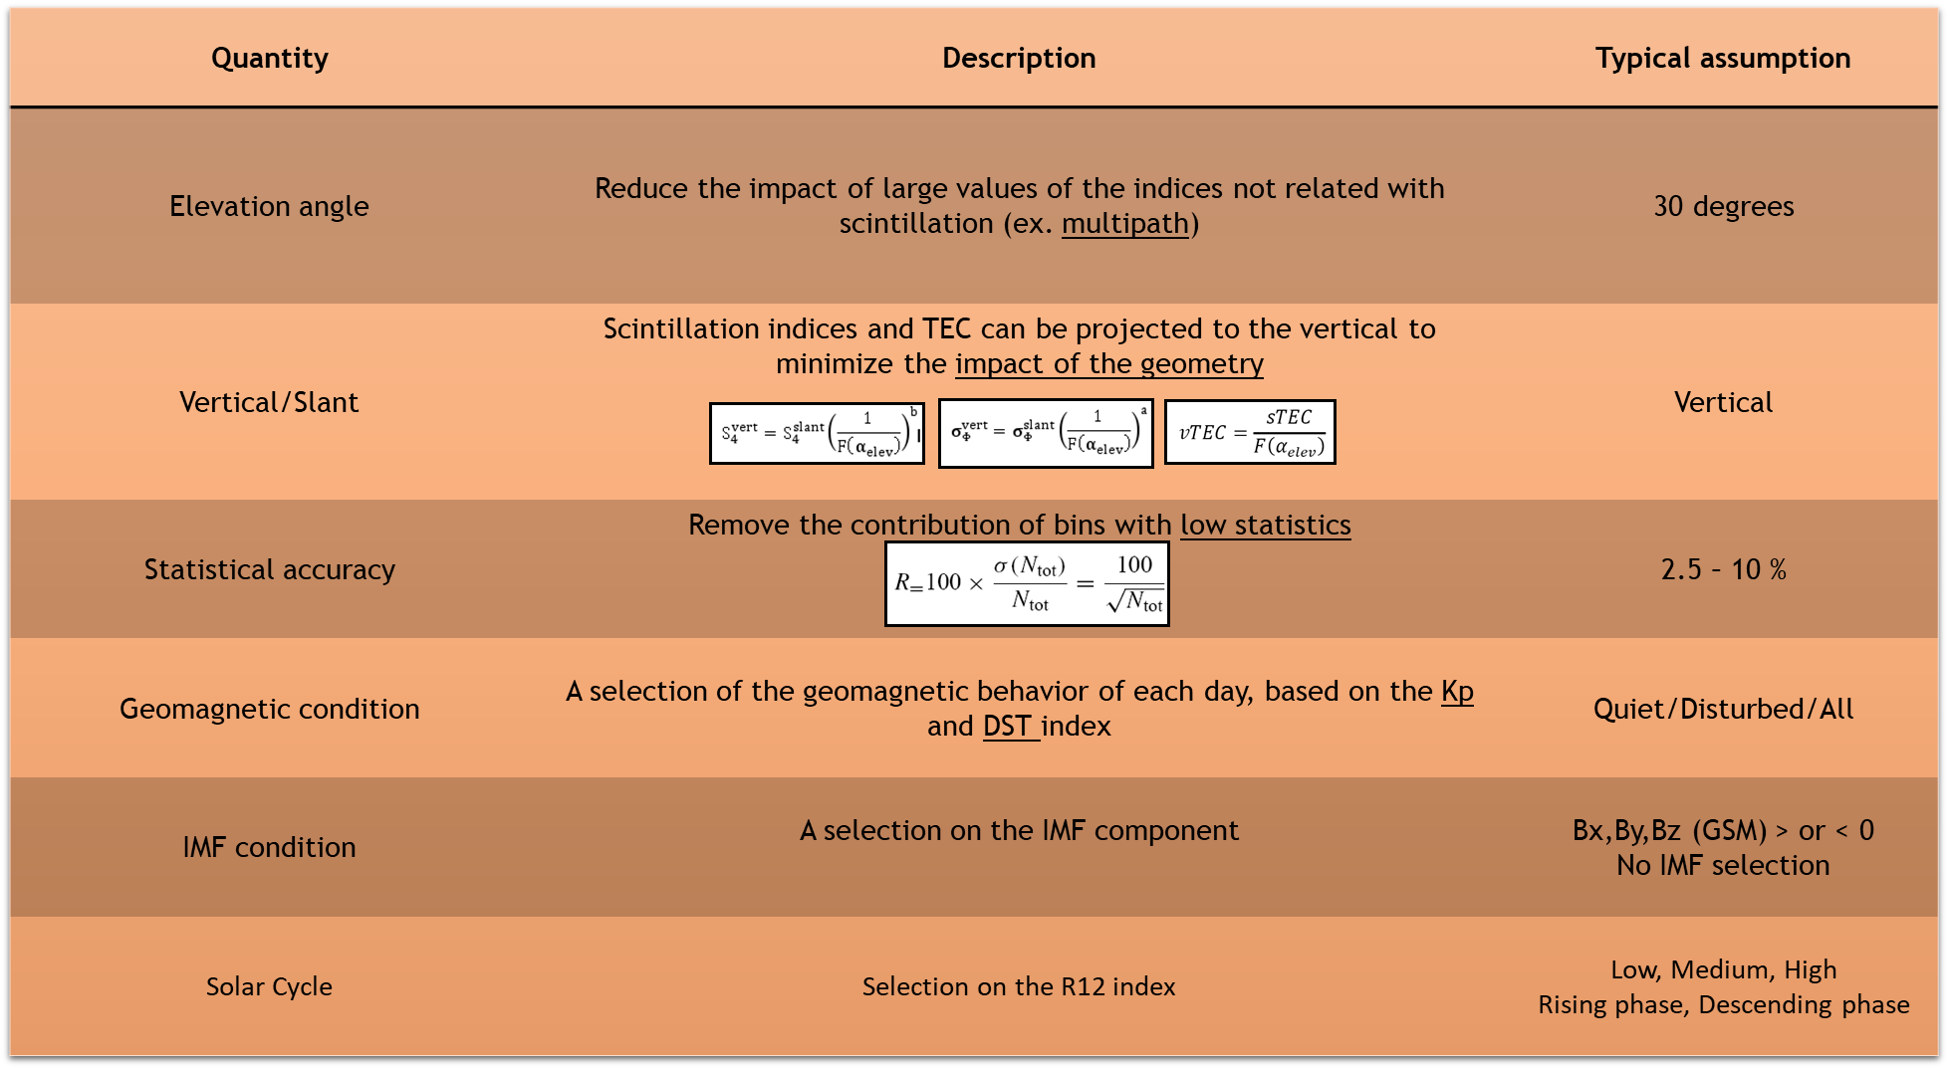

GBSC selectable features

Slide 16
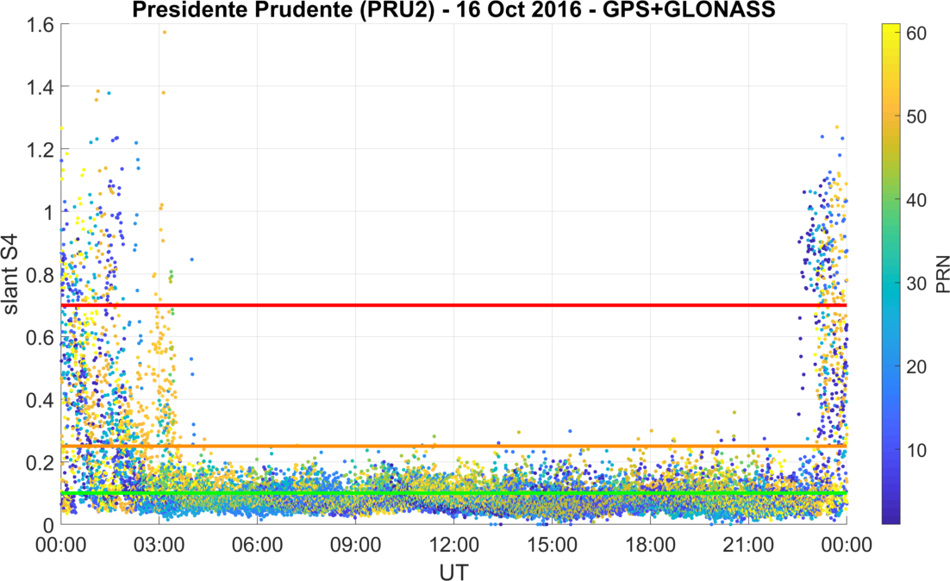
GBSC selectable features: about thresholds for the occurrence calculation
0.7 STRONG
0.25 MODERATE
0.1 WEAK
*
*LT=UT-3

Slide 17
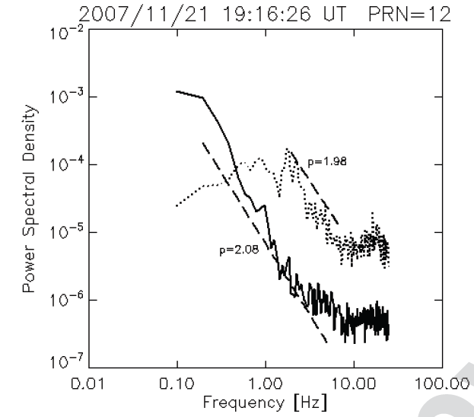
GBSC: Physical assumptions
Ionospheric piercing point at 350 km
Geometry ambiguity faced trough verticalization
  Allows merging different receivers
  Vert. of scintillation indices: weak scintillation approximation
    Underestimation of the real scintillation
Phase spectral index:
  Phase spectrum approximation (single p)
  Assumed as constant for Station6, GSV4004, Scintmon, Javad
  Measured by PolaRx(5)S
Wernik et al., 2008

Slide 18
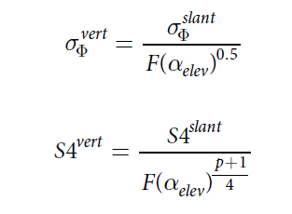
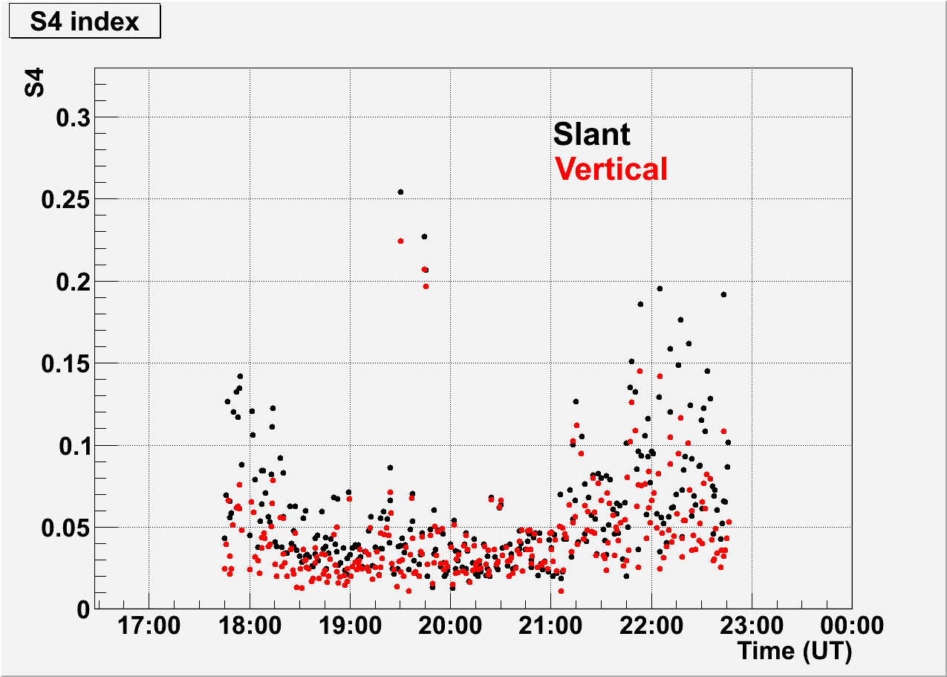
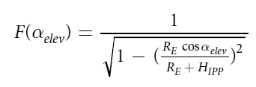

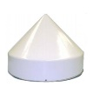
Impact of the geometry
The angular dependence of the scintillation indices in the formula is valid only under the conditions of weak scattering and when single phase screen approximation is suitable.
However, especially for climatology of the scintillation occurrence above user-defined thresholds, this is not an issue.
Examples from the GISTM receiver in Tucuman (Argentina) on 21 November 2010 - Satellite G26
Virtual receivers

Slide 19
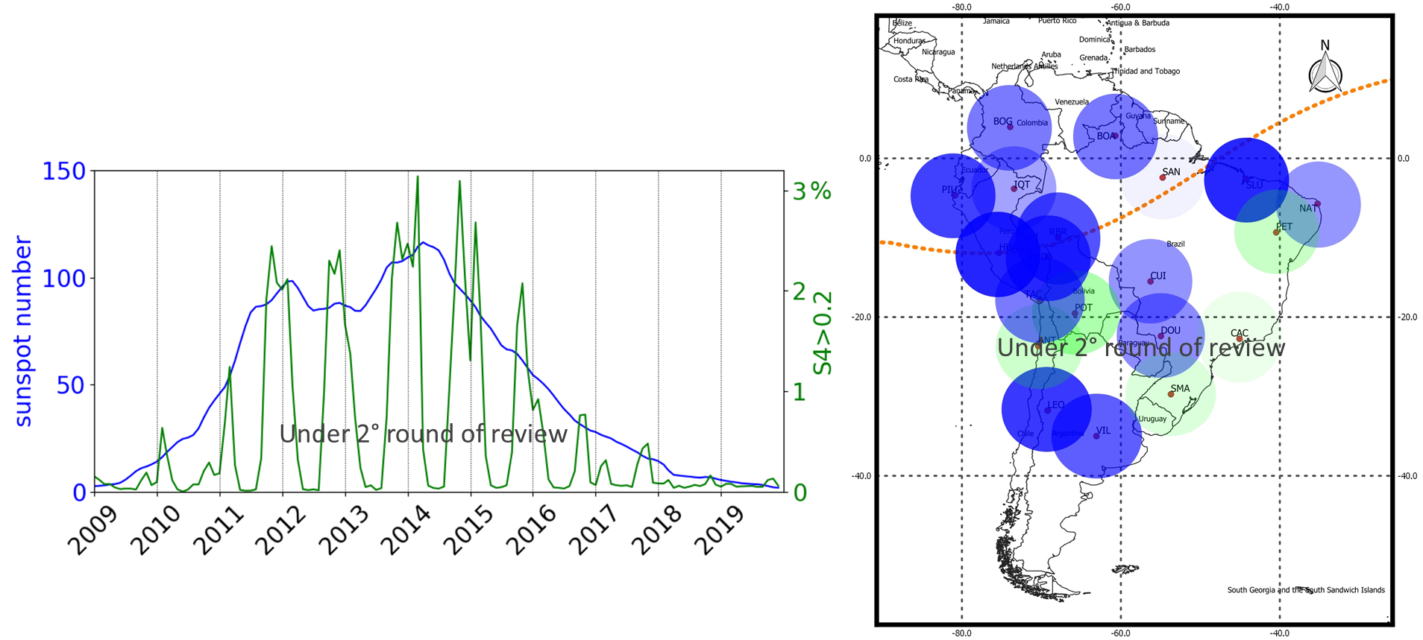
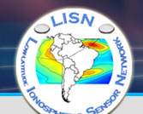
Highlights from Climatology: Solar Cycle dependence
Perez-Macho et al., Earth Planet and Space, submitted
Data available at http://lisn.igp.gob.pe/

Slide 20
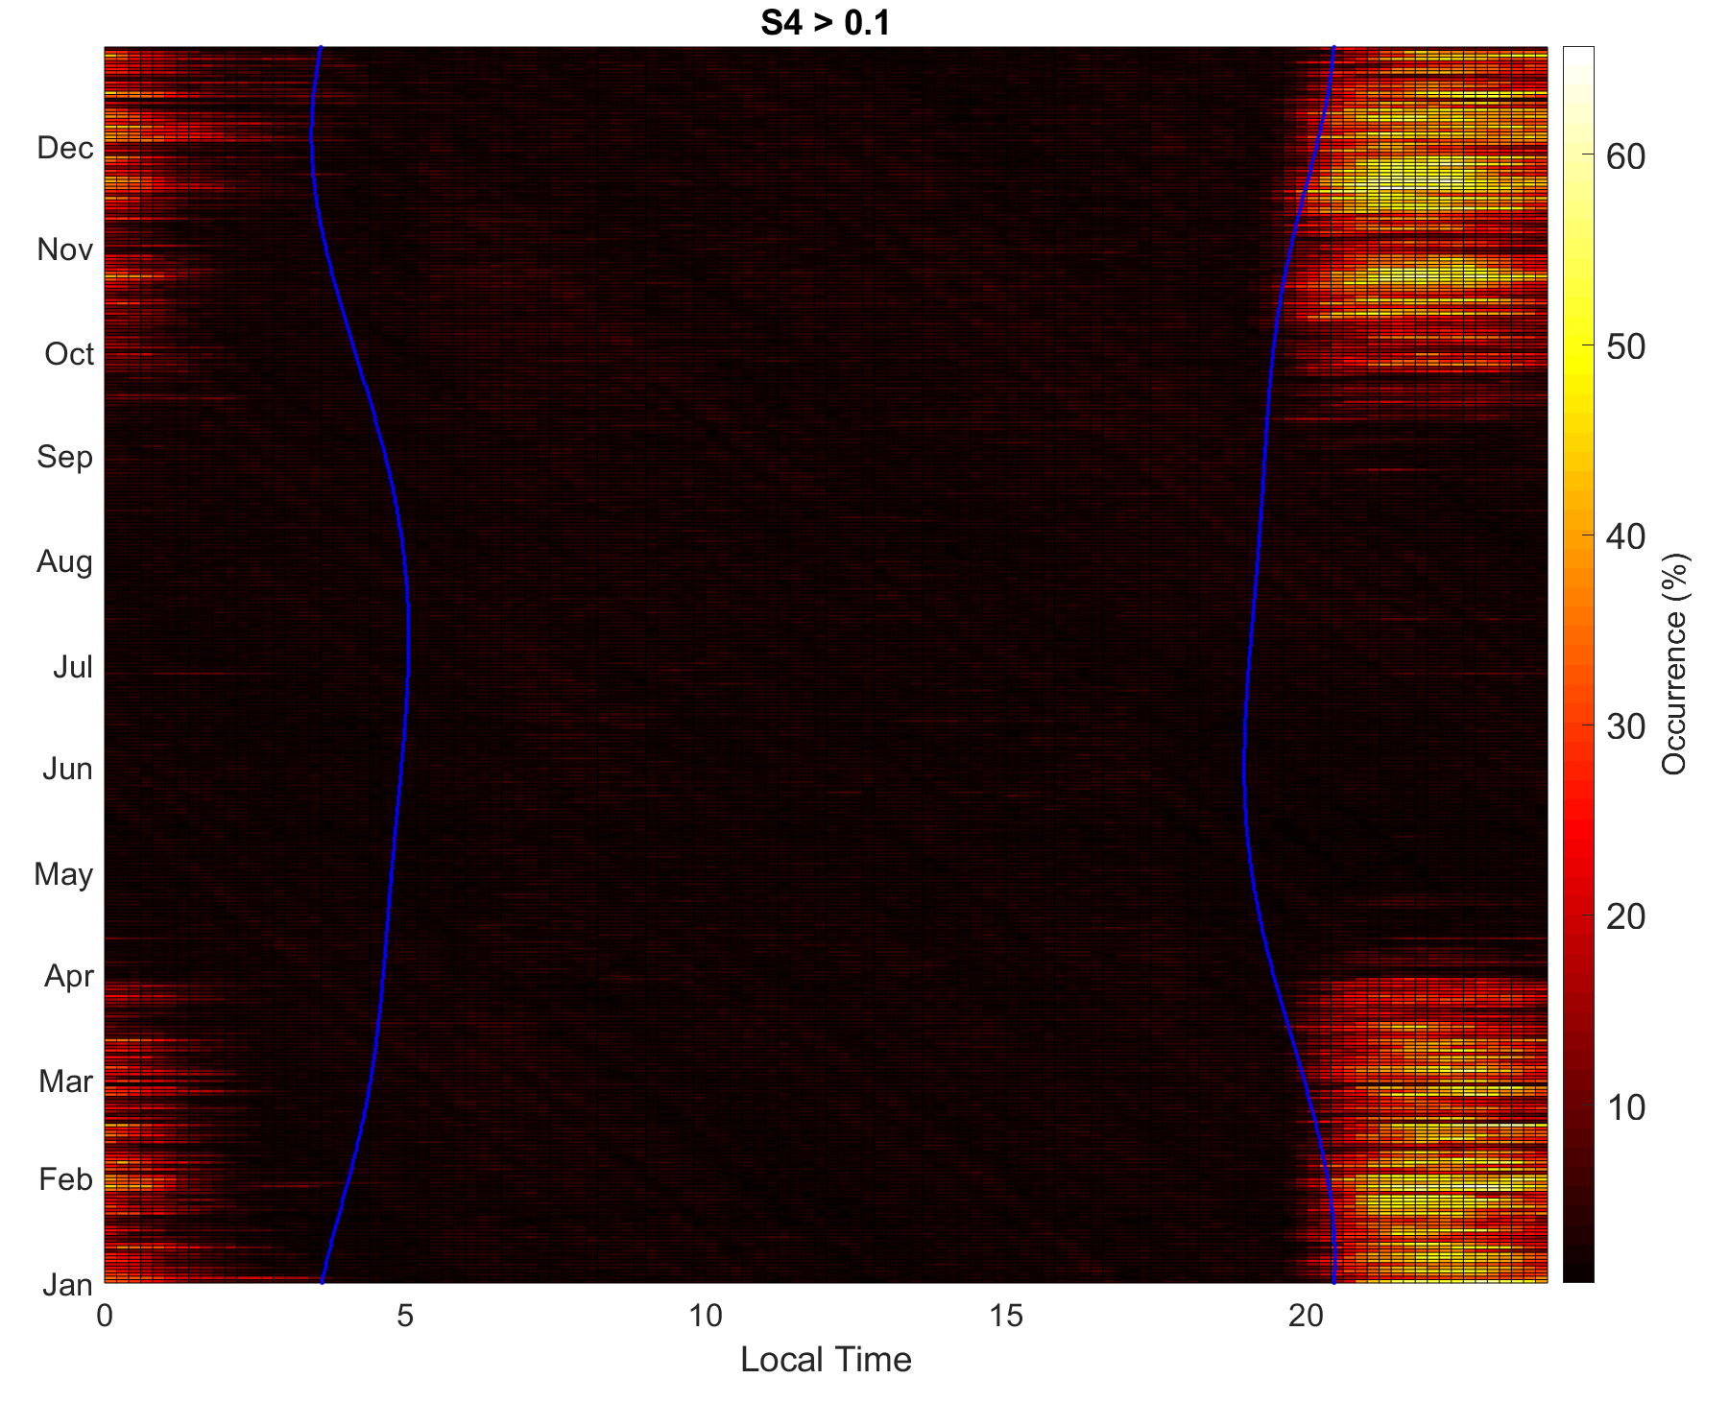
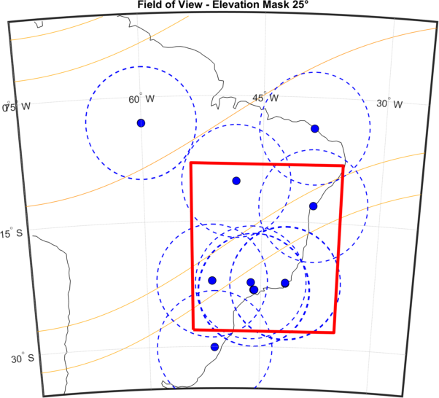
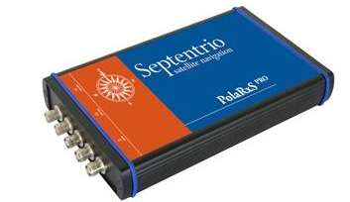

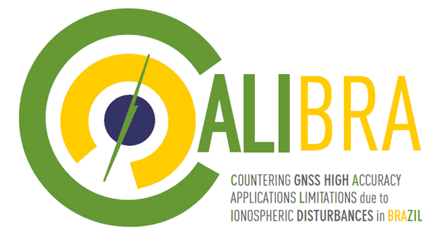
Highlights from Climatology: LT and season
Ground-based GNSS for scintillation
CIGALA/CALIBRA network
PolaRxS
multipath
Period: 2013-2015
Occurrence above weak to strong threshold
Post-sunset scintillation maximizes between sunset and sunrise
Occurrence maximizes between September and April
Residual multipath effects (streaks in the occurrence) → elevation cutoff at 25° in not suitable
Sunrise & Sunset
Data available at http://is-cigala-calibra.fct.unesp.br

Slide 21
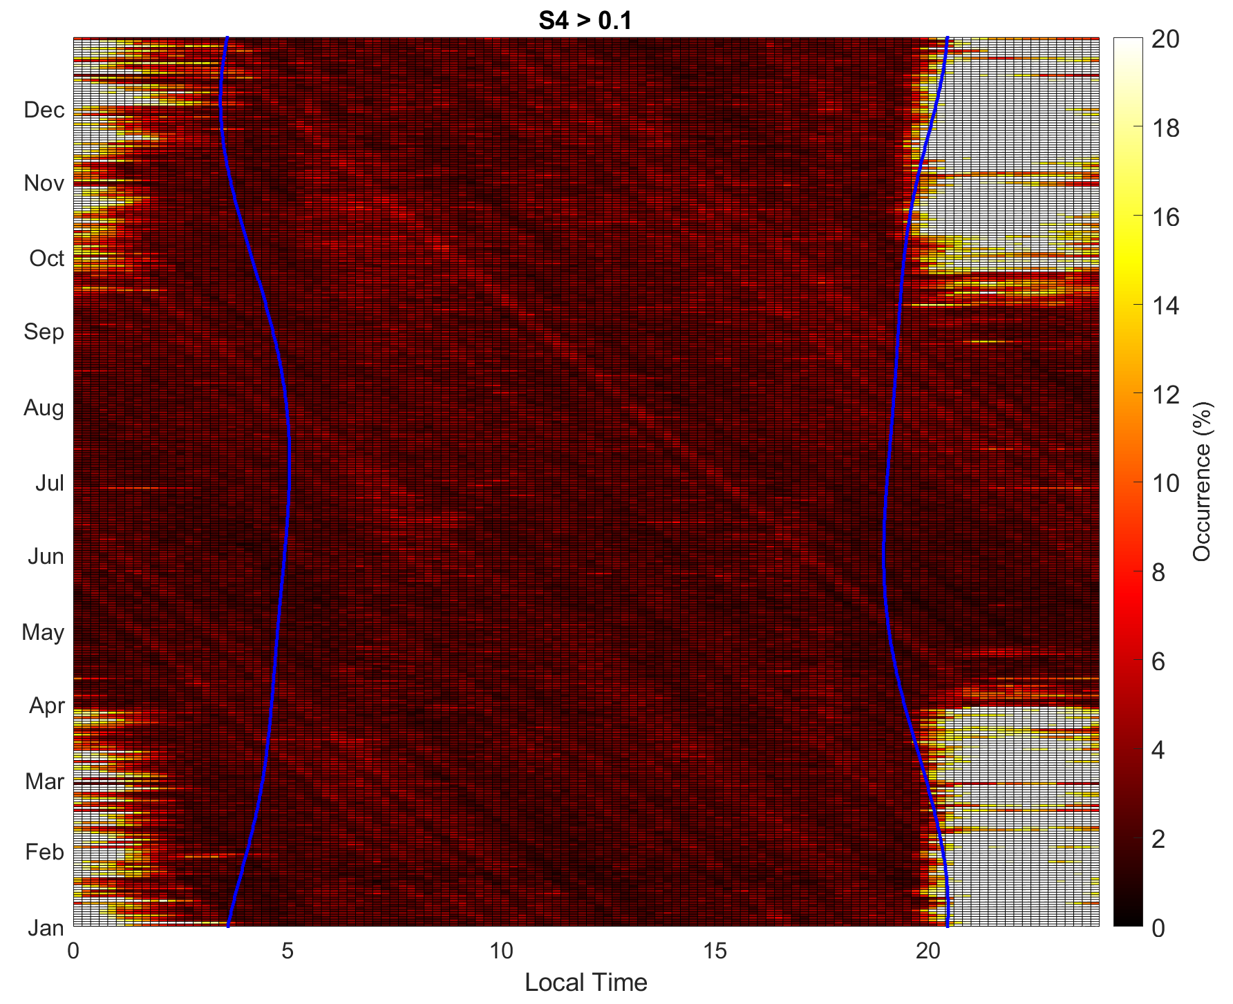
Highlights from Climatology: LT and season
Ground-based GNSS for scintillation
CIGALA/CALIBRA network
PolaRxS
multipath
Period: 2013-2015
Occurrence above weak to strong threshold
Post-sunset scintillation maximizes between sunset and sunrise
Occurrence maximizes between September and April
Residual multipath effects (streaks in the occurrence) → elevation cutoff at 25° in not suitable
Sunrise & Sunset
Data available at http://is-cigala-calibra.fct.unesp.br

Slide 22
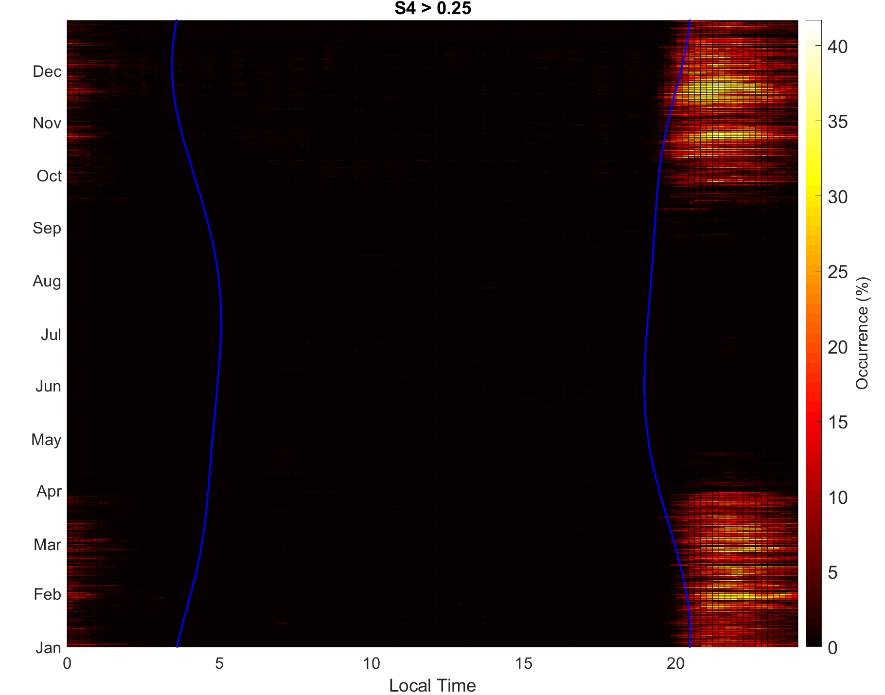
Highlights from Climatology: LT and season
Ground-based GNSS for scintillation
CIGALA/CALIBRA network
PolaRxS
Period: 2013-2015
Occurrence above moderate to strong threshold
Post-sunset scintillation maximizes between sunset and sunrise
Occurrence maximizes between September and April
No multipath (30° elevation cutoff is suitable to identify moderate to strong scintillation regimes)
Sunrise & Sunset
Data available at http://is-cigala-calibra.fct.unesp.br

Slide 23
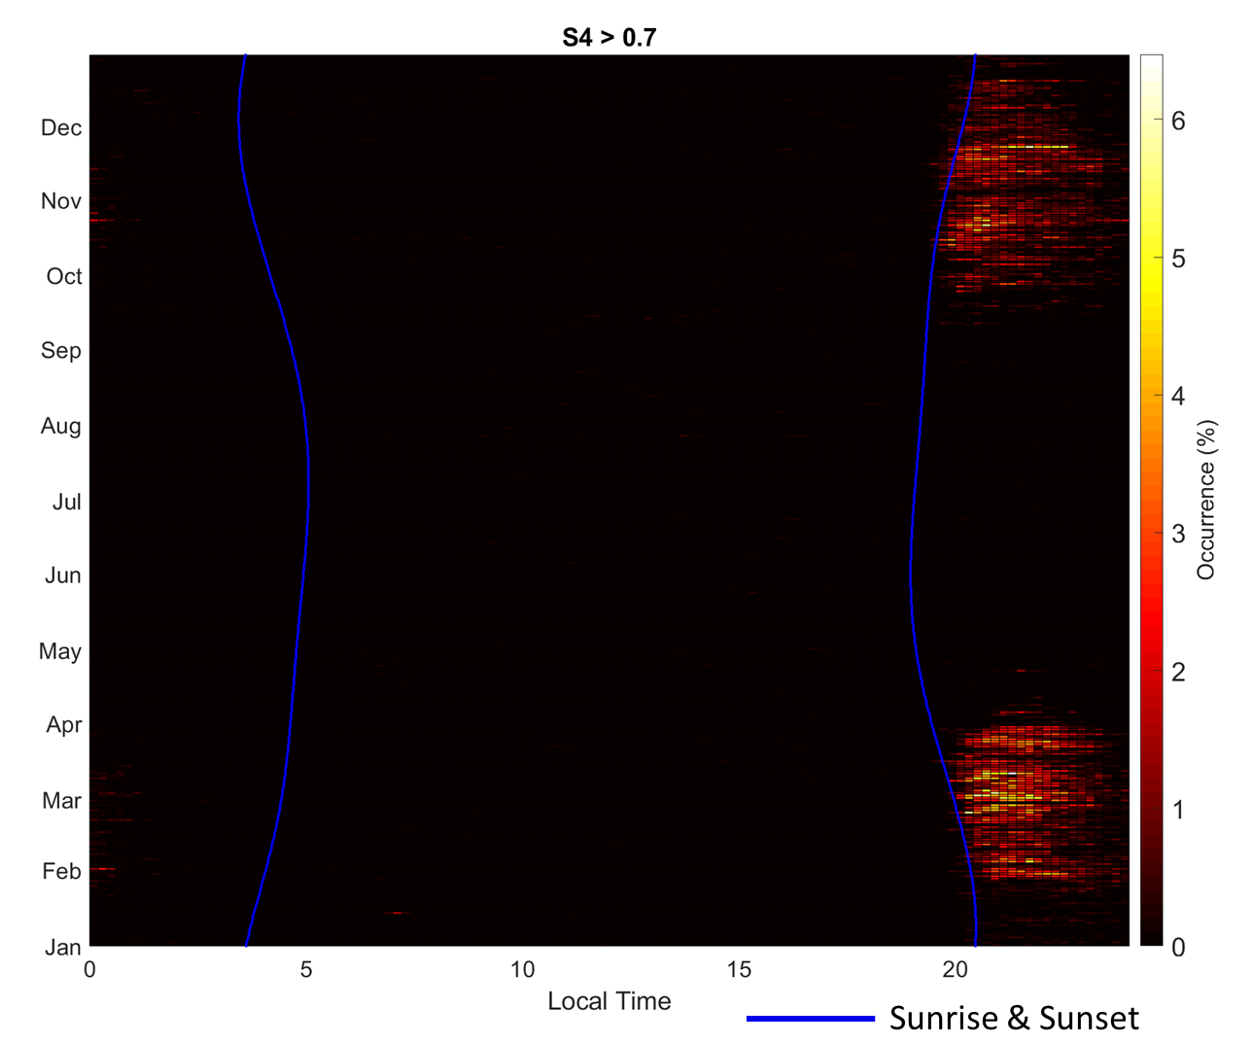
Highlights from Climatology: LT and season
Ground-based GNSS for scintillation
CIGALA/CALIBRA network
PolaRxS
Period: 2013-2015
Occurrence above strong threshold
Post-sunset scintillation maximizes after sunset
February/March and October/September are the months in which GNSS-reliant services are more exposed to precision, accuracy and integrity degradation
Data available at http://is-cigala-calibra.fct.unesp.br

Slide 24
Highlights from Climatology: LT and season
Ground-based GNSS for scintillation
CIGALA/CALIBRA network
HINT FOR THE LOCAL TIME!
LT/MLT in GBSC is the LT of the IPP:
LT(IPP) = HOUR-UT + MINUTE-UT/60 + LON(IPP)/15
LAT(IPP), LON(IPP)
Data available at http://is-cigala-calibra.fct.unesp.br

Slide 25
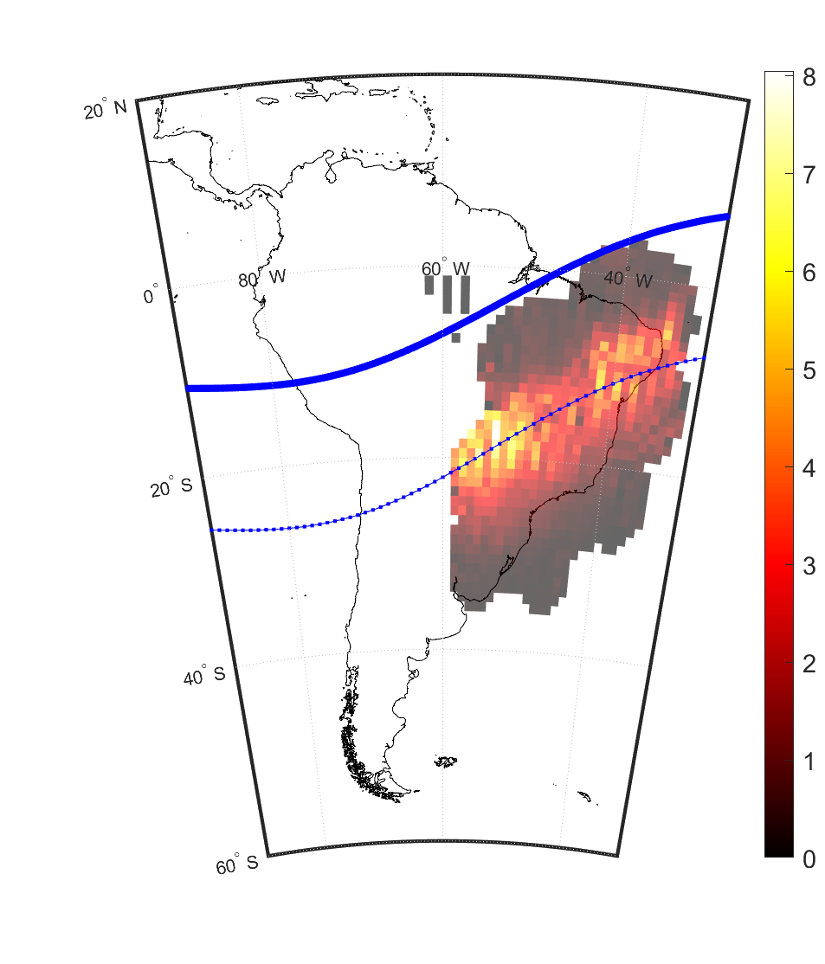
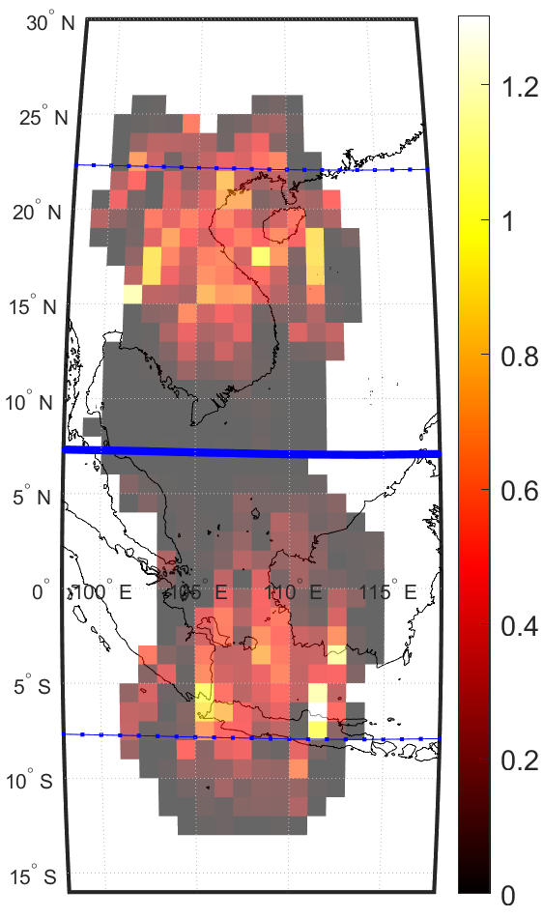

Highlights from Climatology: geographical distribution
Mar-Oct 2015
Period: 2013-2015
+15°
dip
S4 Occurrence > 0.25 (%)
dip
S4 Occurrence > 0.25 (%)
-15°
-15°
CIGALA/CALIBRA network
ERICA - EquatoRial Ionosphere Characterization in Asia

Slide 26
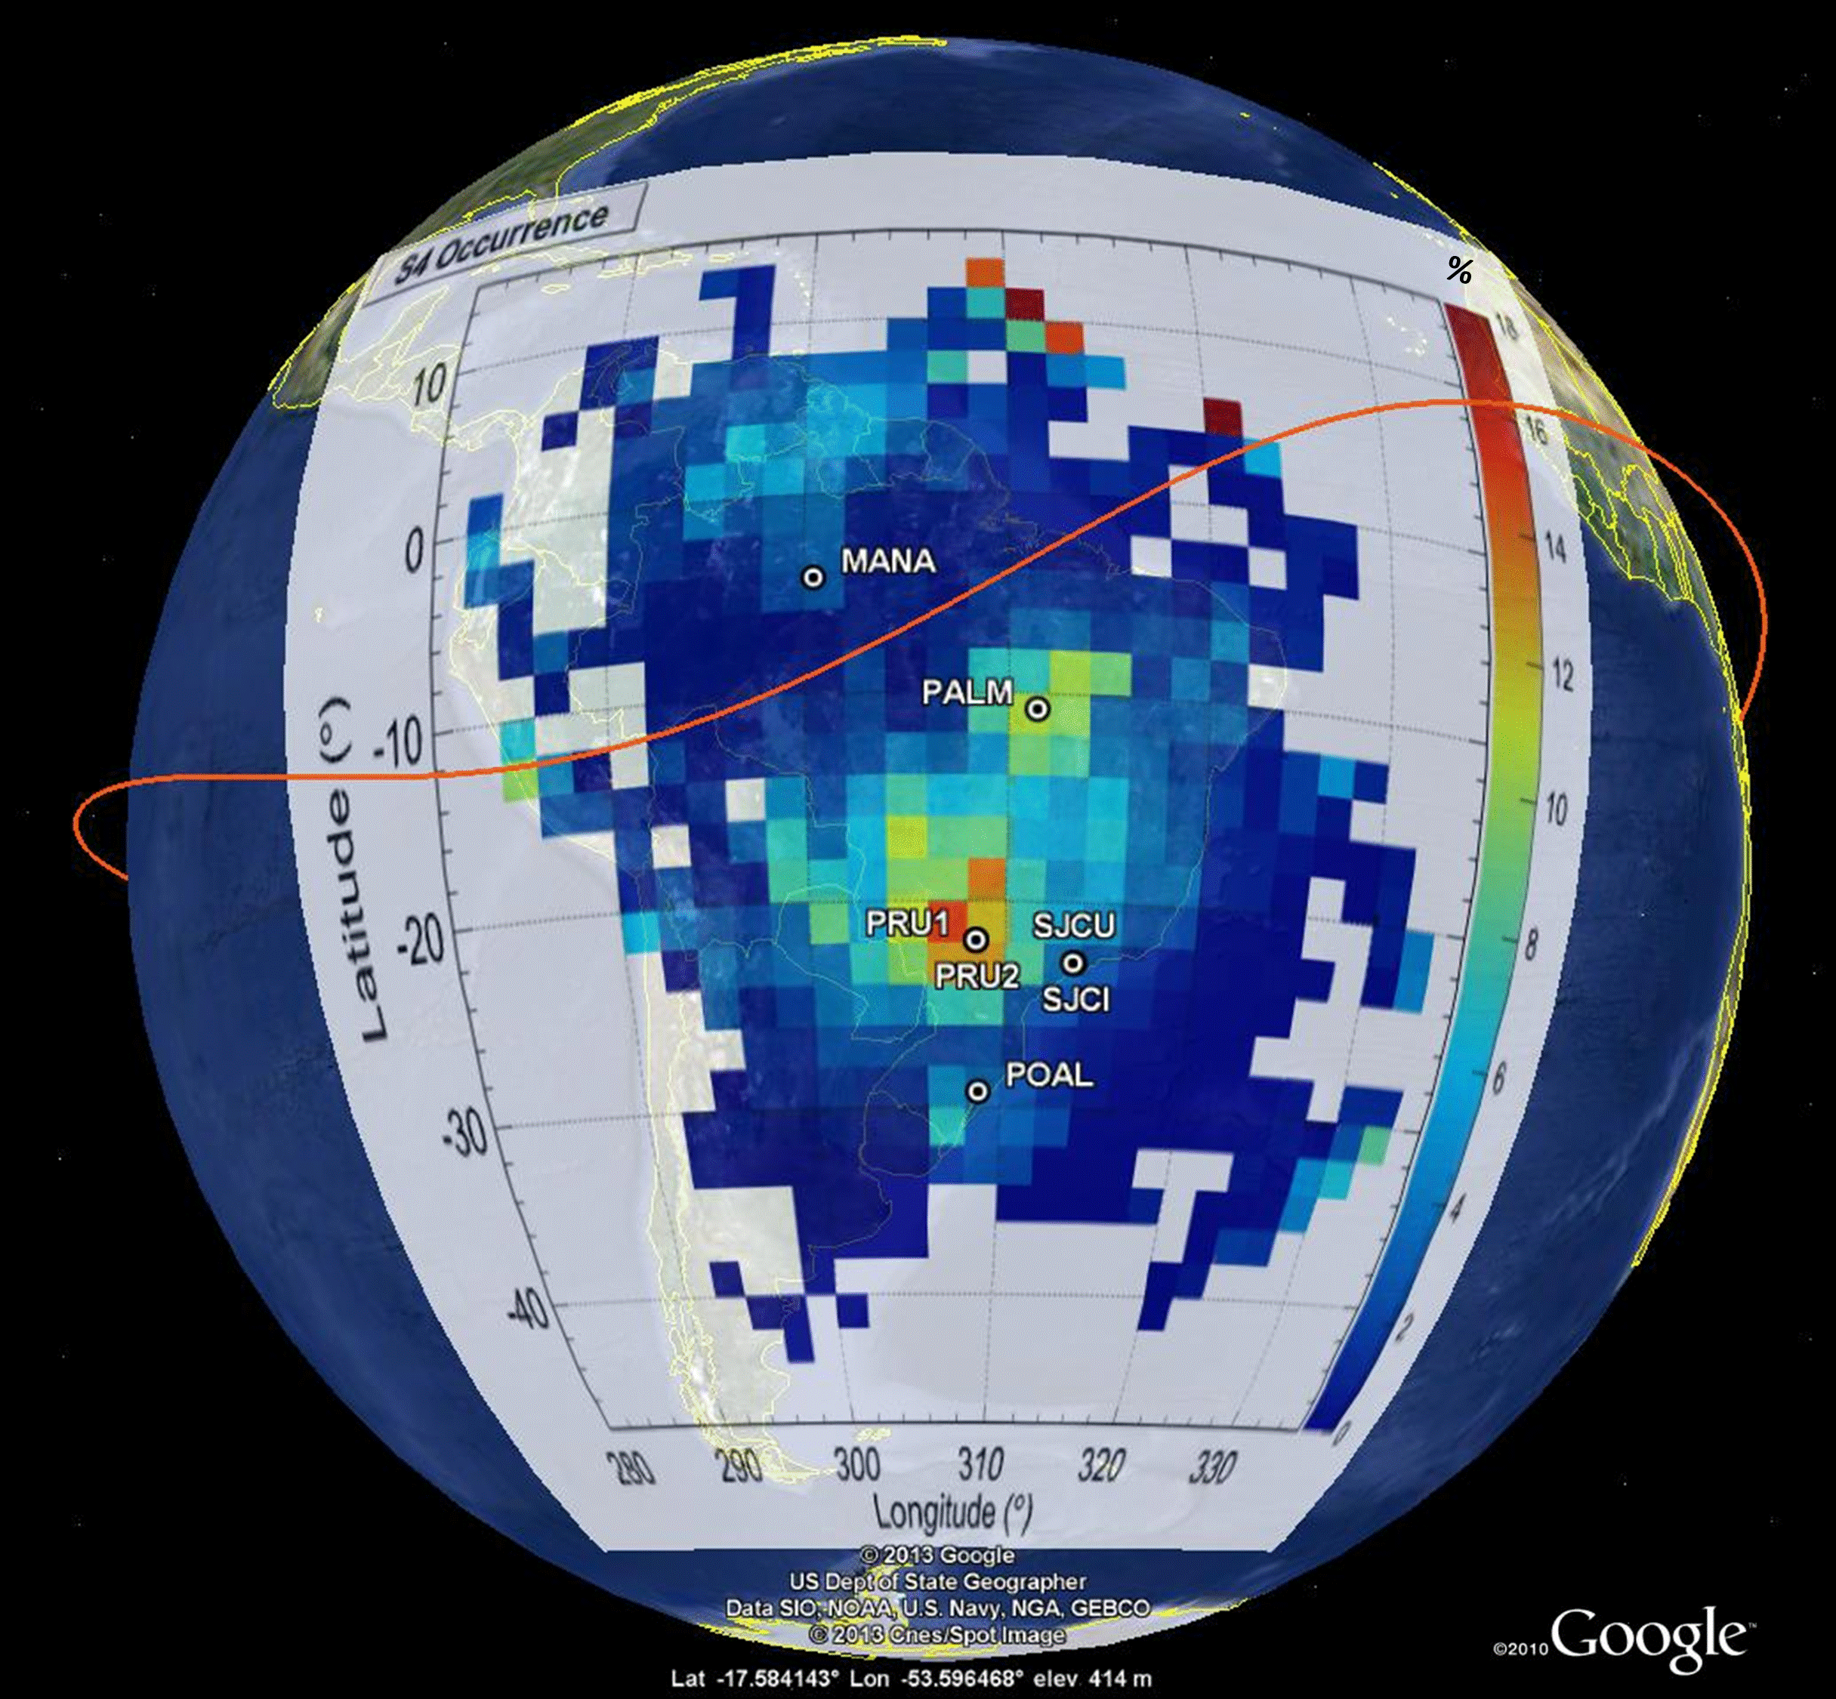
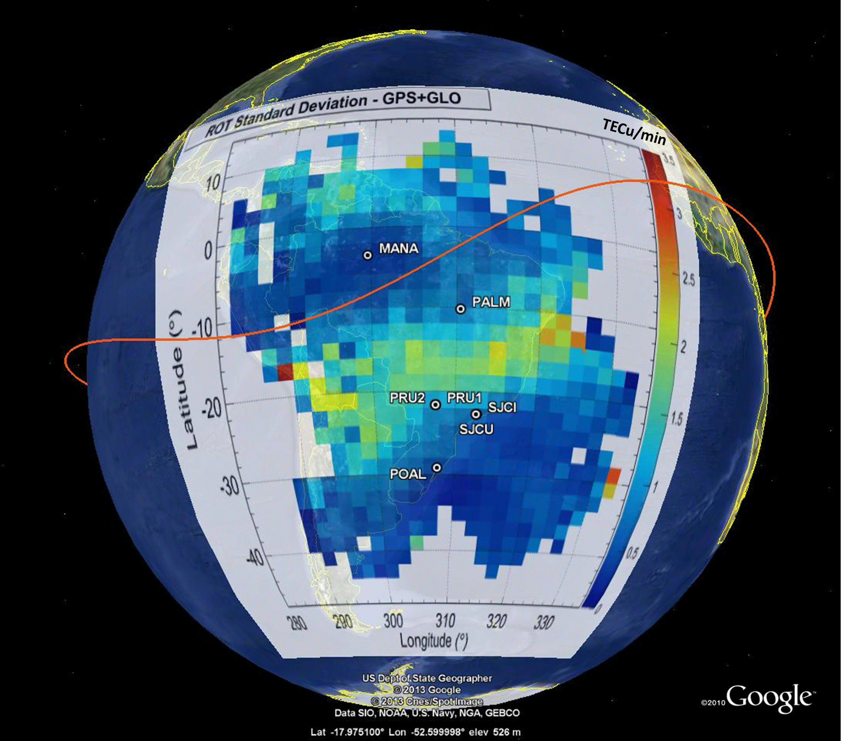
Highlights from Climatology: scintillation and ROT
Years 2013/2014
Post sunset hours
GPS + GLONASS
S4 Occurrence
ROT Standard deviation
Data available at http://is-cigala-calibra.fct.unesp.br

Slide 27
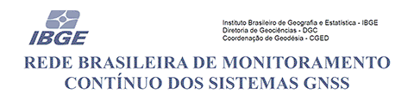
Highlights from Climatology: scintillation and TEC spatial gradients
CIGALA/CALIBRA network
IBGE Rede Brasileira de Monitoramento Contínuo dos Sistemas GNSS
Year 2012
Cesaroni et al., 2015, JSWSC
The correspondence with the S4 occurrence indicates the variability of the N-S gradients as the principal driver of the amplitude scintillation.
Data available at
http://is-cigala-calibra.fct.unesp.br
https://ww2.ibge.gov.br/home/geociencias/download/tela_inicial.php?tipo=8

Slide 28
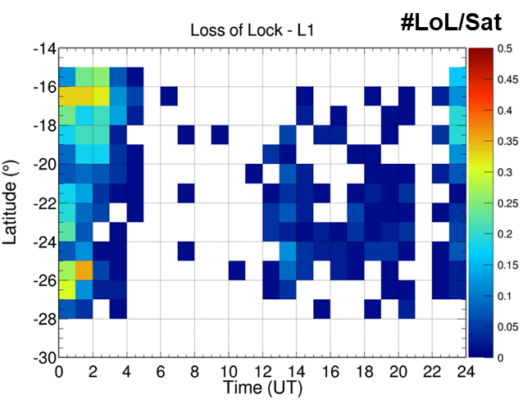
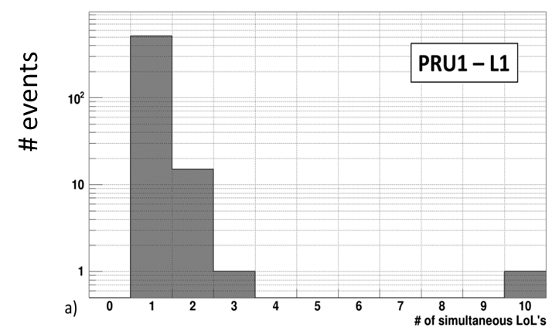



Highlights from Climatology: Loss of Lock
September 2013 to February 2014
Presidente Prudente – 3 PolaRxS receivers
Most of the LoL’s are recorded during post-sunset hours (19-04 LT).
On the average, only 1 satellite is lost at a given epoch. The maximum number of satellites simultaneously lost is 3 for L1 and 5 for L2, both only once during the campaign.
Data available at http://is-cigala-calibra.fct.unesp.br

Slide 29


Highlights from Climatology: Scintillation inhibition/enhancement
GPS L1 - Novatel GSV4004B – Station6 - Period March 2015
Tran Thi et al. (2017). Advances in Space Research
ERICA EquatoRial Ionosphere Characterization in Asia
Spogli et al. (2016). Journal of Geophysical Research: Space Physics, 121(12).

Slide 30



Highlights from Climatology: Scintillation inhibition/enhancement
Catalogue of Geomagnetic Storms based on Disturbance Storm Time, Dst, index available at
www.izmiran.ru/services/iweather/storm/dststorm.txt
Sorting is also made according to IMF-Bz
Period: 2013-2015
According to such catalogue 40 storms occurred between 2013 and 2015 (Equinox/Summer months)

Slide 31


Highlights from Climatology:
Scintillation inhibition/enhancement
Year 2011
GSV4004B – GISTM receiver
12 Dst storms occurred in 2011
Cander and Mihajlovic (2005) proposed a classification of the conditions of the geospace according to the DST values. In particular they divided the geomagnetic behavior of a given day according to 4 conditions:
Quiet conditions, if -20≤DST_{peak}≤20 nT;
Highly disturbed conditions, if -100≤DST_{peak}<-20 nT;
Severe storm conditions, if -100≤DST_{peak}<-250 nT;
Extreme conditions, if DST_{peak}<-250 nT;
where DST_{peak} is the lowest value measured in the considered. According to this 4 conditions, we sort the days of 2011 in two categories:
Quiet day, if the condition 1 is applicable;
Disturbed day, if the applicable conditions are 2, 3 or 4.

Slide 32


Raised questions
Takehome messages
What are the main physical phenomena behind
Scintillation and TEC gradients occurrence?
low-latitude ionosphere is exposed to the electrodynamics changes due to regular and irregular variation of the geospace and lower atmosphere that steer the formation of ionospheric irregularities, possibly leading to scintillation.
What are the pro’s and con’s of a climatological picture?
The climatological approach allows modeling the average behavior sorted according helio-geophysical parameters. Differences with pure physical models are crucial
What are the sectors of the low-latitude ionosphere more exposed to scintillation?
Equatorial anomaly crests, during local night, equinoxes and summer periods, high-solar flux conditions
What are the main features of the
low-latitude ionosphere highlighted by climatology?
Areas of enhanced probability of formation of irregularities and scintillation, correspondence with electron density spatio-temporal gradients.
What’s the meaning of a ionospheric scintillation climatology and what’s the difference with the (ionospheric) weather.
To assess the general recurrent features of the ionospheric irregularities dynamics and temporal evolution on long data series, trying to catch eventual correspondences with scintillation occurrence.
What are the main results of the recent studies?
Several interesting studies have investigated the main features of the low-latitude ionosphere. Day-to-day variability and storm-time behaviour are still vey challenging for modelling purposes.
What’s the role of the external drivers in modulating the scintillation occurrence?
Interplay between PPEF and DDEF result in strong modulation of the scintillation occurrence, limiting the climatological pictures in being effective. However, some attempts can be tried…
How to cook a good
scintillation climatology?
Good data, wise data preparation, clear idea of what to model

Slide 33

Thank you!

