Slide 1
Zynq Evaluation and Development Board
Cristian Sisterna
Universidad Nacional de San Juan
Argentina

Slide 2
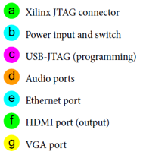
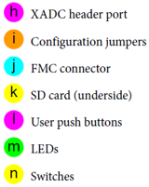
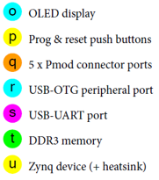
ZedBoard Main Components

Slide 3
ZedBoard Main Connectors to be Used
Notes:
Hardware Setup
The ZedBoard must be connected to a power supply and, in the default configuration, to the host PC for JTAG programming over USB (i.e. the USB-A to micro-USB-B
connection). An additional connection should be made if intending to use the UART to facilitate simple board-PC communication using the Terminal application. The locations of these two connectors on the ZedBoard are shown in Figure 6.3. Note that there is also a third micro-USB port which is reserved for connecting USB peripherals, if used (this can be seen at the bottom of the photograph).
It is important to note that the correct device drivers must be installed in order to use the USB-UART connection. These can be sourced from Cypress, and full details of the installation process can be found in [2], including links to download the relevant driver files.

Slide 4
Conection Between PC-ZedBoard

Slide 5
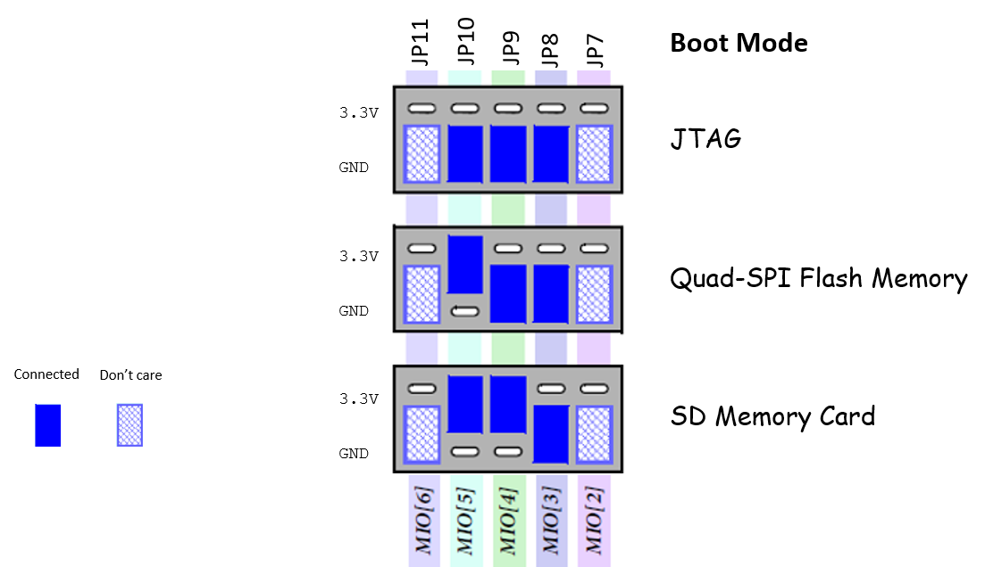
Programming the ZedBoard
Notes:
Programming the ZedBoard
The ZedBoard can be programmed in four different ways. These are:
•USB-JTAG — This is the default and most straightforward method of programming the ZedBoard, given that it can be done directly over the USB-micro-USB cable supplied in the ZedBoard kit.
•Traditional JTAG — A Xilinx JTAG connector is available on the board and may be used in place of the USB-JTAG connection, if desired. This will require a different type of cable than is included in the ZedBoard kit: a Xilinx Platform USB cable [11], or a Digilent USB-JTAG programming cable [10].
•Quad-SPI flash memory — The flash memory on the board is non-volatile and therefore can be used to store configuration data which persists when the board is powered off. Using this method removes the requirement for a wired connection to program the Zynq device.
•SD card — There is an SD slot on the underside of the ZedBoard. This facility can be used to program the Zynq with files stored on the SD card, thus requiring no wired connections for programming. This method is featured in the ZedBoard Getting Started Guide [6].
Notably, the JTAG methods are ideal for the development phase, when it is convenient to establish a USB / JTAG connection between the development PC and the ZedBoard. The other two methods are more portable, and ultimately more representative of the type of programming method which would be used in the field. It is also significant that JTAG is a non-secure mechanism, while the other methods are secure; this is another factor in favour of the flash and SD-based configuration methods when outside the lab environment. Booting will be discussed in detail in Chapter 24, in the context of Linux-based systems.
The ZedBoard user specifies the method of booting / programming via a set of jumper pins, which are positioned above the Digilent logo, as clarified in Figure 6.4. Of the five jumpers in the group, the central three are used to define the source for programming the board (JTAG, flash memory, or SD card), the jumper on the far right controls the JTAG mode, and the jumper on the far left determines whether the internal PLL is used.
These last two options require further clarification. The JTAG mode refers to the method of debugging using JTAG; this can either be cascaded, in which case a single JTAG connection is used to interface to the debug access ports in both the PS and PL, or independent, wherein the debug access ports in the PS and PL are accessed separately, requiring one cable for each. The PLL mode determines whether the process of configuring the device includes a phase of waiting for the PLL to lock, before starting the boot process. The alternative is to bypass the PLL, but in this case, booting takes longer.
Extensive further information about configuration options and processes is available in the Zynq-7000 Technical Reference Manual [13].
Table 6.1 specifies permitted jumper settings, and selected examples are also given in Figure 6.5.

Slide 6
DRAM Memory
512 Mbytes DDR3 connected to the PS part of the Zynq
The DDR3 is controled by the DRAM Controller
It is posible to add more memory to the PL part using the Memory Interface Generator (MIG), for example using a daughter card connected to the FMC connector.
PS DDR Bandwidth
By default the DDR Controller clock is 533MHz
Total Bw: 4 * 533 * 2 = 4.2 GB/s
Notes:
andwidth:
Default clock 533MHz
Total Bw
4 * 533 * 2 = 4.2 GB/s

Slide 7
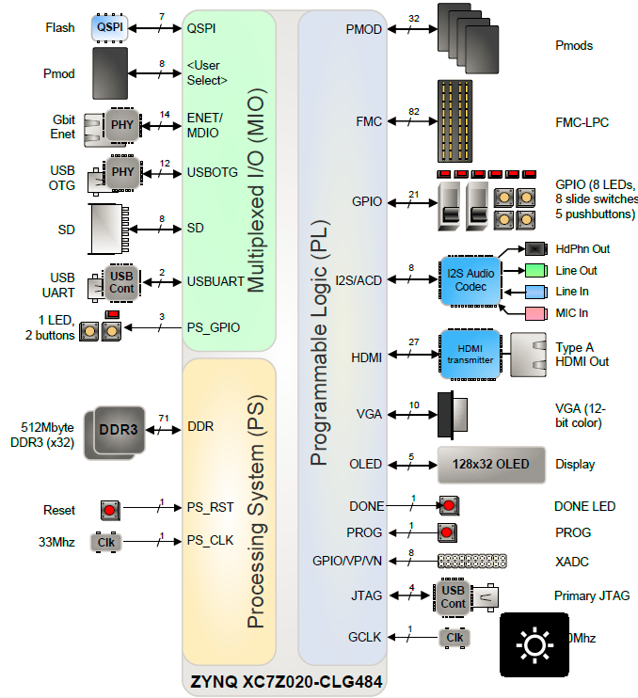
256 Mbit- Serial NOR
Flash
PMOD
PMOD
10/100/1000 Ethernet Phy
LPC FMC Connector
68 Single Ended
34 Differential
LEDs (8)
USB OTG
User I/O
Push Buttons(5)
SD Card
DIP Switch(8)
USB-UART
AUDIO
LD9 (PS)
Buttons (PS)
HDMI
512MB (32 bits)533MHz
VGA
OLED
Processor Subsystem Reset
Done Blue LED
Program Push Button
Clock
Analog Mixed Signaling (AMS) Connector
USB-JTAG
PL Clock Source
100MHz
Notes:
DDR3
The ZedBoard includes two Micron DDR3 128 Megabit x 16 memory components creating a 32-bit interface, totaling 512 MB.
The multi-protocol DDR memory controller is configured for 32-bit wide accesses to a 512 MB address space. The PS incorporates both the DDR controller and the associated PHY, including its own set of dedicated I/Os. DDR3 memory interface speeds up to 533MHz (1066Mbs) are supported.
The DDR3 uses 1.5V SSTL-compatible inputs. DDR3 Termination is utilized on the ZedBoard. The Zynq-7000 AP SoC and DDR3 have been placed close together keeping traces short and matched.
QSPI
The ZedBoard features a 4-bit SPI (quad-SPI) serial NOR flash. The Spansion S25FL256S is used on this board. The Multi-I/O SPI Flash memory is used to provide non-volatile code, and data storage. It can be used to initialize the PS subsystem as well as configure the PL subsystem (bitstream). Spansion provides Spansion Flash File System (FFS) for use after booting the Zynq-7000 AP SoC.
The relevant device attributes are:
• 256Mbit
• x1, x2, and x4 support
• Speeds up to 104 MHz, supporting Zynq configuration rates @ 100 MHz o In Quad-SPI mode, this translates to 400Mbs
• Powered from 3.3V
The SPI Flash connects to the Zynq-7000 AP SoC supporting up to Quad-I/O SPI interface. This requires connection to specific pins in MIO Bank 0/500, specifically MIO[1:6,8] as outlined in the Zynq datasheet. Quad-SPI feedback mode is used, thus qspi_sclk_fb_out/MIO[8] is connected
SD Card Interface
The Zynq PS SD/SDIO peripheral controls communication with the ZedBoard SD Card (A 4GB Class 4 card is included in the ZedBoard kit.) The SD card can be used for non-volatile external memory storage as well as booting the Zynq-7000 AP SoC. PS peripheral sd0 is connected through Bank 1/501 MIO[40-47], including, Card Detect and Write Protect.
USB OTG
The usb0 peripheral is used on the PS, connected through MIO[28-39] in MIO Bank 1/501.
This USB port will not power the board. However, ZedBoard provides 5V when in Host or OTG modes. REFCLK pin of TUSB1210 is tied to ground as the Zynq-7000 AP SoC will drive the CLOCK input of this part.
USB-to-UART Bridge
The ZedBoard implements a USB-to-UART bridge connected to a PS UART peripheral. A Cypress CY7C64225 USB-to-UART Bridge device allows connection to a host computer. The USB/UART device connects to the USB Micro B connector, J14, (TE 1981584-1) on the board. Only basic TXD/RXD connection is implemented. If flow control is required this can be added through Extended MIO on a PL-Pmod™.
USB-JTAG
The ZedBoard provides JTAG functionality based on the Digilent USB High Speed JTAG Module, SMT1 device. This USB-JTAG circuitry is fully supported and integrated into Xilinx ISE tools, including iMPACT, ChipScope, and SDK Debugger. Designers who want to re-use this circuit on their board can do so by acquiring these modules from Avnet
HDMI Output
An Analog Devices ADV7511 HDMI Transmitter provides a digital video interface to the ZedBoard. This 225MHz transmitter is HDMI 1.4- and DVI 1.0-compatible supporting 1080p60 with 16-bit, YCbCr, 4:2:2 mode color.
The ADV7511 supports both S/PDIF and 8-channel I2S audio. The S/PDIF can carry compressed audio including Dolby® Digital, DTS®, and THX®. There is an independent DPDIF input and output. The I2S interface is not connected on ZedBoard. Analog Devices offers Linux drivers and reference designs illustrating how to interface to this device.
VGA Connector
The ZedBoard also allows 12-bit color video output through a through-hole VGA connector, TE 4-1734682-2. Each color is created from resistor-ladder from four PL pins.
I2S Audio Codec
An Analog Devices ADAU1761 Audio Codec provides integrated digital audio processing to the Zynq-7000 AP SoC. It allows for stereo 48KHz record and playback. Sample rates from 8KHz to 96KHz are supported. Additionally, the ADAU1761 provides digital volume control. The Codec can be configured using Analog Devices SigmaStudio™ for optimizing audio for specific acoustics, numerous filters, algorithms and enhancements. Analog Devices provides Linux drivers for this device.
OLED
An Inteltronic/Wisechip UG-2832HSWEG04 OLED Display is used on the ZedBoard. This provides a 128x32 pixel, passive-matrix, monochrome display. The display size is 30mm x 11.5mm x 1.45mm.
Clock sources
The Zynq-7000 AP SoC’s PS subsystem uses a dedicated 33.3333 MHz clock source, IC18, Fox 767-33.333333-12, with series termination. The PS infrastructure can generate up to four PLL-based clocks for the PL system. An on-board 100 MHz oscillator, IC17, Fox 767-100-136, supplies the PL subsystem clock input on bank 13, pin Y9.
Processor Subsystem Reset
Power-on reset, labeled PS_RST/BTN7, erases all debug configurations. The external system reset allows the user to reset all of the functional logic within the device without disturbing the debug environment. For example, the previous break points set by the user remain valid after system reset. Due to security concerns, system reset erases all memory content within the PS, including the OCM. The PL is also reset in system reset. System reset does not re-sample the boot mode strapping pins.
User Push Buttons
The ZedBoard provides 7 user GPIO push buttons to the Zynq-7000 AP SoC; five on the PL-side and two on the PS-side.
Pull-downs provide a known default state, pushing each button connects to Vcco.
User DIP Switches
The ZedBoard has eight user dip switches, SW0-SW7, providing user input. SPDT switches connect the I/O through a 10kΩ resistor to the VADJ voltage supply or GND.
User LEDs
The ZedBoard has eight user LEDs, LD0 – LD7. A logic high from the Zynq-7000 AP SoC I/O causes the LED to turn on. LED’s are sourced from 3.3V banks through 390Ω resistors.
10/100/1000 Ethernet PHY
The ZedBoard implements a 10/100/1000 Ethernet port for network connection using a Marvell 88E1518 PHY. This part operates at 1.8V. The PHY connects to MIO Bank 1/501 (1.8V) and interfaces to the Zynq-7000 AP SoC via RGMII. The RJ-45 connector is a TE Connectivity 1840750-7 featuring integrated magnetics. The RJ-45 has two status indicator LEDs that indicate traffic and valid link state.
LPC FMC Connector
A single low-pin count (LPC) FMC slot is provided on the ZedBoard to support a large ecosystem of plug-in modules. The LPC FMC exposes 68 single-ended I/O, which can be configured as 34 differential pairs. The FMC interface spans over two PL I/O banks, banks 34 and 35. To meet the FMC spec, these banks are powered from an adjustable voltage set by jumper, J18. Selectable voltages include 1.8V, default, and 2.5V. It is also possible to set Vadj to 3.3V. Since 3.3V could potentially be the most damaging voltage setting for Vadj, this is not available with the default board hardware. To set Vadj to 3.3V, solder a short across the 3V3 pads at J18 or solder in an additional 1x2 header. The FMC pin out can be copied from the Master UCF, see ZedBoard.org.
Digilent Pmod™ Compatible Headers (2x6)
The ZedBoard has five Digilent Pmod™ compatible headers (2x6). These are right-angle, 0.1” female headers that include eight user I/O plus 3.3V and ground signals as show in the figure below.
Four Pmod connectors interface to the PL-side of the Zynq-7000 AP SoC. These will connect to Bank 13 (3.3V). One Pmod, JE1, connects to the PS-side on MIO pins [0,9-15] in MIO Bank 0/500 (3.3V). Uses for this Pmod include PJTAG access (MIO[10-13]) as well as nine other hardened MIO peripherals (SPI, GPIO, CAN, I2C, UART, SD, QSPI, Trace, Watchdog).
The four PL Pmod connectors are placed in adjacent pairs on the board edge such that the clearance between Pin 6 of header #1 and Pin 1 of header #2 is 10mm.
Two of the Pmods, JC1 and JD1, are aligned in a dual configuration and have their I/O routed differentially to support LVDS running at 525Mbs.
Agile Mixed Signaling (AMS) Connector, J2
The XADC header provides analog connectivity for analog reference designs, including AMS daughter cards like Xilinx’s AMS Evaluation Card.
The analog header is placed close to the LPC FMC header as shown. Both analog and digital IO can be easily supported for a plug in card. This allows the analog header to be easily connected to the FMC card using a short ribbon cable as shown. The analog header can also be used “stand alone” to support the connection of external analog signals.
Program Push Button Switch
A PROG push switch, BTN6, toggles Zynq PROG_B. This initiates reconfiguring the PL-subsection by the processor.

Slide 8
ZedBoard Hardware User Guide

Slide 9
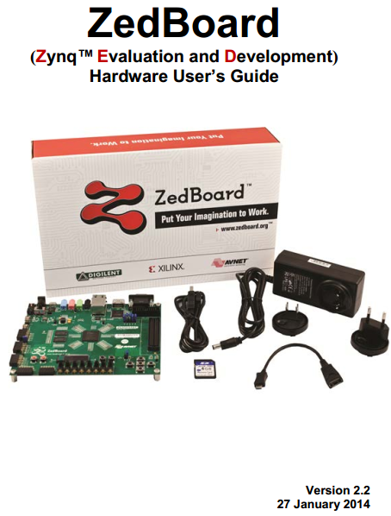

Slide 10
ZedBoard Clock Sources

Slide 11
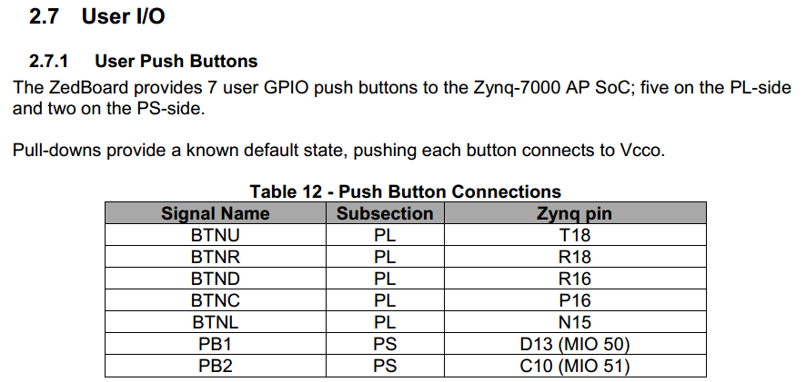
ZedBoard Available I/O for the User (1)

Slide 12
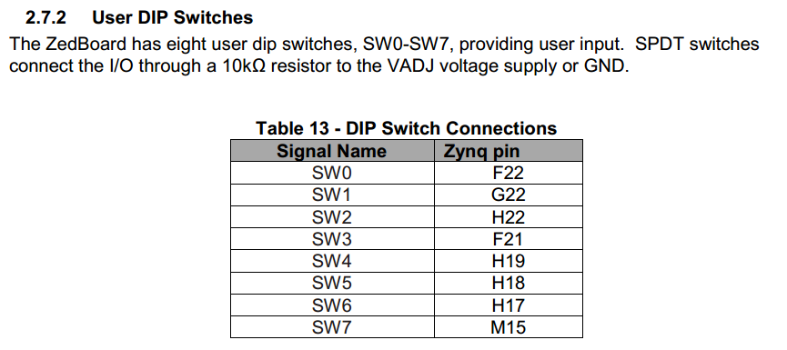
ZedBoard Available I/O for the User (2)

Slide 13
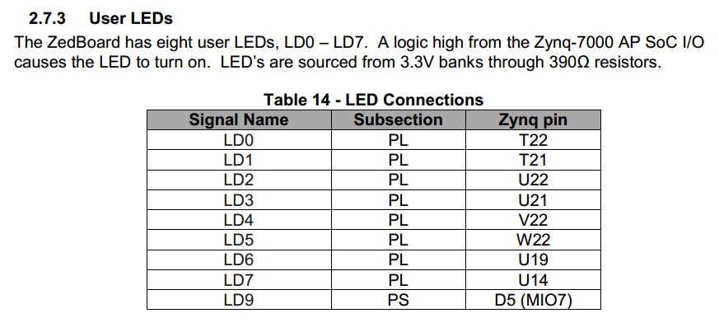
ZedBoard Available I/O for the User (3)

Slide 14
ZedBoard PMOD Connectors

Slide 15
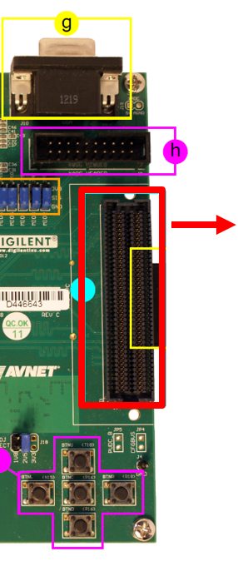
ZedBoard Expansion Headers: LPC FMC Card Connector
LPC FMC : Low Pin Count (LPC) FPGA Mezzanine Card Connector
68 single-ended I/O or 34 differential pairs
J18 defines the power for the connector: 1.8V by default.
The FMC pin out can be copied from the Master UCF

Slide 16
Thanks !!
http://c7technology.com/
https://www.facebook.com/CristianC7T
@Cristian_C7T
cristian@unsj.edu.ar
cristian@c7technology.com

