Slide 1
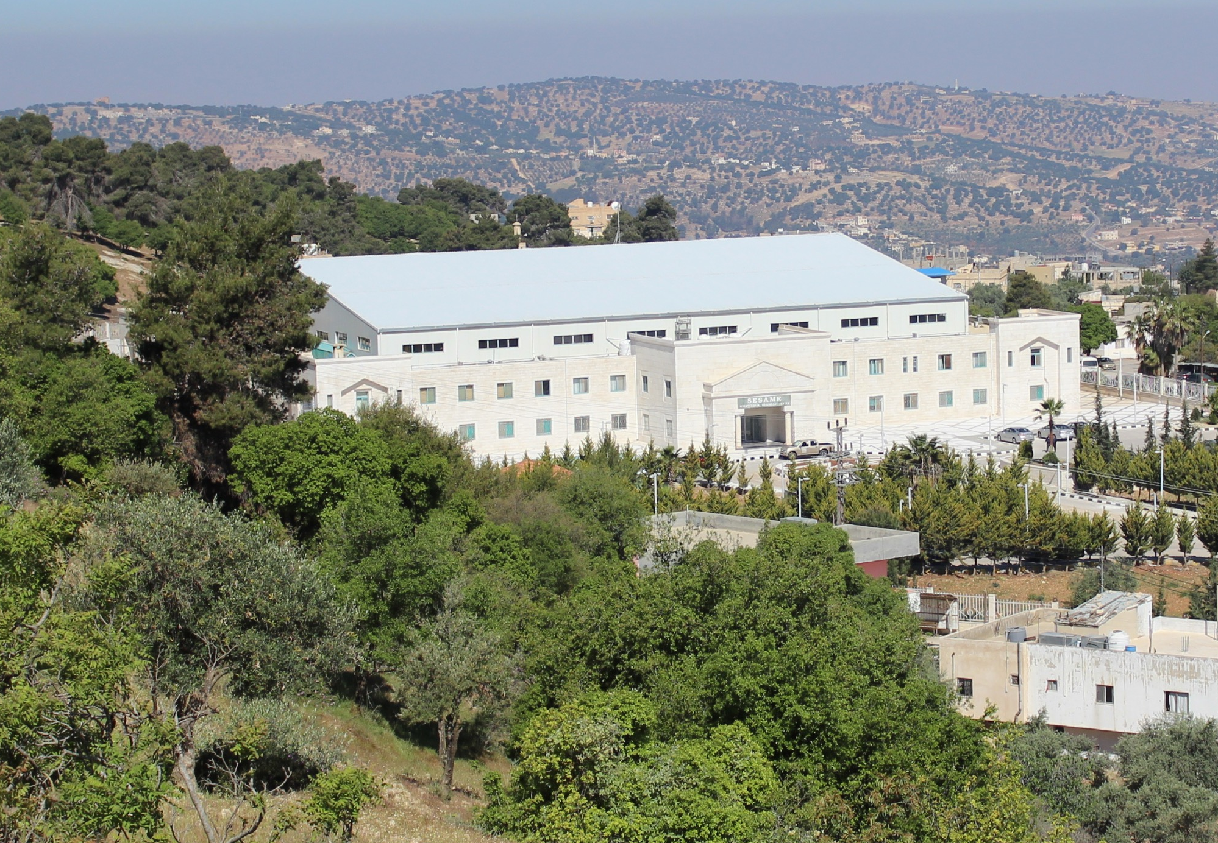

SESAME
a Regional
Research
Opportunity
Andrea Lausi
SESAME Scientific Director
andrea.lausi@sesame.org.jo

Slide 2
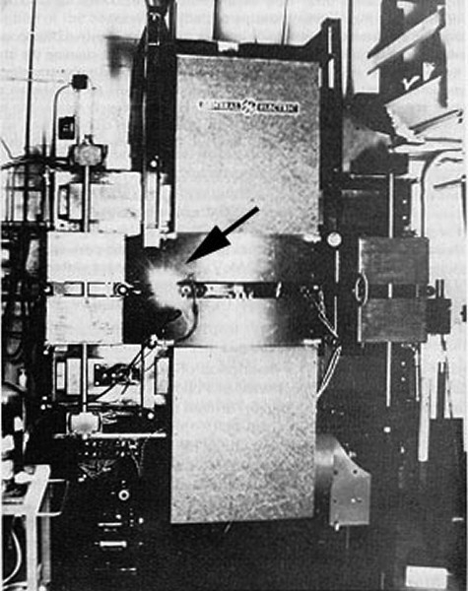
Synchrotron Radiation was named after its discovery in a General Electric synchrotron accelerator built in 1946 and announced in May 1947 by Frank Elder, Anatole Gurewitsch, Robert Langmuir, and Herb Pollock in a letter entitled "Radiation from Electrons in a Synchrotron".
Synchrotron Radiation covers a broad spectrum from microwaves to hard X-rays
Synchrotron Radiation is extremely collimated
Scientific Cultural Centers in continuous evolution
75 years
SR

Slide 3
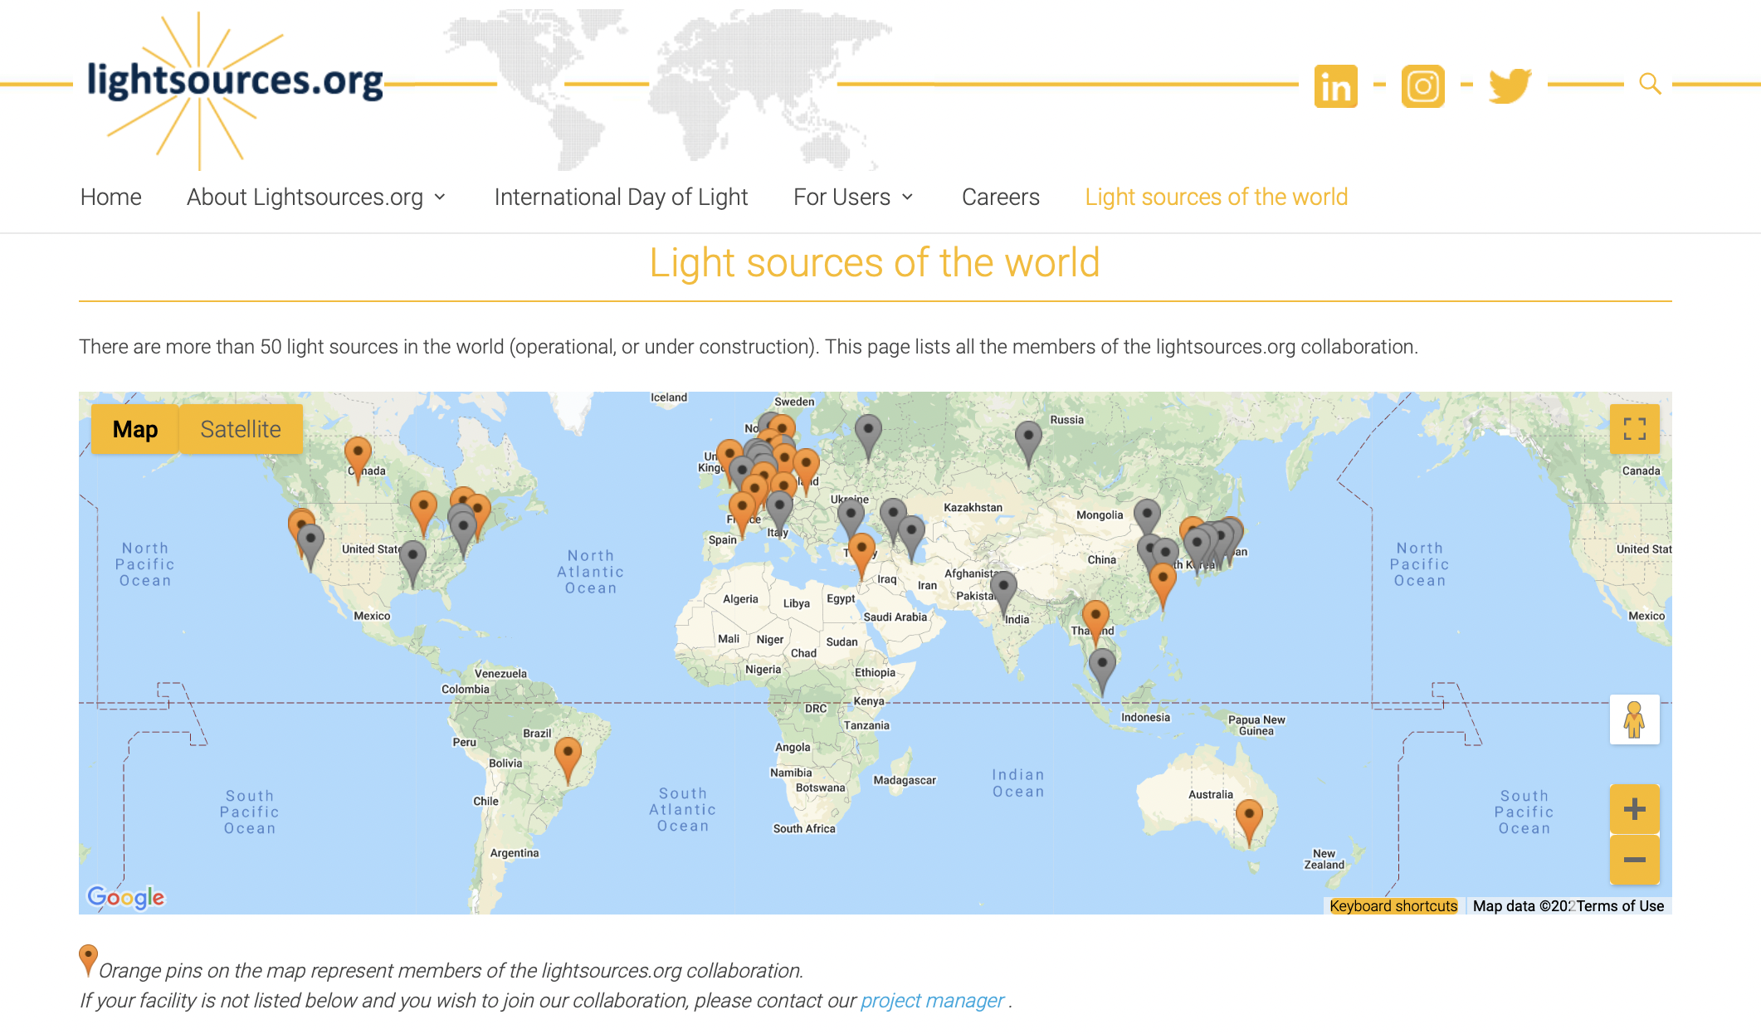
50.000 users, the largest scientific community in the world

Slide 4
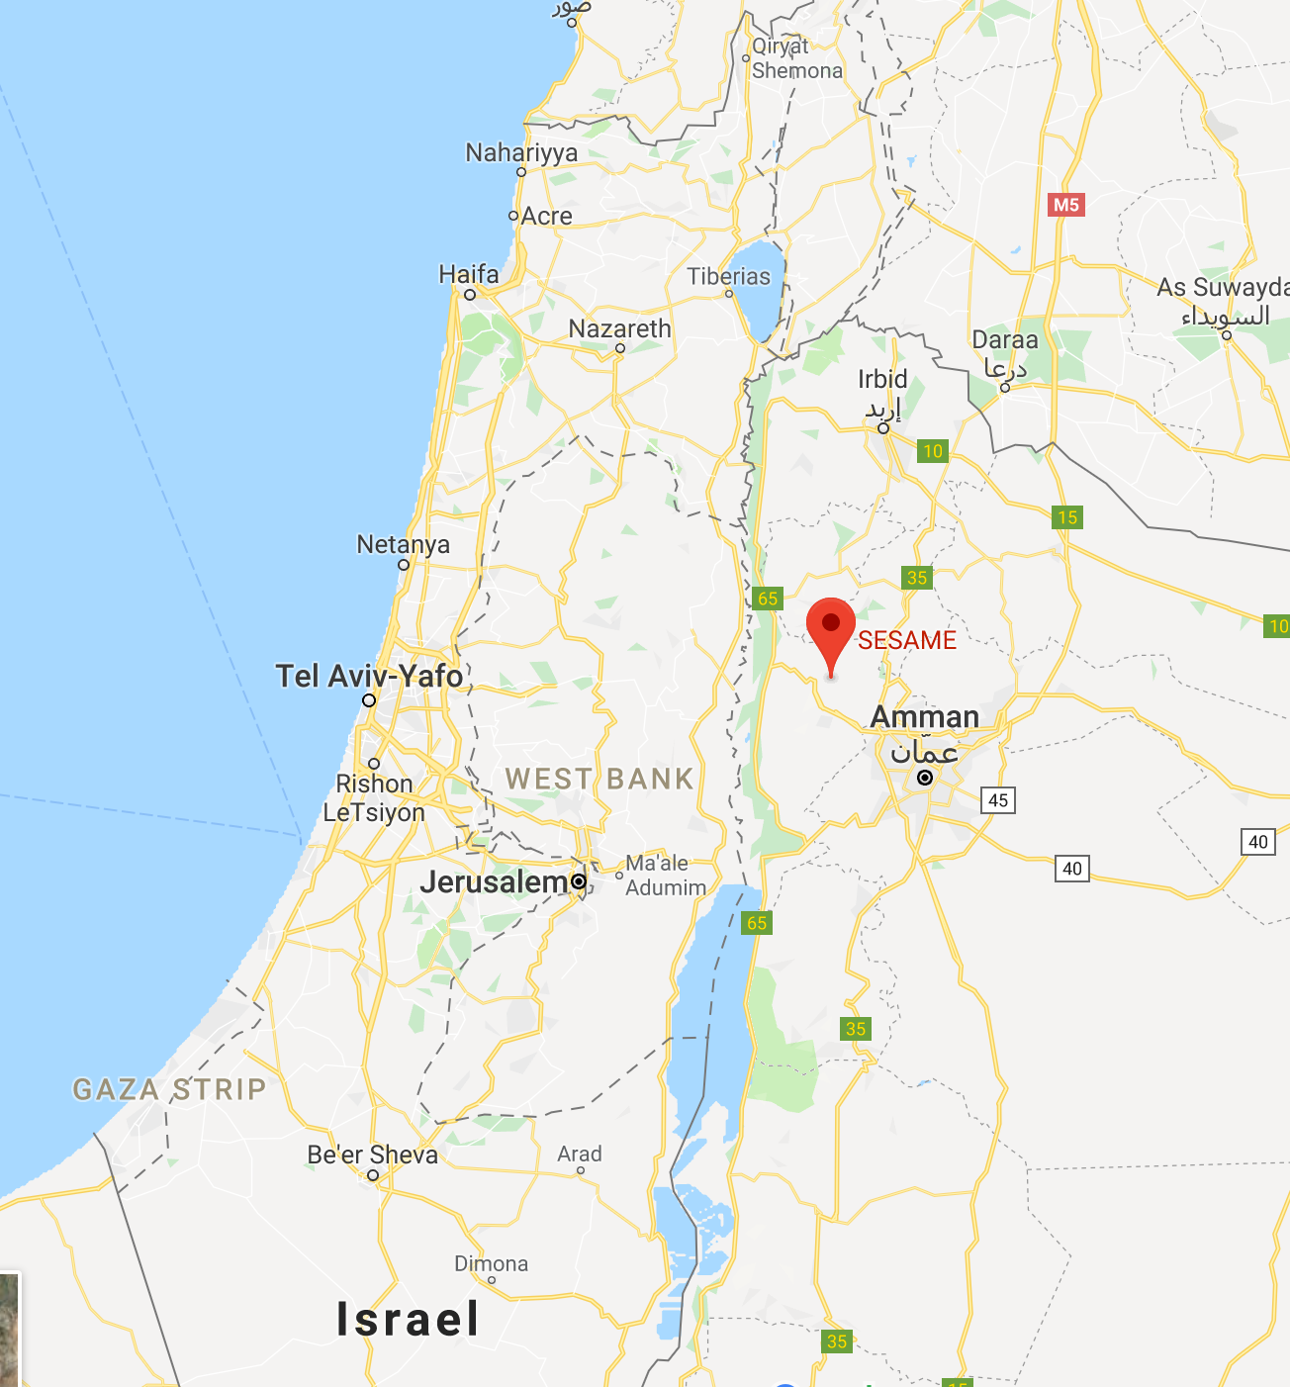

SESAME is located in Allan, NW of Amman, the capital of Jordan
SESAME is a cooperative venture by scientists and governments of the region set up on the model of CERN (European Organization for Nuclear Research) although it has very different scientific aims.
It was developed under the auspices of UNESCO (United Nations Educational, Scientific and Cultural Organization) following the formal approval given for this by the Organization's Executive Board (164th session, May 2002).

Slide 5
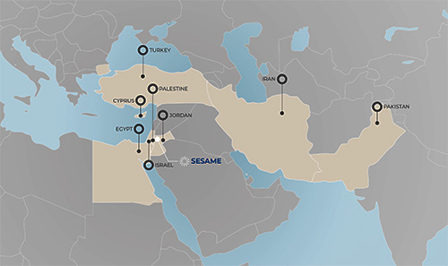
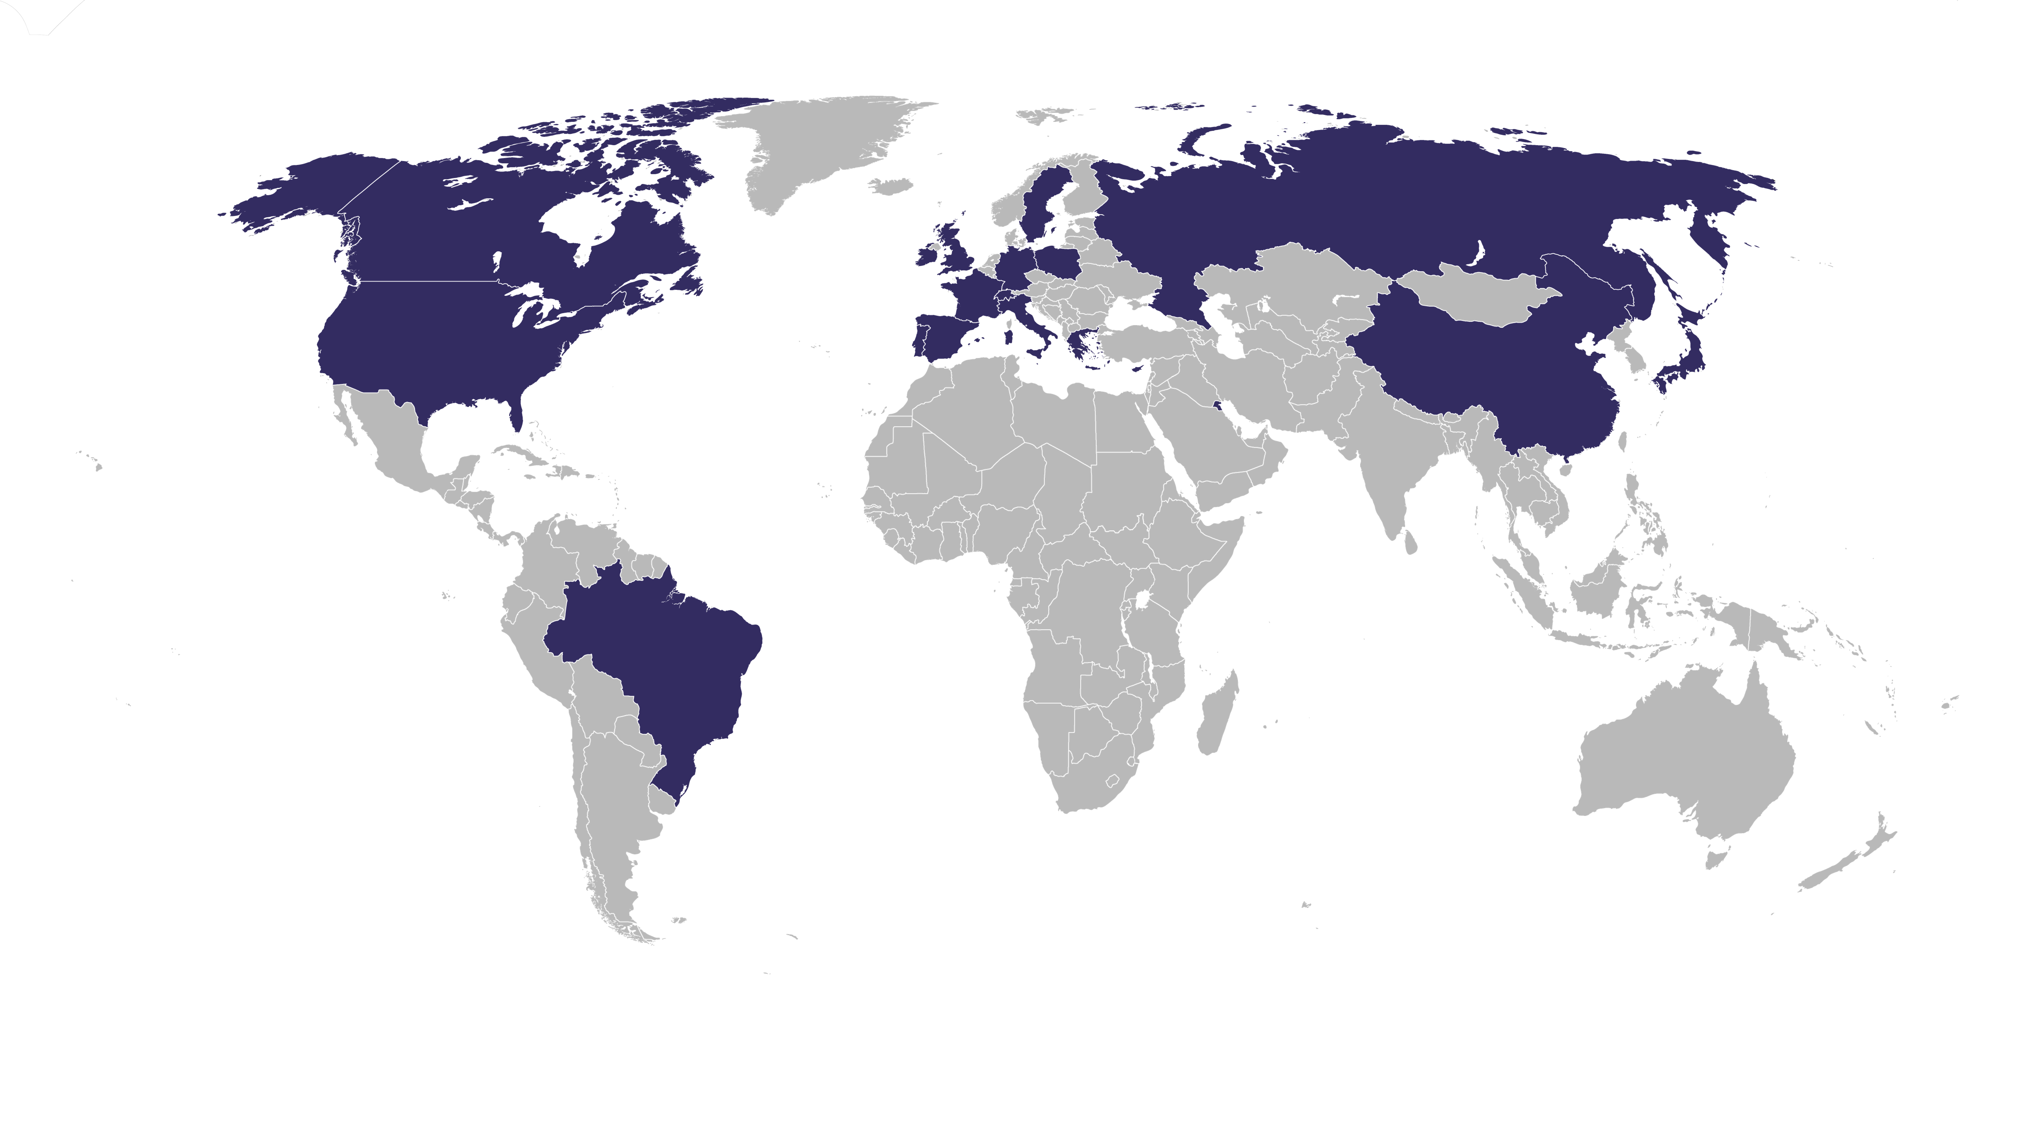
Members: Cyprus, Egypt, Iran, Israel, Jordan, Pakistan, Palestine, and Turkey.
Observers: Brazil, Canada, CERN, China, the European Union, France, Germany, Greece, Italy, Japan, Kuwait, Portugal, Russian Federation, Spain, Sweden, Switzerland, the United Kingdom, United Arab Emirates, and the United States of America.

Slide 6
SESAME Opening Ceremony, May 16, 2017 His Majesty King Abdullah II following the opening of SESAME, flanked by Heads of the delegations of the SESAME Members and Directors of International Organisations that have supported SESAME. To the King's left, HRH Princess Sumaya of Jordan, who headed the Jordanian delegation, and Fabiola Gianotti, Director General of CERN; to the right, Irena Bokova, Director-General of UNESCO, Carlos Moedas, European Commissioner for Research, Science and Innovation, and Rolf Heuer, President of SESAME Council

Slide 7
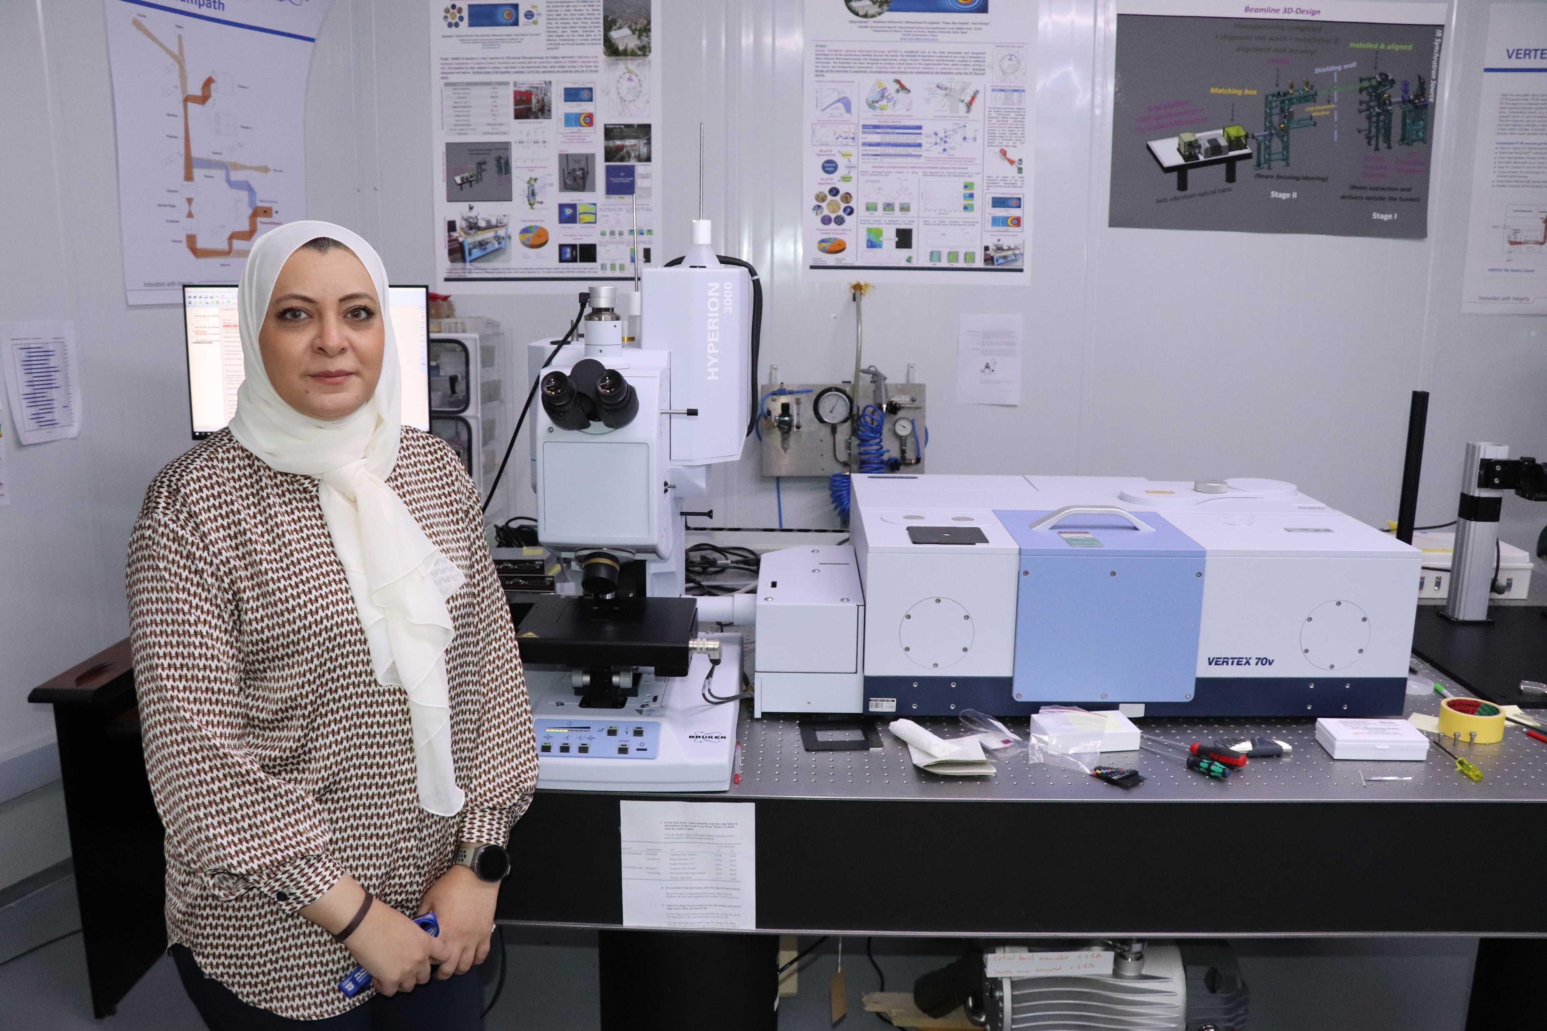
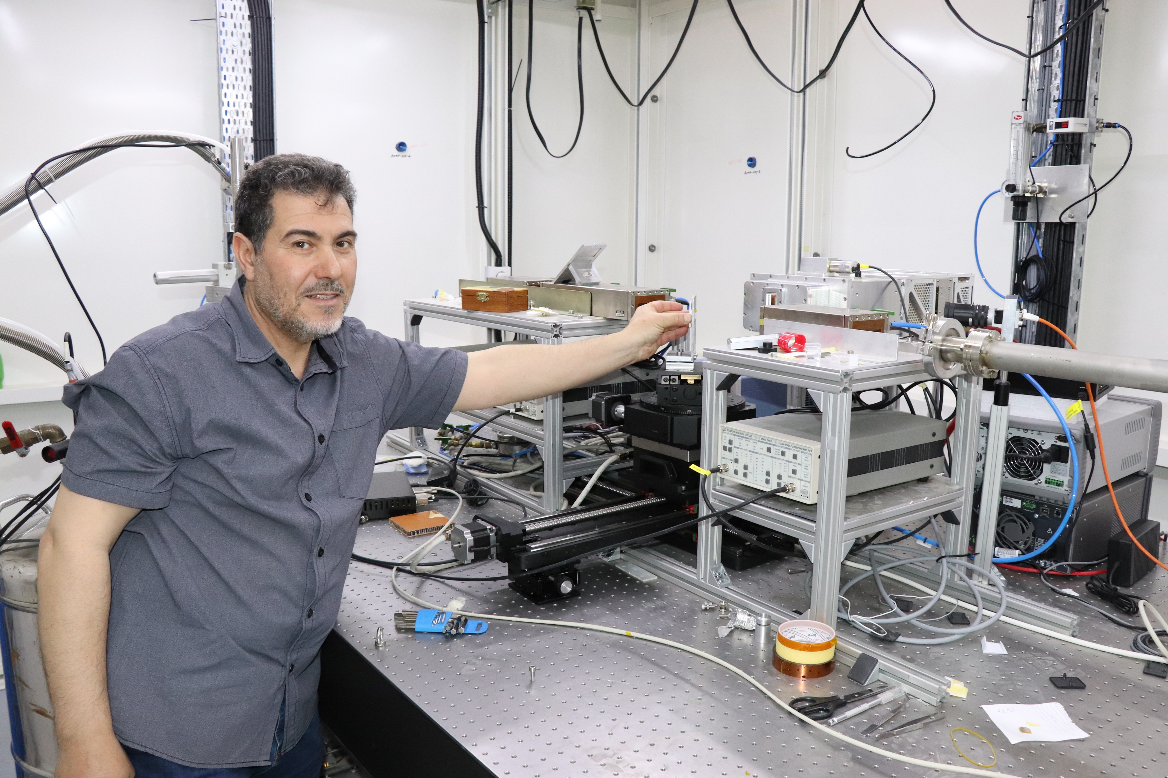
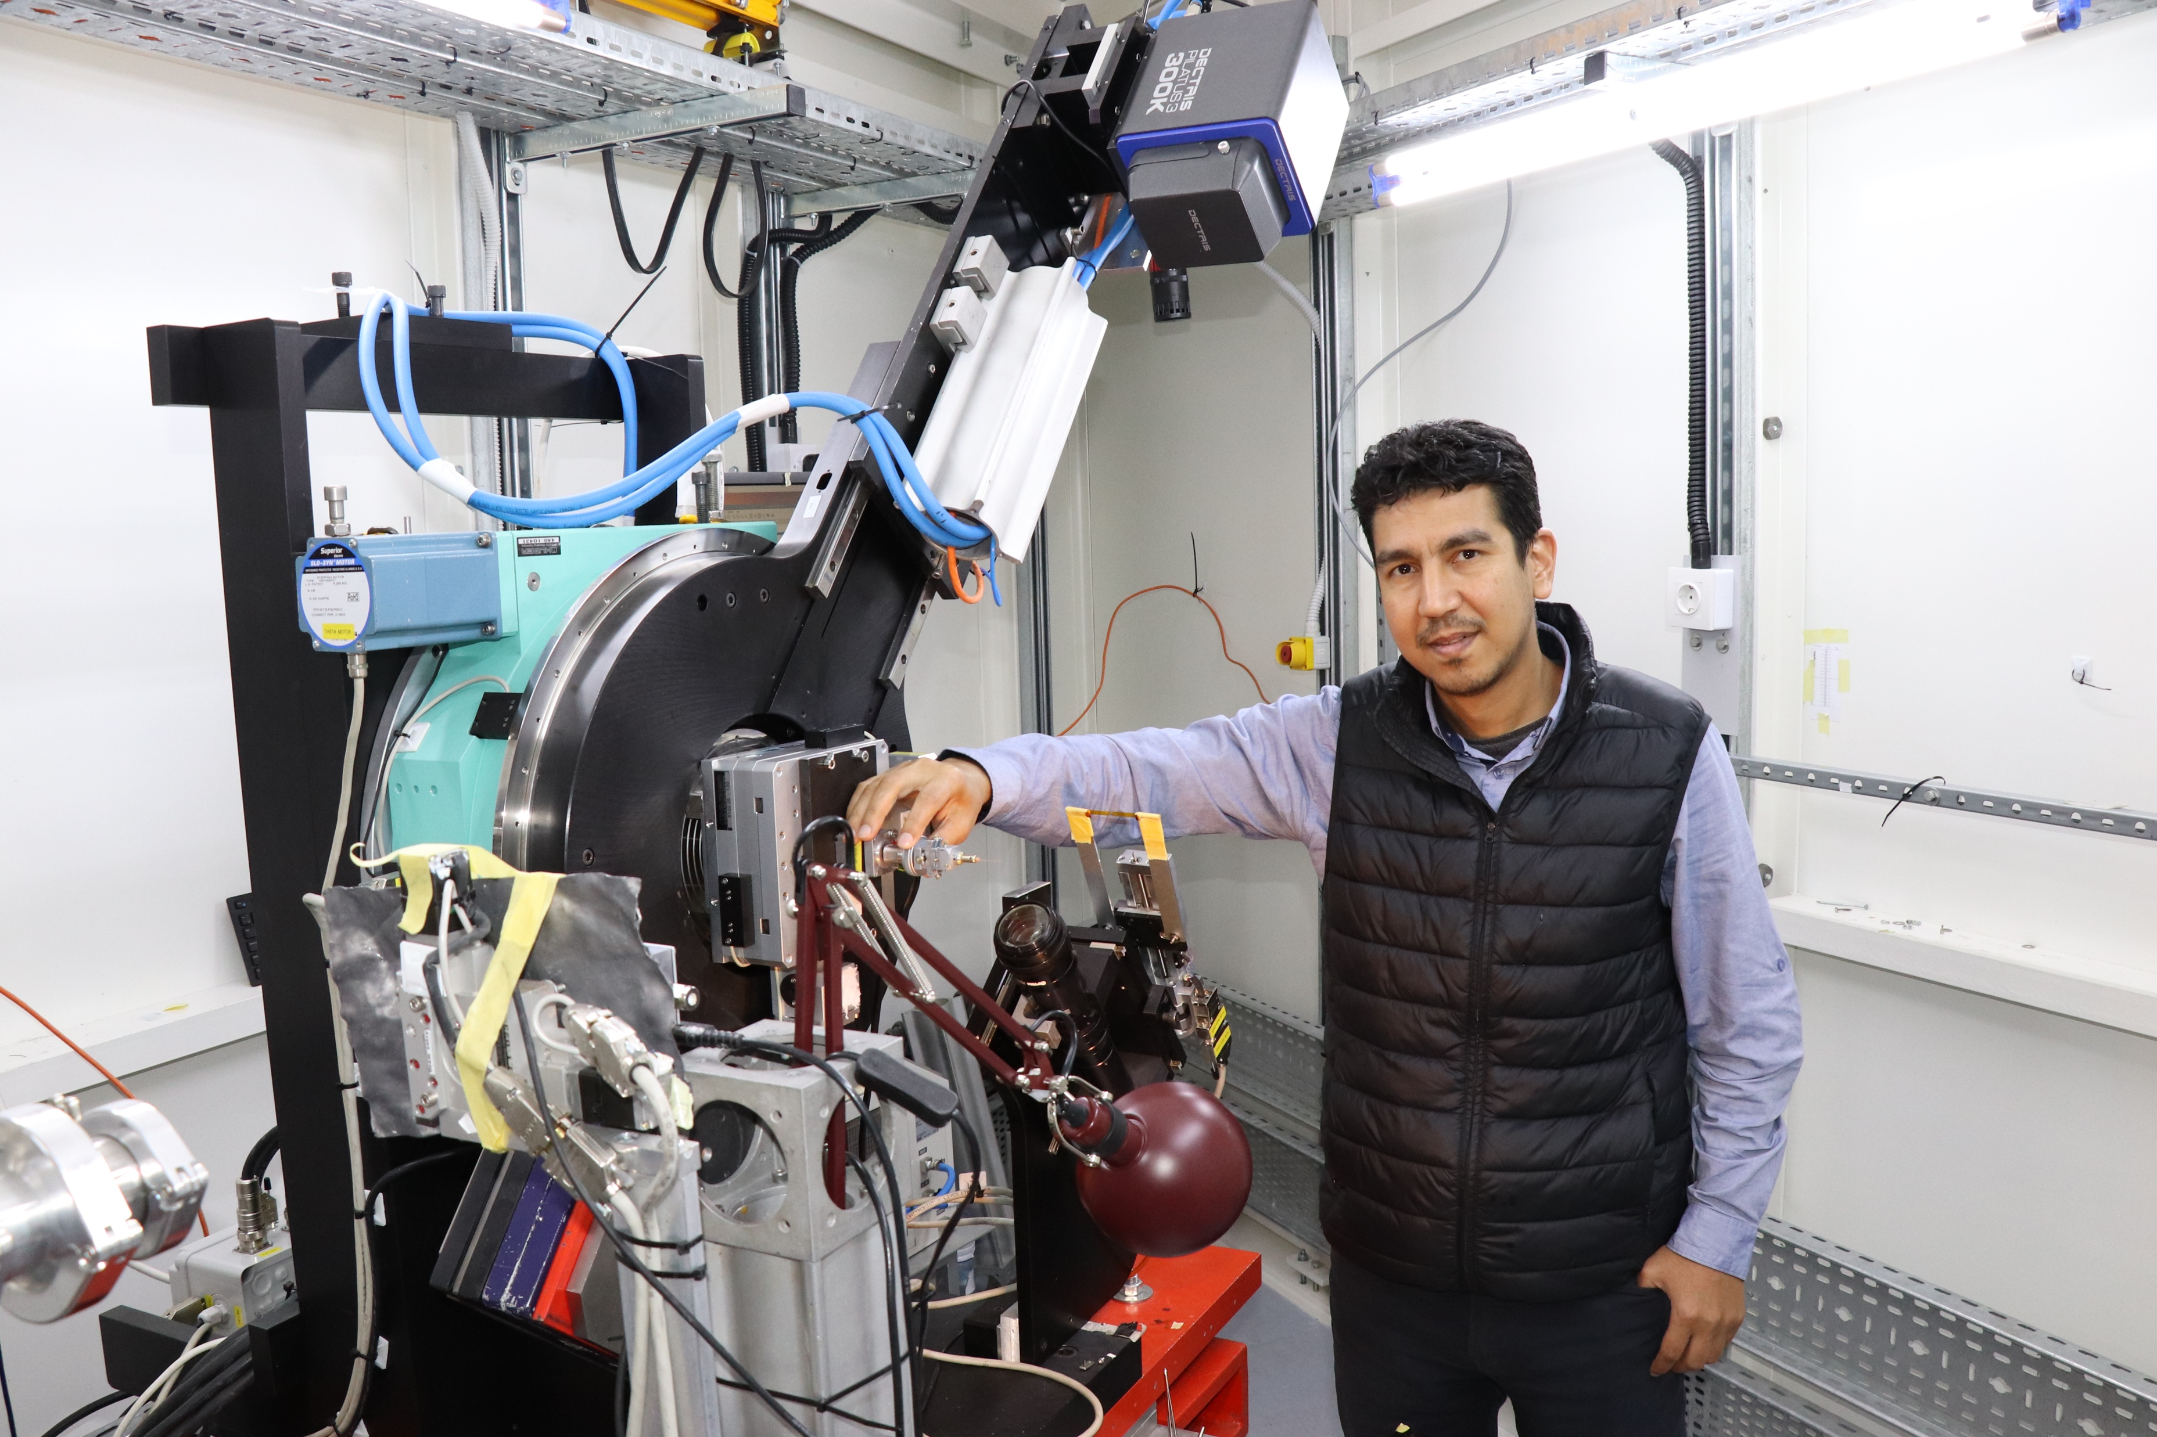
2018
2018
2020
BM02
IR
BM08
XAFS/XRF
ID09
MS
461 proposals from 27 countries

Slide 8
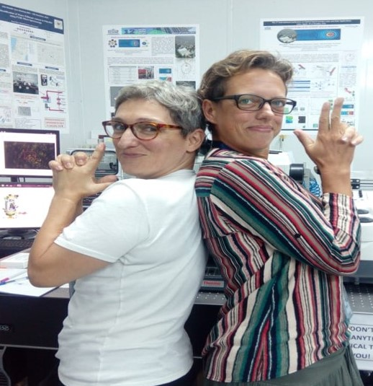
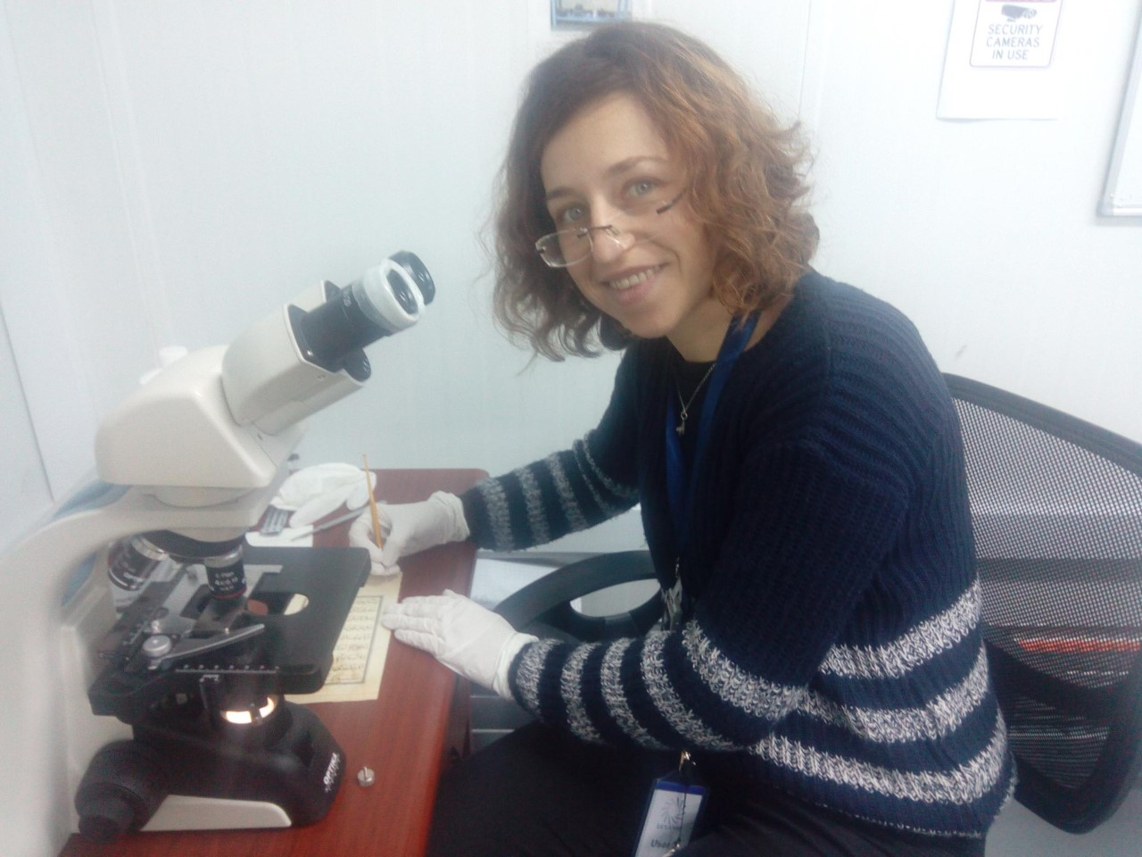
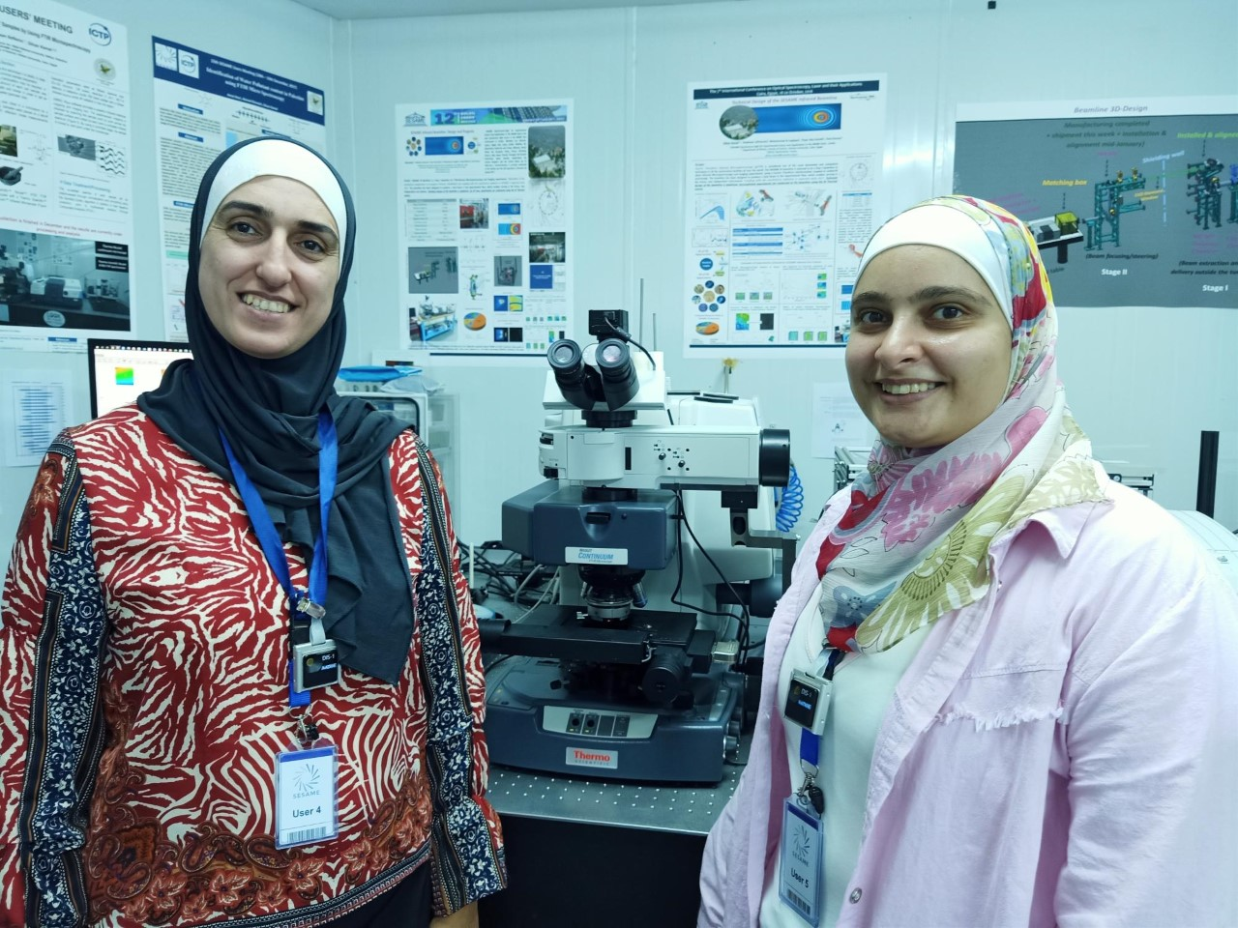
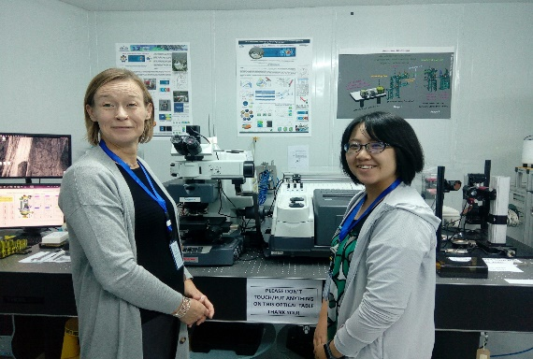
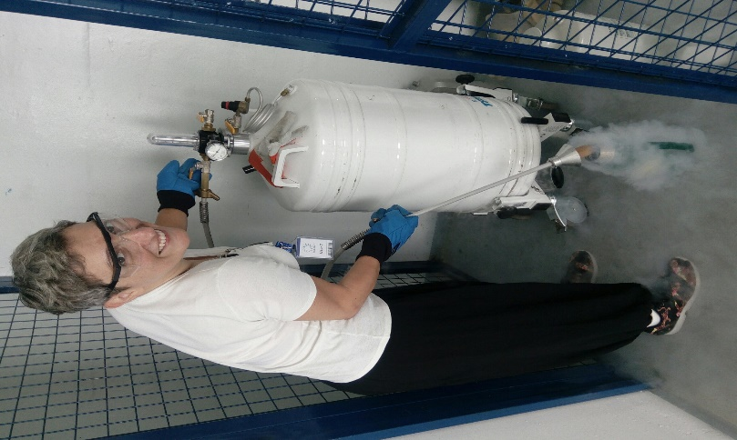
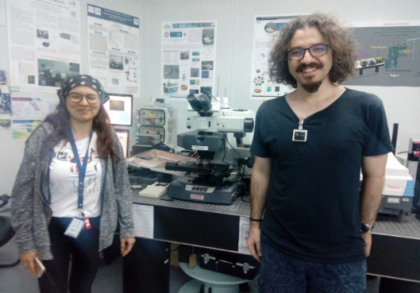
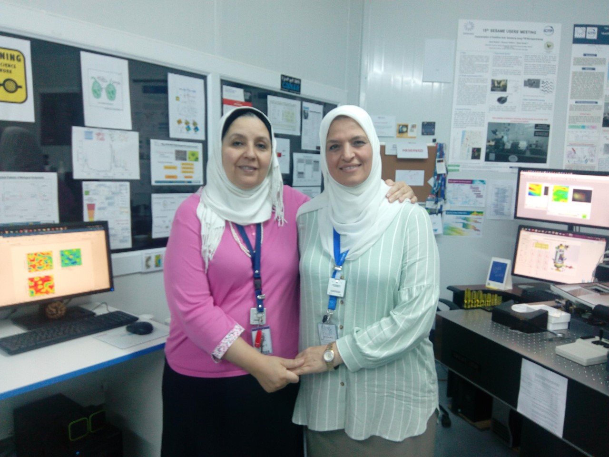
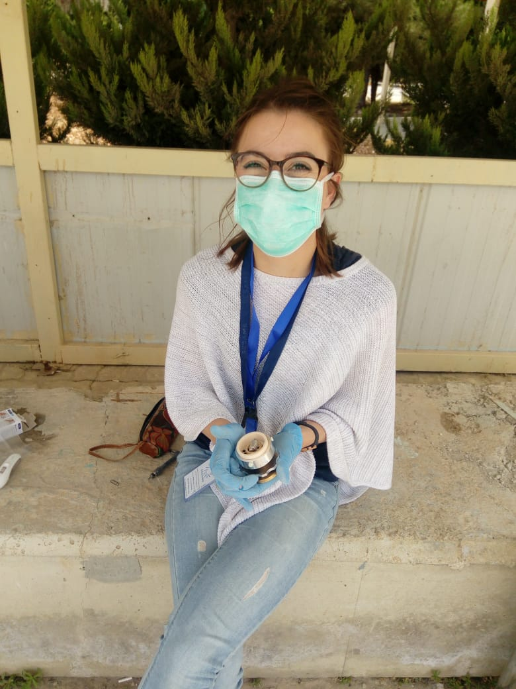
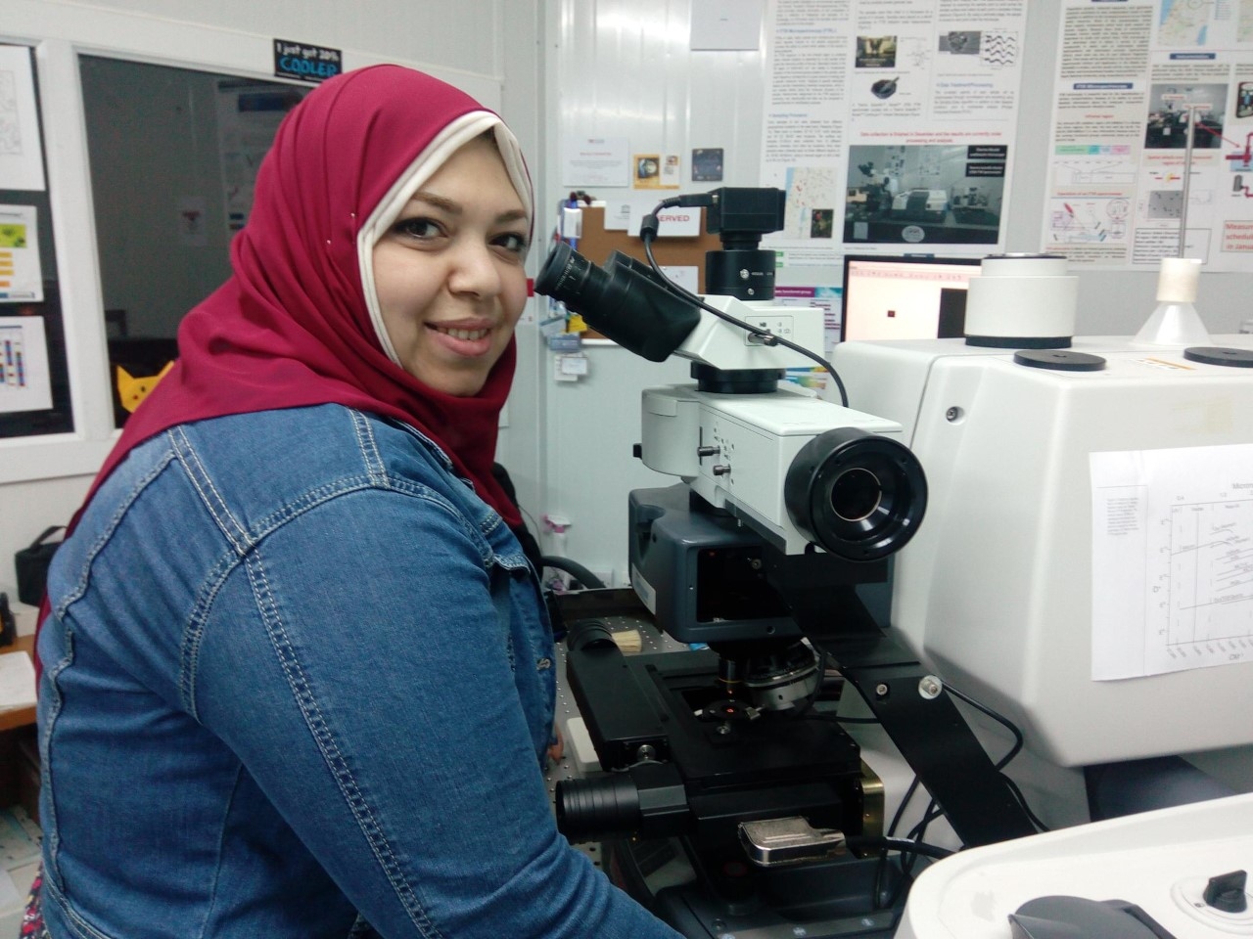
IR beamline 2018-19

Slide 9
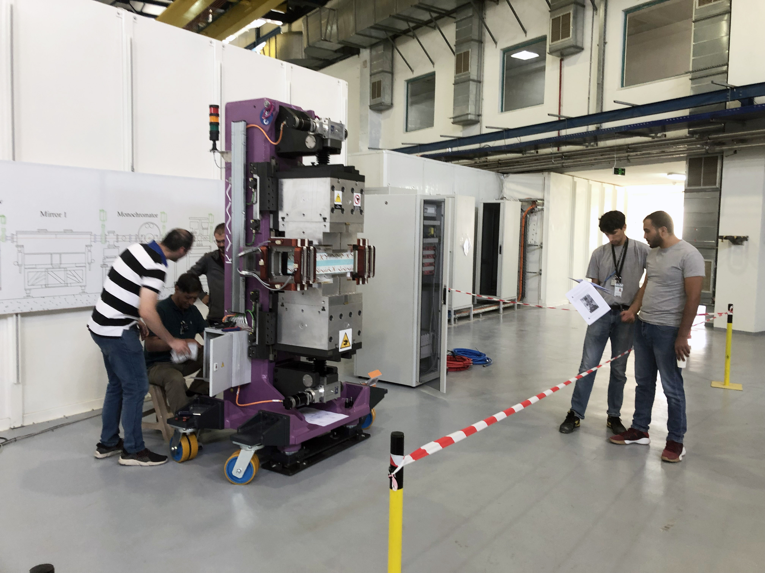
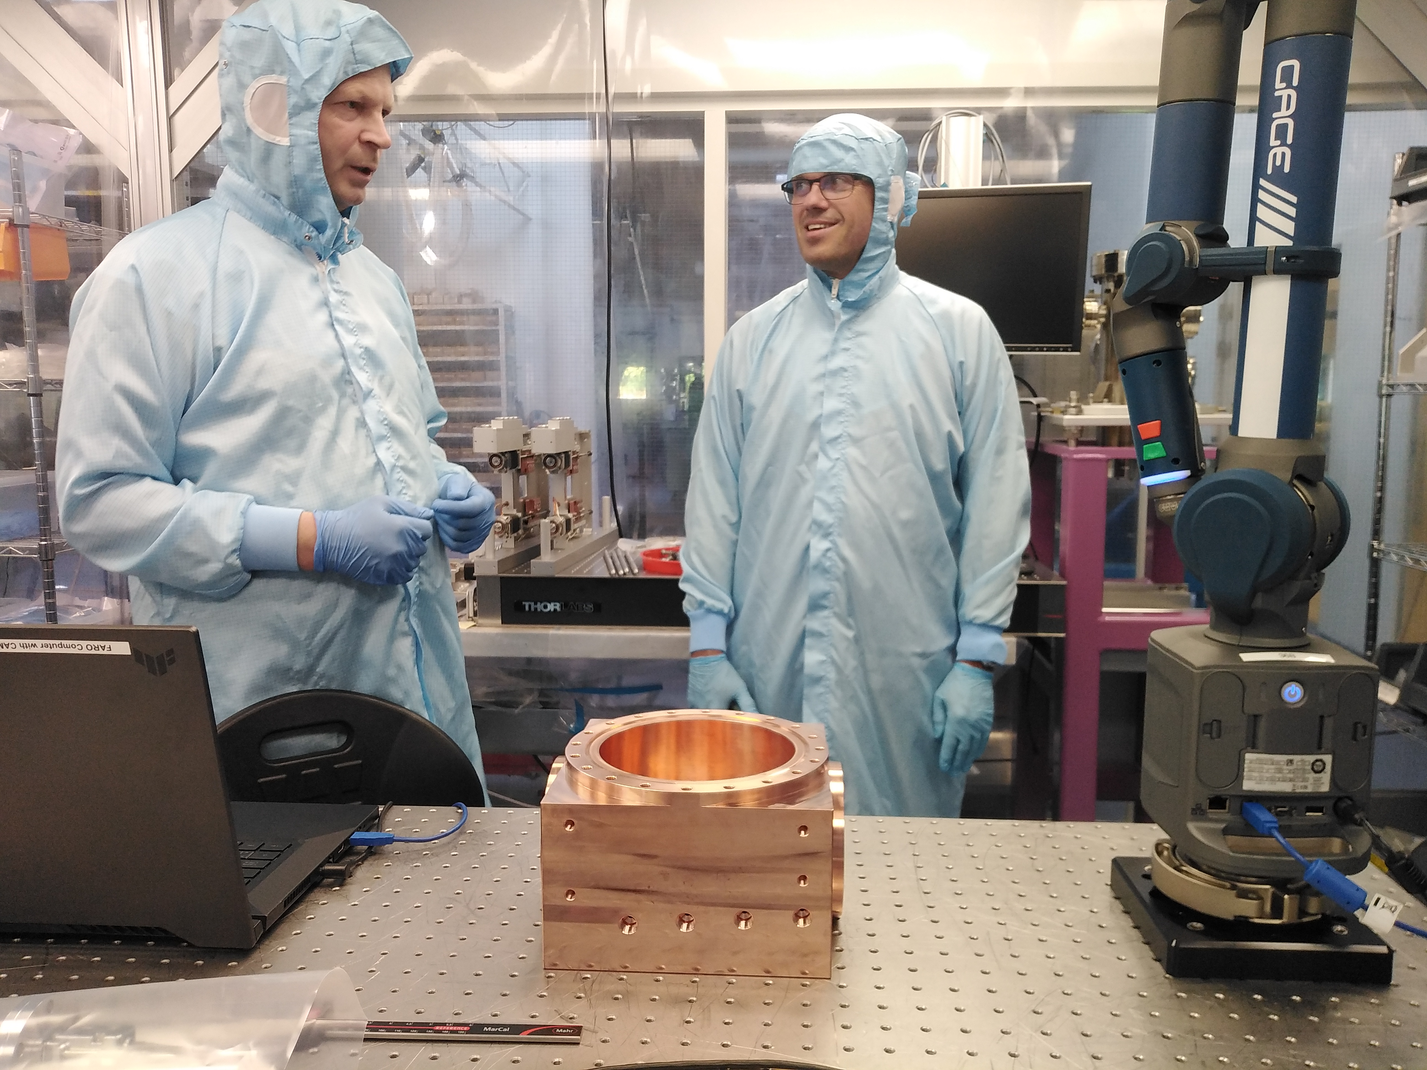
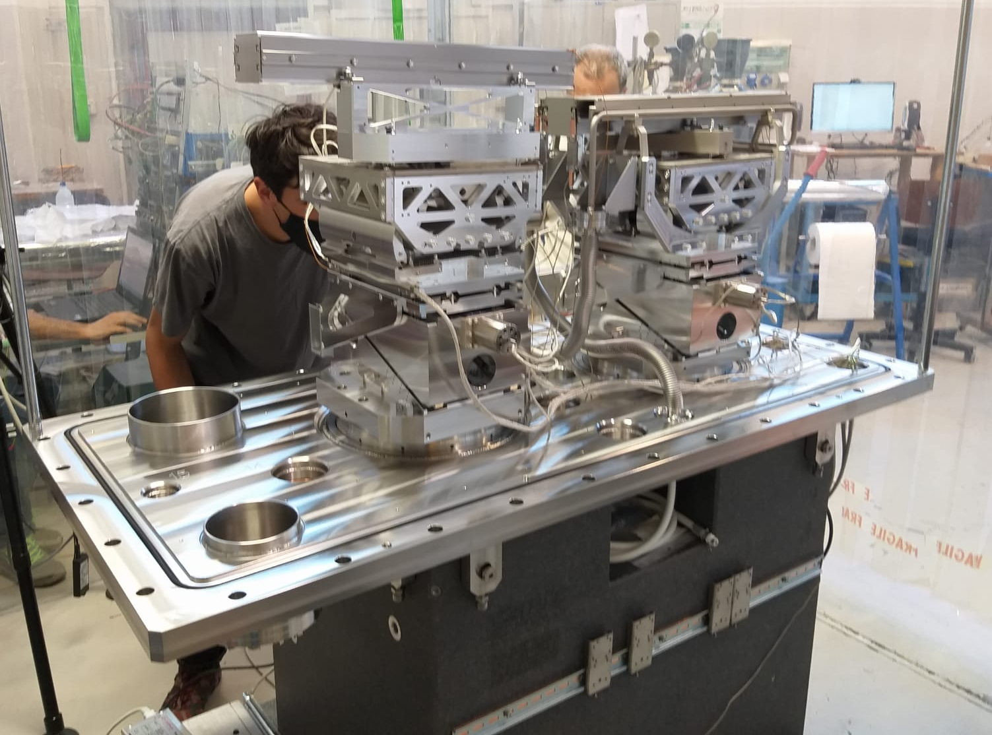


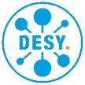





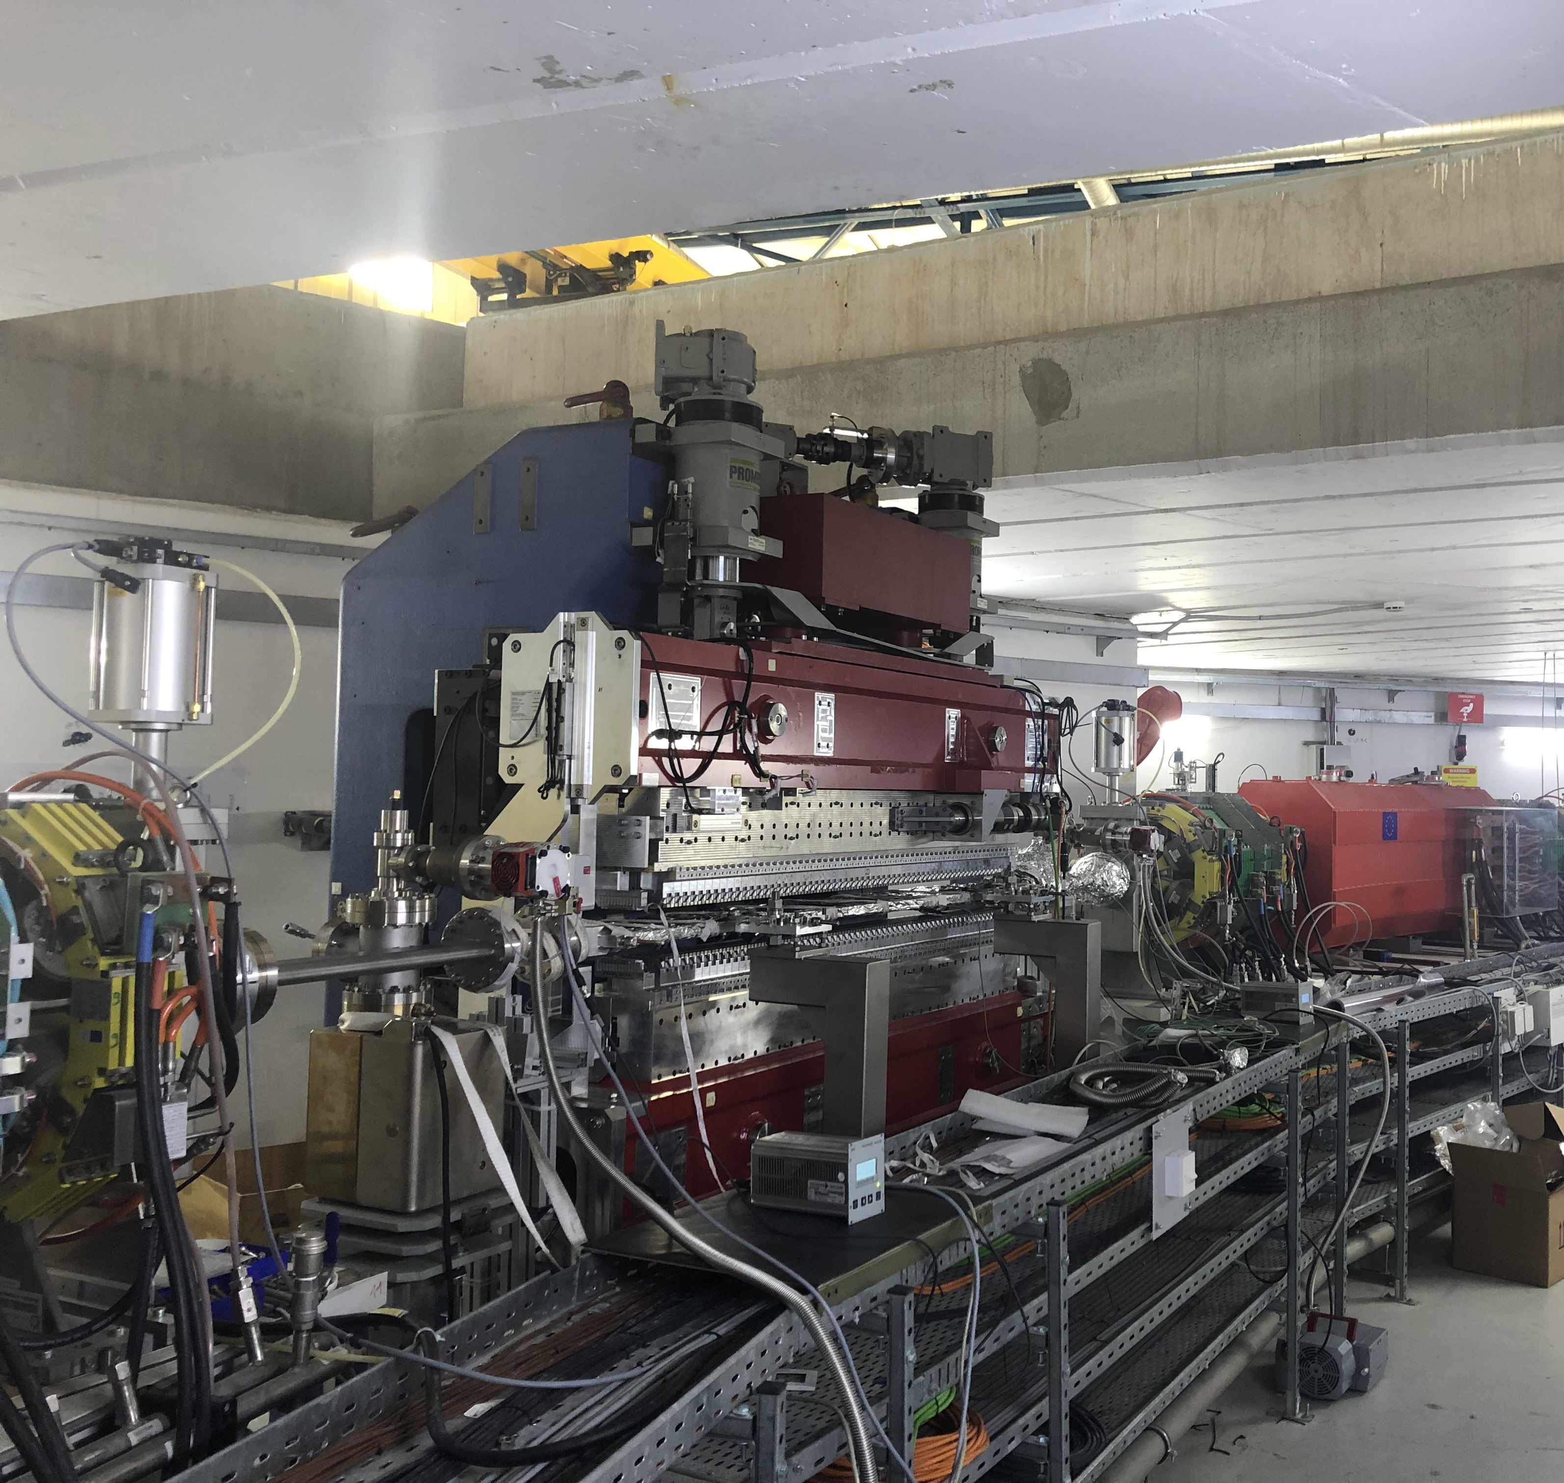
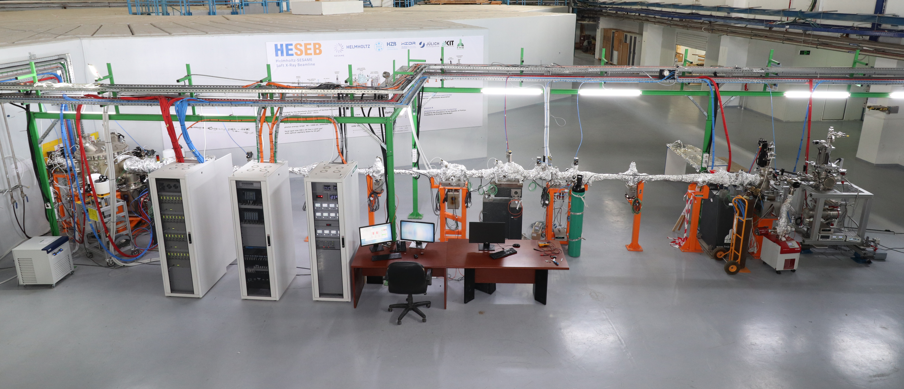
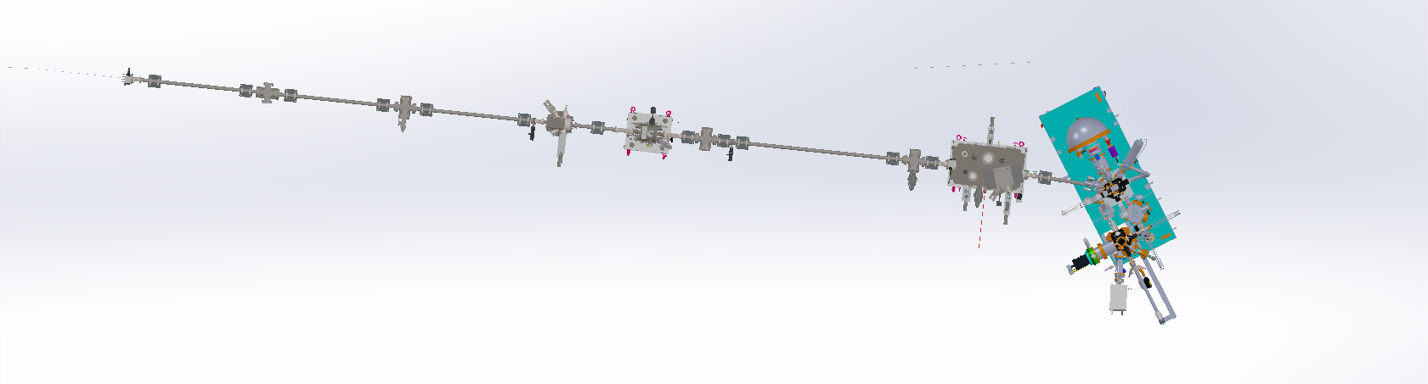




ID10 - BEATS
BEAmline for Tomoghraphy at SESAME (2022)
ID11 left – HESEB
Helmholtz-SESAME Beamline (2022)
Inaugurated on June 12, 2022
ID11 right – TXPES
Türkiye X-ray PhotoEmission
Spectroscopy Beamline (2023)

Slide 10
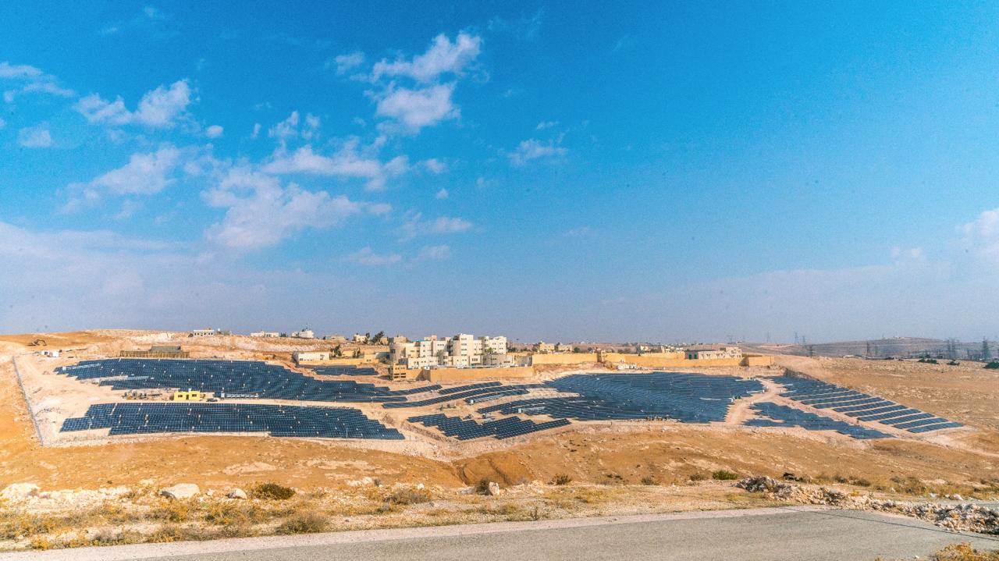
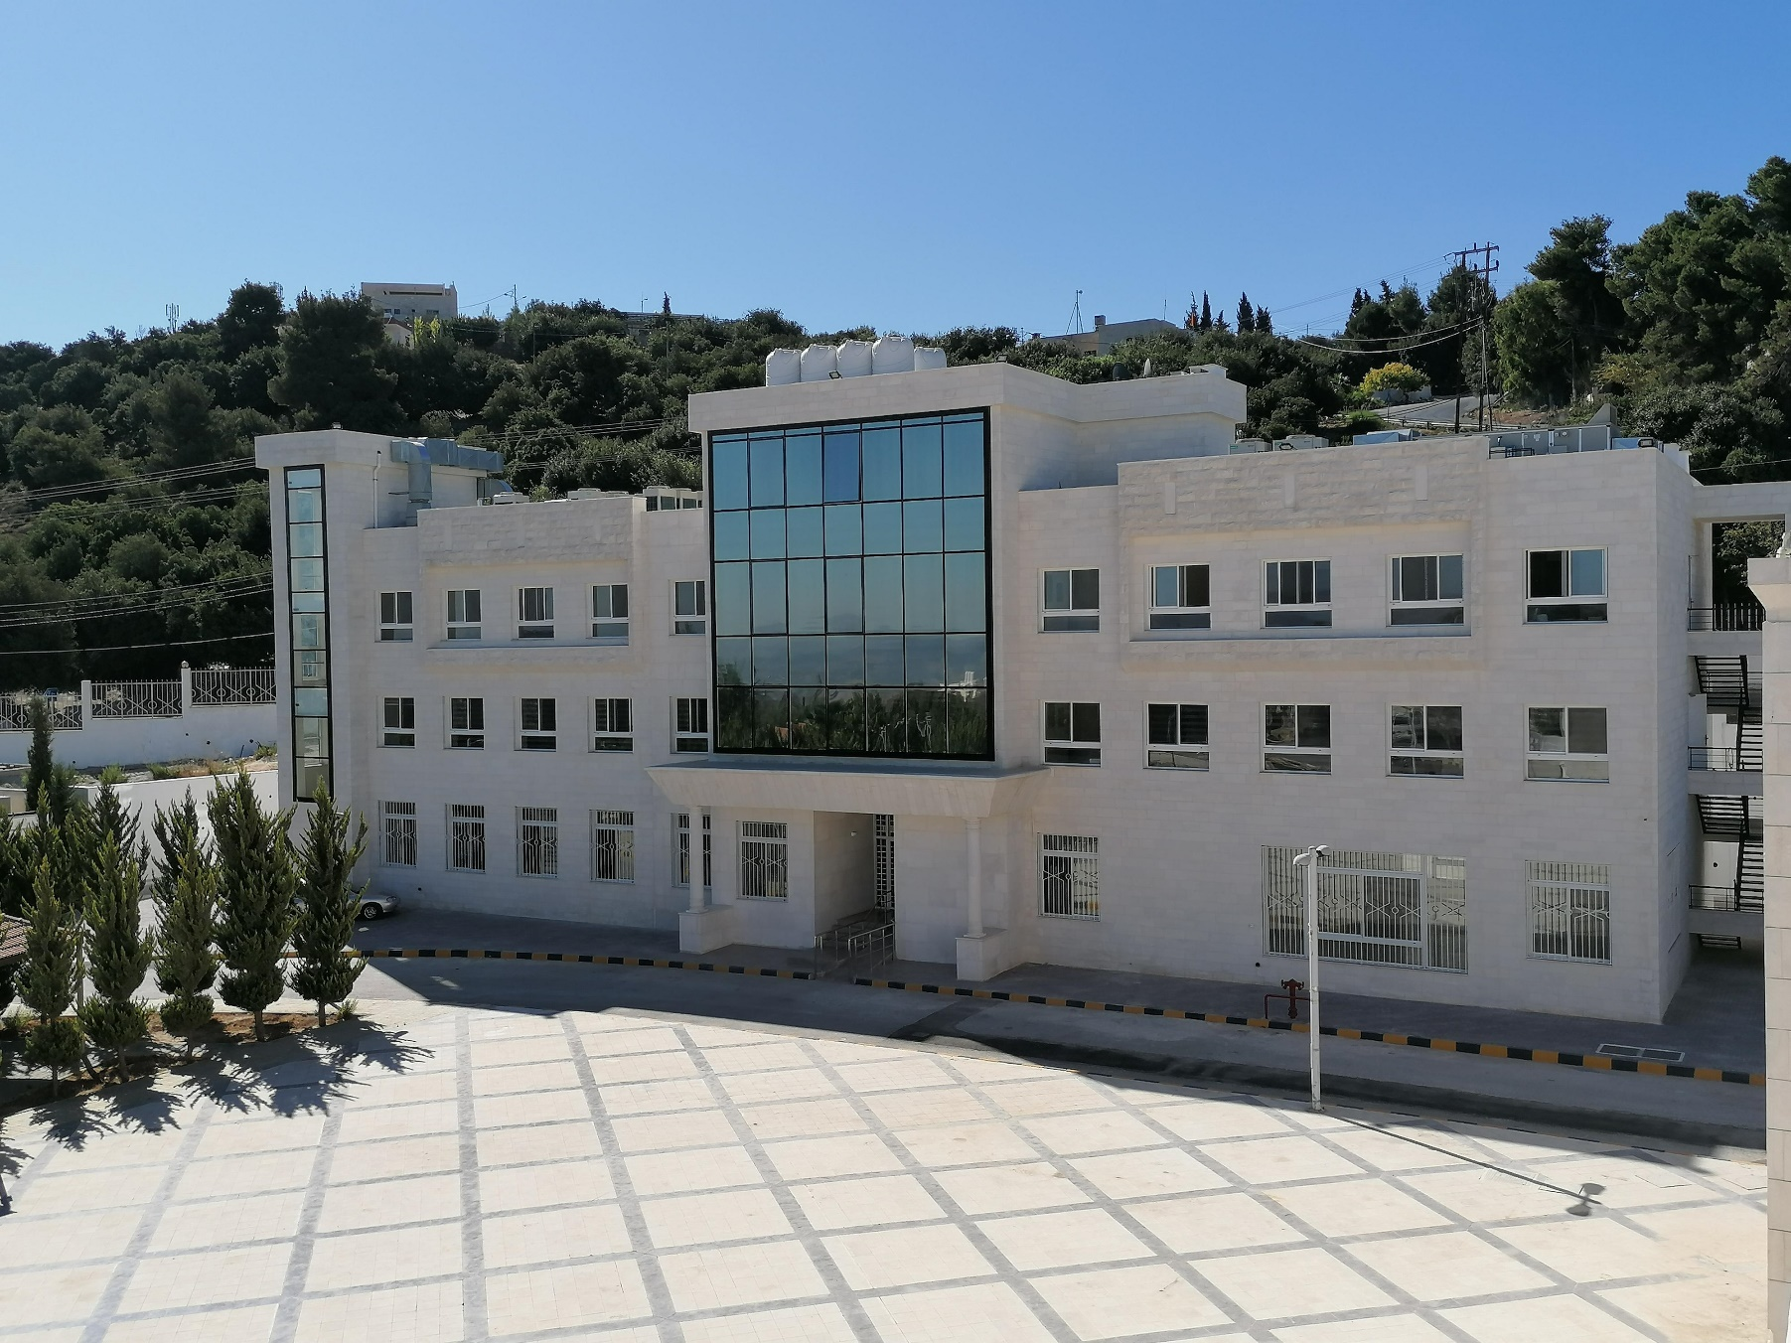
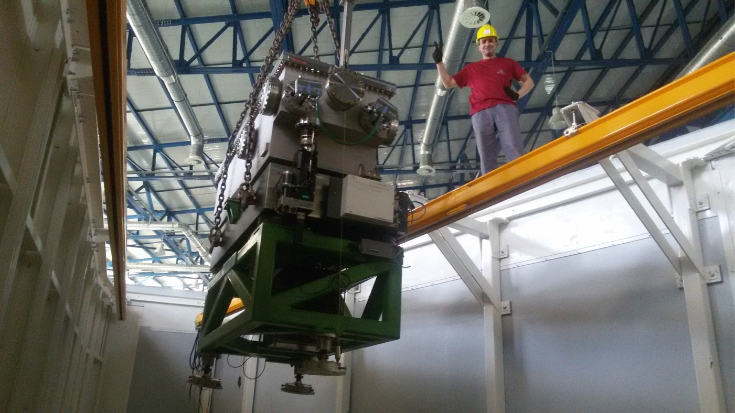
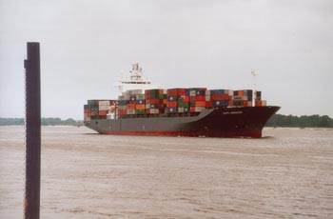
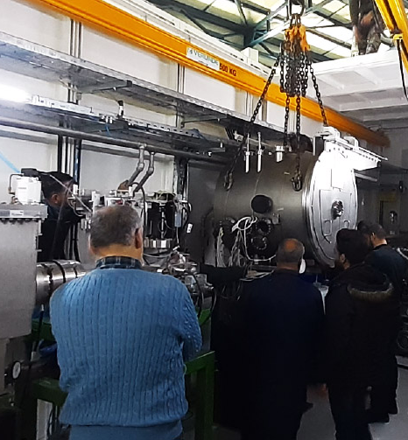
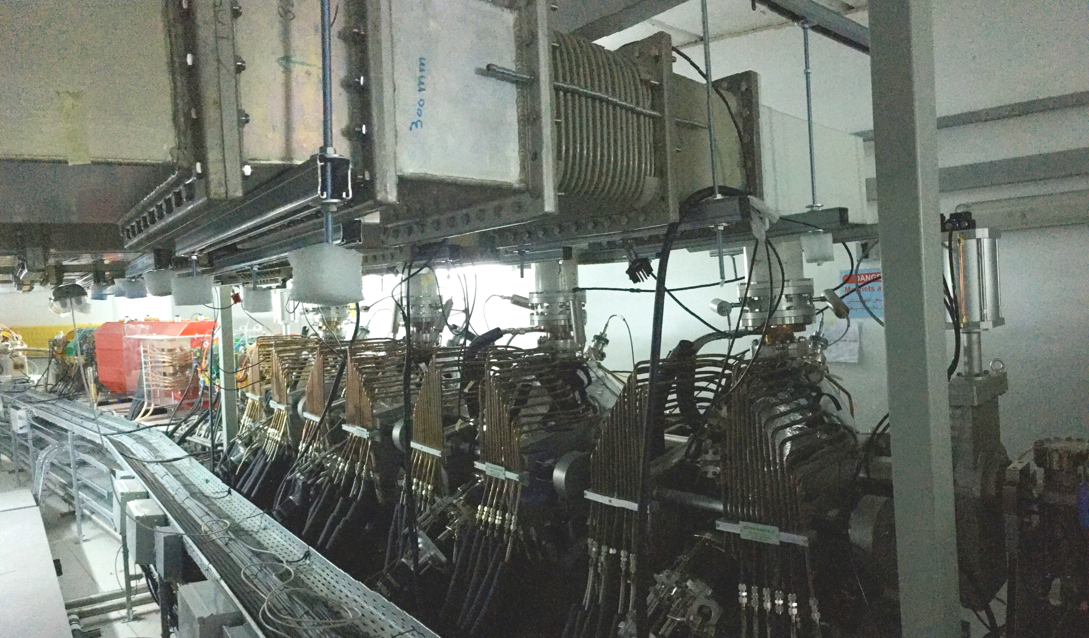
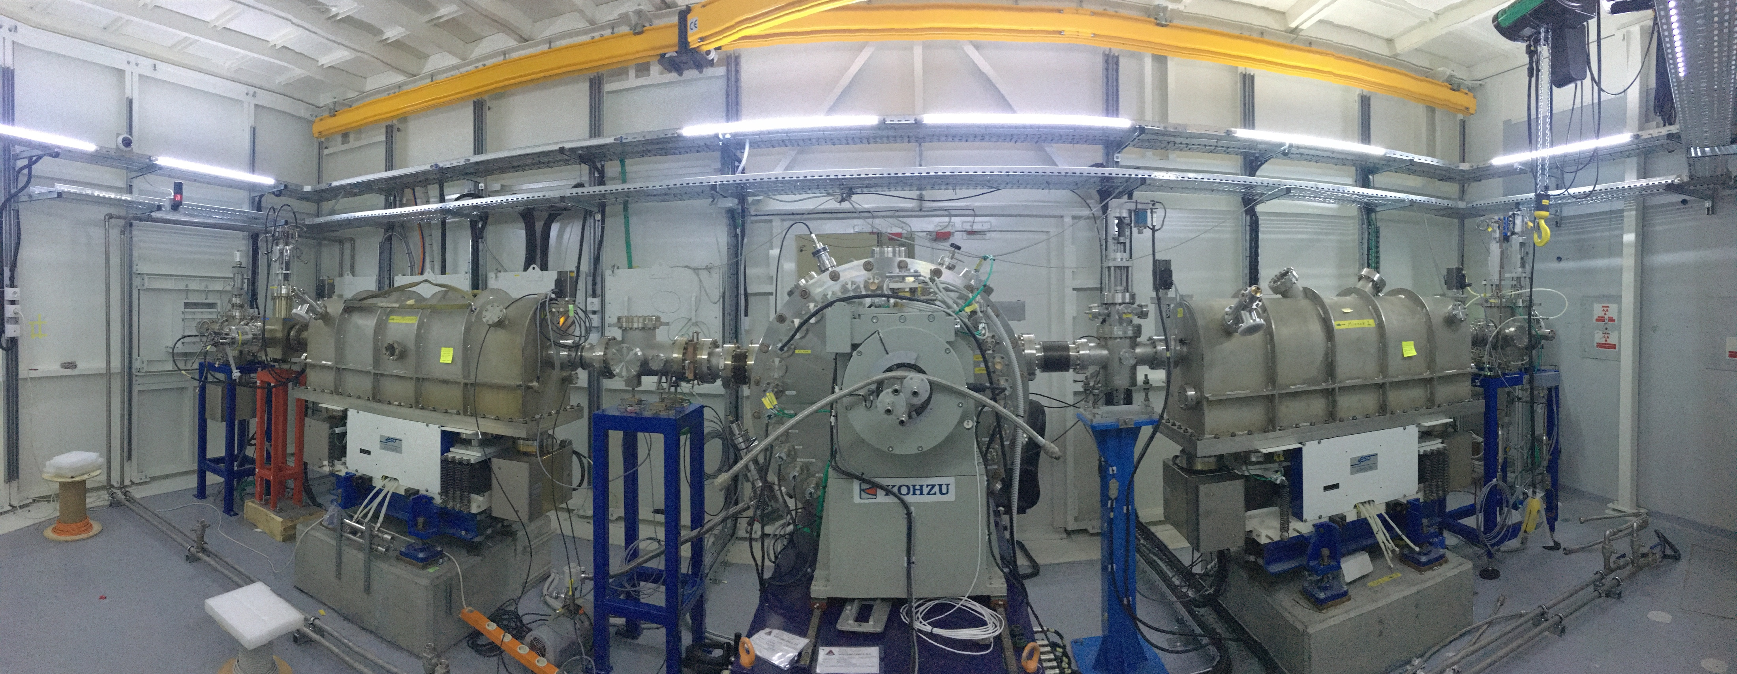
Solar Power Plant (EU)
Sergio Fubini Guest-House (I)
SESAME received much support from non-members.
Examples are…
The boat at Hamburg harbor on its way to Aqaba, Jordan with BESSY I on board; June 7, 2002
Rossendorf Beamline (D)
XAFS/XRF Monochromator (UK)
Material Science Beamline (CH)
The 4 RF Cavities (I)

Slide 11
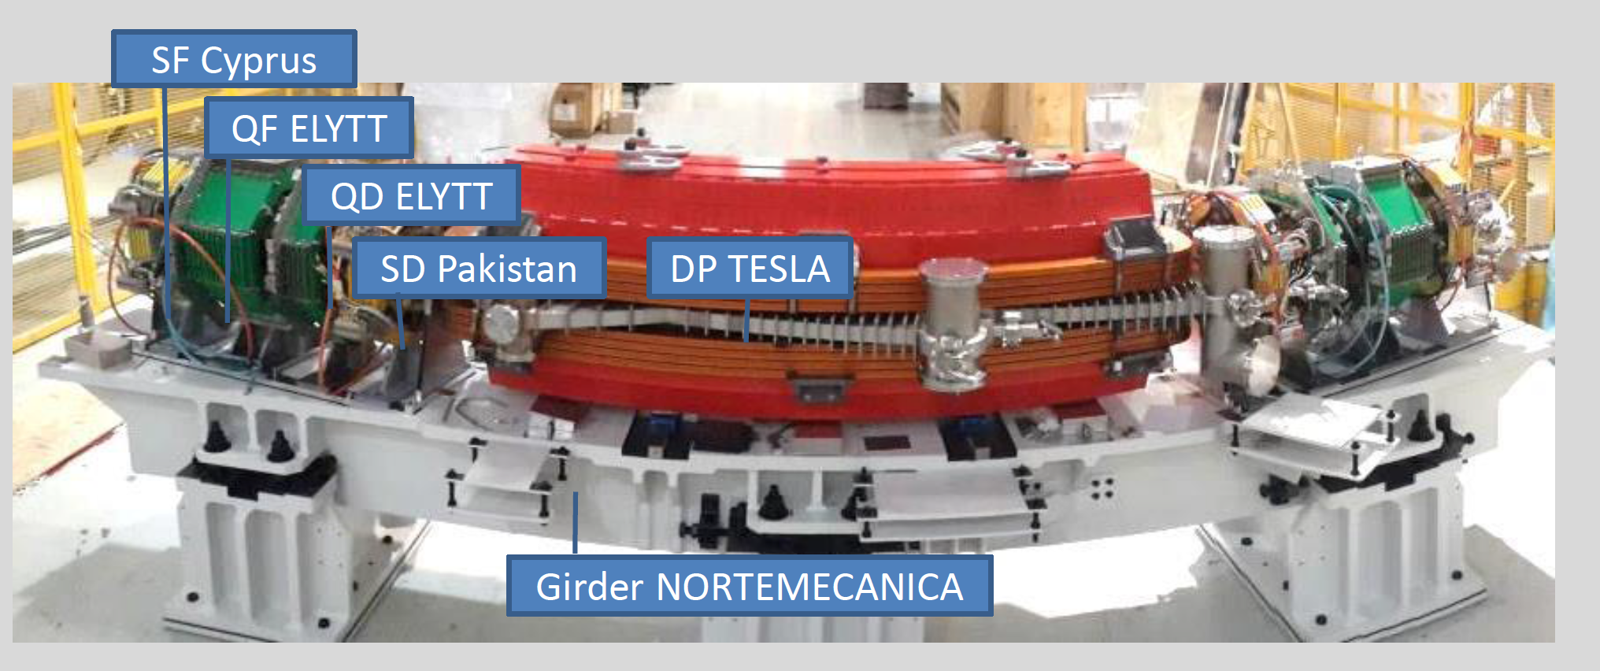
It takes a village to build a storage ring….
dipole magnets: TESLA, United Kingdom
quadrupole magnets: ELYTT: Spain
sextupole magnets: Cyprus and Pakistan
girders: NORTEMECANICA, Spain
magnets designed at SESAME,
procured by SESAME/CERN office (CESAMAG)
QA/QC at ALBA (Spain) and at CERN

Slide 12
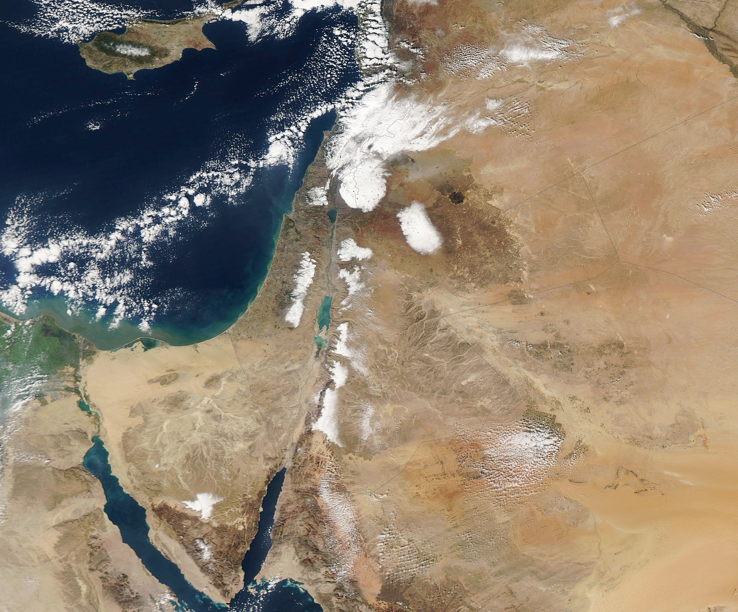
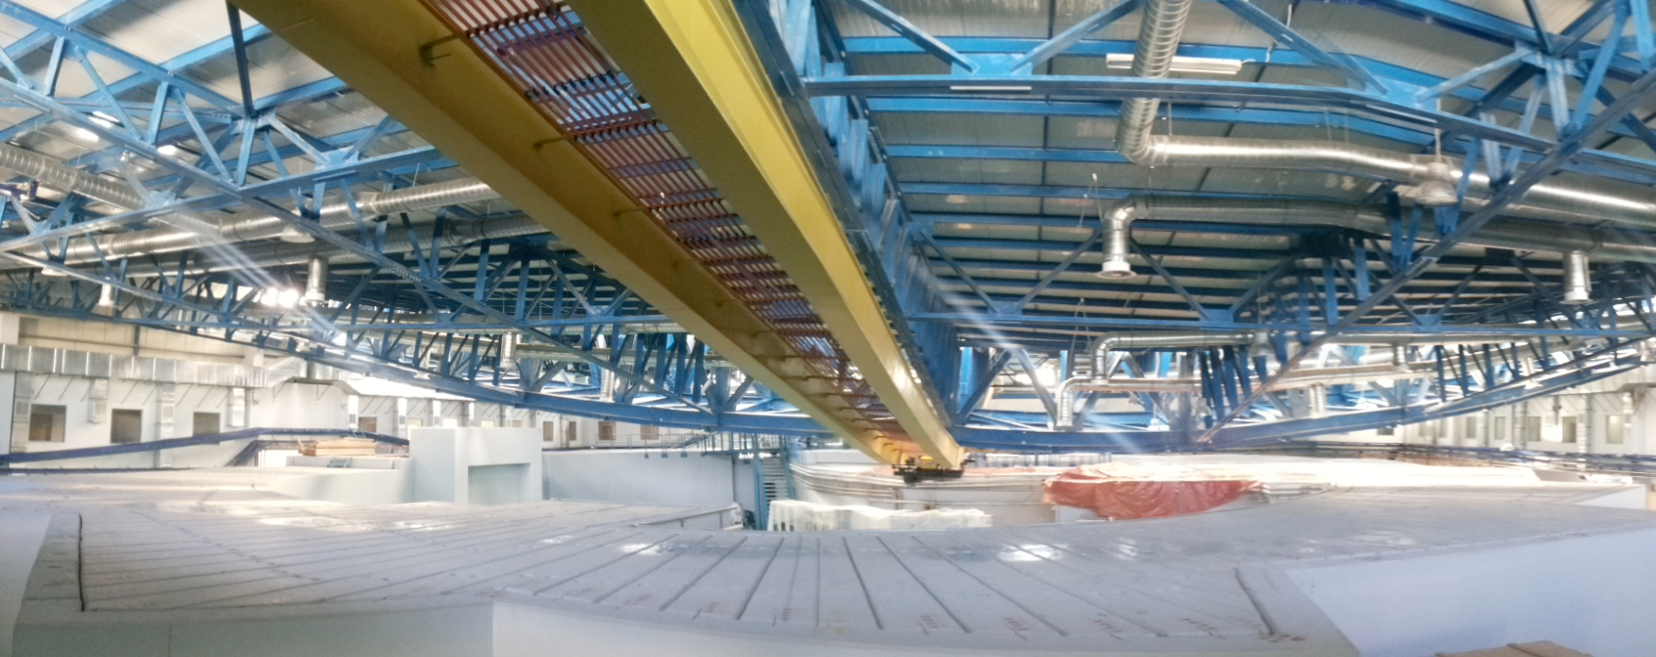
…. and a little bit of luck.
December 14, 2013, winter storm ALEXA
A fifty year snow fell on Amman and Jerusalem

Slide 13
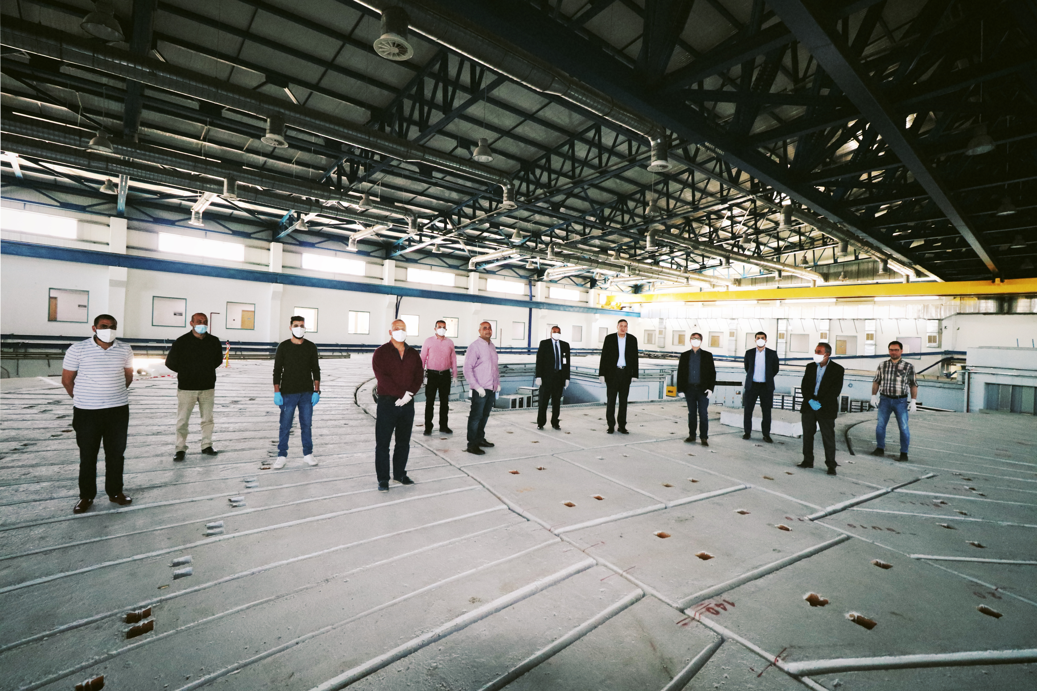

Slide 14
Why did SESAME survive ?
It has survived because it was a good idea !

Slide 15
New members
Cooperation with Africa
Strenghten Cultural Heritage
Next steps

Slide 16

SAVE THE DATE 28 July 2022

