Slide 1
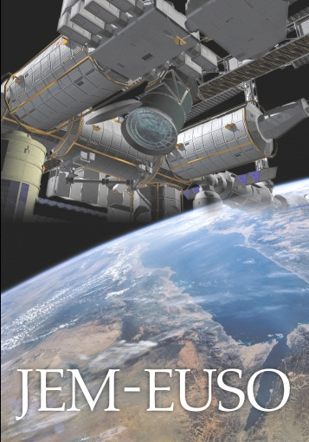













Cosmic Rays of Extreme Energies
The JEM-EUSO mission
“Doing astronomy by looking downward”
Piergiorgio Picozza
INFN and University of Rome Tor Vergata
RIKEN, Japan
Workshop on Recent Developments in
Astronuclear and Astroparticle Physics
ICTP, Trieste
November 19 – 23, 2012

Slide 2
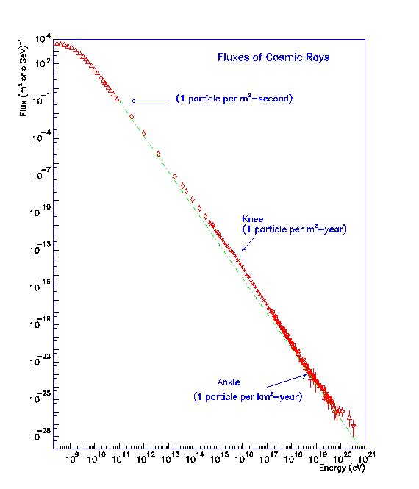
Extreme Energy CR
[AUGER, JEM-EUSO, TUS/KLYPVE,]

Slide 5
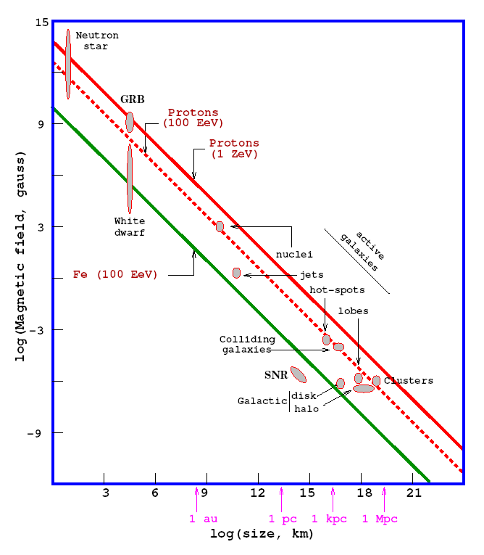
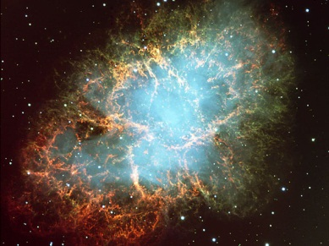
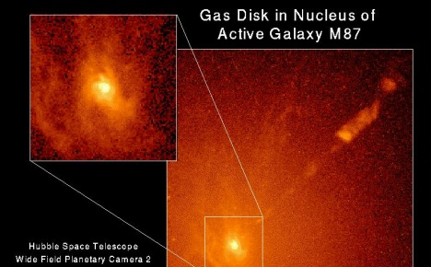
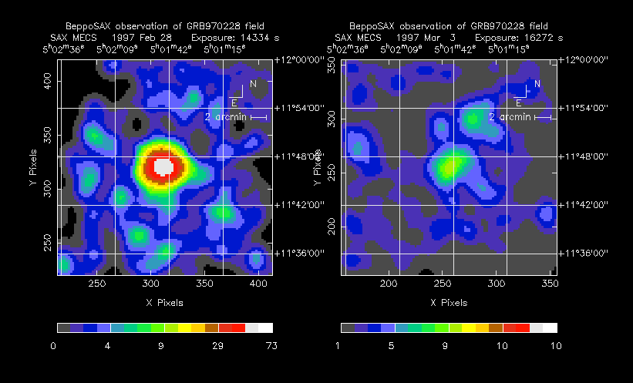
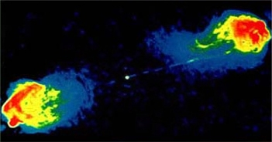
Hillas plot
Pulsar
All Astrophysical models are limited to
SNR
A.G.N.
GRB
Radio Galaxy Lobe
Ptytsina & Troitsky, 2008, 2010
Torres & Anchordoqui, 2004
Hillas, 1987; Stanev 2003

Slide 6
What can originate such cosmic rays?
“Top-Down” scenario:
Produced by early universe symmetry breaking, decay of cosmic supermassive background particles, violation of Lorentz invariance……
Cosmic
strings
E or M_{X} ≈ 10²¹ eV
photons

Slide 8
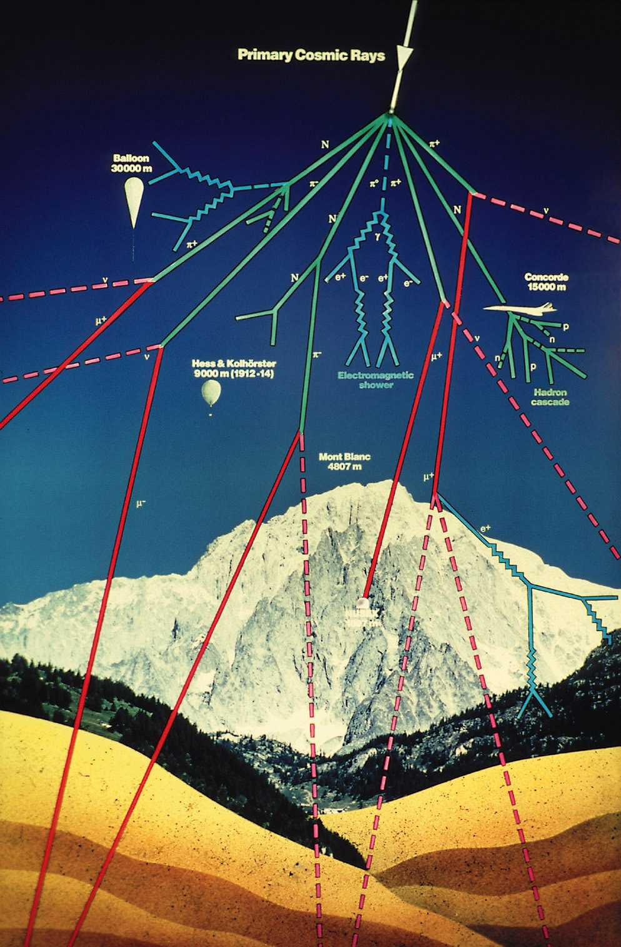
How to detect UHECR?
The atmosphere as a detector
Primary cosmic ray
Top of atmosphere
.
Ground

Slide 9
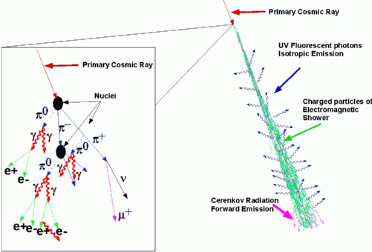
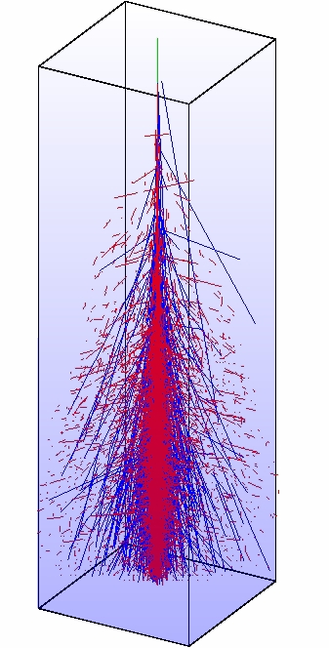
Extend Air Shower
The primary interaction can be hadronic. A number of secondaries mainly pions are generated. These give rise to further hadronic interactions
Hadronic Cascade
Charged pions→muons
10-100 km
30-300 μs

Slide 10
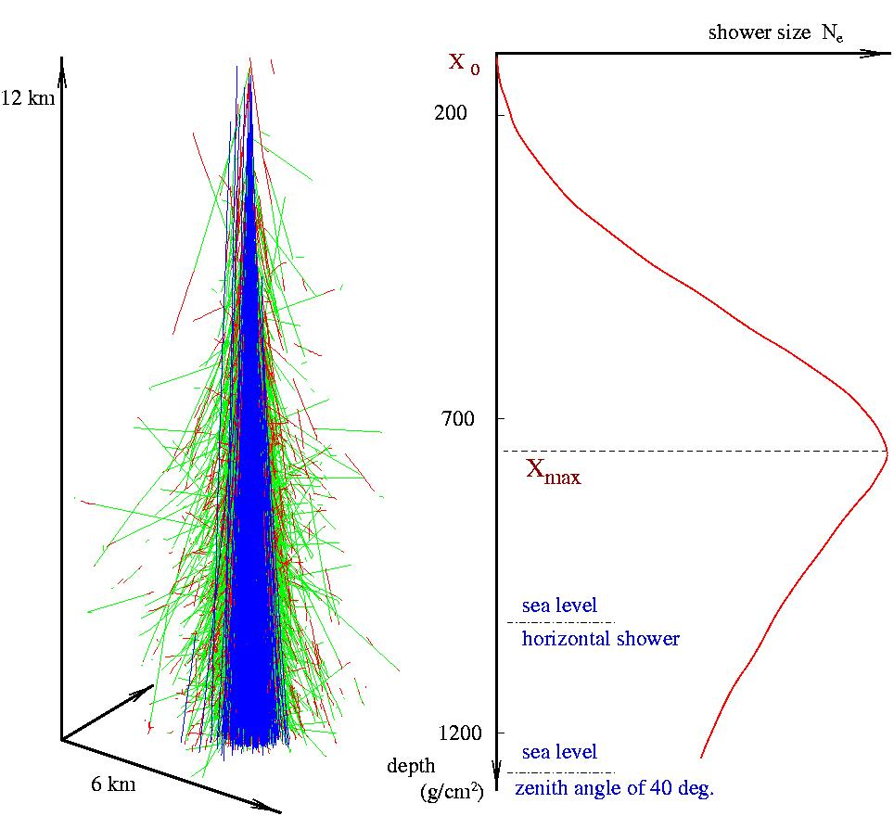
Viewed from a distance, an EAS appears as a luminous disc moving at the speed of light. Its luminosity increases up to a maximum and gradually fades
The number of charged particles (mainly e+ and e-) can be parametrized by the Gaisser-Hillas function
X₀ is the depth of the first interaction
X_{max} is the depth of the maximum (Energy, particle type)
X is the cumulate slant depth, in g/cm² (thickness of air traversed)

Slide 11
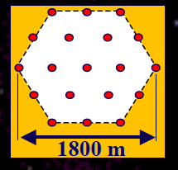
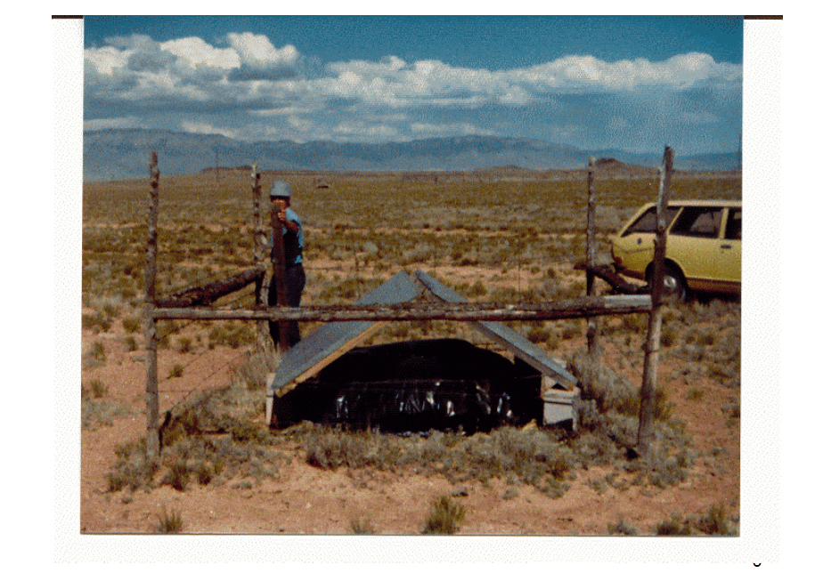
At Volcano Ranch, New Mexico,
“The Queen of the Desert, MIT Array 19 plastic scintillators”

Slide 12
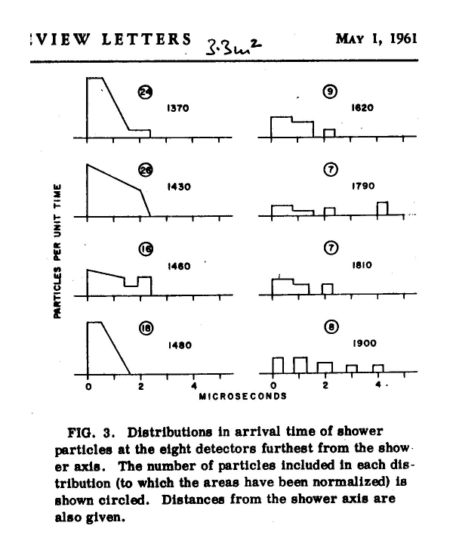
©Copyright J. Linsley and L. Scarsi private archive. Commercial use regulated by the current legislation
* Event at 6x10¹⁹ eV; Linsley, Scarsi & Rossi, PRL (1961)

Slide 13
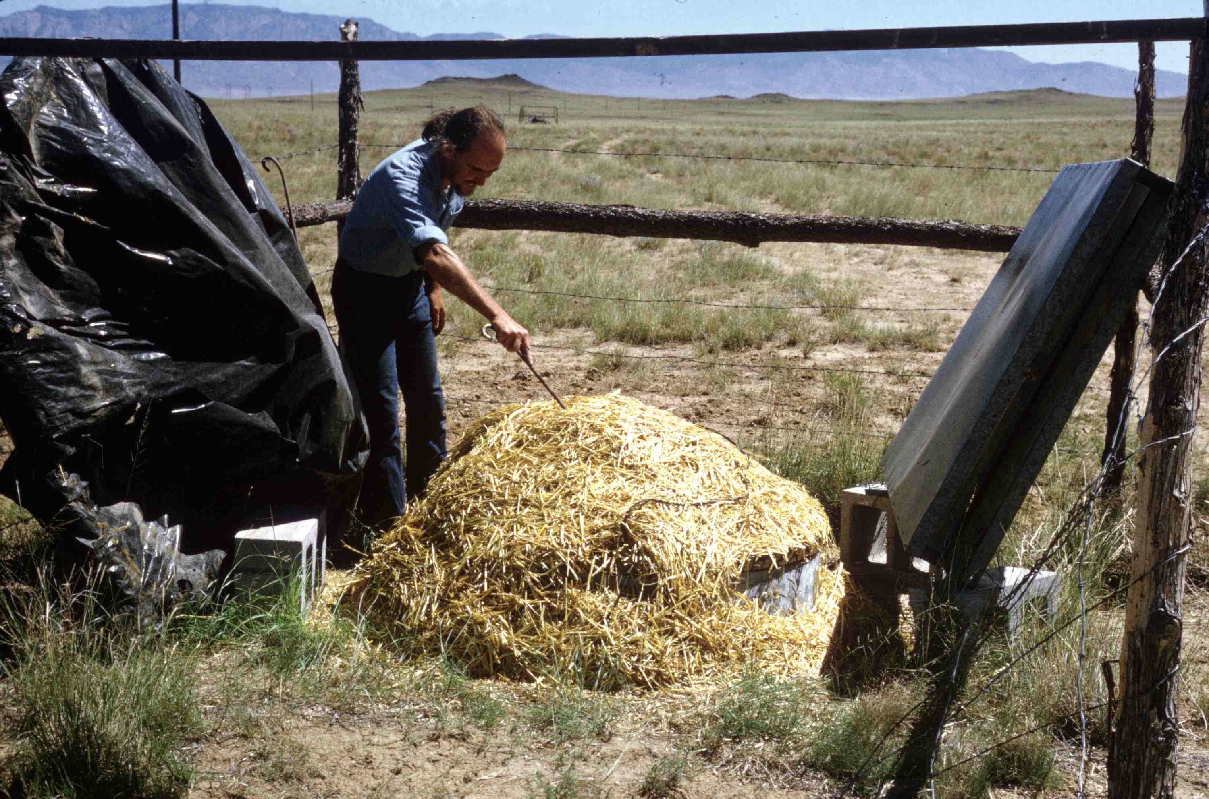
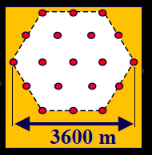
John Linsley, Volcano Ranch, 1962 : first event with E > 10²⁰ eV (PRL, 10,146, 1963)
rattlesnakes ??

Slide 14
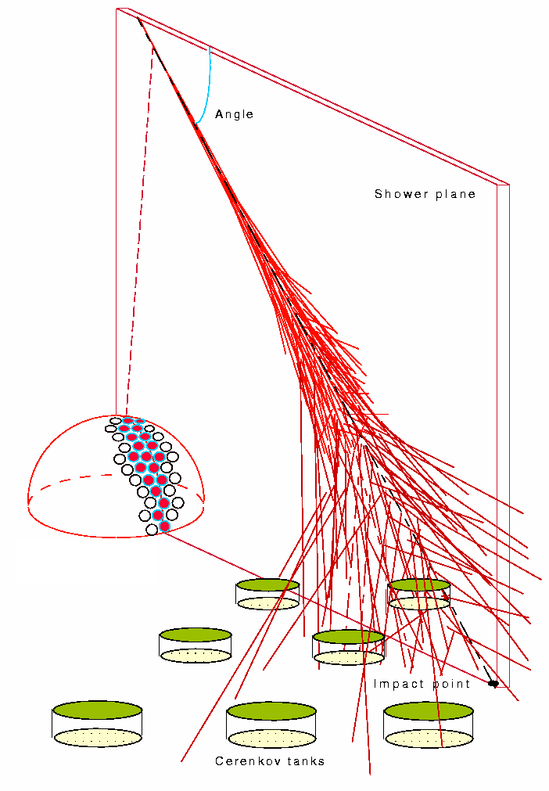
Current Observatories
Fluorescence Detectors (FD)
Longitudinal development of the shower
Calorimetric measurement of the energy
12% duty cycle
Surface Detectors (SD)
On ground shower measurement
Model dependent energy measurement
~ 100% duty cycle (High Statistics)
FD
SD

Slide 17
UHECR
Three basic observables:
spectrum
chemical composition
anisotropy

Slide 18
UHECR
The behavior of the UHECR spectrum is mainly conditioned by:
the interaction of such particles with the
astrophysical backgrounds
the cosmological evolution of the Universe
In the energy range 10¹⁸ - 10¹⁹ eV the propagation of UHE particles is extended over cosmological distances with a typical path length of the order of Gpc

Slide 19
UHECR Spectrum

Slide 20
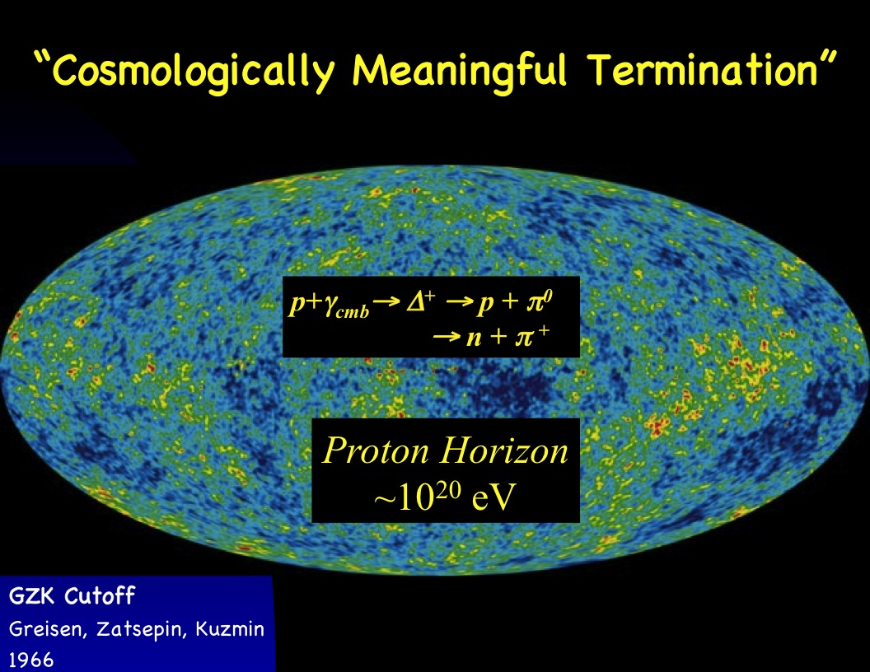
p+γ_{CMB}→ p + e⁺ e⁻

Slide 22
Does GZK exist?
Fukushima (2011)

Slide 23
Particle spectrum from different distances

Slide 24
Discrepancies

Slide 25
arXiv:0910.4184
HiRes Composition
Mean depth of maximum vs energy
TA data agree with HiRes

Slide 28
Nuclei UHECR
R. Aloisio astro-ph 1211.2004
The interaction processes that condition the propagation of UHE nuclei are pair production, that involves only the CMB background, and photo-disintegration
A + γ_{CMB;EBL}→ (A - nN) + nN ( n = 1 most relevant process)
The photo-disintegration of nuclei, together with the pair production process, produces a steepening in the observed spectrum not as sharp as the GZK and it is placed at lower energies respect to the GZK energy scale

Slide 29
Discrepancies

Slide 32
Open Questions remain
  Is this the GZK suppression?
  Or are the sources running out of fuel…
  Do we see a recovery of the spectrum ?
  Has the spectrum an end?
  Which is the maximum energy ?
Requirement: high precision measurements of the UHECR spectrum around and beyond the „GZK“ feature

Slide 33
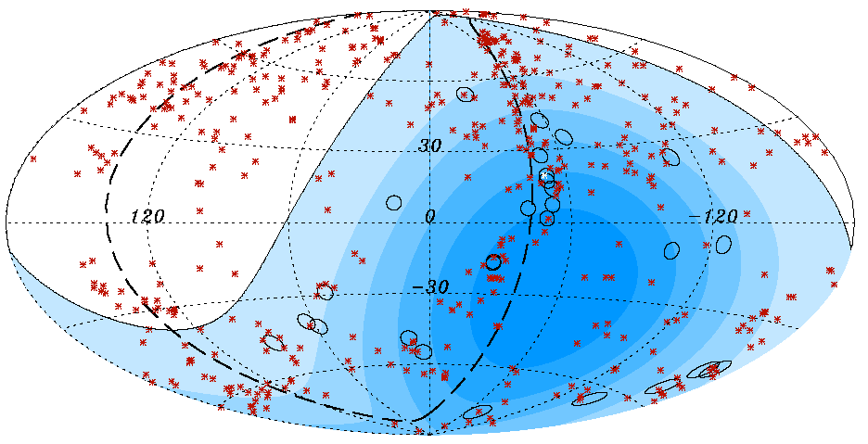
A key result from Auger
The Auger Collaboration (2007)
Ang. Sep. ψ < 3.1°, z < 0.018 (75 Mpc) and E > 56 EeV
Enables Particle Astronomy
Observation anisotropy of UHE particles at E>5x10¹⁹ eV
Notes:
Statistical identification, that is correlation studies between the arrival directions of the events and the position of sources in various astronomical catalogues. These resources are severely limited by the low available statistics at the highest energies, and to less extent by the small observed fraction of the sky and by the dependence of the exposure on declination (by non-uniform exposure).

Slide 34
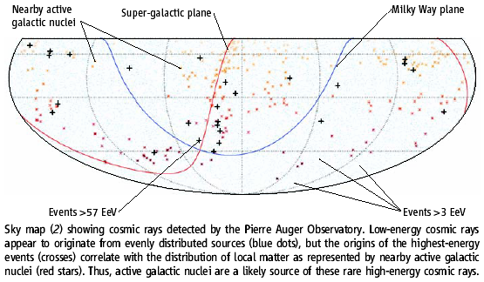

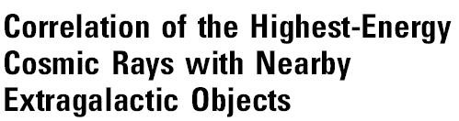
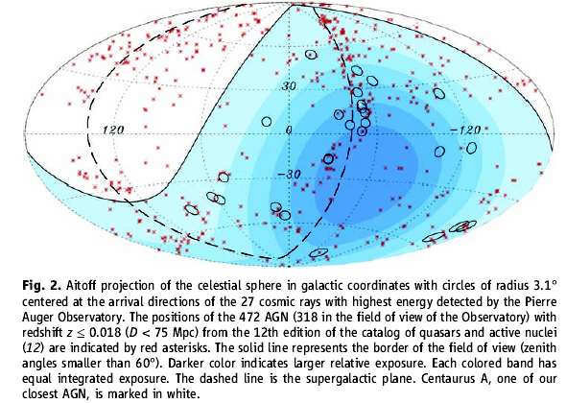
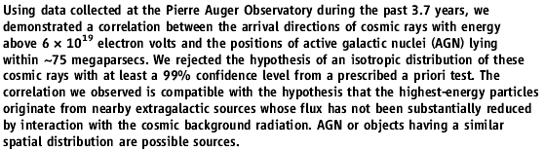

Slide 35
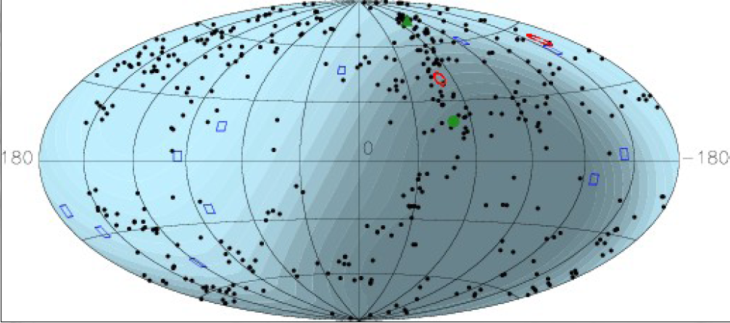
HiRes no correlation (!?)
Abbasi et al. (2010)

Slide 36
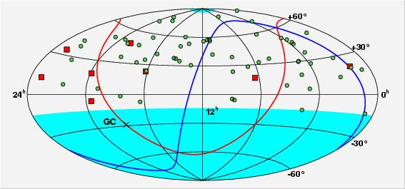
AGASA’S «Compact » Sources of CR ?
AGASA Arrival Direction Distribution
1 Triplets
6 Doublets

Slide 38
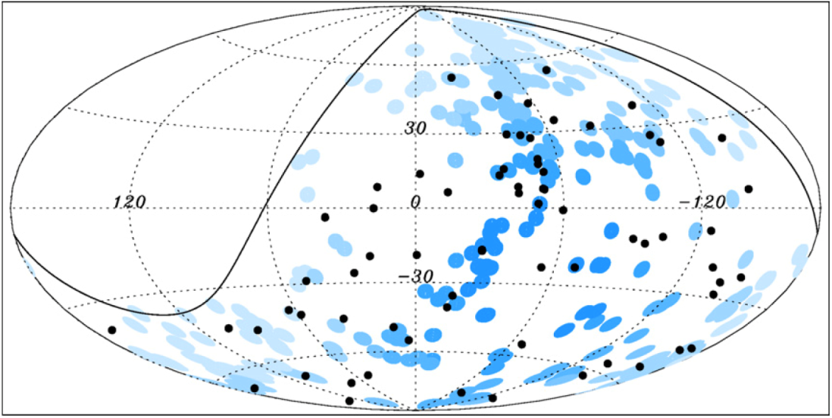
The Pierre Auger Observatory, HiRes, TA are too small
Need the NEXT GENERATION UHE Observatory!

Slide 39
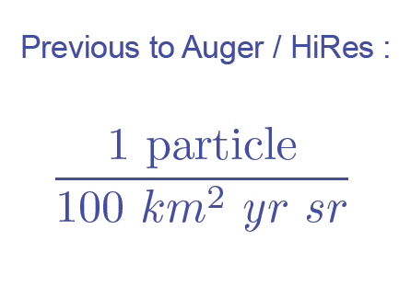
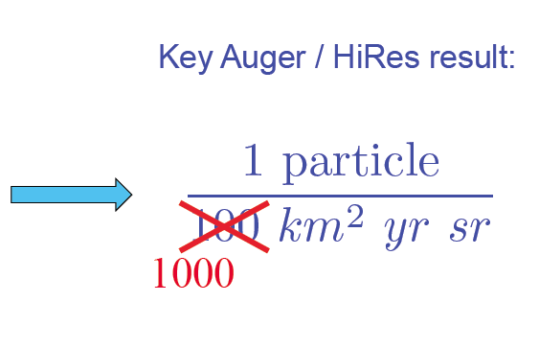
UHECR status in just one word

Slide 42
JEM-EUSO
The Extreme Universe Space Observatory onboard the JAPANESE EXPERIMENT Module
“Doing astronomy by looking downward”

Slide 43


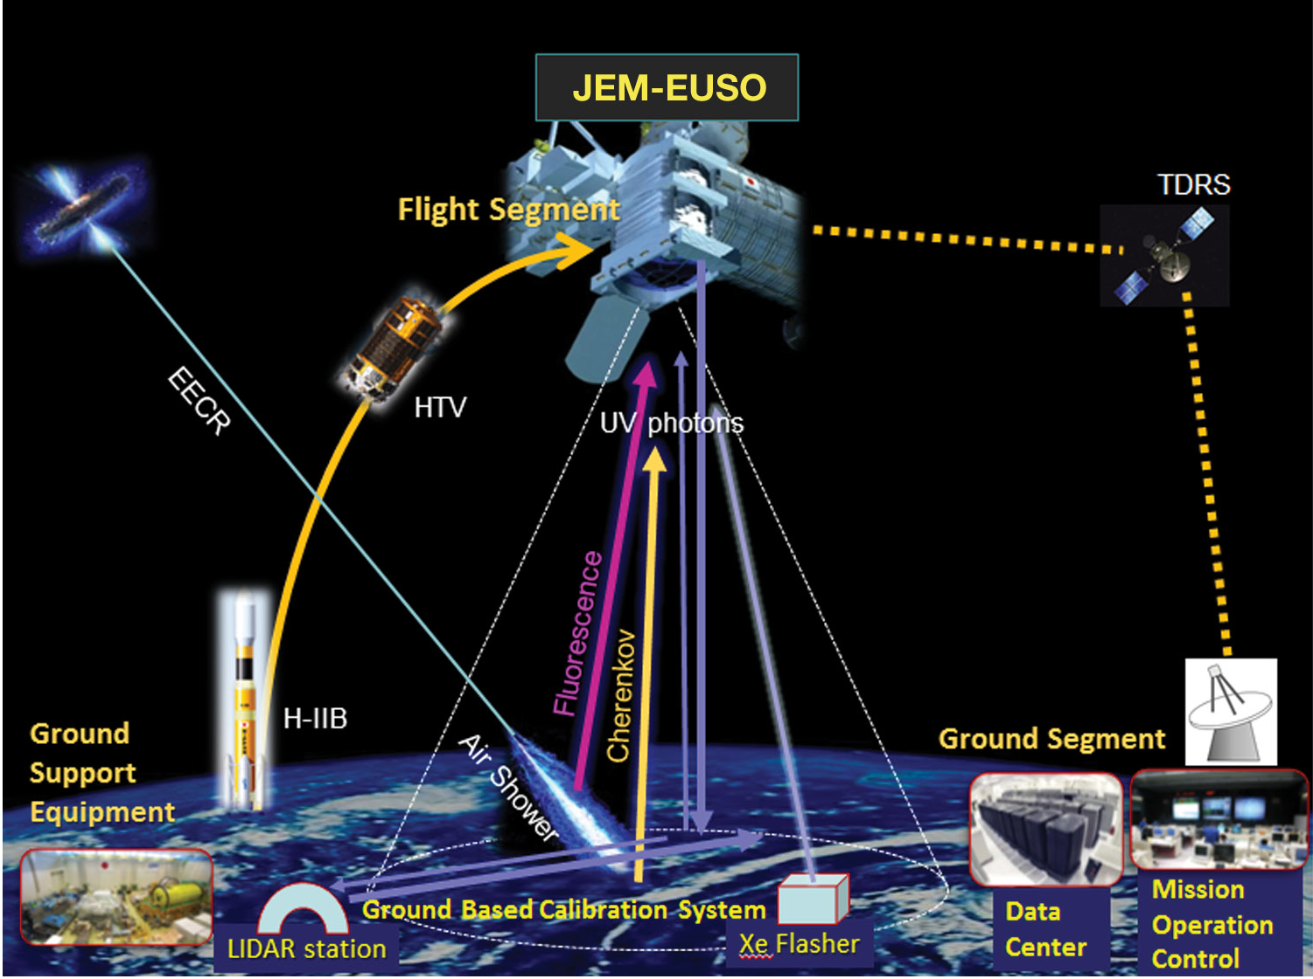



Notes:
Data download to ISS uses Ethernet protocol for high speed data transfer. Data are subsequently downlinked to the ground via Tracking Data Relay Satellite (TDRS) link or stored on Hard Disks.

Slide 44
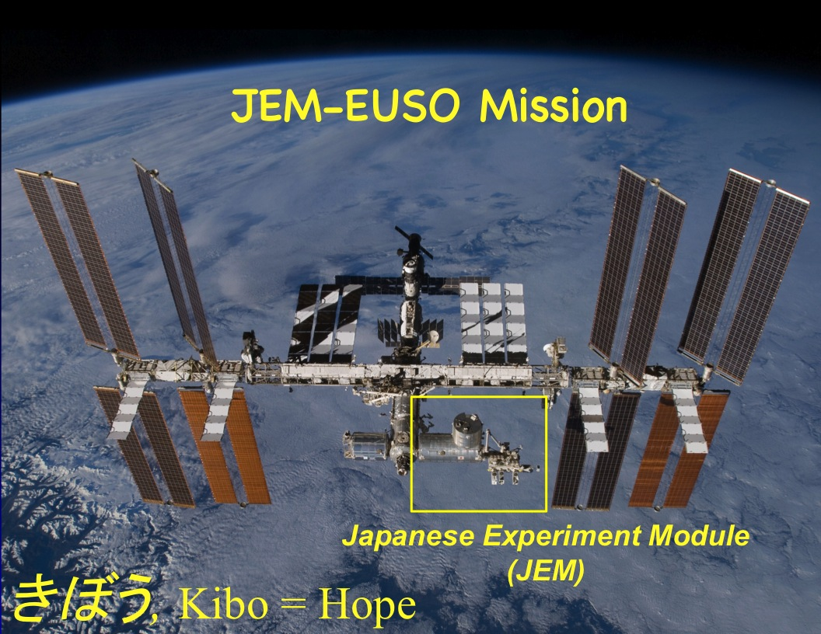

Slide 45
Mission aspects have been successfully studied by JAXA and RIKEN
Parameter | Value
Launch date | 2017
Mission Lifetime | 3+2 years
Rocket | H2B
Transport Vehicle | HTV
Accommodation on JEM | EF#2
Mass | 1938 kg
Power | 926 W (op.) 352 W (non op.)
Data rate | 285 kbps (+ on board storage)
Orbit | 400 km
Inclination of the Orbit | 51.6°
Operation Temperature | -10° to +50°

Slide 46
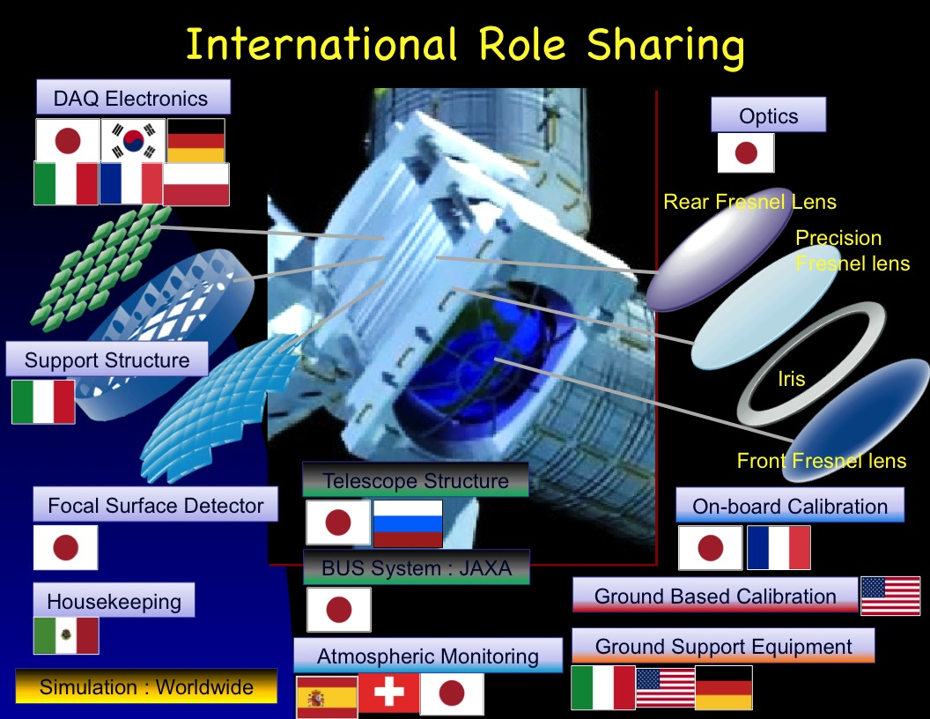
Conceptual view of the telescope

Slide 47
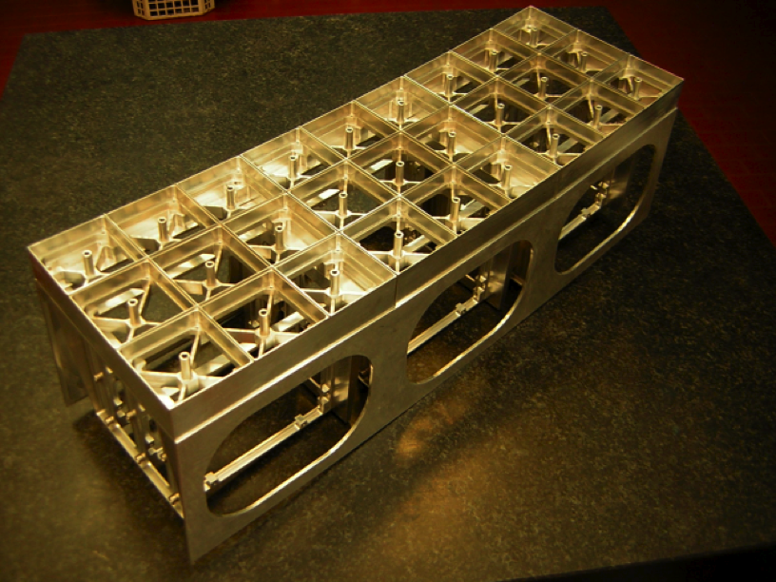
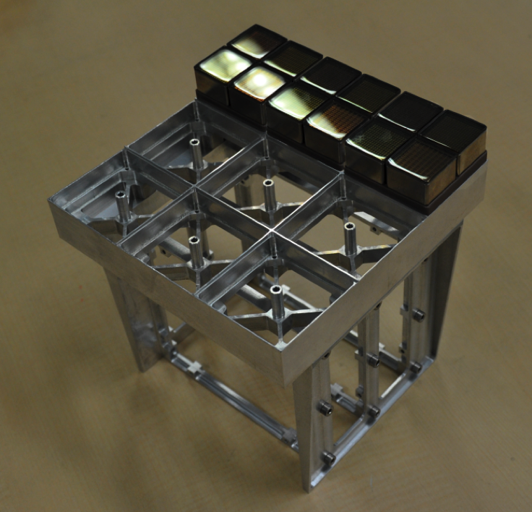
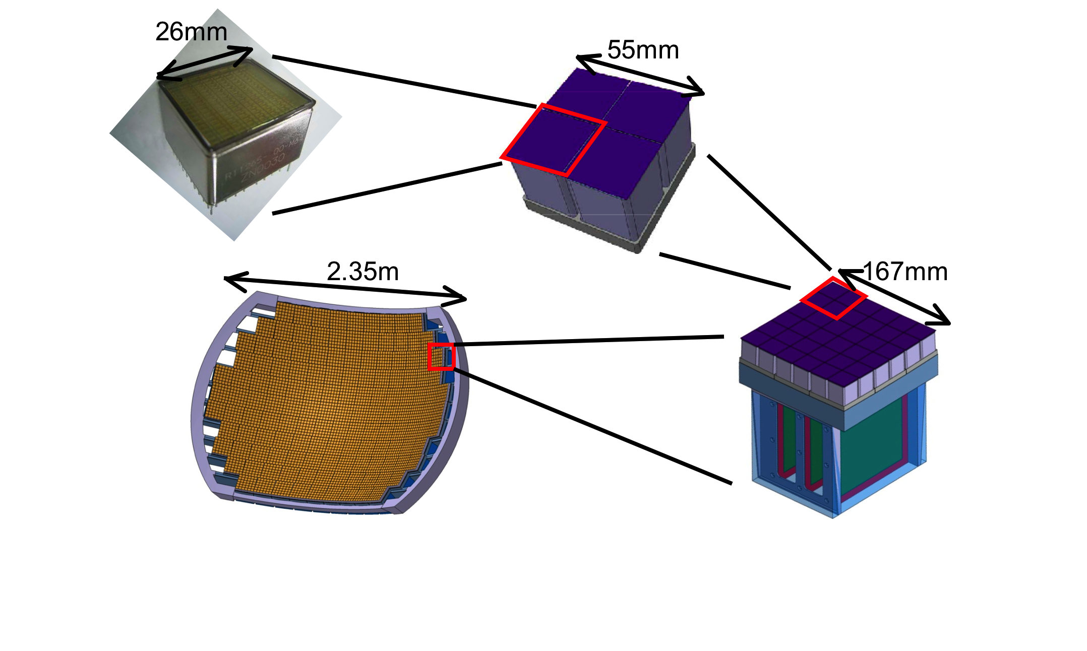
Focal Surface Detector
Elementary Cell (EC)
(2x2 PMTs = 256 pixels)
4932 MAPMTs
(8x8 pixels)
Photo-Detector Module (PDM)
(3x3 ECs = 36 PMTS
2,304 pixels)
1 High Voltage / PDM
Focal Surface detector
137 PDMs
= 0.3M Pixels

Slide 48
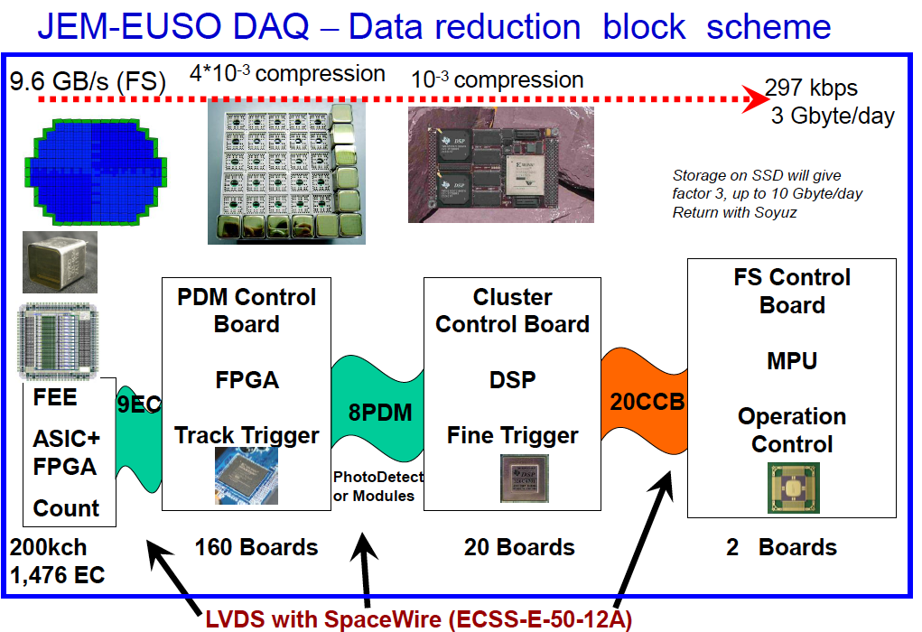
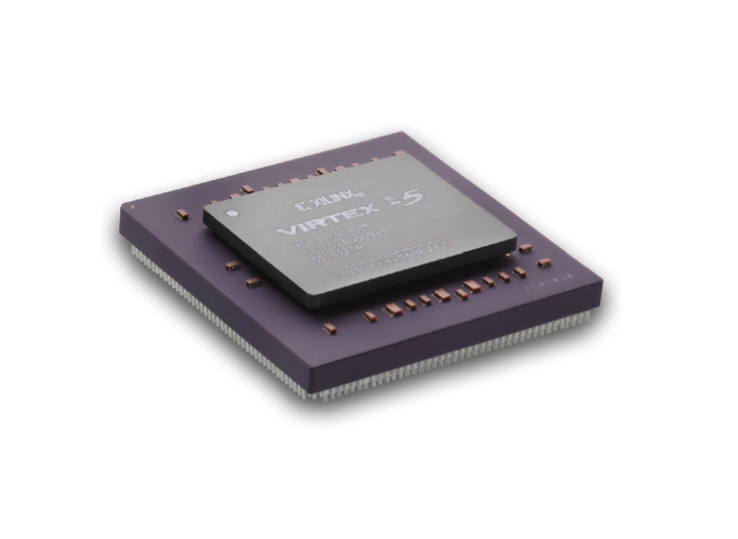
Notes:
SSD = Solid State Drive

Slide 51
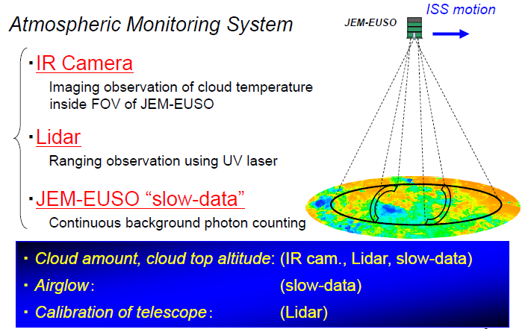
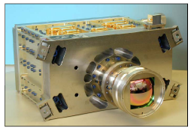
Spain
Switzerland Japan

Slide 54
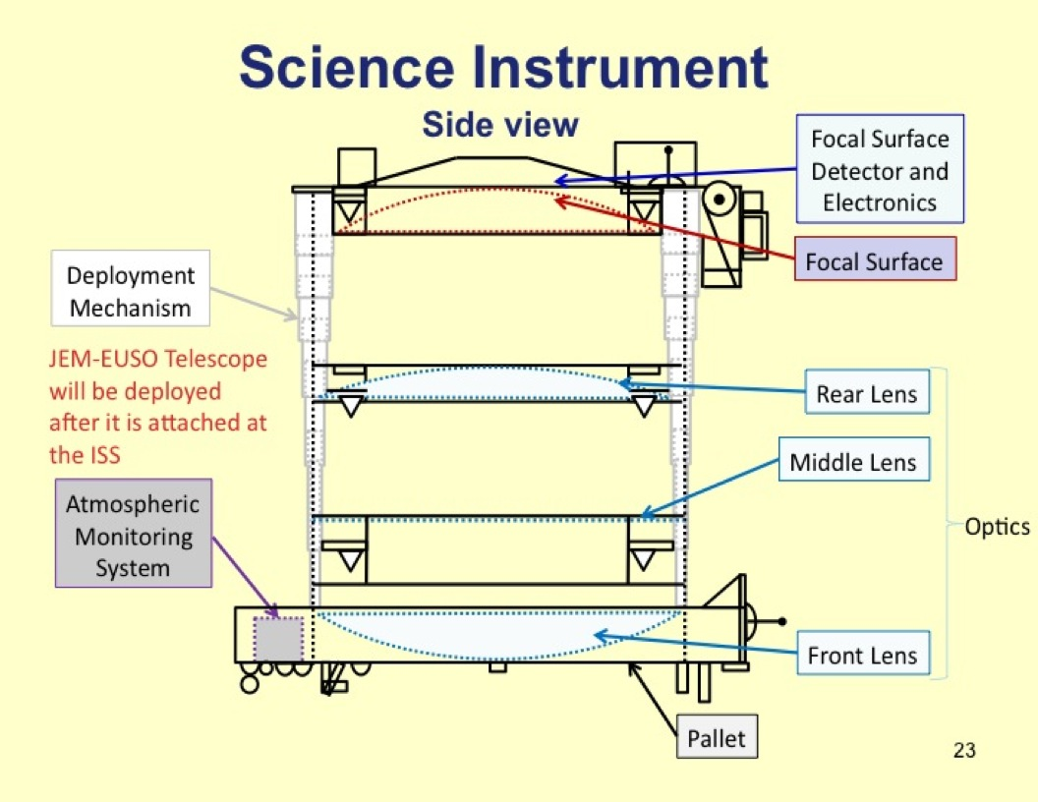
Energia Russia

Slide 56
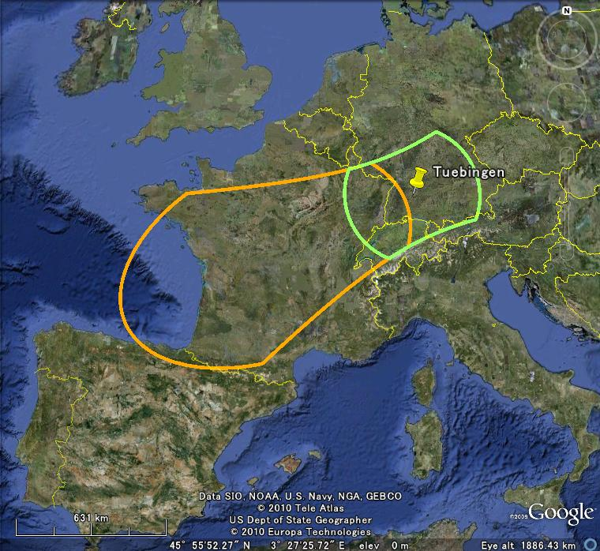
Monitored area

Slide 59
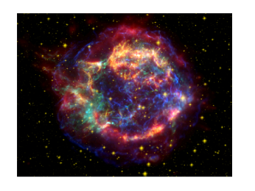
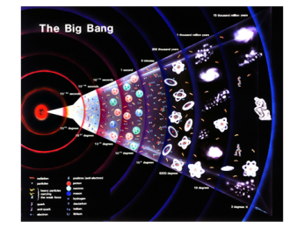
JEM-EUSO Science
Astrophysics and Cosmology:
Main Science Objectives:
identification of UHE sources
measurement of the energy spectra of individual sources
measurement of the trans-GZK spectrum
Exploratory objectives:
discovery of UHE Gamma-rays
discovery of UHE neutrinos
study of the galactic and local extragalactic magnetic field
“Top-Down” scenario
Atmospheric Science
Nightglow
the transient luminous events (TLE)
meteors and meteoroids

Slide 62
Top-down models are strongly constrained

Slide 63
The key concept

Slide 64
Neutrinos vs. Protons: X_{max}
Supanitsky & Medina-Tanco 2011
Distribution of X_{max} for protons and neutrinos for E=10²⁰ eV and θ=85° (First Peak of the shower profile)

Slide 67
JEM-EUSO sky
Forecast in case of 1,000 events
Brightness proportional to AGN
Takami 2008
Brightness of particles ∝ X ray （AGN）
- We expect to discover several tens of clusters
- Can observe the whole sky

Slide 68
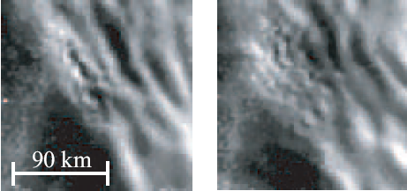
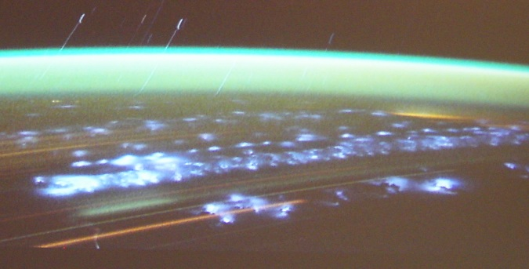
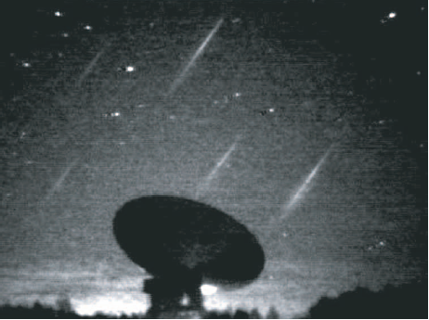
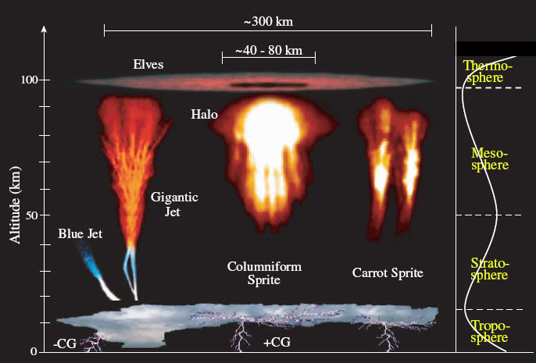
Atmospheric Luminous Phenomena
OH airglow observed from ground
Lightning picture observed from ISS
Leonid meteor swarm in 2001 taken by Hivison camera
Various transient airglows

Slide 70
JEM-EUSO Reviews
JEM-EUSO and its scientific case have been successfully reviewed by more than 10 panels of JAXA, ESA, NASA, ROSCOSMOS, CNES, INFN, IN2P3, MCCIN, and has been included in the Roadmap of the ESA’S FP-RMT, in the European ASPERA Roadmap, and the Roadmap of the world-wide Astro-particle Physics International Forum (APIF) of the OECD Global Science Forum.

Slide 71

JEM-EUSO Collaboration
Japan, USA, Korea, Mexico, Russia
Europe: Bulgaria, France, Germany, Italy, Poland, Slovakia, Spain, Switzerland
13 Countries, 77 Institutions, more than 280 researchers
RIKEN: Leading institution
Notes:
The JEM-EUSO collaboration

Slide 72
Major Institutions
Bulgaria: U. Sofia
France: LAL, APC, IN2P3, CESR
Germany: U. Tubingen, KIT
Italy: INFN, ASI, INAF
Japan: RIKEN, ICRR U. Tokyo, ISAS/JAXA, Konan U., Saitama U.
Korea: Ehwa W U., KAIST, KASI
Mexico: UNAM
Poland: NCBJ, IPJ, UJK, CBK
Russia: SINP MSU, Dubna, JINR
Slovakia: KOSCICE
Spain: UAH, INTA, U. Carlos III
Switerland: ISDC, CSEM
USA: U. Chicago, UAH, NASA/MSFC, Vanderbilt U., LBL, UCLA, U. Wisconsin, Colorado S. Mines

Slide 73
JEM-EUSO System Name Definition
Flight Segment
ISS
Bus
System
Science
Instrument
System
JEM
HTV
Ground Support Equipment
Ground Segment
Mechanical Ground Support
Equipment
Electrical Ground Support
Equipment
Optical
Ground Support
Equipment
FS Calibration Support
Equipment
Ground Based
Calibration
System
Mission Operation
Control
Data Center

Slide 74
Technical Readiness Level
Updating of phase A, 2008, documentation
Study of critical parts of the Telescope: Focal Surface Structure, Telescope expansion mechanism
Development and testing of the JEM-EUSO Optics Bread board models
Development and manufacturing of the engineering models of key electronics components.
These elements will be tested in two real experiments, JEM-EUSO
pathfinders :
EUSO - TA TRL 4 TA Utah site February 2013
EUSO – Balloon TRL 5 CNES first flight early 2014

Slide 75
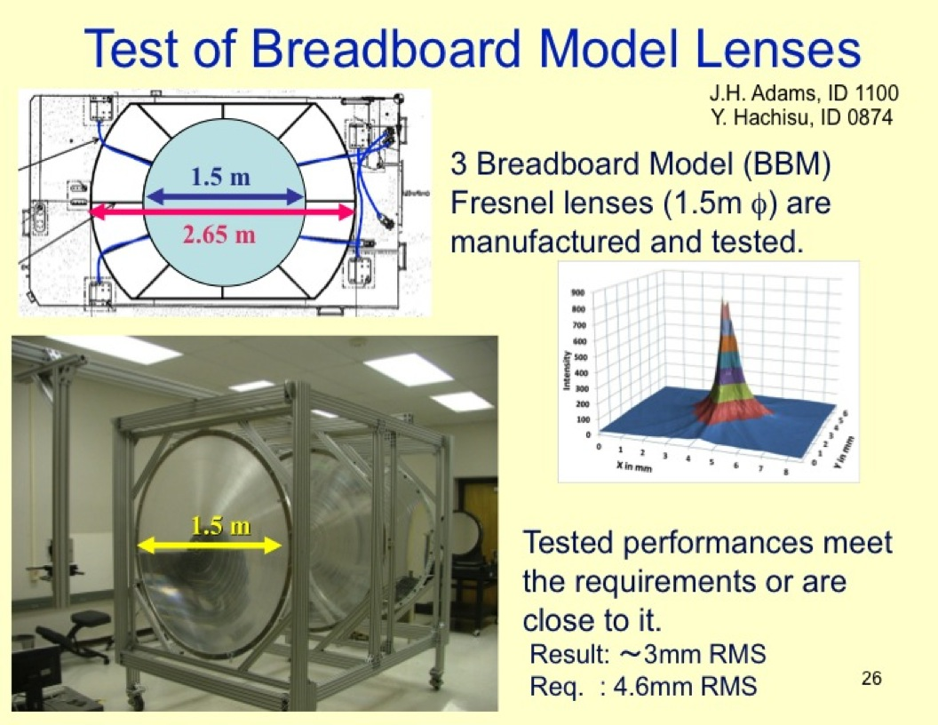

Slide 76
EUSO-TA and EUSO-Balloon

Slide 77
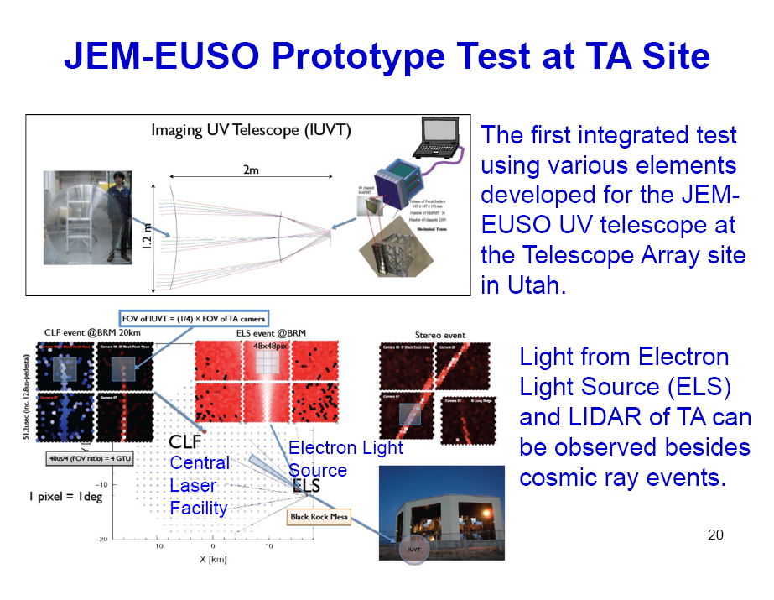
2300 channels

Slide 78
Objectives of EUSO-TA
Engineering Test TRL 4
Absolute calibration by lidar and electron beam shots
Cross calibration with TA FD
Take few showers in coincidence with TA.
Final integration: RIKEN, December 2012
Installation on the site of Telescope Array, Black Rock Mesa, Utah, Jan-Feb 2013
Data taking: March 2013

Slide 79
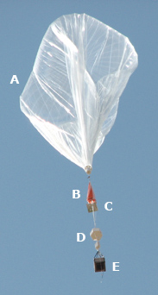
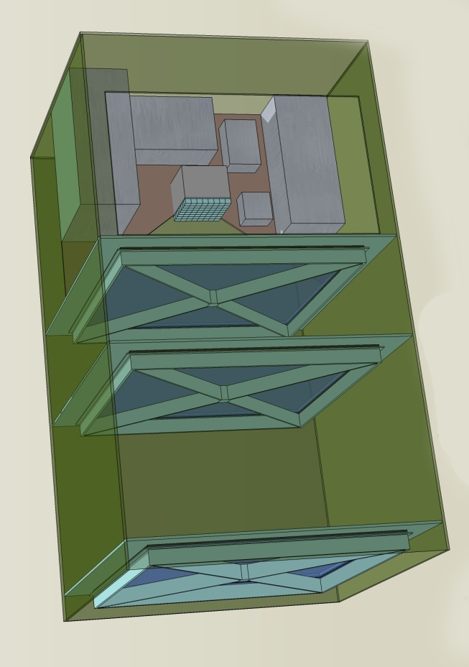


Electronics Detector
EUSO Balloon
Lenses
1m
1m
Simulations
Laser and IR Camera

Slide 80
EUSO Balloon
  EUSO Balloon objectives
  Engineering test TLR 5
  Look down from the balloon with an UV telescope (PDM + 3 lens system)
  UV-Background measurement
  Airshower observations from 40 km altitude
  Delivery to CNES: December 2013
  First Ballon Flight: early 2014

Slide 81
















Balloon-TA EUSO DAQ – Electronic System scheme
1GB/s (FS)
3*10⁻³ compression
No compression
3Mbyte/s
10 Gbyte/hour
1 PDM
36 x 64 channels
Most data
Stored on SSD
17 GB/hour (save all stream)
1
PMT
PDM Control Board
FPGA
Track Trigger
Cluster Control Board
FPGA
Fine Trigger
CPU
Spacewire
Clock Board
GPS
Data Storage
Software
Telemetry CNES
(Siren System)
36
1
1CCB
FEE
ASIC+FPGA
Count
9EC
1PDM
PhotoDetector Modules
2304ch
36 EC
1 Boards
1 Board
1
36
36-3lay
6

Slide 82

1m*1m square lens manufacturing

Slide 83



Precisione lenti: 20 nm
3rd groove surface roughness measurement
Electrical noise
RMS surface roughness requirement : < 0.0200um (=20nm)

Slide 84
JEM-EUSO Current Status
The JEM-EUSO scientific case has been defined
The JEM-EUSO Instrument has been designed
The performance have been simulated
Key parts of the apparatus have been implemented
Two pathfinder experiments are in progress
Large consensus from the scientific community
The procedures for the final approval are in progress

Slide 86
THANKS!

