Slide 1
(ATLAS) Higgs Prospects at HL-LHC

Slide 2

Center-of-Mass Energy (Nominal)
14 TeV ?
Center-of-Mass Energy (close to nominal)
13TeV
LHCb
ATLAS
Center-of-Mass Energy (2012)
8 TeV
CMS
ALICE
Center-of-Mass Energy (2010-2011)
7 TeV

Slide 3

The Machine Challenges in a Nutshell
  Unprecedented beam energy and luminosities (for a hadron machine)
  This results in the main LHC challenge : Stored beam energy two orders of magnitude higher than existing machines… 350 MJ (nominal)
  There is of course also the total stored energy in the magnets (11 GJ, enough to melt 15 tons of copper)
  Risk of damage is the main concern :
  From the stored beam energy
  (as an indication, a few cm groove in an SPS vacuum chamber from a beam 1% of nominal LHC beam, vacuum chamber ripped open)
  Similar incident at LHC : 3 months stop.
  From the stored energy in the magnets
  The November 19 2008 incident… (700 m damage area with 39 dipoles and 14 quadrupoles and beam vacuum affected over 2.7 km, 1 year repair)

Slide 4
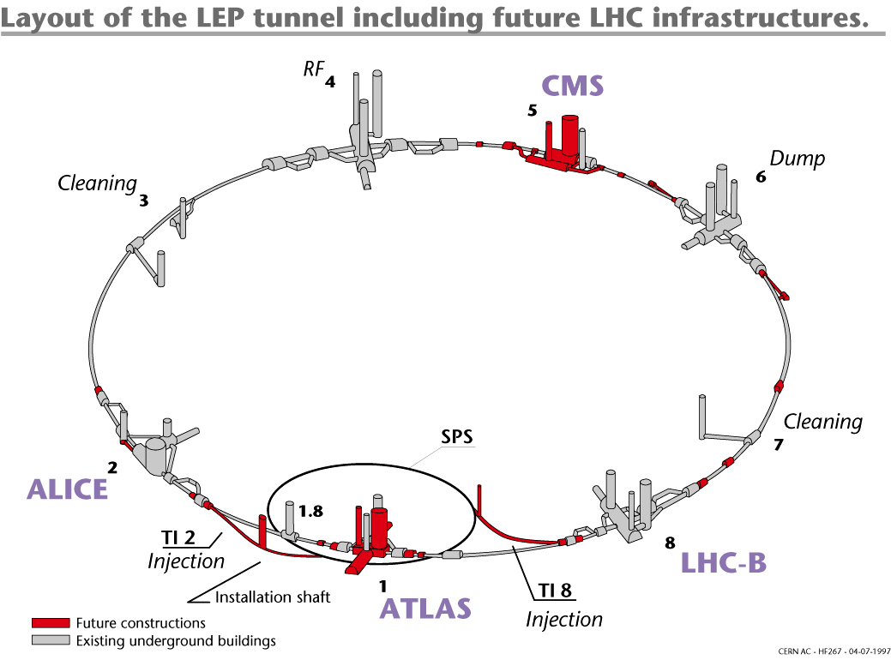
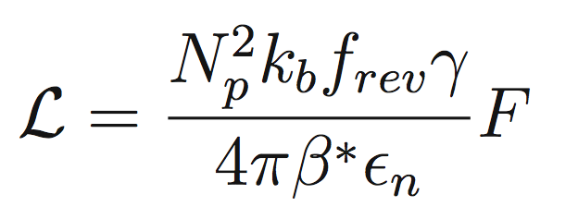
The LHC Design and First Run
First High Energy Run Completed
The LHC
- Circumference 27 km
- Up to 175 m underground
- Total number of magnets 9 553
- Number of dipoles 1 232
- Operation temperature 1.9 K
(Superfluid He)
Event taken at random (filled) bunch crossings
… in LS1
Parameter | 2010 | 2011 | 2012 | Nominal
C.O.M Energy | 7 TeV | 7 TeV | 8 TeV | 14 TeV
Bunch spacing / k | 150 ns / 368 | 50 ns / 1380 | 50 ns /1380 | 25 ns /2808
ε (mm rad) | 2.4-4 | 1.9-2.3 | 2.5 | 3.75
β* (m) | 3.5 | 1.5-1 | 0.6 | 0.55
L (cm⁻²s⁻¹) | 2x10³² | 3.3x10³³ | ~7x10³³ | 10³⁴

Slide 5
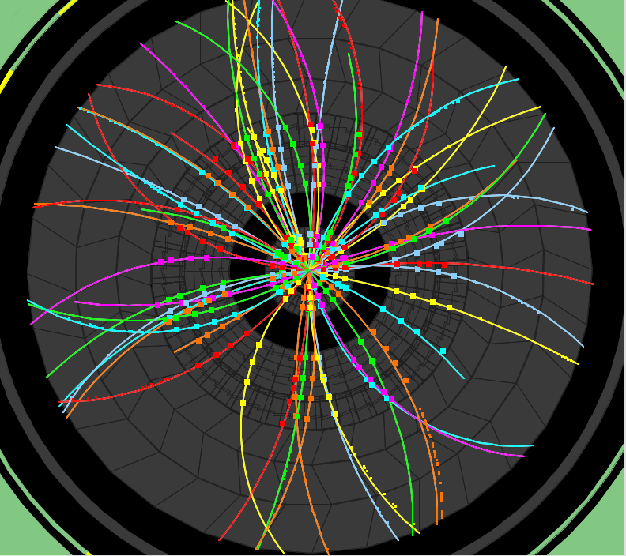

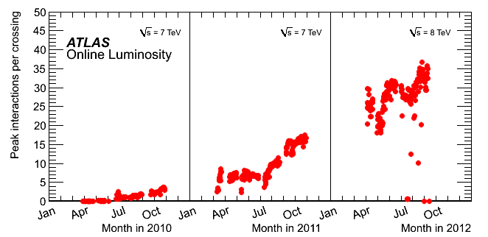

Three Years of LHC operations at the Energy frontier
2010
2011
2012
23 fb⁻¹
at 8 TeV
O(2) Pile-up events
150 ns inter-bunch spacing
Event taken at random (filled) bunch crossings
4th July seminar
and ICHEP
2011
5.6 fb⁻¹
at 7 TeV
2010
0.05 fb⁻¹
at 7 TeV
2011
O(10) Pile-up events
Event taken at random (filled) bunch crossings
50 ns inter-bunch spacing
Design value
(expected to be
reached at L=10³⁴ !)
2012
O(20) Pile-up events
50 ns inter-bunch spacing

Slide 6
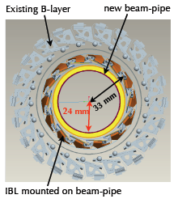
The LHC timeline
LHC timeline
2009
Start of LHC
LS1 Machine Consolidation
New Insertable Pixel B-layer (IBL)
New Pixel service quarter panels (nSQP)
New ID evaporative cooling plant
New Al forward beam pipe
New calorimeter LVPS
Consolidation of other detectors and infrastructure
Complete muon spectrometer (EE, RPC, feet)
Add specific muon shielding
Upgrade magnet cryogenics
Detector readout for Level-1 100 kHz rate
Run 1, 7+8 TeV, ~25 fb⁻¹ int. lumi
2013/14
Prepare LHC for design E & lumi
LS1
Collect ~30 fb⁻¹ per year at 13/14 TeV
2018
Phase-1 upgrade ultimate lumi
LS2
LS2 Machine upgrades for high Luminosity
Collimation
Cryogenics
Injector upgrade for high intensity (lower emittance)
Phase I for ATLAS : Pixel upgrade, FTK, and new small wheel
Twice nominal lumi at 14 TeV,
~100 fb⁻¹ per year
~2022
Phase-2 upgrade to HL-LHC
LS3
LS3 Machine upgrades for high Luminosity
Upgrade interaction region
Crab cavities?
Phase II: full replacement of tracker, new trigger scheme (add L0), readout electronics.
~300 fb⁻¹ per year, run up to > 3 ab⁻¹ collected
~2030

Slide 7
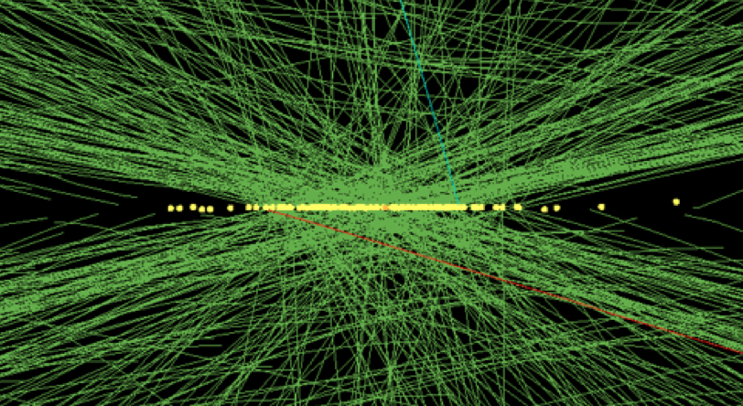
HL-LHC Beam Parameters
Two HL-LHC scenarios
Parameter | 2012 | Nominal | HL-LHC (25 ns) | HL-LHC (50 ns)
C.O.M Energy | 8 TeV | 13-14 TeV | 14 TeV | 14 TeV
N_{p} | 1.2 10¹¹ | 1.15 10¹¹ | 2.0 10¹¹ | 3.3 10¹¹
Bunch spacing / k | 50 ns /1380 | 25 ns /2808 | 25 ns /2808 | 50ns /1404
ε (mm rad) | 2.5 | 3.75 | 2.5 | 3.0
β* (m) | 0.6 | 0.55 | 0.15 | 0.15
L (cm⁻²s⁻¹) | ~7x10³³ | 10³⁴ | 7.4 10³⁴ | 8.4 10³⁴
Pile up | ~25 | ~20 | ~140 | ~260
Event taken at random (filled) bunch crossings
Pile up is a crucial issue!
CMS event with 78 reconstructed vertices

Slide 8
ATLAS Higgs Physics Program
Made for two scenarios 300 fb⁻¹ and 3ab⁻¹
Using realistic conditions of up to 140 PU events

Slide 9
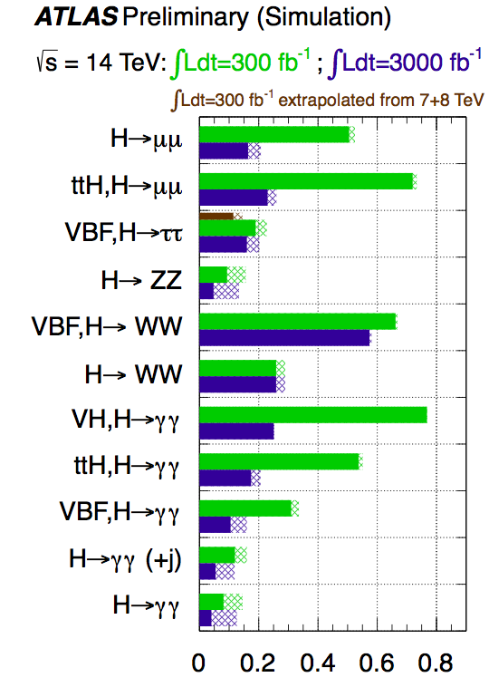
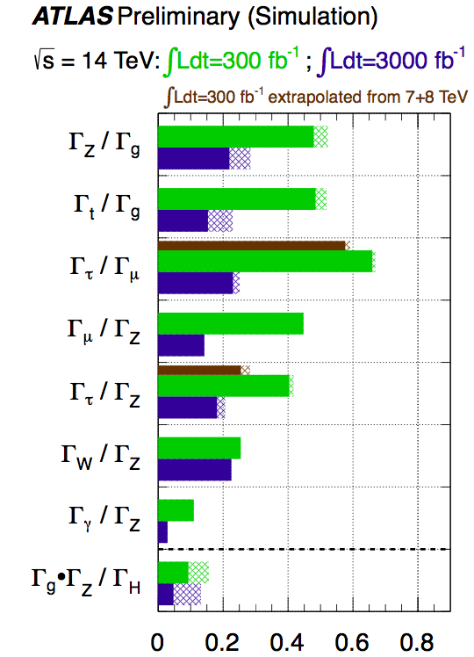
ATLAS Higgs Physics Program: Main Couplings
Couplings Projections Only a sample of analyses
Uncertainty on
signal strengths
Uncertainty on
width ratios
e.g. ~ 5% level constraint
on NP in loops
Only indirect (however not negligible) constraint on the total width
Necessary to use assumptions or measure ratios: Precision down to 5% level

Slide 10
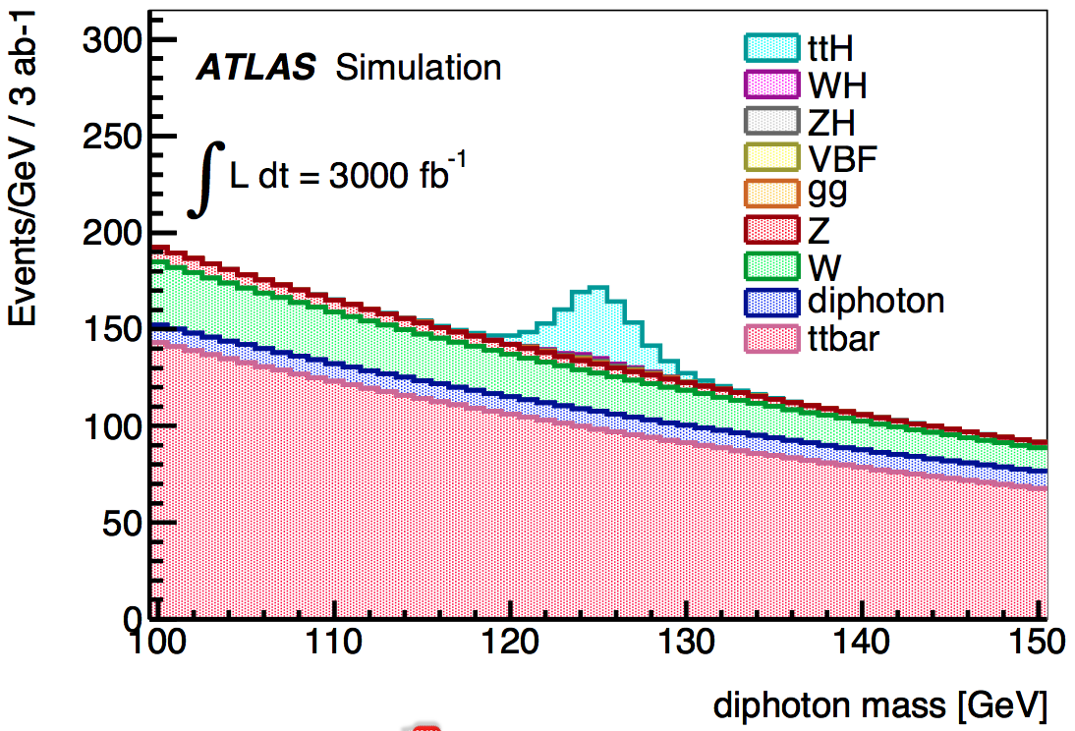
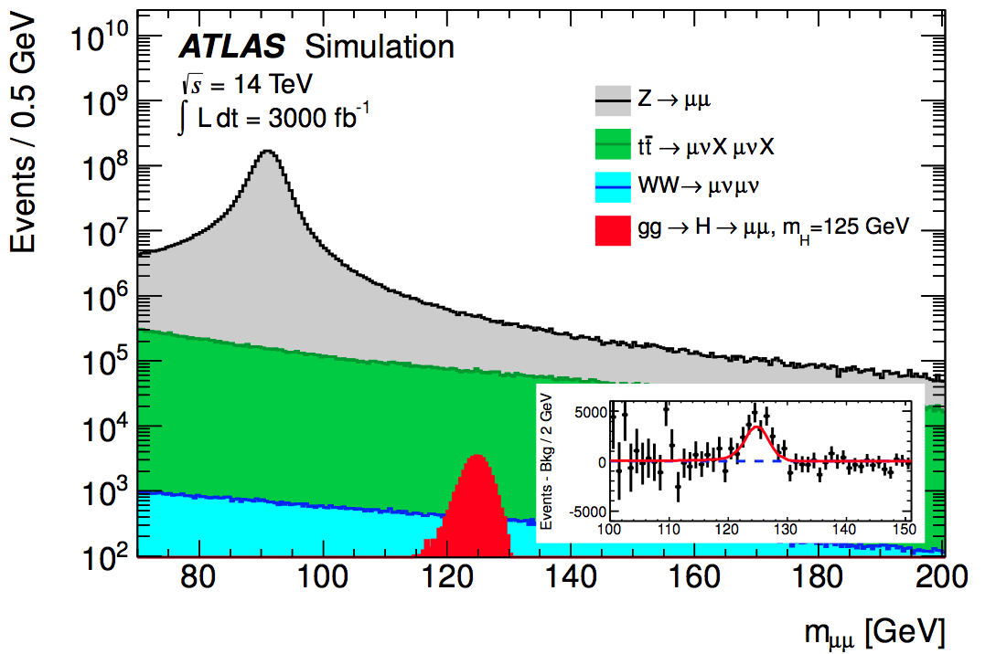
Reaching ttH Production in (robust) rare modes
Analyses not relying on more intricate decay channels (bb, tt and WW)
γγ channel: more than 100 Events expected with s/b~1/5
μμ channel: approximately 30 Events expected with s/b~1
Analyses (rather) robust to PU
μμ decay mode established at more than 5 standard deviation

Slide 11
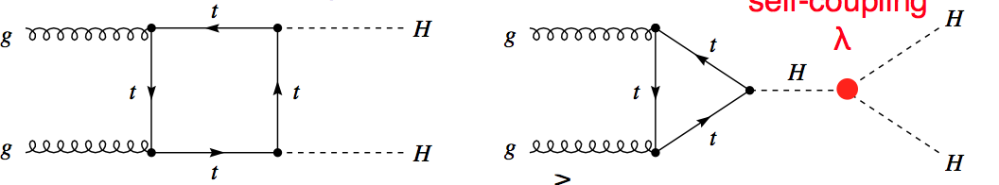
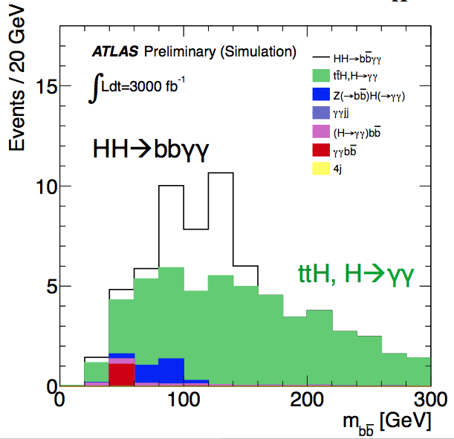
Self Couplings
Determination of the scalar potential, essential missing ingredient : self couplings !
Are they as predicted : λ₃ ~ m_{H}²/(2v) , λ₄ ~ m_{H}²/(8v²)
λ₄ : hopeless in any planed experiment (?)
λ₃ : very very hard in particular due to the double H production, which also interferes with the signal…
… but some hope, in (rather) robust
pp → HH → bbγγ
(S ~ 15, B ~ 21 for 3 ab⁻¹ and some faith…) bbτ⁺τ⁻ (under study)
~3 standard deviations expected on λ₃ with 3 ab⁻¹

Slide 12
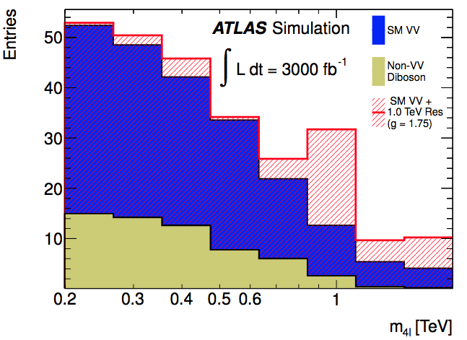
Completing the Picture WBS
Weak Boson Scattering
Only taking into account the cleanest signals : ZZjj in the 4 leptons final state
Very clean signature for a TeV resonance (in anomalous WBS models)
Sensitivities for 300 fb⁻¹ and 3 ab⁻¹:
Model (anomalous WBS) | 300 fb⁻¹ | 3 ab⁻¹
500 GeV and g=1 | 2.4 σ | 7.5 σ
1 TeV and g=1.75 | 1.7 σ | 5.5 σ
1 TeV and g=2.5 | 3.0 σ | 9.4 σ

Slide 13
Conclusions
Promising HL-LHC Higgs physics program
  Good precision on most couplings (with assumptions) or on coupling ratios.
  ttH (robustly) reachable directly at a precision ~15-20%
  Cover to a large degree of precision the WBS
However more work is needed to complete the physics prospects (or case)
  More in depth full simulation of PU conditions
  Exploring the reach of the direct constraints on invisible decays
Intermediate scenarios should also be considered to consolidate the current foreseen scenarios both in PU running conditions and integrated luminosity

Slide 14

Outlook
European strategy for particle physics recommendation:
Important (next) dates:
    Snowmass workshop Summer 2013
    ECFA HL-LHC workshop October 2013
Europe’s top priority should be the exploitation of the full potential of the LHC, including the high-luminosity upgrade of the machine and detectors with a view to collecting ten times more data than in the initial design, by around 2030.

