Slide 1
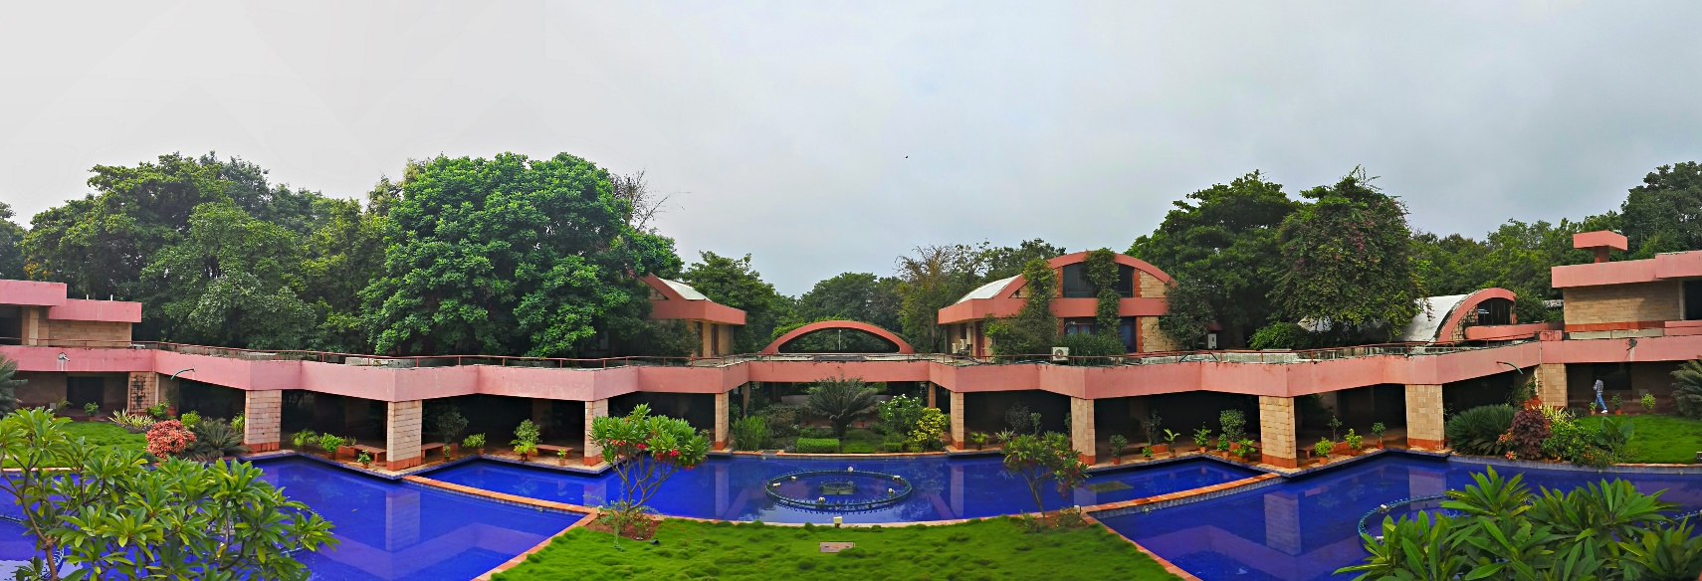
Institute for Plasma Research
Gujarat
INDIA
Arvind Mohan Singh

Slide 2
Research Areas:
Studies on high temperature magnetically confined plasmas.
Basic experiments in plasma physics
Industrial plasma processing and applications.
ITER-India
Staff - 150
FCIPT
Staff - 35
CPP
Staff - 30
IPR
Staff - 500

Slide 3
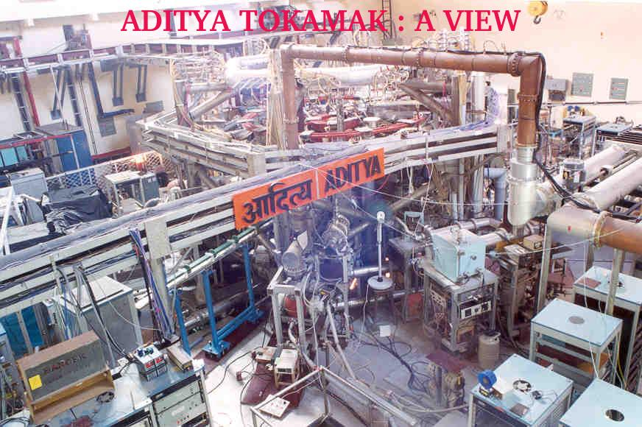
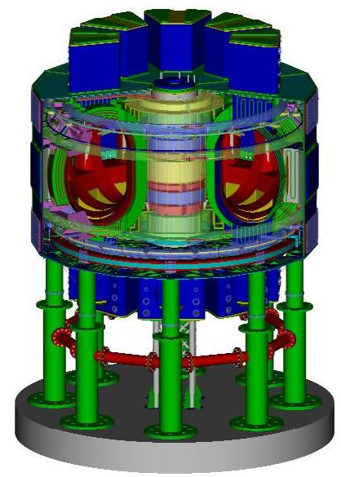
“Aditya” Tokamak :
“Aditya” is India’s first indigenous medium size tokamak.
Major Radius is 0.75 m
Minor radius is 0.25 m
Plasma discharge duration is ~100msec
Plasma current ~ 100-150 kA
Steady State Superconducting Tokamak (SST-1):
Upgraded version of Aditya Tokamak
Major Radius is 1.1 m
Minor radius is 0.20 m
Plasma discharge duration is 1000 sec.
Plasma current ~ 100-150 kA

Slide 4
Computer Division - IPR
Computer Division is responsible for providing computational facility to IPR users through LAN of roughly 600 machines, comprising of Servers and Desktops. A fast Ethernet network comprising of L3 and L2 switch, with mix of copper and fiber connectivity across the Institute.
Total IT staff – 6 nos.
Service Areas :
Mail server
Internet server
DNS server
Intranet servers
Network etc.

Slide 5
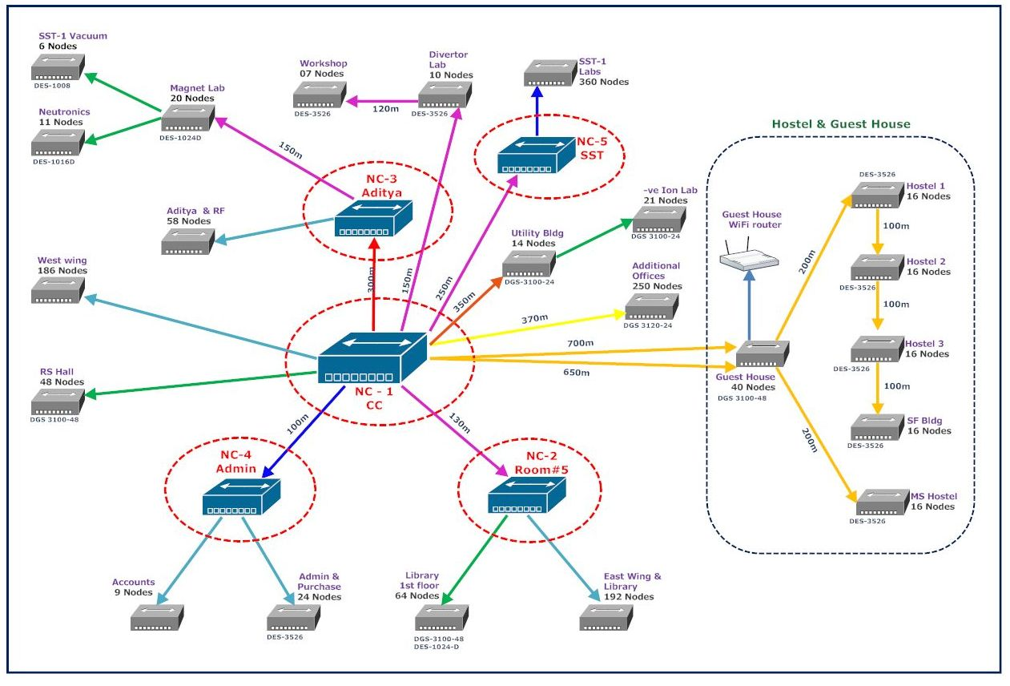
IPR - Network

Slide 6
Computer Division - IPR
Computer Division has two types of HPC cluster –
34 node Desktop based HPC cluster
2 node Rack mount based HPC cluster

Slide 7
Desktop based Cluster
Head node (1 No.):
Intel Xeon 3.2 GHz 4 core processor with 2MB L2 cache
Memory – 5GB
Storage Capacity – 293GB
Compute Node (34 nos.):
Intel Pentium 4 3GHz 2 core processor with 1MB L2 cache
Memory – 3GB
Storage Capacity – 80GB
These Compute nodes and head node are interconnected with a 48 port gigabit Ethernet switch.

Slide 8
Desktop based Cluster
This cluster contains a gamut of free open source scientific software as well as procured compilers and computational libraries and various flavours of MPI.
Maui and Torque are being used as scheduler and resource manager.
Following is the list of software used in the cluster :
Intel C and Fortran compilers
Intel MKL libraries
Intel MPI 2.0 and Mpich2
Lahey/Fujitsu Fortran 95
GNU scientific library
Scilab
Automatically tuned Linear Algebra Software (ATLAS)
FFTW3.1.2 library for computing discrete Fourier transform

Slide 9
Desktop based Cluster
Theoretical peak performance – 867.2 GFlops
Through Linpack – 50%
Approximately 30 nos. of Scientists and Research Scholars are using
for computational purpose
Computer Centre helps cluster users in porting different applications on this cluster and also actively involved in parallelizing scientific codes using MPI

Slide 10
Rack Mount based Cluster
Head Node (1 No.):
Intel Xeon E5405 2GHz processor
No. of cores – 4
Memory – 4GB
Storage Capacity – 300 GB
Network – 1Gbps
Compute Node (2 nos.):
Intel Xeon E7530 1.87GHz processor
No. of cores – 24
Memory – 24 GB
Storage capacity – 1.2TB
Network – 1Gbps

Slide 11
Rack Mount Cluster
Theoretical peak performance – 391.04 GFlops
Through Linpack – 70%
Number of users using this cluster – 25
This cluster also contains a gamut of free open source scientific software as well as procured compilers and computational libraries.
Maui and Torque are being used as scheduler and resource manager

Slide 12
Cluster Related Responsibilities
Installing , configuring and maintaining software of HPC clusters
Coordinating with vendors to resolve hardware and software problems
Tuning OS and applications to increase performance and reliability of services
Automating system administration tasks utilizing both open source configuration management tools and in-house scripts
Documenting system administration procedures for routine and complex tasks
Providing reliable and efficient backups/restores for all managed systems.

Slide 13
New HPC cluster
The hardware configuration of 5.2 TF HPC cluster :
Master/ Head Node (Qty – 1No.) and Computer Node (Qty – 9Nos.)
CPU based IBM System x3750 M4
4 Processor – Intel Xeon E5-4640 8C (2.4 GHz, 20MB L3, 95 W 4s)
256GB RAM (per core 8GB,ECC,DDR3,1.3GHz LP RDIMM)
Mellanox single port QSFP QDR/FDR10/10GbE HCA
The storage capacity for Head node is 2TB and for Compute nodes is 1 TB
Cluster Management Node (Qty. – 1 No.):
CPU based IBM System x3250 M4
Intel Xeon Processor E3-1220 4C (3.1GHz,8MB cache,80W)
16GB RAM(per core 4GB, ECC, DDR3, 1.3GHz LP UDIMM)

Slide 14
New HPC Cluster
Storage Node (Qty - 1No.):
IBM system x3650 M4
2 Processor Intel Xeon E5 2609 4C (2.4 GHz, 10MB cache, 80W)
32GB RAM (per core 4GB, ECC,DDR3, 1.6GHz LP RDIMM)
Storage capacity is 1TB
Mallanox Dual port QSFP QDR/FDR10/10GbE HCA
1 no. of 6GB SAS HBA
2 no. of Emulex 8Gb FC Dual Port HBA
Storage System:
IBM storwize V3700 SFF Dual Control Enclosure
20 nos. of 900 GB SAS HDD
2 nos. of 8GB FC 4 port Host interface card

Slide 15
New HPC Cluster
Tape Back-up Drive:
TS2900 tape library with LTO5 SAS drive and rack mount kit
Miscellaneous items:
IBM 42U Rack – 1 no.
IB 18 port Mellanox switch – 1 No.
26 port Gig managed switch – 1 no.
KVM (with console, keyboard, mouse) switch – 1 no.
List of supplied software with cluster:
SuSe Linux 11.0
Intel Cluster Studio XE
System X V3.x monitoring software
V3.x LSF Express for job scheduling
Tivoli storage backup software

Slide 16
Block Diagram of 5.2TF HPC Cluster

Slide 17
Thank You For Attention

