Slide 1
HPC at University of Moratuwa & Sri Lanka
Dilum Bandara, PhD
Dilum.Bandara@uom.lk
Senior Lecturer
Dept. of Computer Science & Engineering,
University of Moratuwa,
Sri Lanka

Slide 2
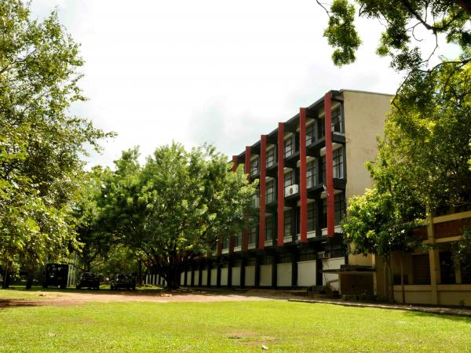
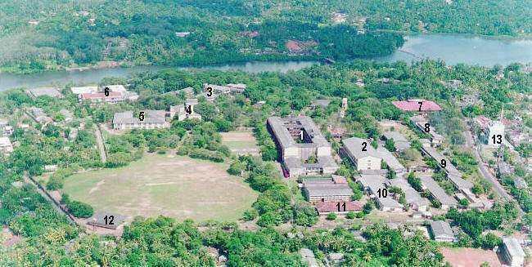
University of Moratuwa (www.UoM.lk)
Premier University for Engineering, IT, & Architecture in Sri Lanka
6000 students
Undergraduate teaching → research university

Slide 3
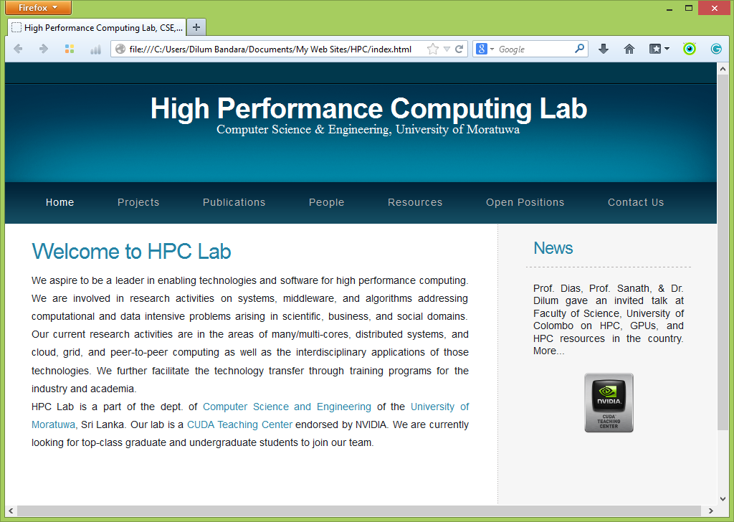
HPC Lab
Recent initiative
Vision
Evolve HPC lab into the National HPC resource for researchers on a collaborative & resource-use basis
Mission
Leader in enabling technologies & software for HPC
Research & teaching
Systems, middleware, & algorithms addressing computational/data intensive problems in scientific, business, & social domains
Collaboration with internal & external researchers
http://cse.mrt.ac.lk/hpc

Slide 4
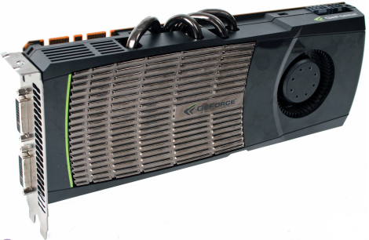
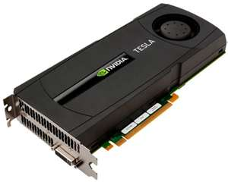
Resources
GPUs
CUDA Teaching Center
52 Nvidia Gforce GTX 480 cards
1 Nvidia Tesla 2070 card
Workstations
3 Intel i7, quad core, 3 GHz, 8 GB, 500 GB, 2 GPUs each
2 Intel quad core, 2.66 GHz, 16 GB, 400 GB
8 Intel i5, dual core, 2.4 GHz, 8 GB, 500 GB
More on the way
8 Intel i7, quad core, 2.4 GHz, 16 GB, 1TB
Couple of high-memory nodes (64 GB)

Slide 5
Expectations
“If you build they will come” model have failed
Issues that we identified
Limited understanding about CS & how to port applications to parallel/distributed systems
Lack of awareness about existing/potential resources
Interdisciplinary barriers
Lower interests among CS graduates for full-time research
Break/lower barriers
Education & technology transfer
Access to our resources
Build a community of researchers
Use community to justify the need for more advanced HPC resources

