Slide 1
Introduction to Synchrotron Radiation and Evolution from Undulator Radiation to Free Electron Lasing
David Attwood
University of California, Berkeley
http://ast.coe.berkeley.edu/sxr2009
http://ast.coe.berkeley.edu/srms

Slide 2
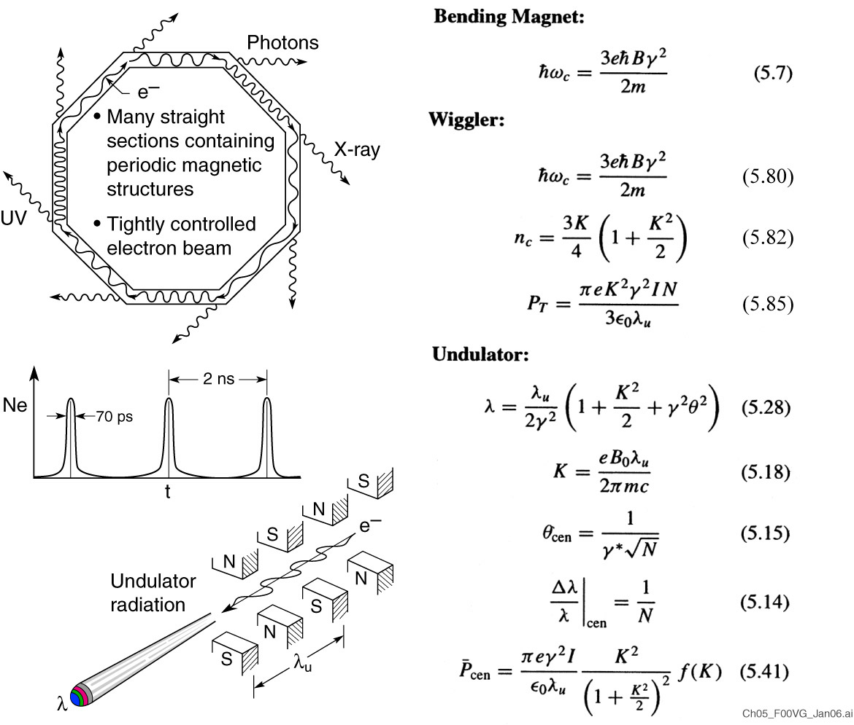
Synchrotron radiation

Slide 3
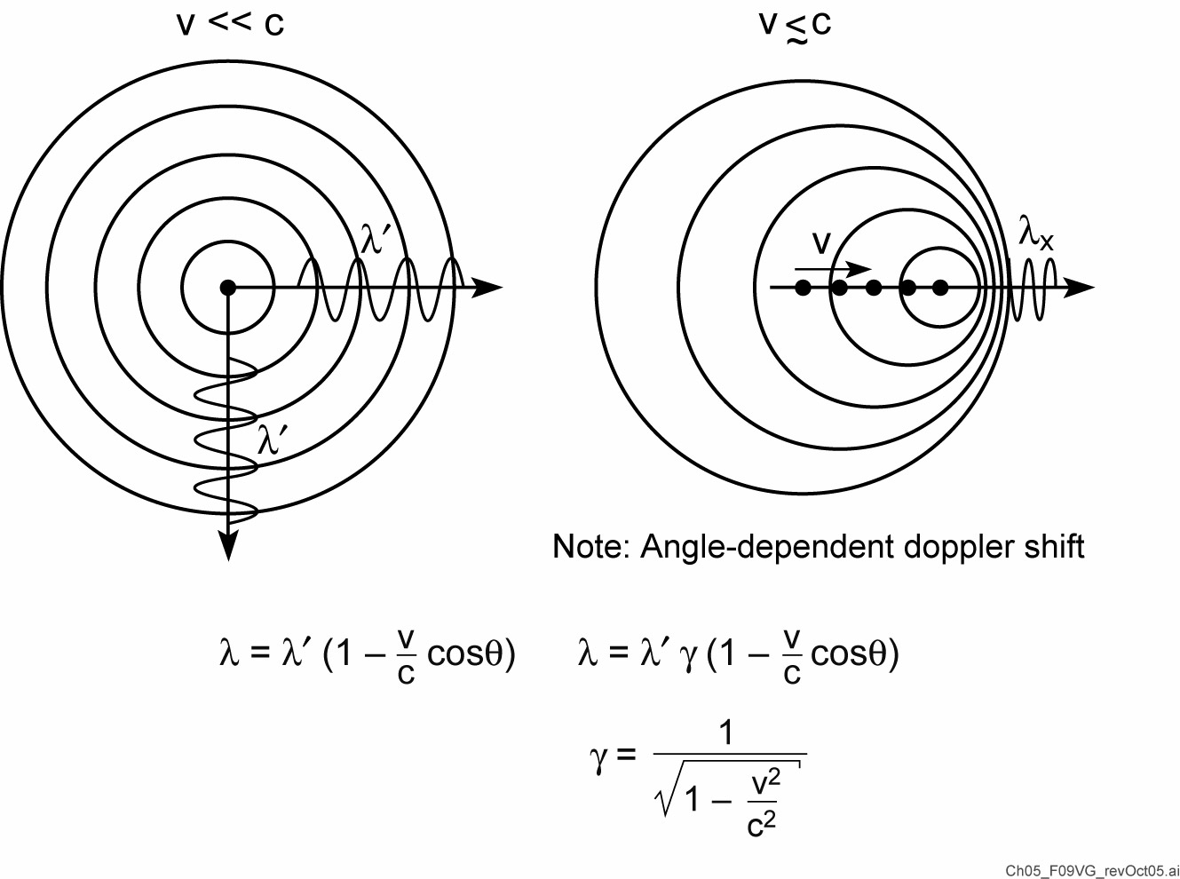
Synchrotron radiation from relativistic electrons

Slide 4
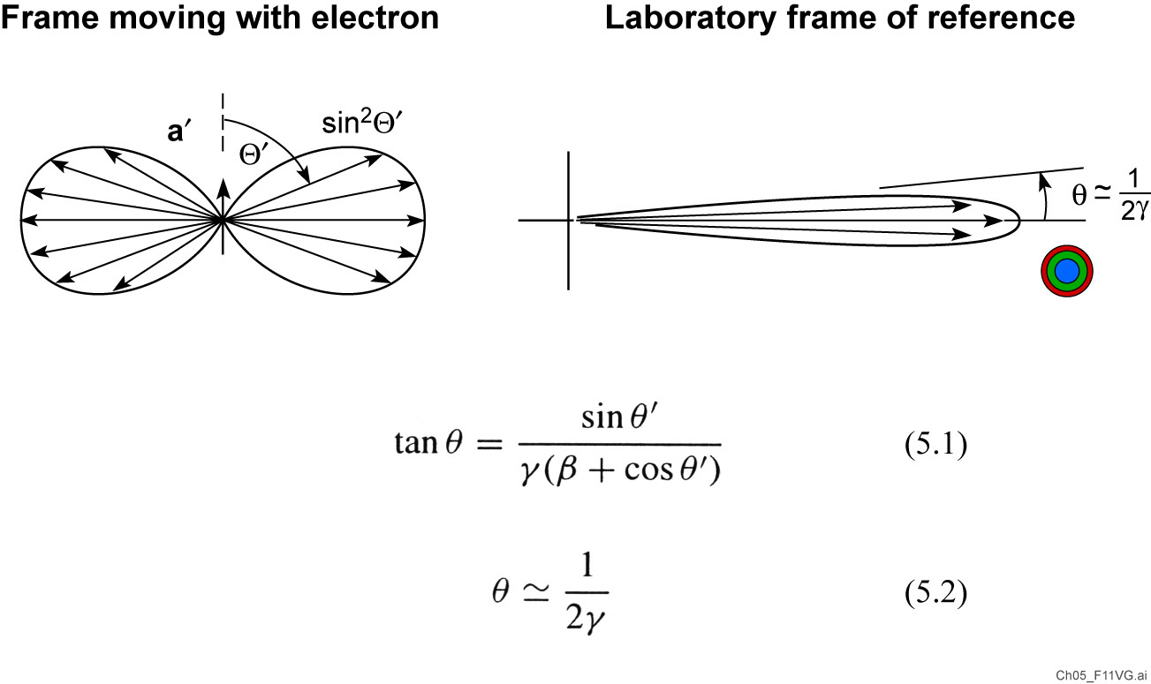
Synchrotron radiation in a narrow forward cone

Slide 5
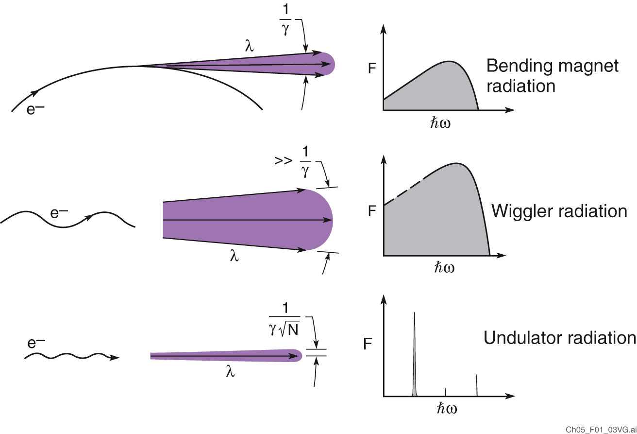
Three forms of synchrotron radiation

Slide 6
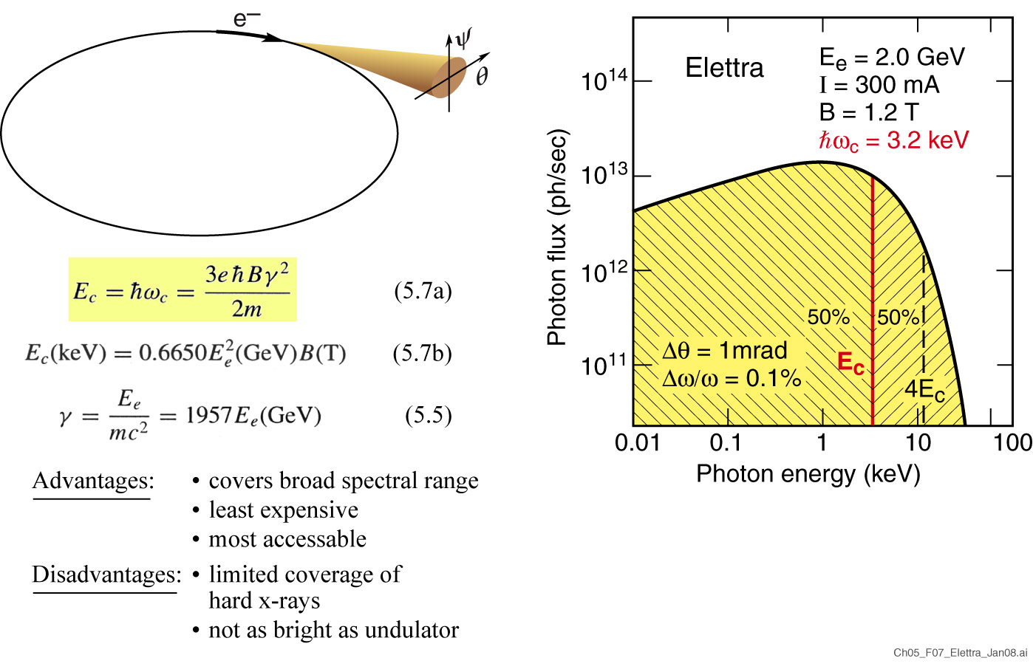
Bending magnet radiation covers a broad region of the spectrum, including the primary absorption edges of most elements
What is E_{c} at a facility near you?
What is 4E_{c}?

Slide 7
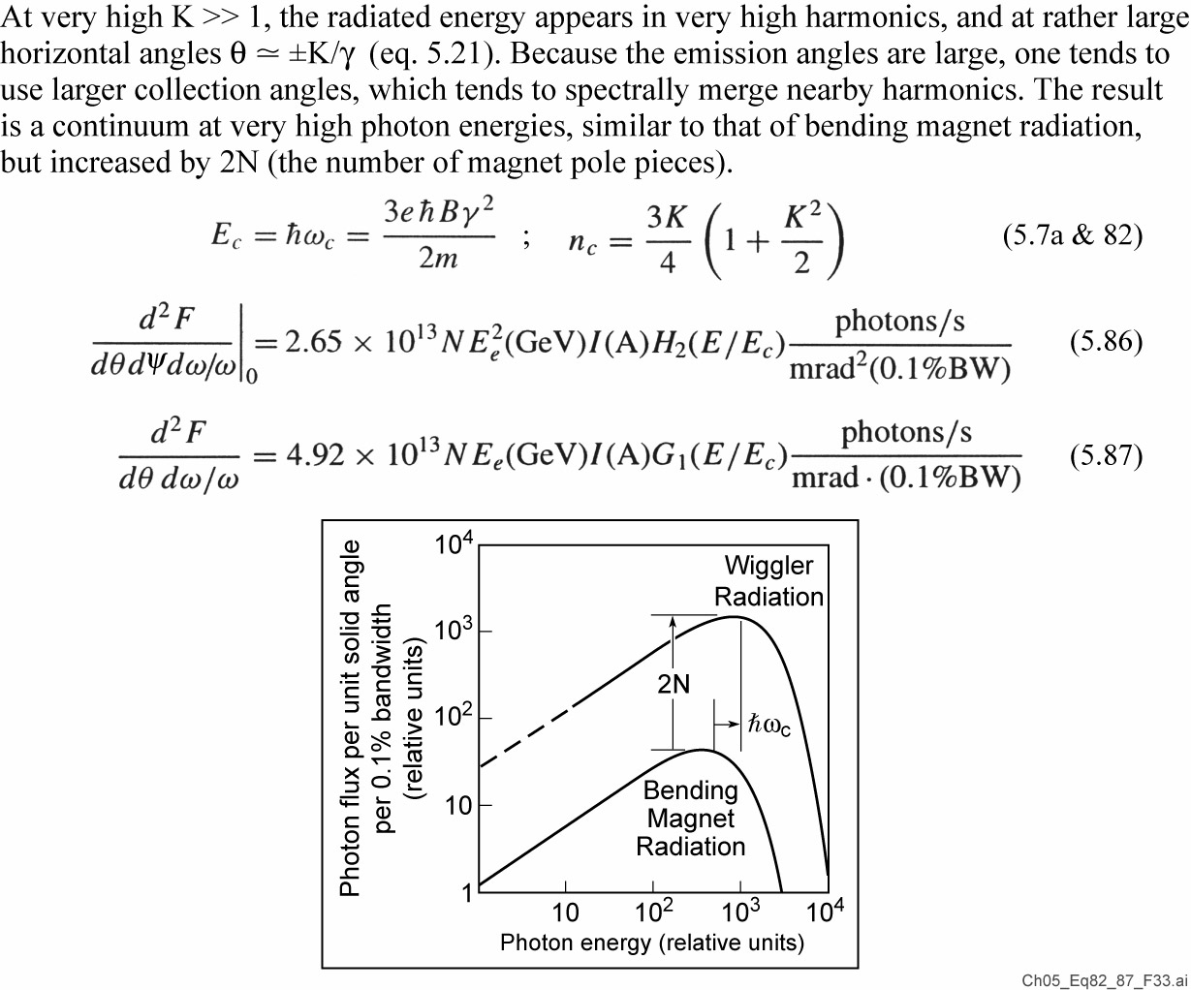
Wiggler radiation

Slide 8
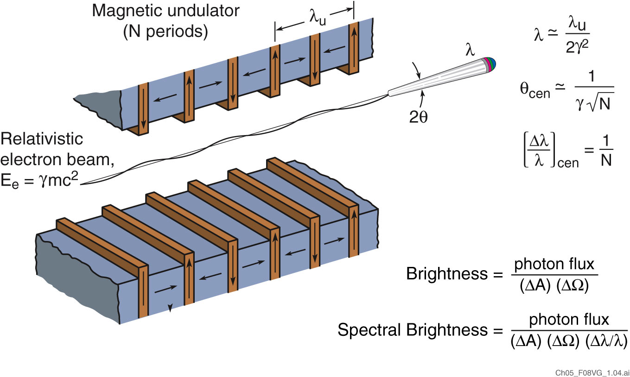
Undulator radiation from a small electron beam radiating into a narrow forward cone is very bright

Slide 9
Undulator radiation

Slide 10
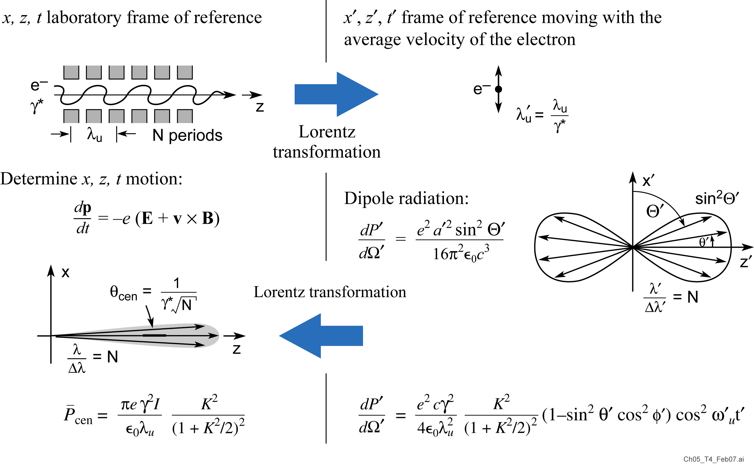
Calculating Power in the Central Radiation Cone: Using the well known “dipole radiation” formula by transforming to the frame of reference moving with the electrons

Slide 11
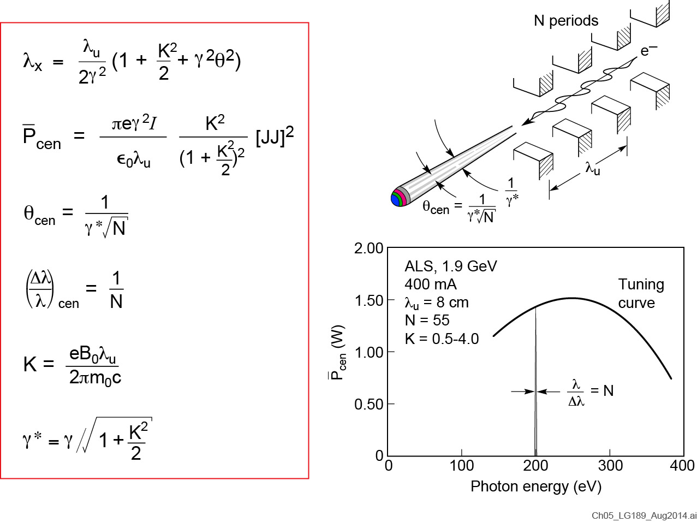
Power in the central cone

Slide 12
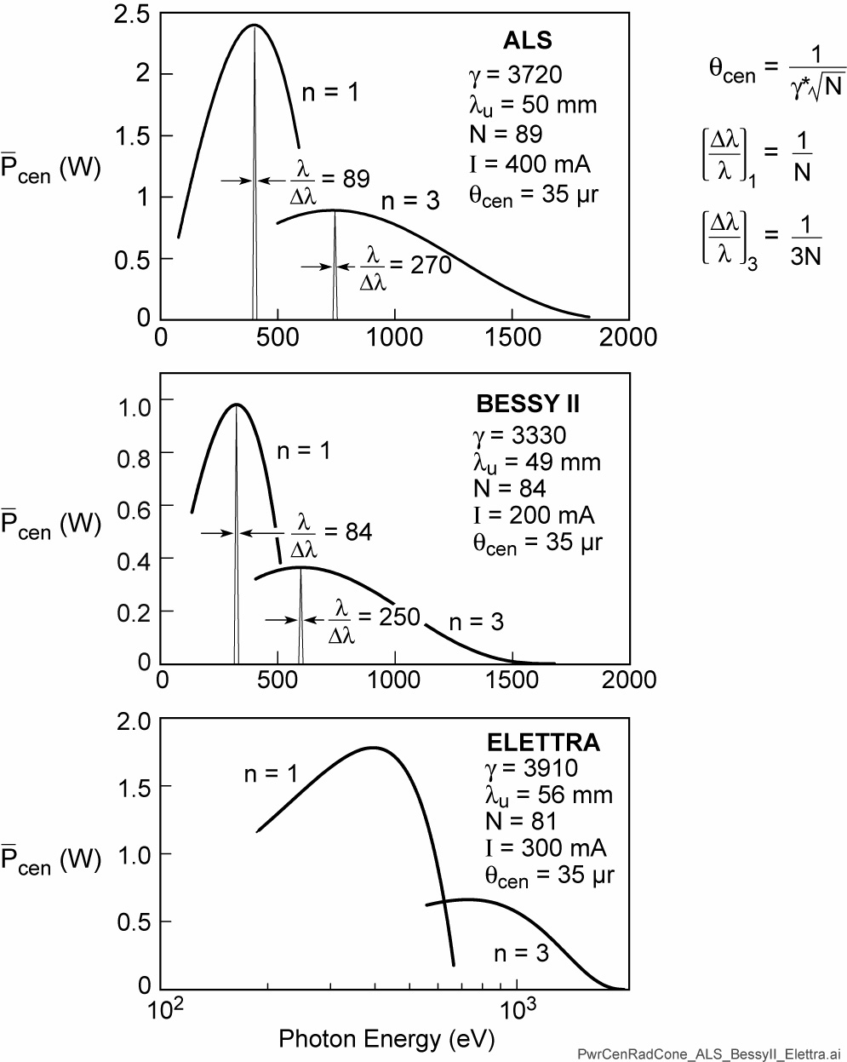
Power in the central radiation cone for three soft x-ray undulators

Slide 13
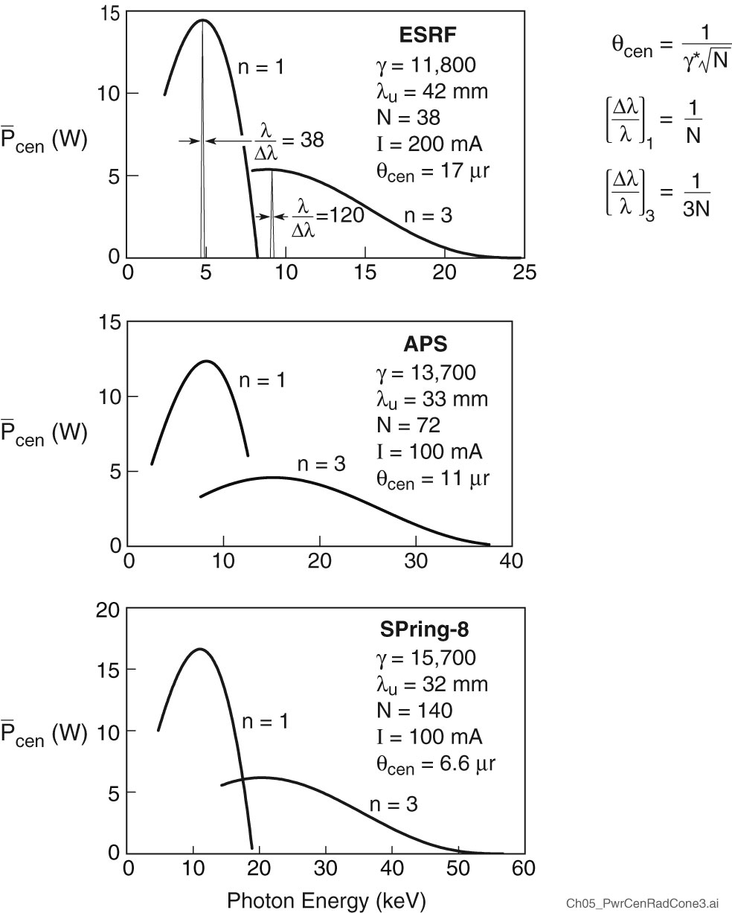
Power in the central radiation cone for three hard x-ray undulators

Slide 14
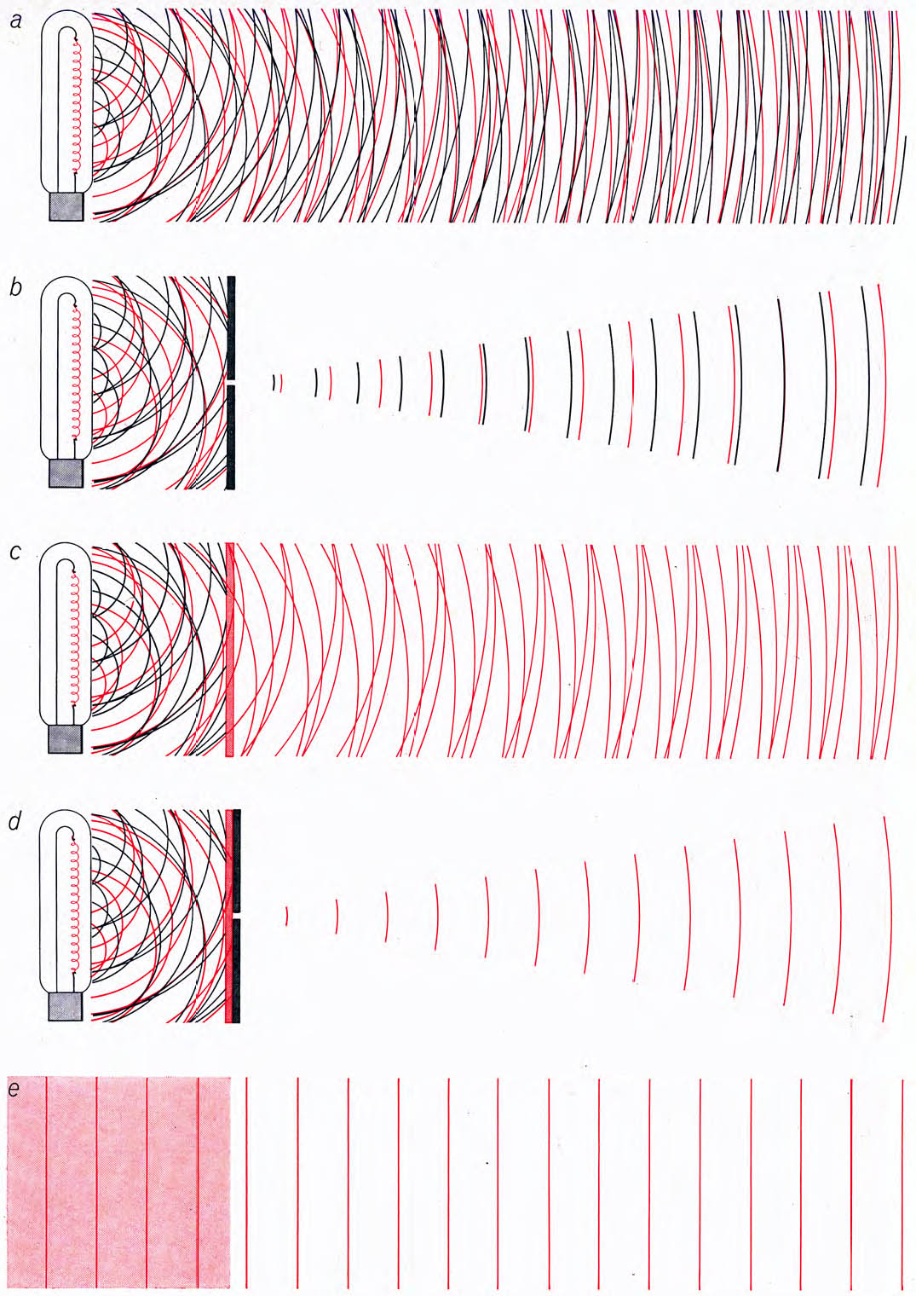
Ordinary light and laser light
Ordinary thermal light source, atoms radiate independently.
A pinhole can be used to obtain spatially coherent light, but at a great loss of power.
A color filter (or monochromator) can be used to obtain temporally coherent light, also at a great loss of power.
Pinhole and spectral filtering can be used to obtain light which is both spatially and temporally coherent but the power will be very small (tiny).
All of the laser light is both spatially and temporally coherent*.
Arthur Schawlow, “Laser Light”, Sci. Amer. 219, 120 (Sept. 1968)

Slide 15
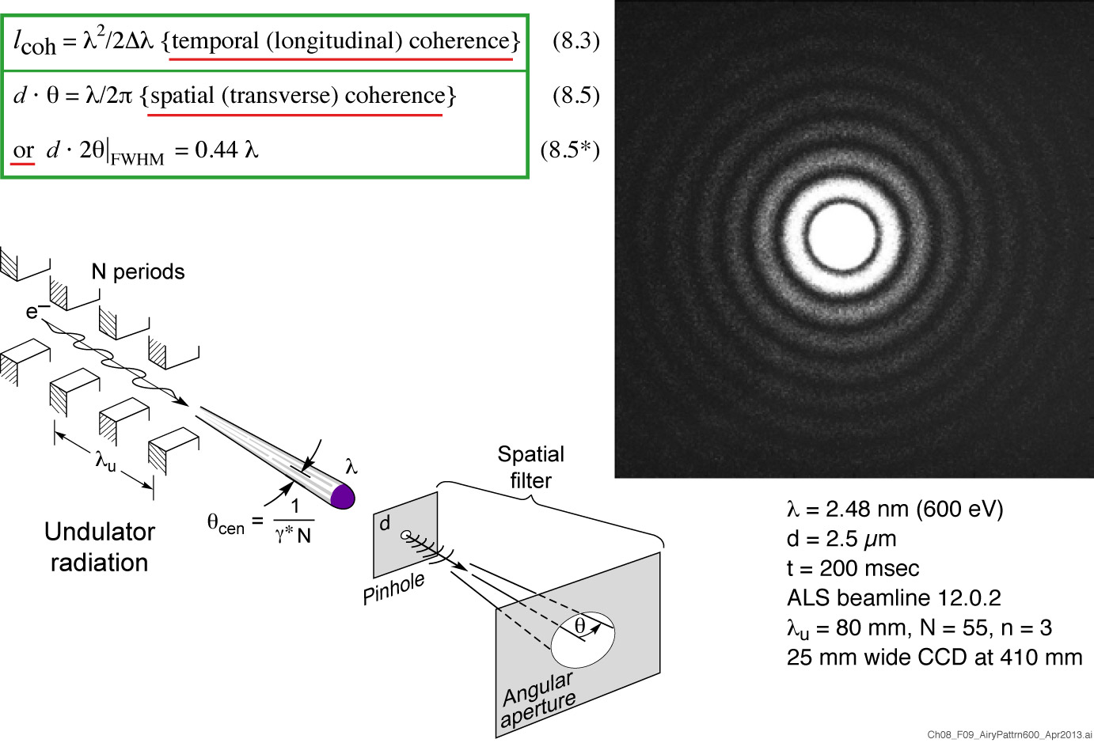
Spatially coherent undulator radiation
Courtesy of Kris Rosfjord, UCB

Slide 16
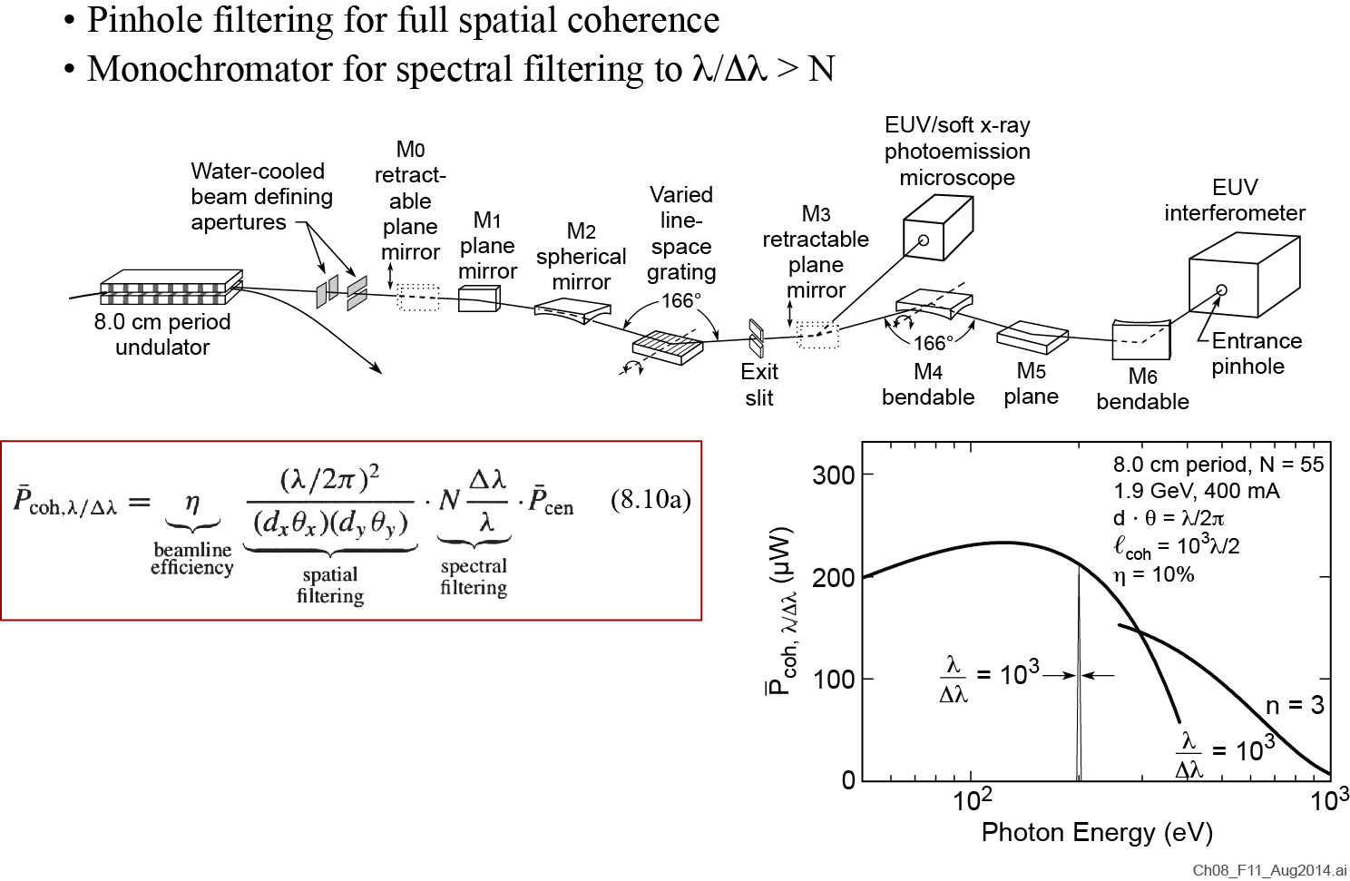
Spatially and spectrally filtered undulator radiation

Slide 17
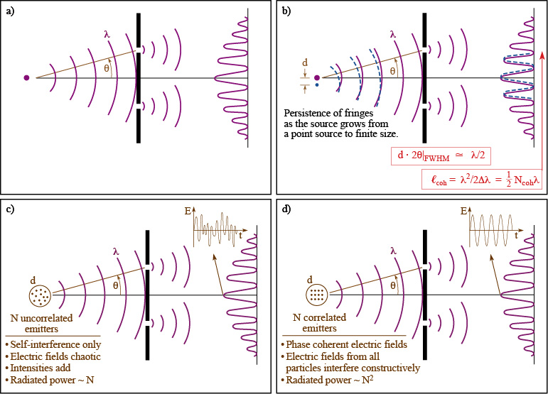
Spatial coherence and phase with Young’s double slit interferometer

Slide 18
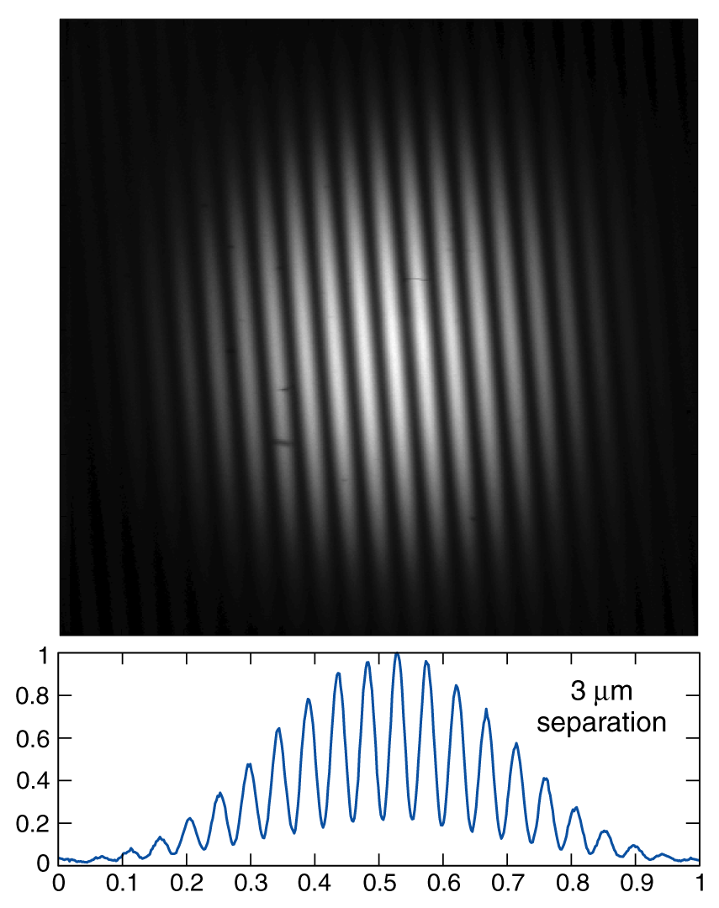
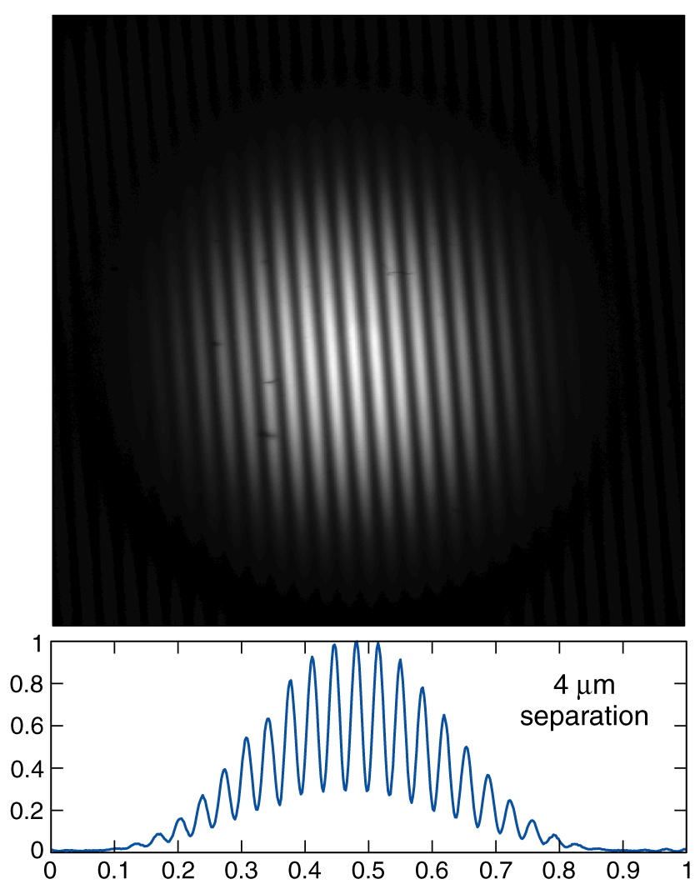
Spatial coherence measurements of undulator radiation using Young’s 2-pinhole technique
Courtesy of Chang Chang, UC Berkeley and LBNL.
λ = 13.4 nm, 450 nm diameter pinholes, 1024 x 1024 EUV/CCD at 26 cm ALS, 1.9 GeV, λ_{u} = 8 cm, N = 55

Slide 19
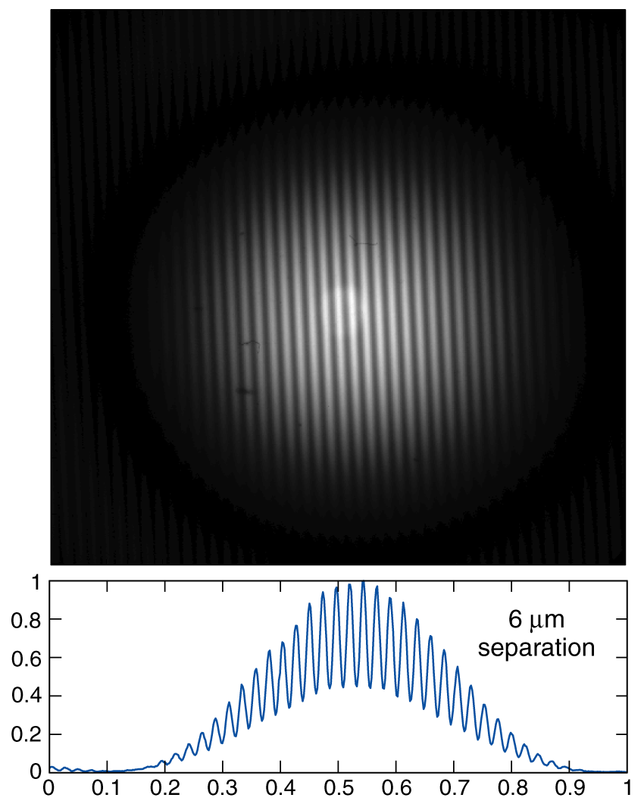
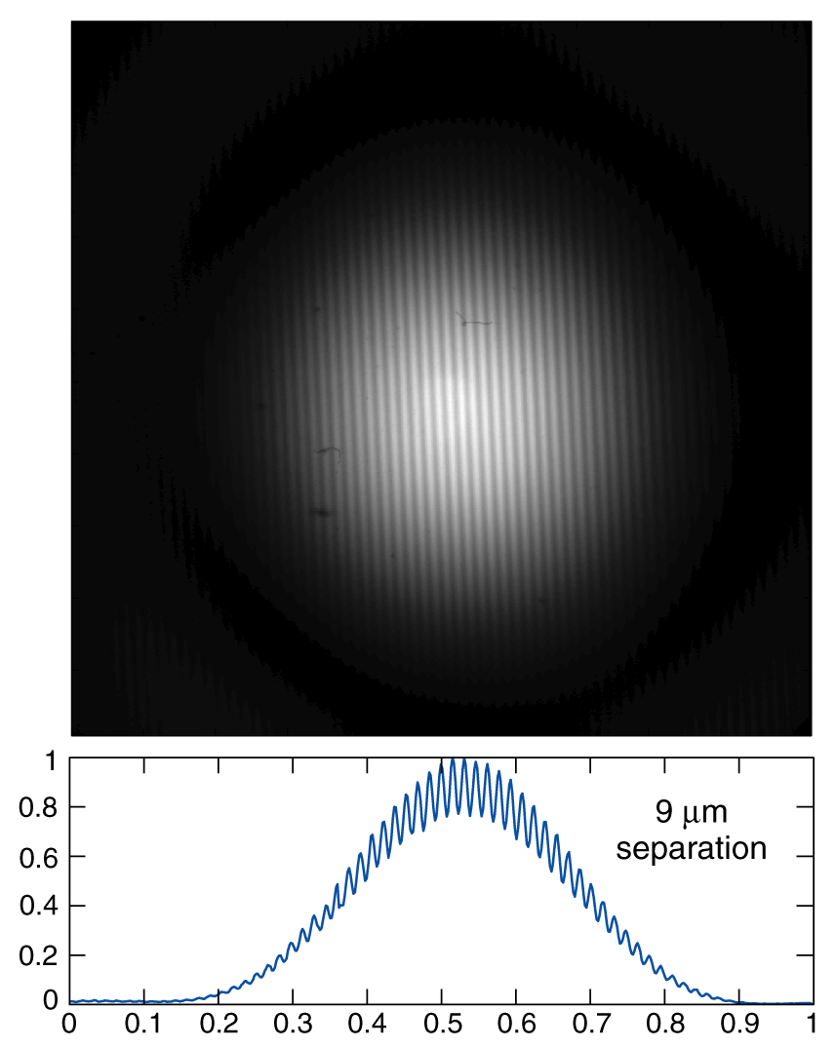
Spatial coherence measurements of undulator radiation using Young’s 2-pinhole technique
Courtesy of Chang Chang, UC Berkeley and LBNL.
λ = 13.4 nm, 450 nm diameter pinholes, 1024 x 1024 EUV/CCD at 26 cm ALS, 1.9 GeV, λ_{u} = 8 cm, N = 55

Slide 20
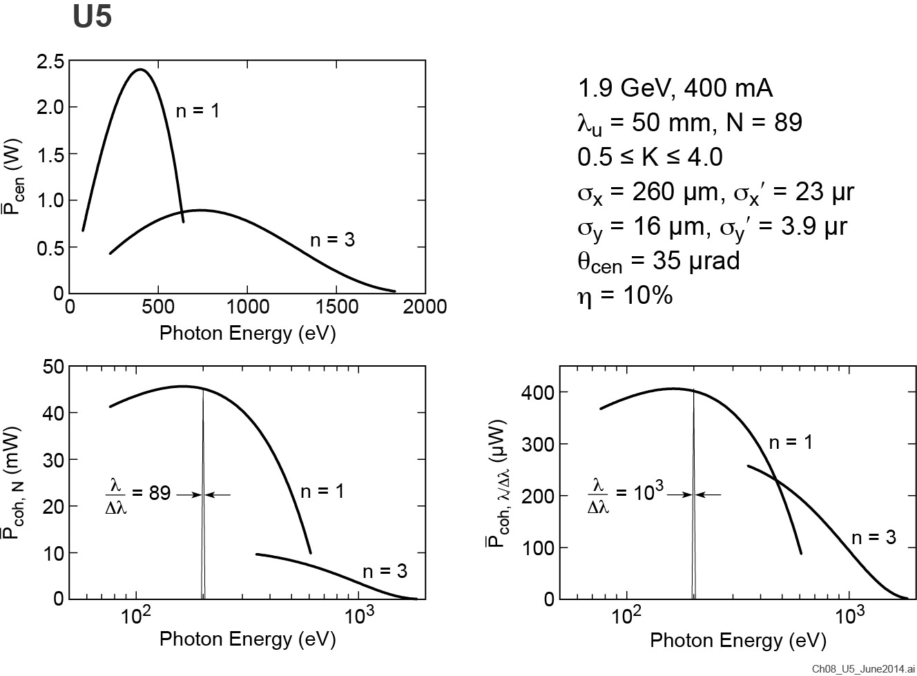
Coherent power at the ALS

Slide 21
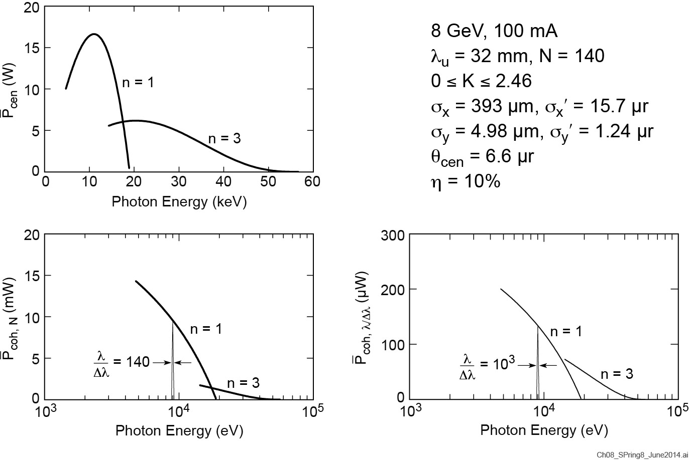
Coherent power at SPring-8

Slide 22
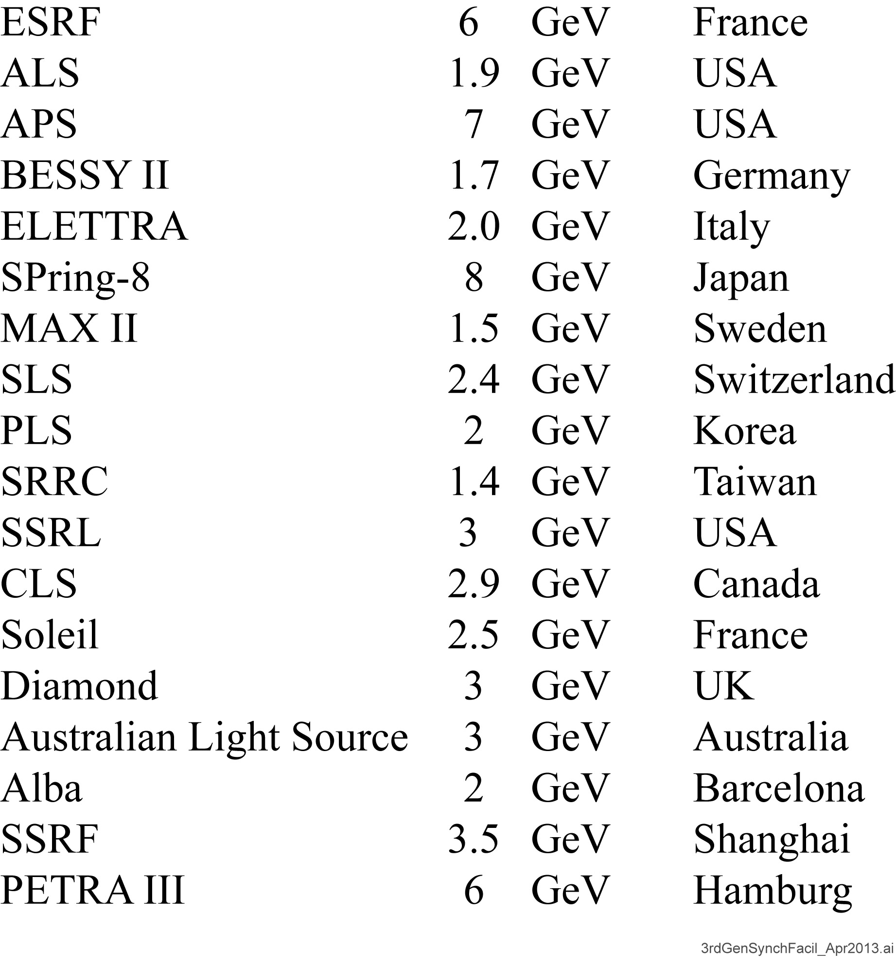
Third generation synchrotron facilities

Slide 23
Ordinary light and laser light
Ordinary thermal light source, atoms radiate independently.
A pinhole can be used to obtain spatially coherent light, but at a great loss of power.
A color filter (or monochromator) can be used to obtain temporally coherent light, also at a great loss of power.
Pinhole and spectral filtering can be used to obtain light which is both spatially and temporally coherent but the power will be very small (tiny).
All of the laser light is both spatially and temporally coherent*.
Arthur Schawlow, “Laser Light”, Sci. Amer. 219, 120 (Sept. 1968)

Slide 24
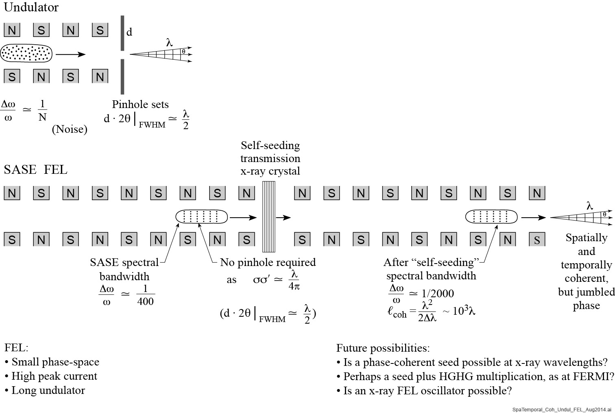
Spatial and temporal coherence with undulators and FELs

Slide 25
The bunching advantage of FELs
In an undulator with random, uncorrelated electron positions within the bunch, only the radiated self-fields E add constructively.
Coherence is somewhat limited
Power radiated is proportional to N_{e} (total # electrons)
For FEL lasing the radiated fields are strong enough to form “microbunches” within which the electron positions are well correlated. Radiated fields from these correlated electrons are in phase. The net electric field scales with N_{ej}, the # of electrons in the microbunch, and power scales with N_{ej}² times the number of microbunches, n_{j}.
Essentially full spatial coherence
Power radiated is proportional to Σn_{j}N_{ej}²; Gain ~ 3 × 10⁶

Slide 26
FEL Physics

Slide 27
Equations of motion for the stronger electric field FEL

Slide 28
Undulators and FELs

Slide 29
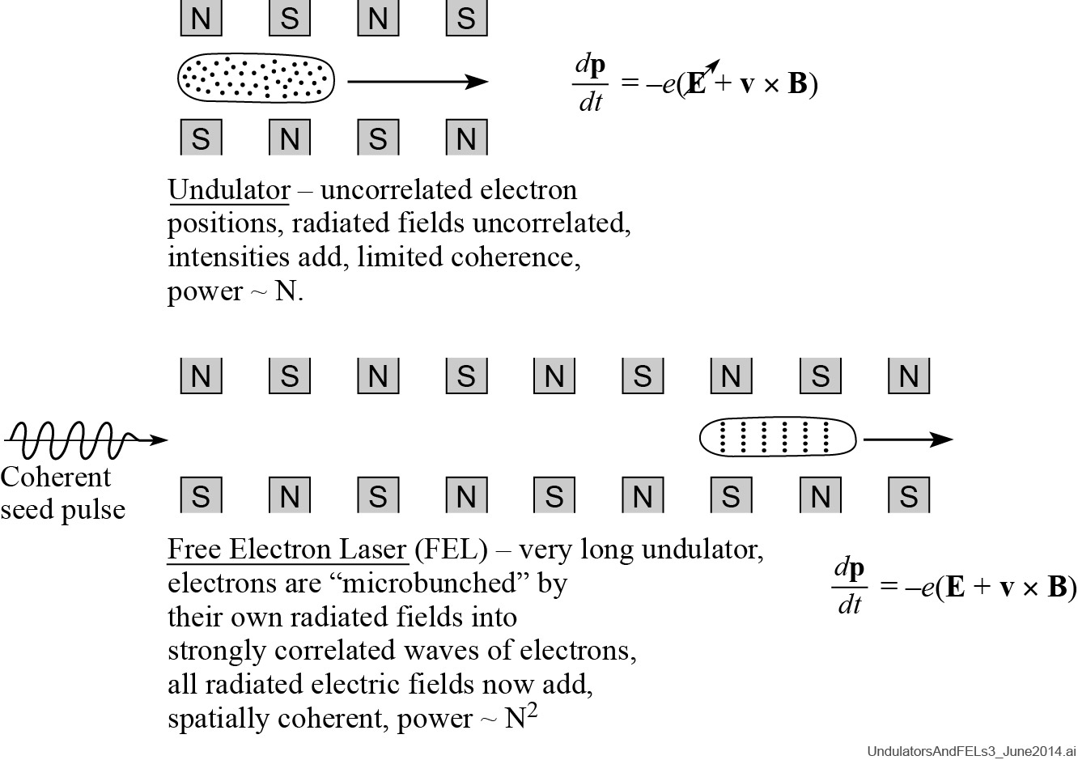
Seeded FEL
Seeded FEL. Initial bunching driven
by phase coherent seed laser pulse. Improved pulse structure and spectrum.

Slide 30
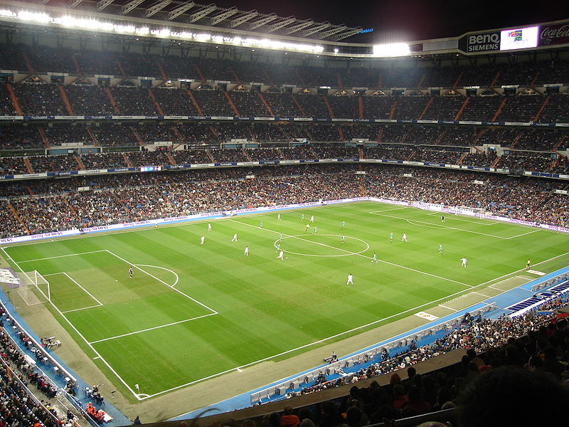
The evolution of incoherent clapping (applauding) to coherent clapping
Suggested by Hideo Kitamura, (RIKEN)

Slide 31
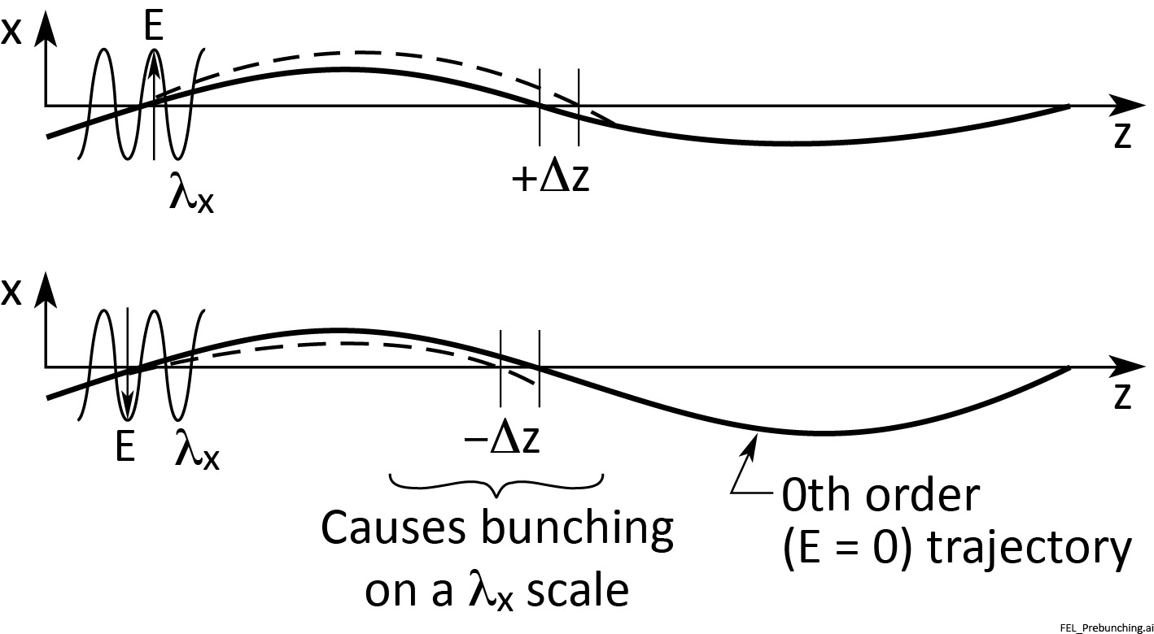
Electron energies and subsequent axis crossings are affected by the amplitude and relative phase of the co-propagating field

Slide 32
FEL Microbunching
Courtesy of Sven Reiche, UCLA, now SLS

Slide 33
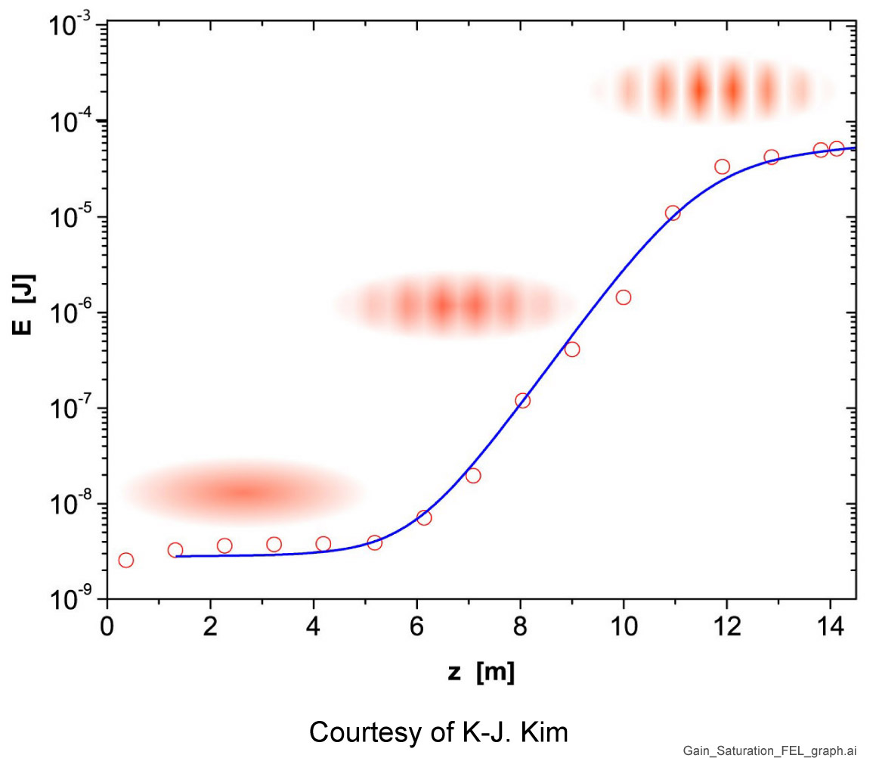
Gain and saturation in an FEL

Slide 34
FEL lasing and the parameter ρ_{FEL}

Slide 35
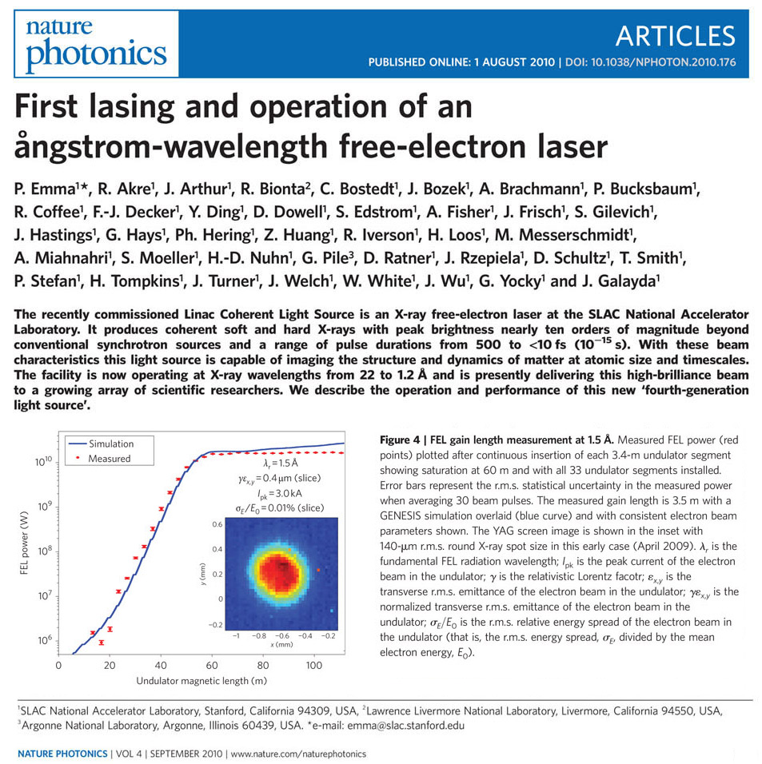
(LCLS, lasing April 2009, 1st day; saturated lasing 2009; publ. Sept. 2010)

Slide 36
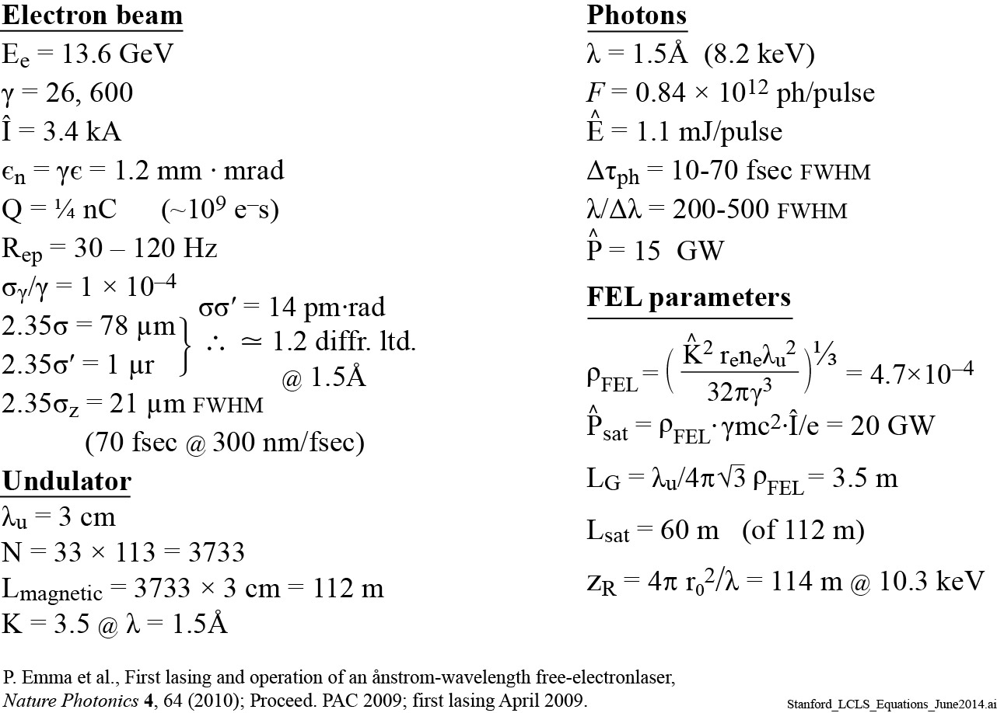
Stanford’s LCLS Free Electron Laser

Slide 37
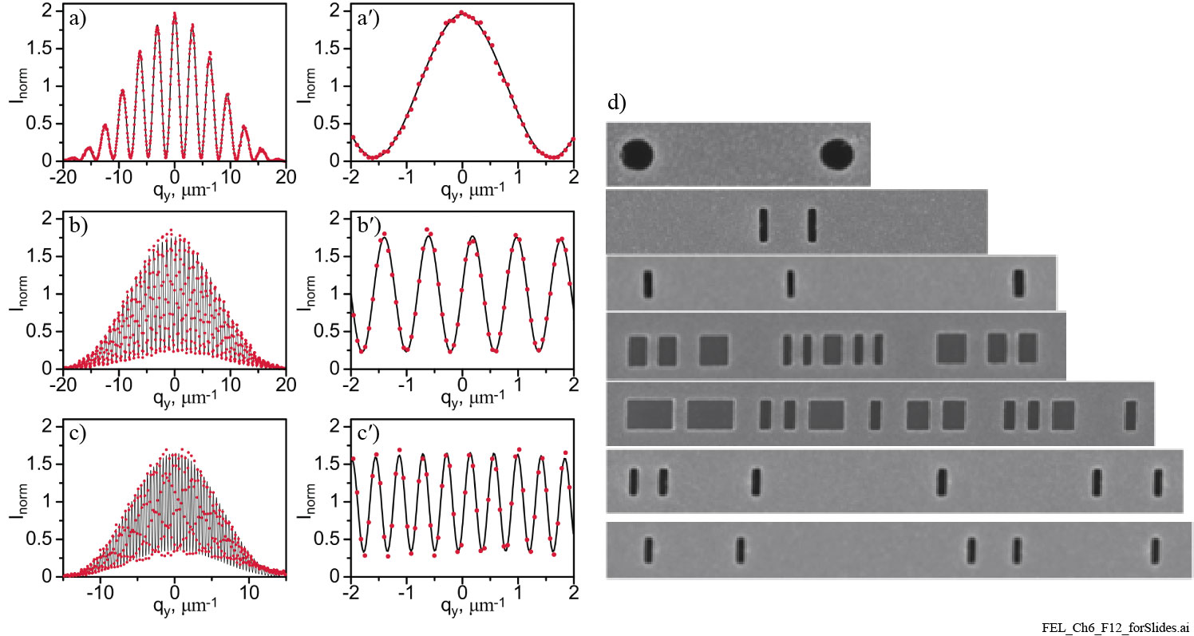
Measuring spatial coherence at LCLS
LCLS, 780 eV, 300 fsec, ¼ nC,1mJ/pulse
78% energy in TEM₀₀ mode
Courtesy of I. Vartanyants (DESY) and A. Sakdinawat (SLAC); PRL 107, 144801 (30Sept2011)

Slide 38
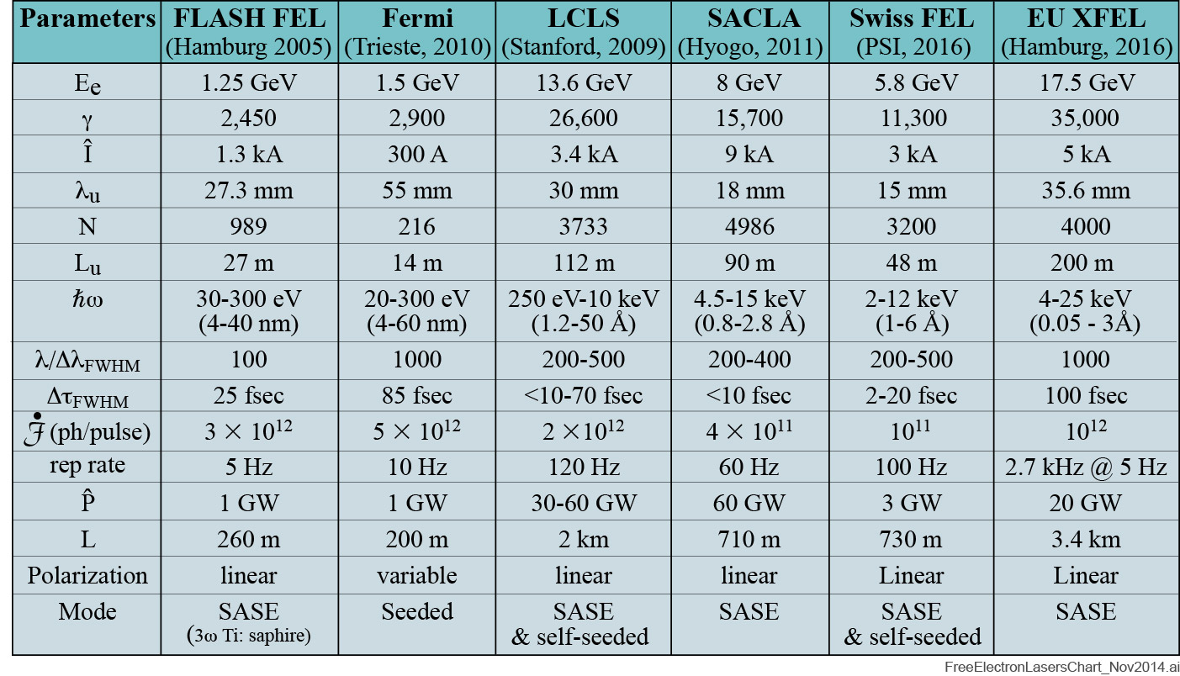
Typical FEL parameters

Slide 39
Probing matter on the scale of nanometers and femtoseconds
Science and Technology of Future Light Sources (Argonne, Brookhaven, LBNL and SLAC: Four lab report to DOE/Office of Science, Dec. 2008)

