Slide 1
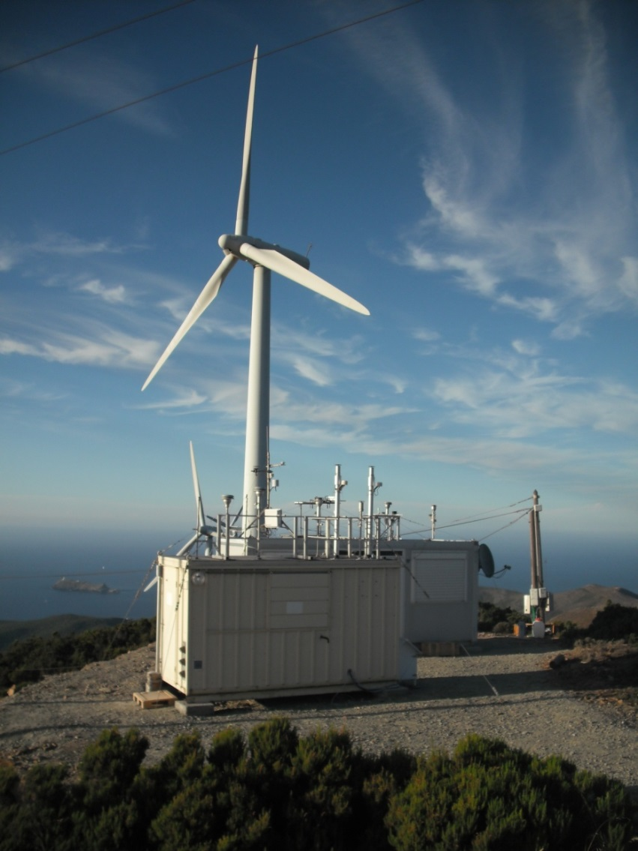








2-year observation of Organic Aerosol properties
In Cape Corsica
J. Sciare, and co-workers @ LSCE

Slide 2
Cape Corsica monitoring activities
Aerosol Chemistry by ACSM
2012
2013
2014
Instrument & Stations
failures
ACSM
Intercomparison
exercise at LSCE
ACTRIS-ACSM
Intercomparison
exercise at LSCE
Comparison with SMPS data
(2012-2014)
+ 535 days (24h) of valid ACSM data
+ A component of the ACTRIS-ACSM network (QA/QC controlled datasets)
+ A unique dataset to investigate sources (primary/secondary) and geographic origin of OA in W. Mediterranean

Slide 3
Cape Corsica monitoring activities
Aerosol Chemistry by ACSM
Concentration
µg/m³
Concentration
µg/m³
Concentration
µg/m³
Maximum of OA and SO4 during summertime (max of OA in winter in continental France)
Most the difference between PM1 and PM2.5 relies on primary natural sources (sea salt and dust)

Slide 4
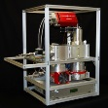
Seasonal variability of the oxidation state of Organic Aerosols (OA) in Corsica
2-year ACSM observations
Temporal variability of specific organic fragments (f44, f43) related to Acid (CO₂⁺) and non-acid (C₂H₃O⁺ & C₃H₇⁺) OOA
Kroll et al., Carbon oxidation state (OSc) as a metric for describing
the chemistry of atmospheric organic aerosol, Nature, 2011
1. Highly oxidized OA for 6 months of the year (from April to August)
2. Less oxidized OA for 3 months of the year (from November to January)
= oxidation State of OA

Slide 5
Seasonal variability of the oxidation state of Organic Aerosols (OA) in Corsica
f44 (Acid fragment in OOA)
LV -OOA
Max OSc = August
Min OSc = November
SV-OOA
f43 (non-acid fragment in OOA)
Triangle plot from Ng et al. (ACP, 2010)
LV –OOA : Low volatile (aged) oxidized OA
SV-OOA : Semi-volatile (fresh) oxidized OA

Slide 6
Seasonal variability of
OA sources in Corsica
Seasonal variation of HOA and OOA
(results from 15-month observations)
On a yearly average
HOA = Hydrogen-Like Organic Aerosol
primary –combustion- aerosols)
OOA = Oxygen-Like Organic Aerosol
(secondary OA)
OOA
70% of OA during winter months
85% of OA during summer months

Slide 7
Oxidation state of in Corsica:
Focus on the Summer 2013 campaign
Aerosol chemical composition in PM₁
determined by the ACSM
ADRIMED
SAFMED
f₄₄ (Acid OOA)
f₄₃ (Non-Acid OOA)
⇒ A factor 10 in the variability of OA concentrations BUT oxidation state of OA (f44, f43) remains very high and poorly variable (few percents)

Slide 8
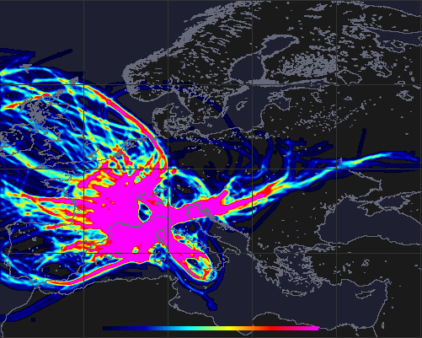
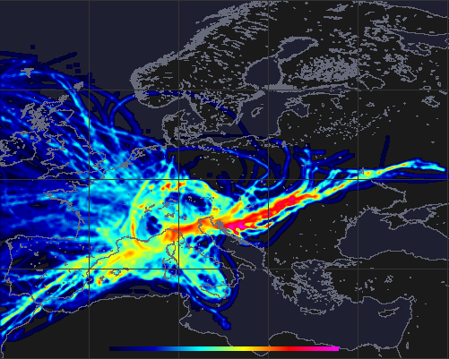
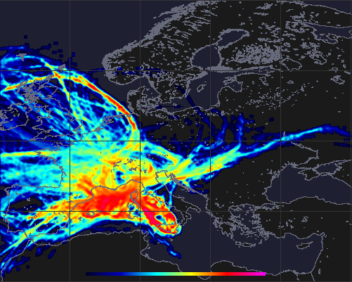
Oxidation state of in Corsica:
Focus on the Summer 2013 campaign
POLTRACK V1.0.2 beta Quick Source mapper
Date: 05/06-05/08/2013 / Hourly mean data / Hysplit – GDAS data
Restricting data to air masses lower than 1000m / Reject backtrajectories: less 2 per 0.1°x0.1° grid cell
Smoothing Kernel-Gaussian function: 5
Occurrence of air masses
Organic Aerosol sources
([OA])
Organic Aerosol oxidation state
(OSc)
Scale Nb Occurrence 0 – 5
Scale [OM] = 0 - 5µg/m³
Scale OSc 0 – 1
⇒ The largest emitting OA region influencing Cape Corsica during summer 2013 are continental originating from Italy and Central/Eastern Europe
⇒ The most oxidized OA are found for marine (highly processed) air masses (e.g. not fed by continental emissions)

Slide 9
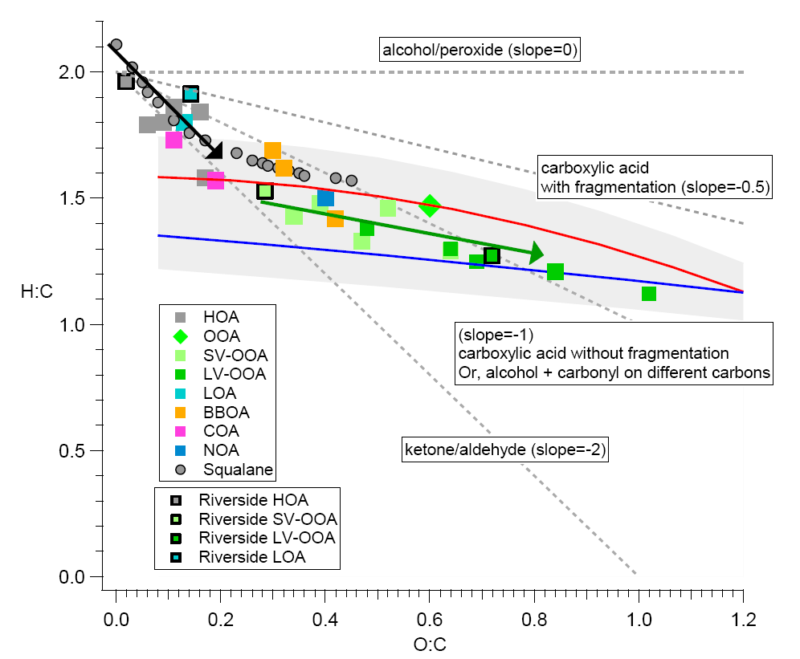
ACSM – Oxidation State of OA
f₄₄ (Acid OOA)
10:00 LT (morning)
21:00 LT (evening)
f₄₃ (Non-Acid OOA)
⇒ Photochemically-induced formation/destruction of non-acid OOA (f₄₃)
⇒ Photochemically-induced formation of acid OOA (f₄₄). Possibly with fragmentation

Slide 10
Conclusions
From the 2-year observation of PM1 chemical composition with ACSM at Cape Corsica …
Ambient chemical composition of PM₁ a factor of 3 lower from compared to Northern France
Highly oxidized OA in Cape Corsica all over the year (70% during winter to up to 85% of OA in summer)
Seasonal cycles of OA and SO₄ (max in summer) in opposite phase compare to Northern France
Seasonal cycle of the oxidation state of OA with minima in November and constant increase
During the SAFMED (summer 2013) campaign …
July 2013 characterized by the highest PM1, OA, and SO₄ levels observed from mid-2012 till mid-2014 (apart from the pollution episod observed in March 2014)
Stable oxidation state of OA (independent of air masses origin) although [OA] have shown variability of a factor of 10
Evidence of continental emissions of OA and higher oxidation state above the marine areas
Diurnal variability in opposite phase for f₄₄ and f₄₃ (e.g. photochemically locally induced formation/destruction of non-acid OOA) concomittant with a decrease in the OM/OC ratio (seen by two different approaches)

