Slide 1
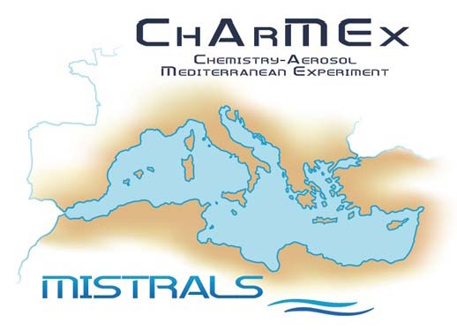



Atmospheric monitoring activities in Cyprus
Kleanthous, S., Vrekoussis, M., Mihalopoulos, N., R. Mamouri

Slide 2

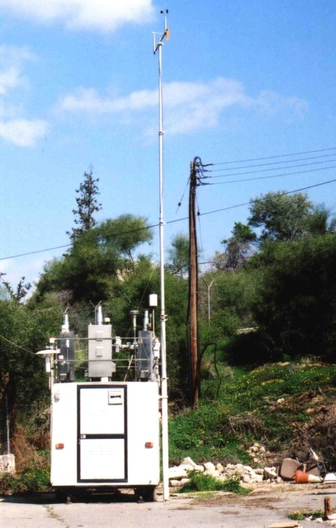
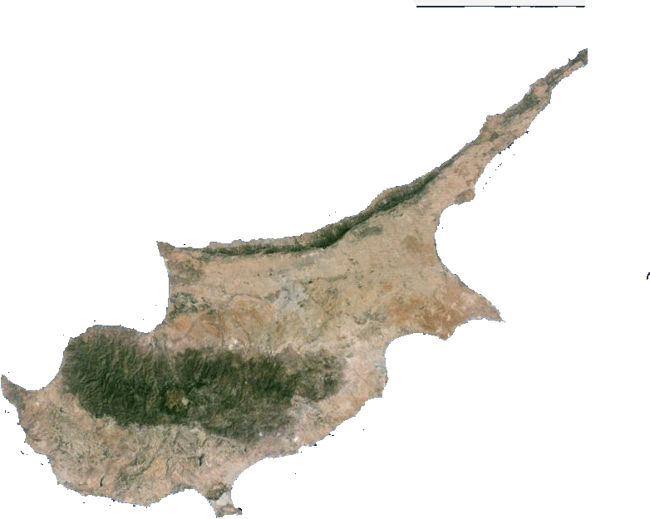
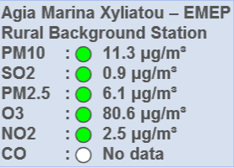
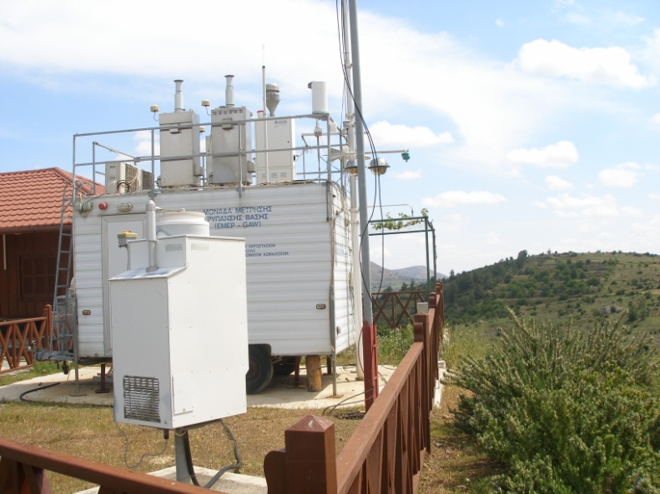
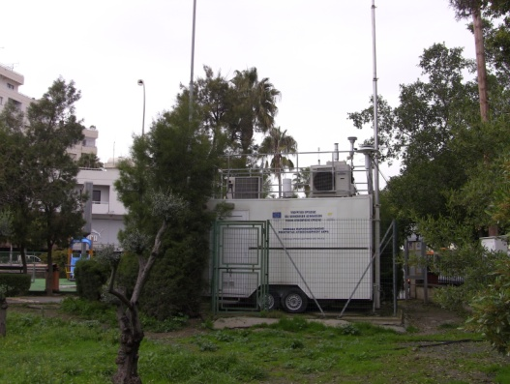
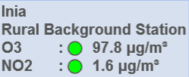
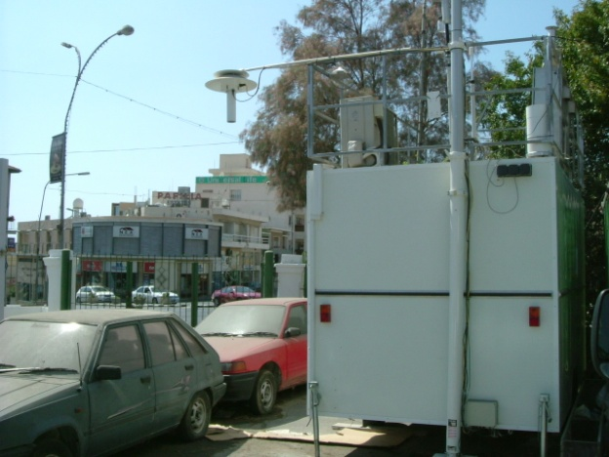
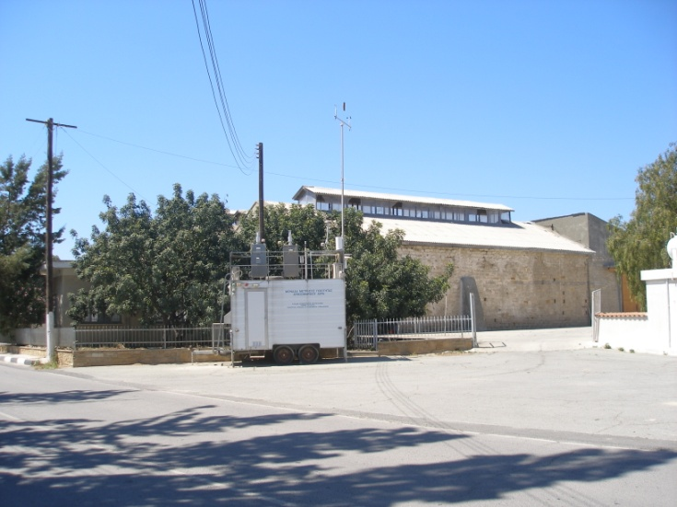
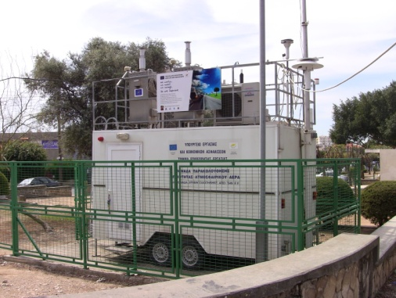
The Air quality Network in Cyprus
Nicosia
Ag. Marina
Inia
Larnaca
Paphos
Zygi
Limassol
http://www.airquality.dli.mlsi.gov.cy/Default.aspx

Slide 3
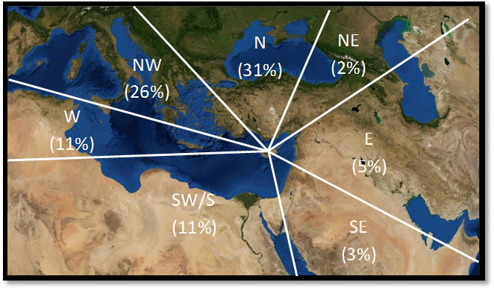
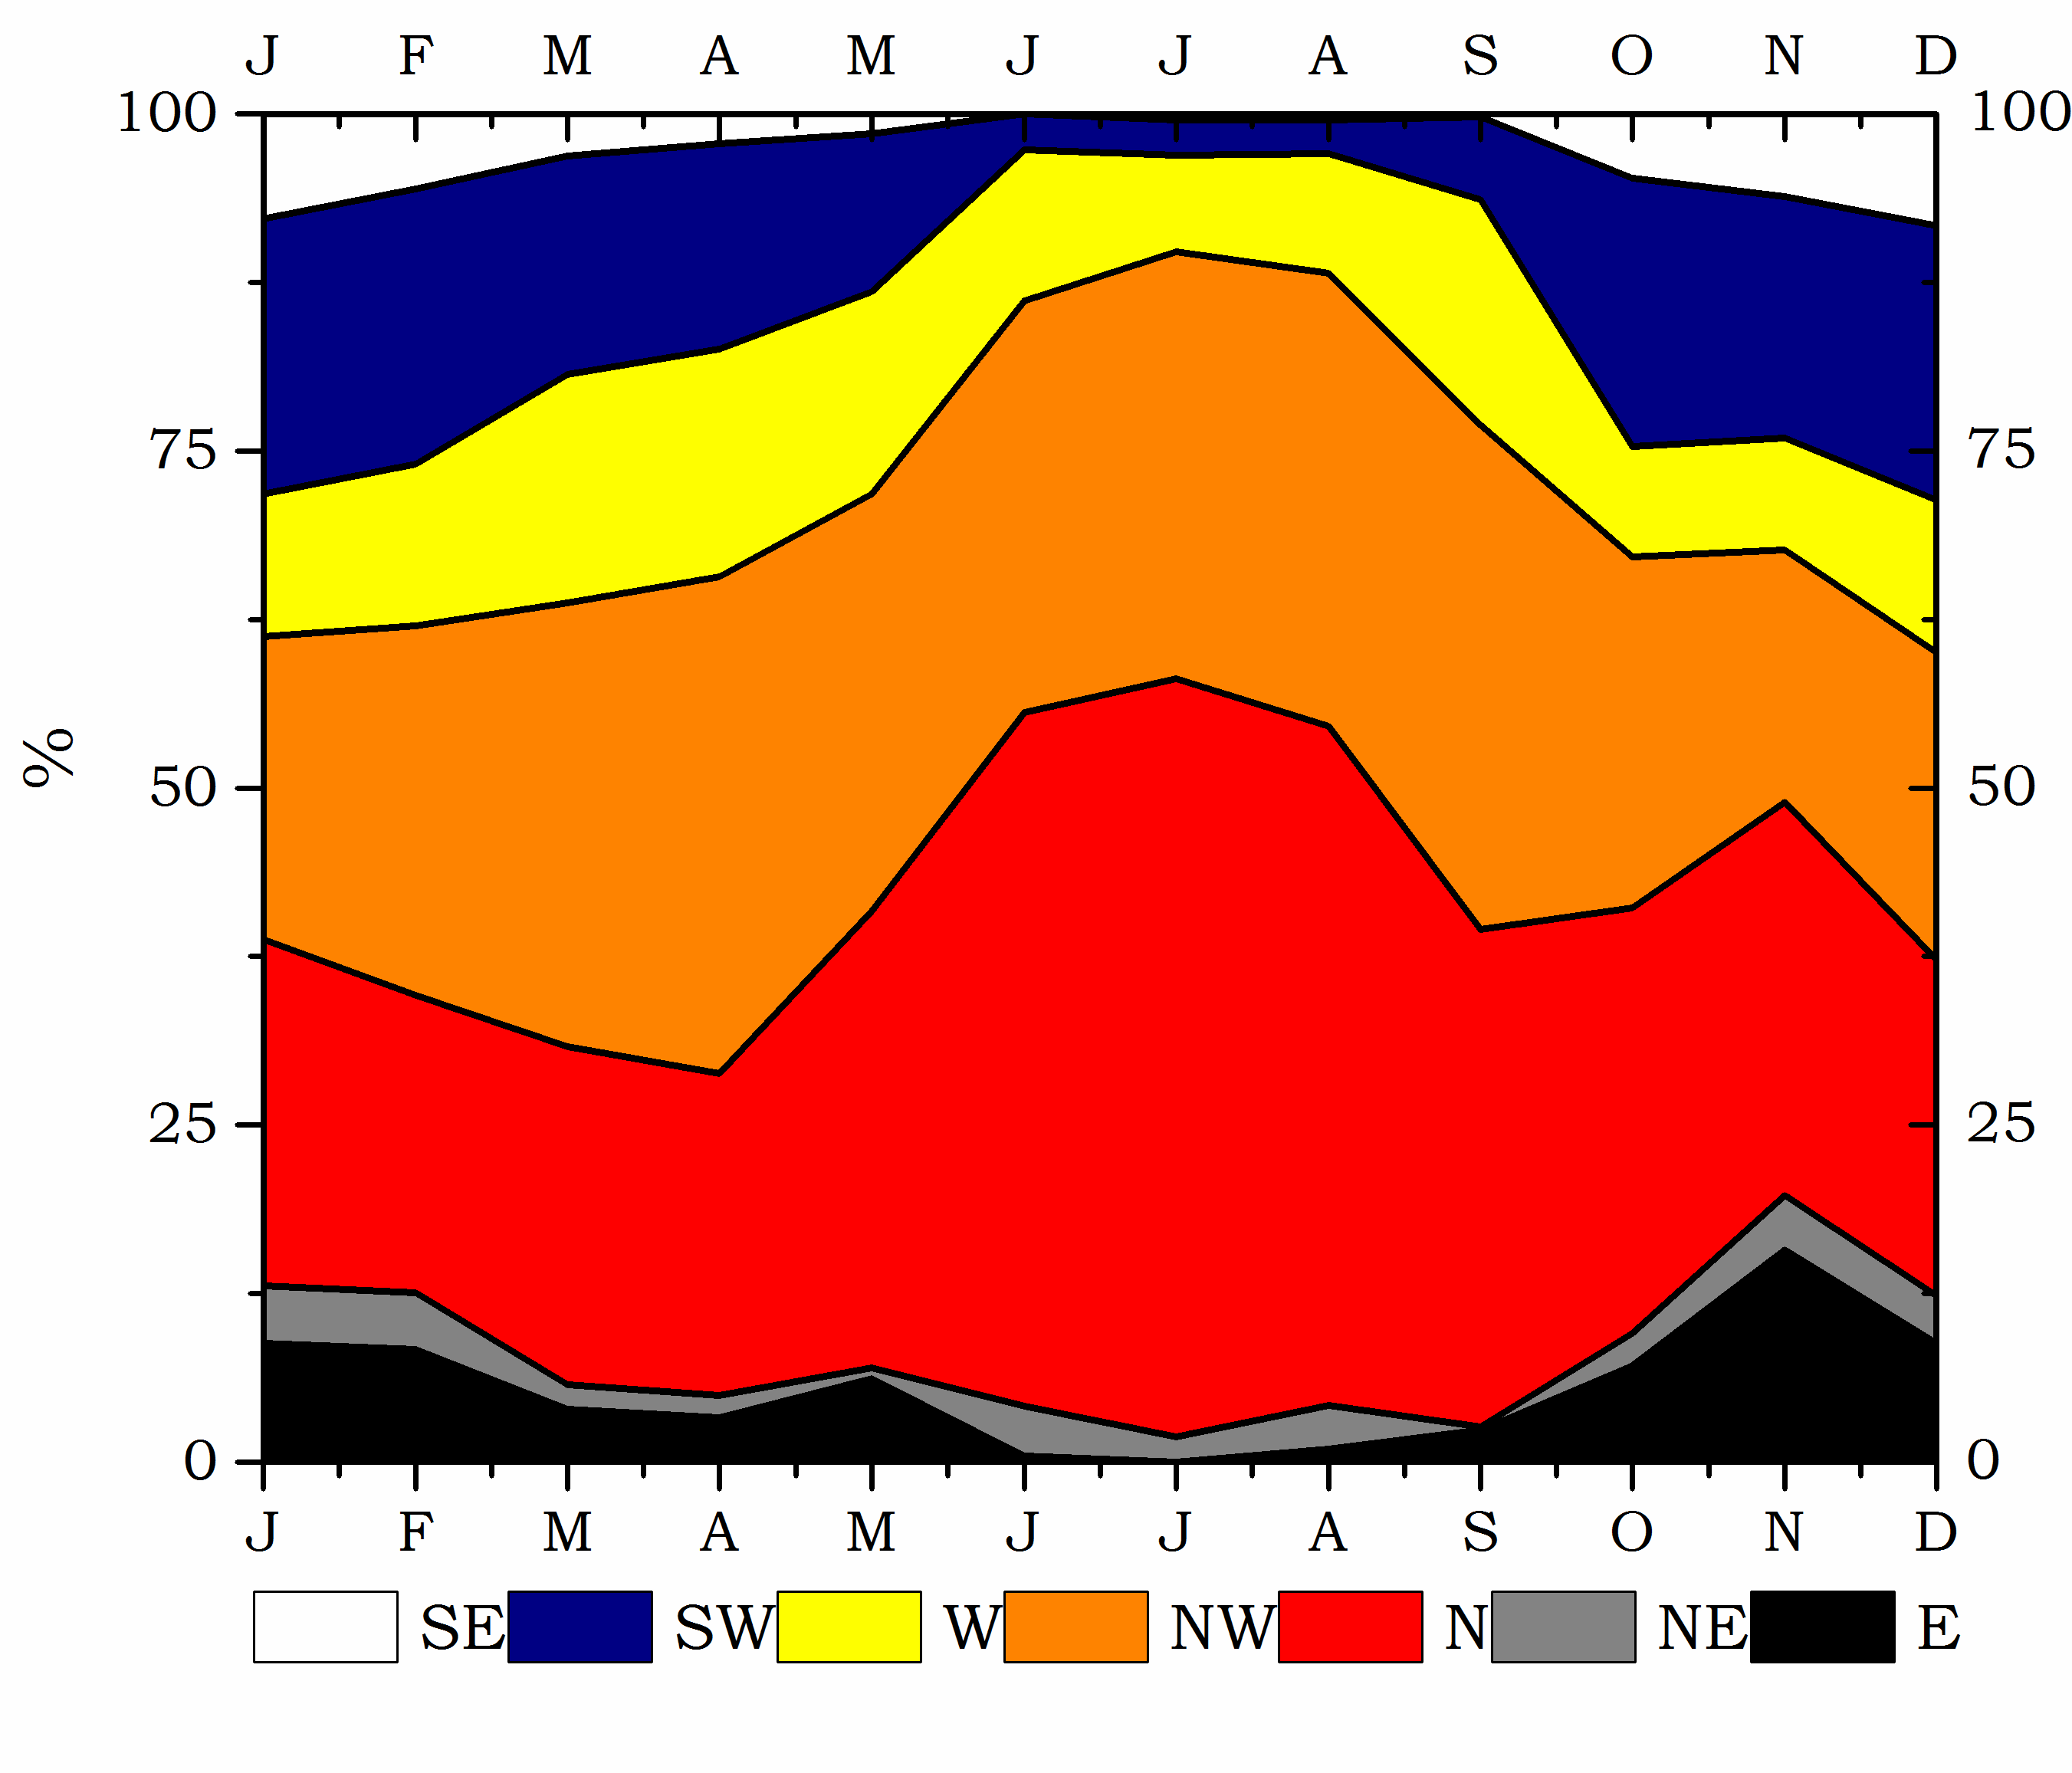
Air masses origin in Cyprus
EMEP atmospheric supersite
Agia Marina Xyliatou, Cyprus
Important contributions from W. Europe and E. Europe (+Turkey) sectors.
Middle East air masses observed during the fall/winter period
Middle East ∼20%
Origin of air masses in Cyprus
(Agia Marina Xyliatou Station; 15-year climatology)
from Kleanthous et al., 2014
from Kleanthous et al., 2014
E. Europe ∼ 50%
during summertime
W. Europe ∼ 25%
on a yearly average

Slide 4
A 15-year record of PM in Cyprus
EMEP atmospheric supersite
Agia Marina Xyliatou, Cyprus
High levels of PM10, with among the highest dust concentrations in the Mediterranean
Yearly average PM₁₀ Cape Corsica
Cape Corsica
  A clear West-to-East gradient of dust aerosols
  Cyprus>Crete>Corsica
Kleanthous, Mihalopoulos, Vrekoussis, Sciare, unpublished data, 2014

Slide 5
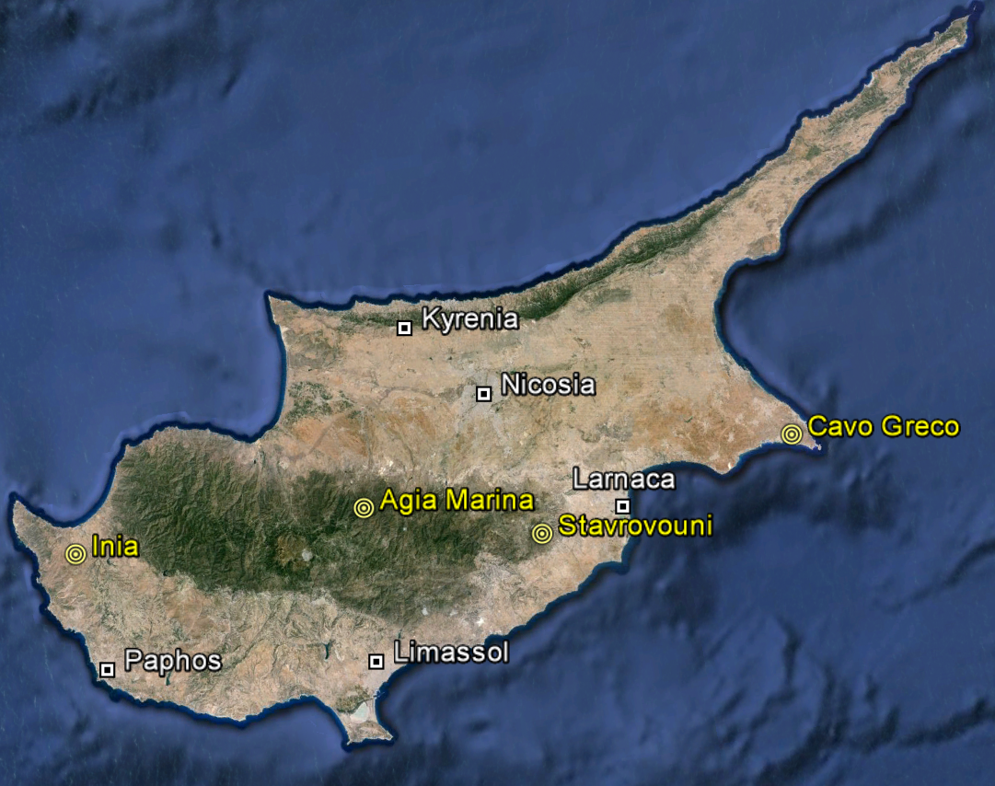
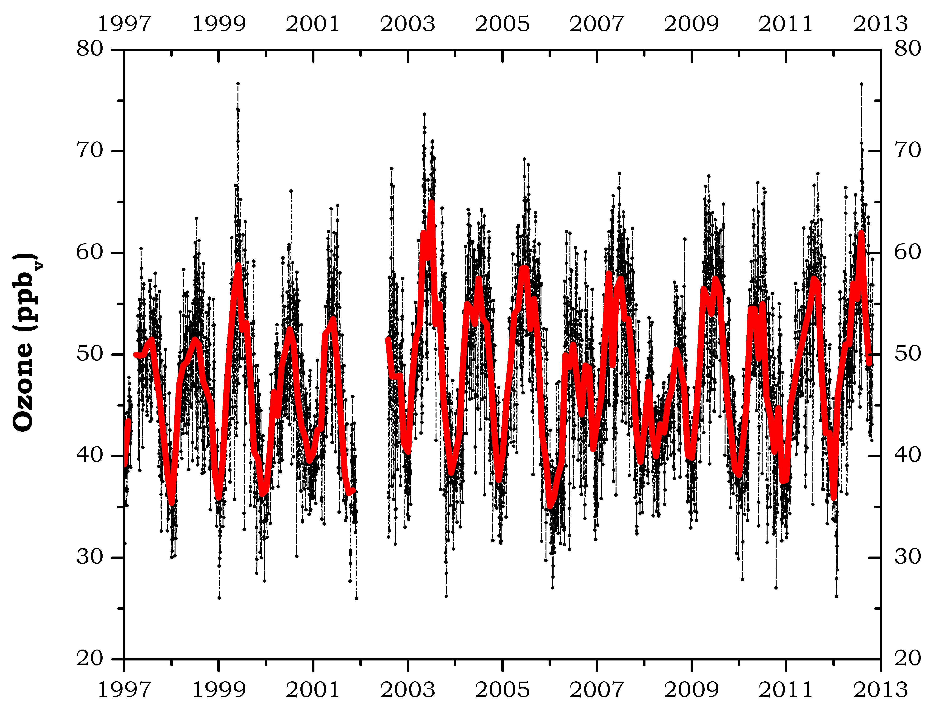
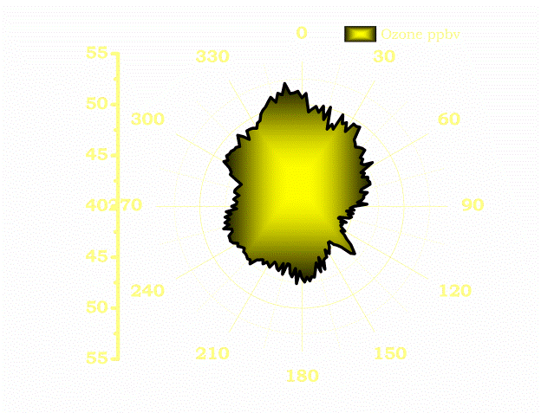
A 15-year record of O3 in Cyprus
EMEP atmospheric supersite
Agia Marina Xyliatou, Cyprus
Among the highest O3 levels in the Mediterranean
Yearly average O₃ Cape Corsica

Slide 6
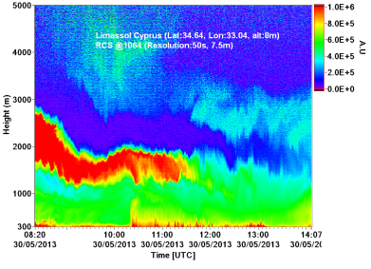
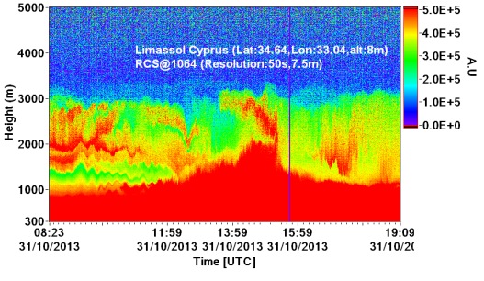
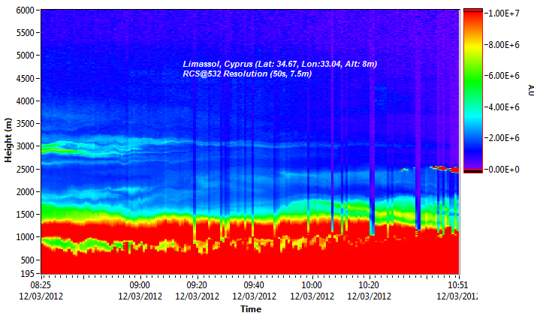


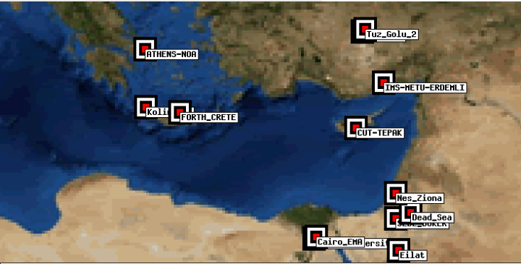
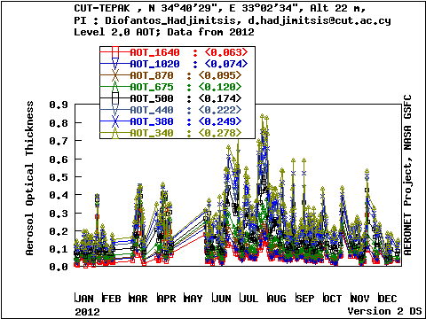
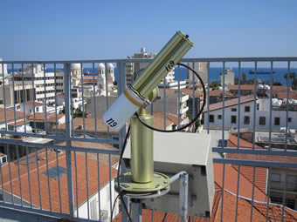
Aerosol Vertical Observations
A large variability of dust events from different origins (Africa, Saudi Arabia)
Western Saharan Desert
Middle East Desert
Eastern Saharan Desert
Cyprus University of Technology
Laboratory of Atmospheric Physics and Remote Sensing
CUT-TEPAK AERONET station
EARLINET depolarization Lidar system

