Slide 1
Calculus for Coloring
Prof. Juan López Linares FZEA-USP, D. de Ciências Básicas, Pirassununga, São Paulo, BRASIL E-mail: jlopez@usp.br

Slide 2
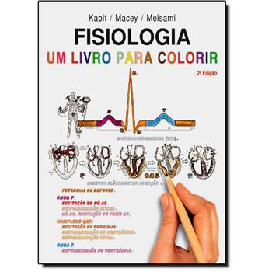
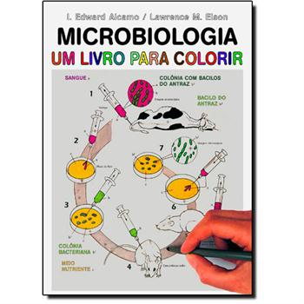
Motivation

Slide 3
Calculus:
Why not?

Slide 4
Why coloring?
Help focus in details.
Active learning: hands and mind must be coordinated. Help Memorization.
More beautiful.
Unique (each one choose his colors).
Better when color are associated with concepts.

Slide 5
Text

Slide 6
For Coloring

Slide 7
Colored

Slide 8
Evaluations
Two surveys: one in 2010 with 77 students of Calculus III and the second in 2013 with 80 students of Calculus IV.
Both cases they found it the method helpful for studying.

Slide 9
Publications
Sergio Adriani David, C. Valentim e J. López, Calculus for Coloring, Creative Education, Vol.4, No.4, 254-258, April (2013). http://www.scirp.org/journal/ce/, DOI:10.4236/ce.2013.44037
Estudantes e professores com cadastro no site de Aprendizado Eletrônico da USP Tidia-Ae (http://tidia-ae.usp.br/portal) podem inscrever-se no curso “Cálculo para Colorir” e ter acesso gratuito a todas as lâminas: de texto, para colorir e coloridas.

