Slide 1
Using Moodle in Physics Learning at UNAH Physics II Science and Engineering
BSc. Roberto Mejia
Teaching Physics – Masters Program in Physics

Slide 2
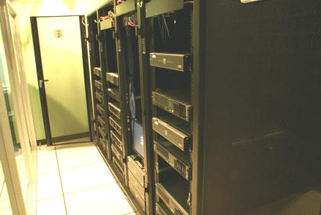
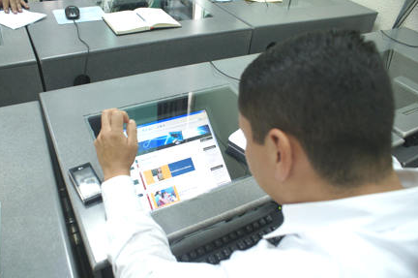
Overview
Project Description
Objectives
Results
Project Methodology
The Course
Conclusion
Servers at Dirección de Innovación Educativa
DIE- UNAH
Users and Students taking academic courses on moodle

Slide 3
Project Description
Objectives
Develop a support tool to meet the demand of students in Physics II
Use audiovisual and interactive media to achieve meaningful learning
Results
Ensures long enough to cover the course topics
Create an interactive environment between the participants
Support classroom courses through virtual laboratories and audiovisual tools

Slide 4
Procedure/Methodology
Development of a job template for the preparation of contents
Unit 1: Presentation Files\GI_U1_T2 Fisica General II 100613.docx
Adaptation of educational videos created by the school and produced by physical UNAH-TV
Unit 1: Presentation Files\FS-200 Video 12.docx
Unit 1: Presentation Files\FS-200 Video 13.docx
Unit 1: Presentation Files\FS-200 Video 20.docx
Evaluations using online forums, interactive videos, problem solving
Creating a virtual classroom that allows interaction between participants and the tutor

Slide 5
The Course
Creators
Eiby Alvarado
María Mejía
Oscar Ocampo
Roberto Mejía
Students of Physics Master Degree Program at UNAH – 2013
Link of the Course
https://www.campusvirtual.unah.edu.hn/die/moodle/course/view.php?id=763

Slide 6
Conclusions
The creation of an online course for the subject of physics II allows adapting a methodology and interactive audiovisual content that enriches Physics II course offered at UNAH
The assistance of an online tutor allows all participants to evacuate most of the questions that traditionally have not fully accomplished in person
The creation of educational videos improves the learning issues that have presented difficulties for students in physics II at UNAH

Slide 7
Questions and Discussion
Any Questions?

