Slide 1


A Blended
Introductory Physics
Course & Lab
Supported by the Gates Foundation & NSF (DUE-0942076)
Notes:
Computational Modeling is using computers to solve problems.
We want to AUGMENT modeling instruction with computational modeling.

Slide 2
Opportunities
+ Incorporate Reforms (Content)
+ Improve On-Campus Learning
+ Advance K-12 Learning
(Beyond “AP”)

Slide 3
General Education
+ Foundational
+ Large-Enrollment (On-Campus)
+ Traditionally “Low-Success”

Slide 4
GT Blended Course with MOOC Content
On-line: Lectures, Homework, Labs, Forum
On-campus:

Slide 5
Discussion Question
Scenario: Your large lecture (200-student)
on-campus lab science course will use online content (lectures and labs).
What will you do in-class?
What’s the main purpose of the lab?

Slide 6
GT Blended Course with MOOC Content
On-line: Lectures, Homework, Labs, Forum
On-campus:
+ Small Group Guided Problem Solving
+ Scientific Communication/Evaluation

Slide 7


Slide 8


(a web cam works, too.)

Slide 9
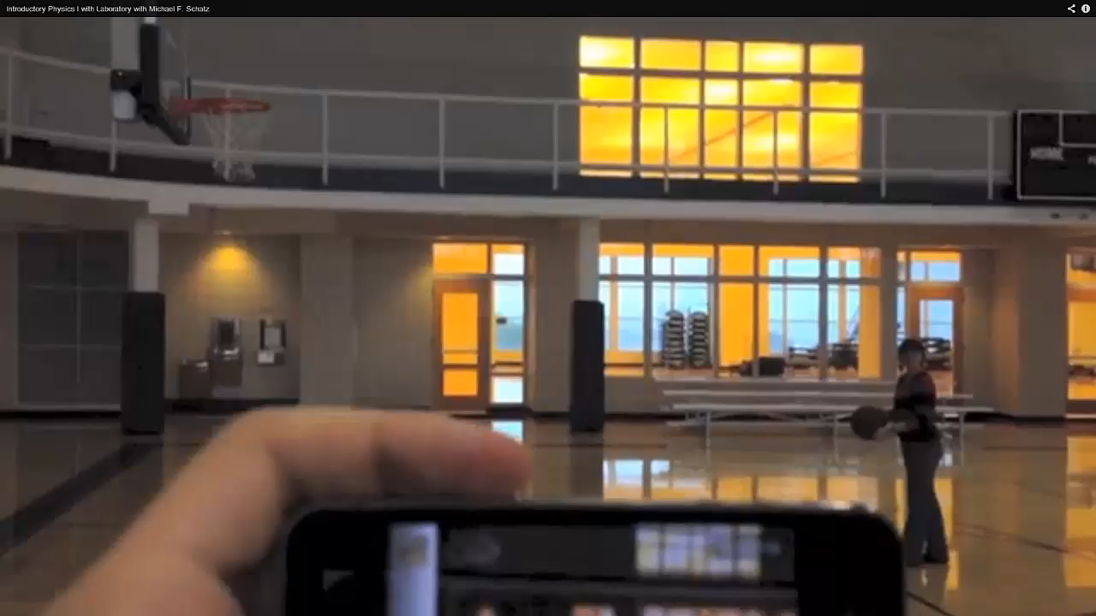
Observe Motion and
Capture on Video

Slide 10
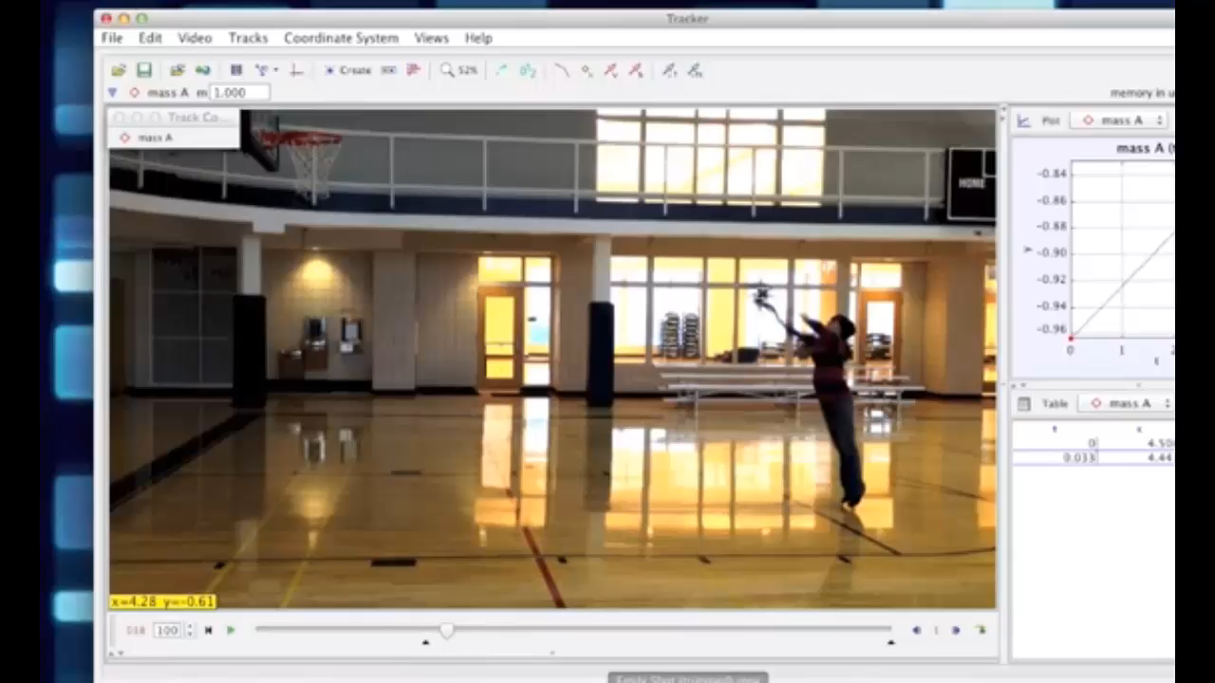
Analyze Video

Slide 11
…on the Shoulders of Giants…
+ Video-analysis-based labs
(Douglas Brown (Tracker); P. Laws, R. Teese, others; )

Slide 12
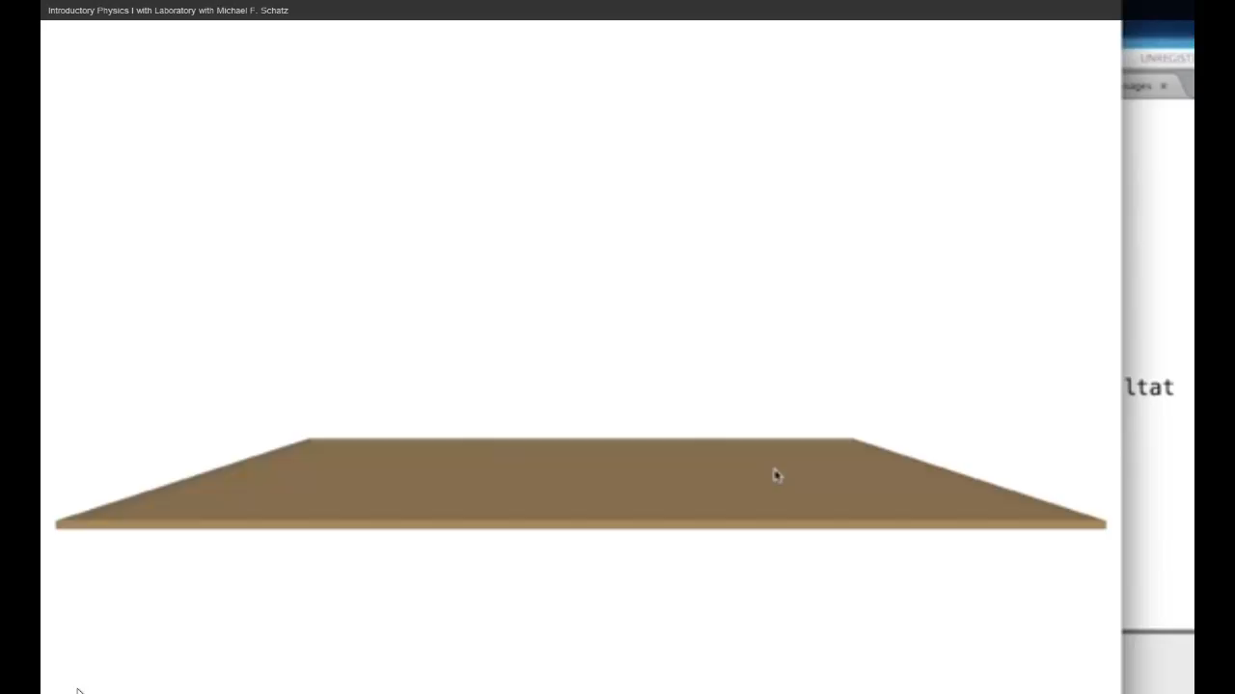
Build Predictive Models
Notes:
Reduce cognitive overhead – students are focused on physics
Model failure leads to new model with one line of code

Slide 13
…on the Shoulders of Giants…
+ Video-Analysis-Based Labs
(Douglas Brown (Tracker); P. Laws, R. Teese, others; )
+ Modeling (including computer models)
(Modeling Instruction : D. Hestenes et al.;
NRC Framework for K-12 Science Education: H. Quinn et al.;
Matter & Interactions: R. Chabay & B. Sherwood)

Slide 14


Foundation for Standards
(from US National Academy of Sciences)
2012

Slide 15
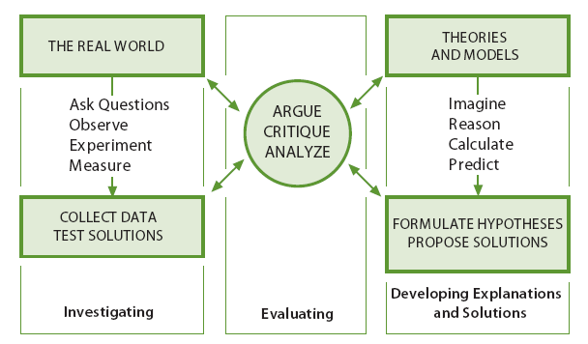
Integrating Practices
NRC Framework for K-12 Science Education

Slide 16
Scientific and Engineering Practices
1. Asking questions and defining problems
2. Developing and using models
3. Planning and carrying out investigations
4. Analyzing and interpreting data
5. Using mathematics and computational thinking
6. Developing explanations and designing solutions
7. Engaging in argument from evidence
8. Obtaining, evaluating, and communicating information
NRC Framework for K-12 Science Education
H. Quinn, Stanford
Notes:
16

Slide 17
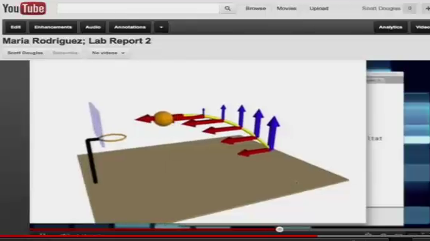
Report & Peer Evaluate

Slide 18
…on the Shoulders of Giants…
+ Video-Analysis-Based Labs
(Douglas Brown (Tracker); P. Laws, R. Teese, others; )
+ Modeling (including computer models)
(Modeling Instruction : D. Hestenes et al.;
NRC Framework for K-12 Science Education: H. Quinn et al.;
Matter & Interactions: R. Chabay & B. Sherwood)
+ Science Communication & Peer Evaluation
(Calibrated Peer Review: A. Russell et al.; E. Price, F. Goldberg, et al.)

Slide 19
GT Blended Course with MOOC Content
Traditional Contact (per week)
Flipped Contact
+ Three 1-hr Large Lectures (MWF)
+ One 3-hr Lab-Recitation (TU or TH)
+ Two 1-hr Group Prob. Solving (M,W)
+ One 1-hr Quiz Period (F)
+ One 3-hr Prob. Solve/Science Comm.

Slide 20




Out-of-Class Activities
Textbook
(Book & e-book)
Labs,
Homework & Quizzes
Video Lectures
(Coursera)
Forum

Slide 21
Peer Evaluation of Labs:
Overview

Slide 22
Peer Grading in Large Courses: Requirements
Students should receive accurate grades for summative assessment
Students should receive useful feedback for formative assessment
Instructors should save time and effort

Slide 23
Labs (with Peer Eval):
Assignment (due in two weeks):
+ Observe motion
+ Record on video; analyze
+ Build predictive model from fundamentals
+ Report results (5 minute video on YouTube)

Slide 24
Rubric
+ Likert-scale (Excellent, Very Good, Good, Fair, Poor)
Organization & Structure
Content Models
Content Prediction Discussion
Content Overall
Production & Delivery

Slide 25
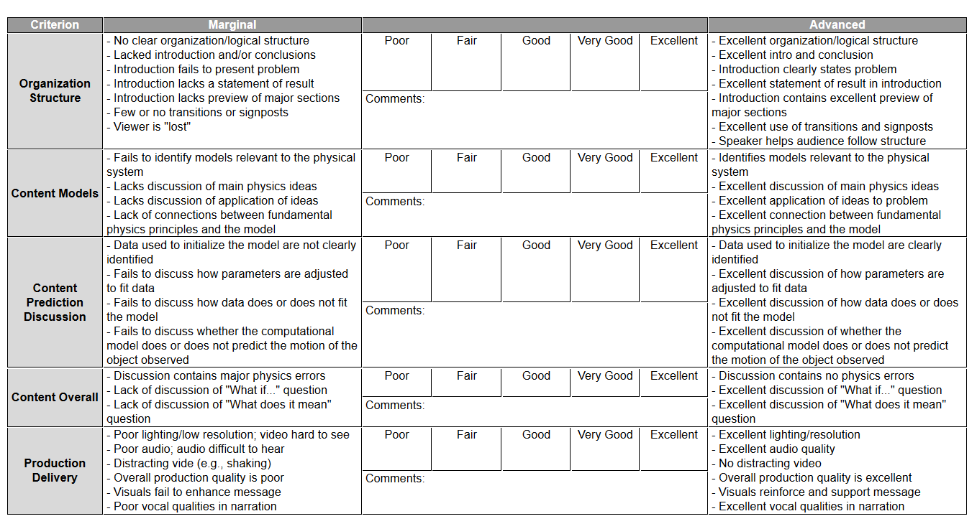
Rubric

Slide 26
Present “Work-in-Progress”
Rough Draft (3-hr session, week lab is due):
+ Present to Small Group at Lab Table
(Presenter + 3-5 Evaluators )
+ Live Presentation (3 minutes)
+ One Rubric Item per Evaluator
+ In Parallel with Problem Solving

Slide 27
Submit Lab Report

Slide 28
Present Final Report
During 3-hr session, week AFTER lab is due:
+ Present to Small Group at Lab Table
(Presenter + 3-5 Evaluators )
+ Live Presentation (3 minutes)
+ One Rubric Item per Evaluator
+ In Parallel with Problem Solving

Slide 29
Peer Evaluation: Practice
Online, due week AFTER lab is due:
+ Evaluate two sample video reports
+ Compare with expert scores, comments
+ No impact on grade

Slide 30
Peer Evaluation: Calibration
Online, due week AFTER lab is due:
+ Must complete practice assignment first
+ Evaluate two sample video reports
+ Compare with expert scores, comments
+ Graded

Slide 31
Peer Evaluation: Grading
Online, due week AFTER lab is due:
+ Must complete calibration assignment first
+ Evaluate 5 video reports: (3 other student reports, own report, and “hidden” sample)
+ Grades: Hidden Sample (Calibration Grade)
Peer Score (Lab Grade)

Slide 32
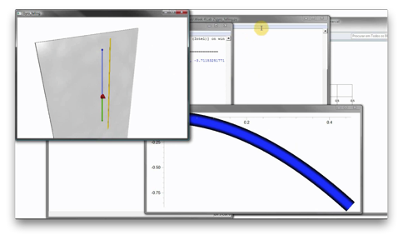
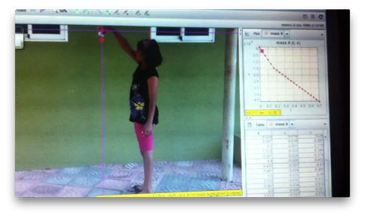
The SWAPR Method:
Statistically Weighted Aggregate Peer Review
Step 1: Students evaluate several instructor-provided videos
Student Responses
Instructor Responses
Student Responses
Instructor Responses
Rubric: Rate 1-5
Structure
Models
Prediction
Overall Content
2
2
5
4
3
2
3
2
3
2
1
5
3
1
3
4
VIDEO 1
VIDEO 2

Slide 33
Evaluation to Grade
Step 1: Students evaluate several instructor-provided videos
Step 2: We calculate student weights (per item)
Instructor Responses
Instructor Responses
Student Responses
Student Responses
Student Weights
2
2
5
4
3
1
3
2
+1
+1
3
2
1
5
3
1
3
4
+1
+1
+1
2
2
0
1
VIDEO 1
VIDEO 2
For each rubric item, a student gets 1 “weight point” each time he or she agrees with the instructor’s response (±1)

Slide 34
Evaluation to Grade
Step 1: Students evaluate several instructor-provided videos
Step 2: We calculate student weights (per item)
Step 3: We calculate student offsets (per item)
Instructor Responses
Instructor Responses
Student Responses
Student Responses
Student Offsets
Difference
Difference
2
2
5
4
3
1
3
2
+1
–1
+2
+2
3
2
1
5
3
1
3
4
0
+1
+2
+1
+0.5
0
+2
+1.5
Take average
per-item difference
VIDEO 1
VIDEO 2
For each rubric item, we record the average difference between the student’s responses and the instructor responses (students tend to over-grade!)

Slide 35

Evaluation to Grade
Finally: Calculate grades!
Student Responses
Student Responses
Student Responses
Student Weights
Student Offsets
Student Weights
Student Weights
Student Offsets
Student Offsets
Final Grade
4
4
3
5
2
2
2
2
-0.5
+1
0
-0.3
3
3
3
4
1
1
2
2
-1
-1.1
+2
+1
1
2
5
1
0
1
0
0
-2
+3
-0.1
+1
2.7
4.2
4
4.9
Peer 1
Peer 2
Peer 3
Subtract each student’s offsets from their responses, then take a weighted average for each item

Slide 36
Time and Effort
Peer grading capacity automatically scales with the number of students, but…
  …we’ve found it important to provide the students with the option of seeking a manual regrade, which requires TA effort in proportion to the number of students seeking regrades
  …the preparation of the calibration assignments requires a lot of instructor time! Not a problem after the first run of the course, assuming the rubrics and grading policy stay the same (a big assumption)

Slide 37
Space Issues
Use Lab Space for Small-Group Meetings
+ Labs unused in a.m.
+ More space needed for widespread flipping of intro. lab courses

Slide 38
Critical Issue: Instructor Career Development
+ Facilitate scientific communication
+ Facilitate small group problem solving

Slide 39
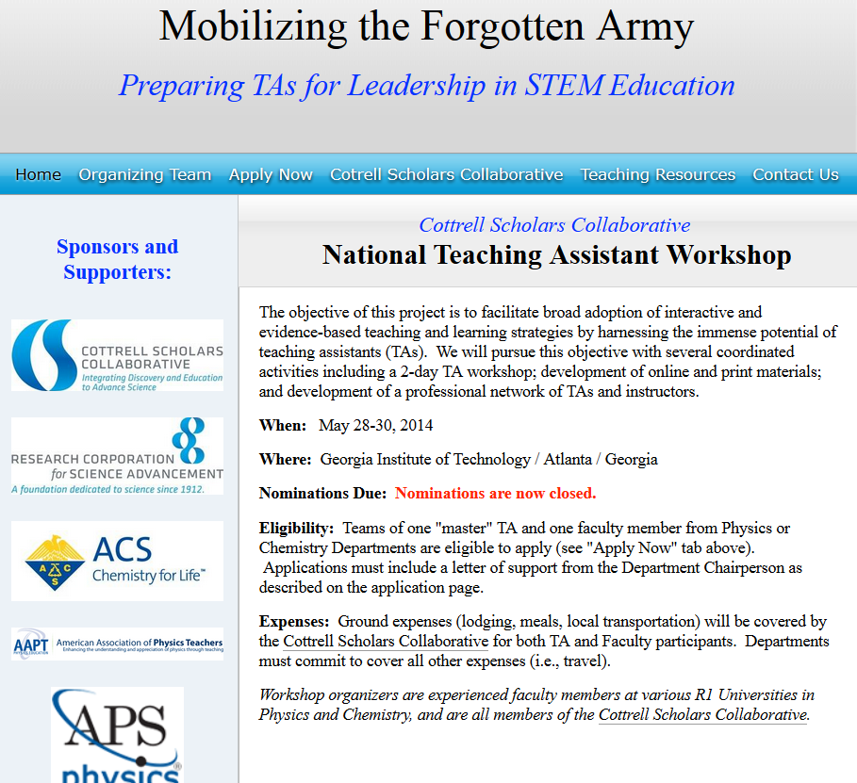
National TA Workshop
May 28-30 2014

Slide 40
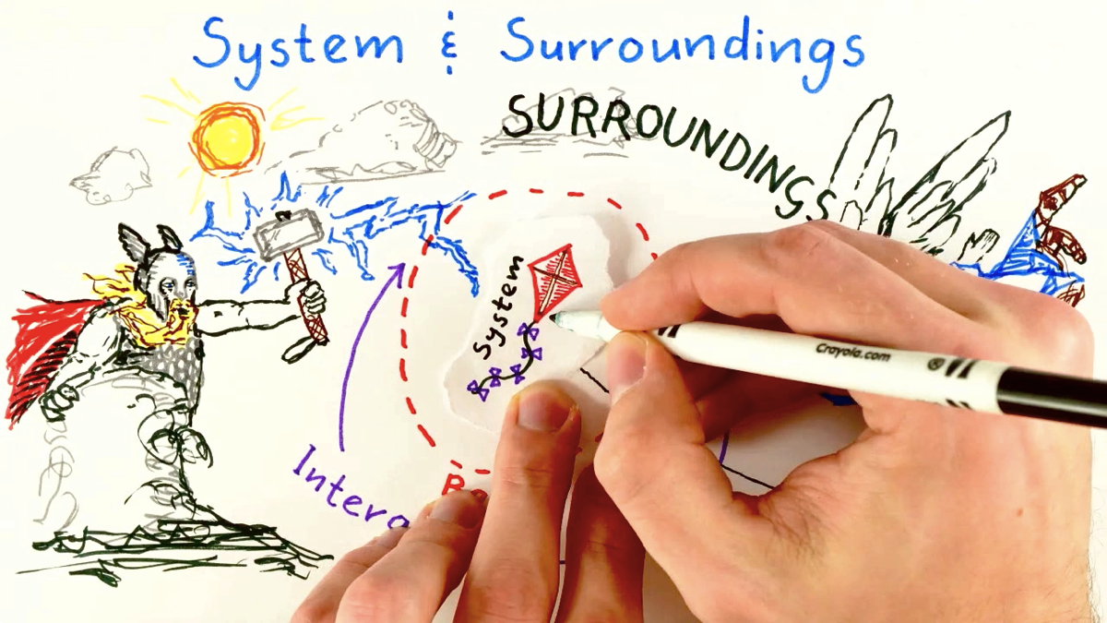
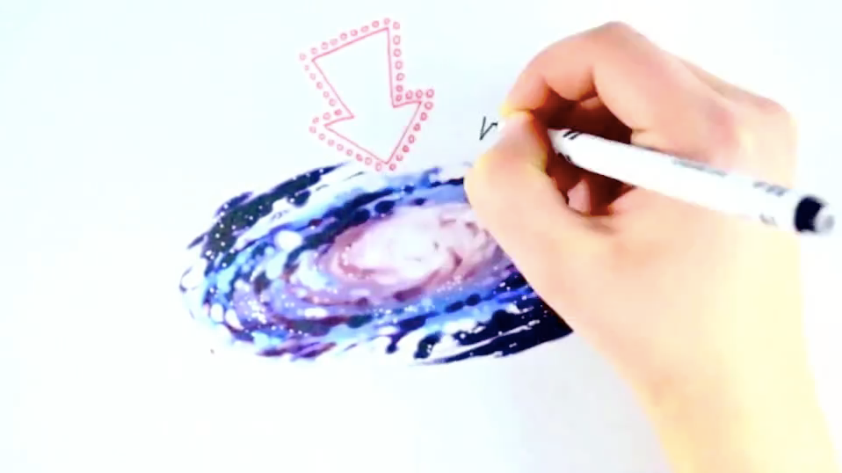
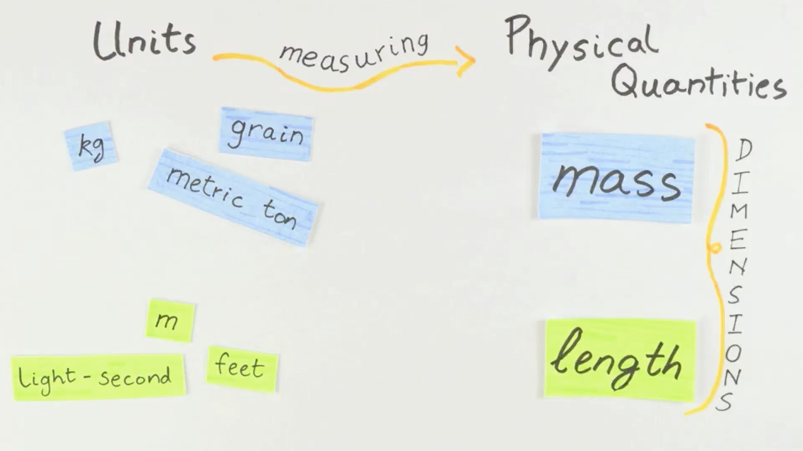
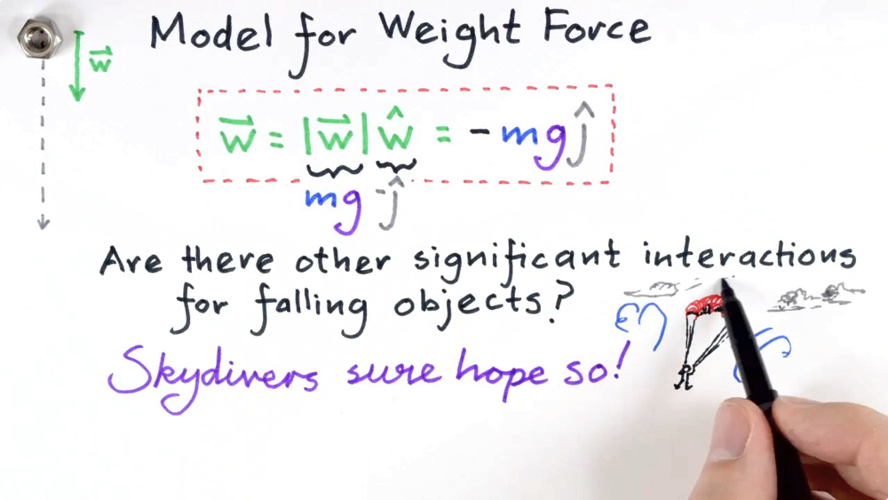
Video Lectures

Slide 41
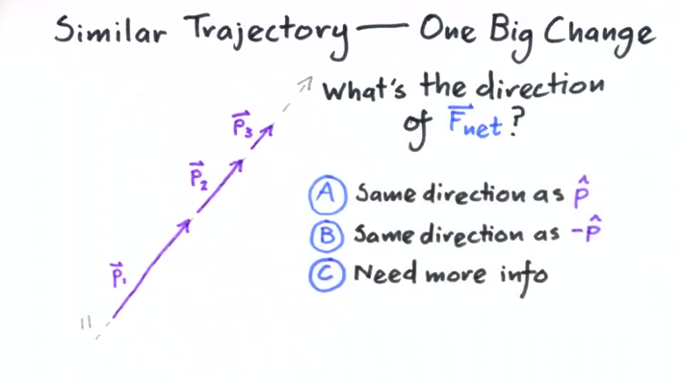
Video Lectures
Our course contains ~70 videos, most around 10 minutes long, many hand-animated
5 animators, 1 full-time graduate student, hundreds of work-hours to produce a one-semester course
We wanted to avoid the more traditional “camera-in-a-lecture-hall” approach
Many videos have clicker questions

Slide 42
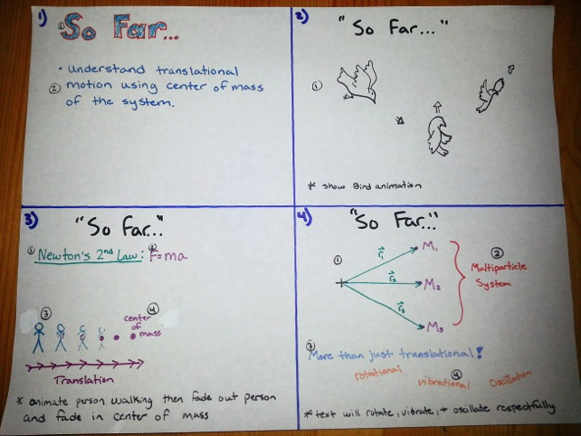
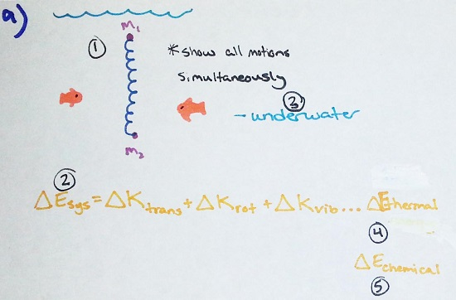
Anatomy of a Storyboard
Script is divided up into “sheets”; each sheet on the storyboard corresponds to 1 piece of paper, and 10s to 1m of video
Each element on each sheet is numbered in the order in which it must be drawn; if you mess up and draw “y” before “x”, you have to start the sheet from the beginning!
Animators will keep the storyboard with them in the studio; it should tell them exactly which pen-stroke is coming up next

Slide 43
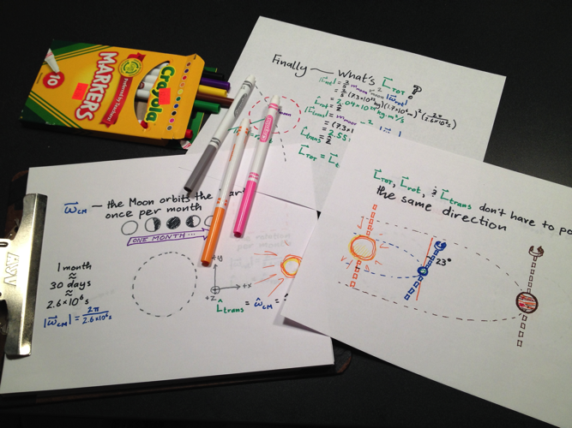

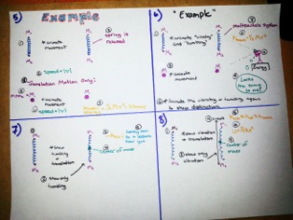
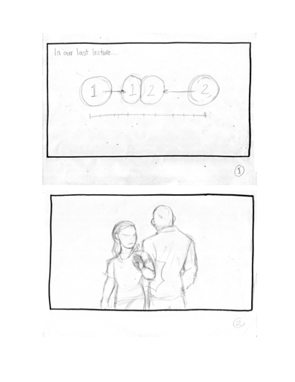
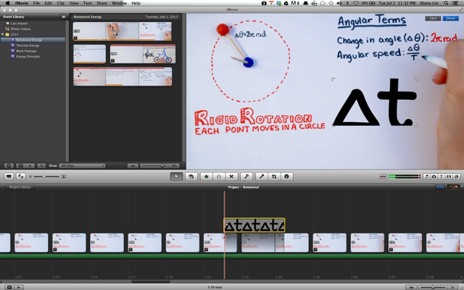
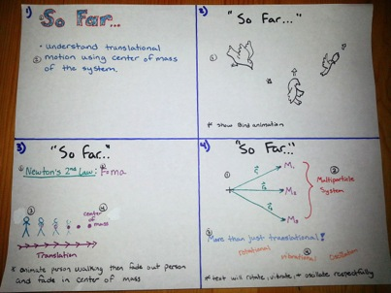
Three Stages of Video Production
Pre-Production:
Video is scripted and storyboarded; storyboard is edited, revised, discarded, restarted from scratch, edited, then finalized (twice)
Post-Production:
Raw footage from production is loaded into video editing software (iMovie or Windows Movie Maker were sufficient for us) and synced with narration audio
Production (Shooting):
Animator warms up the studio lights and puts marker to paper
Each stage takes roughly the same amount of time; plan accordingly!

Slide 44
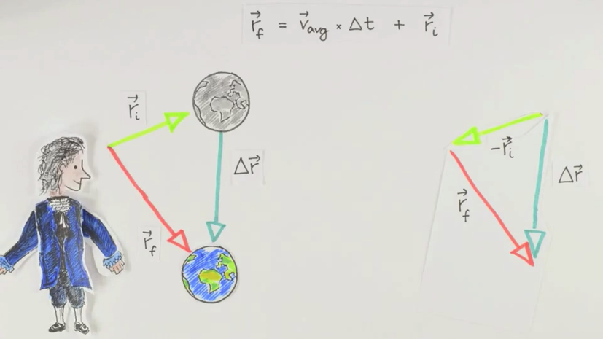
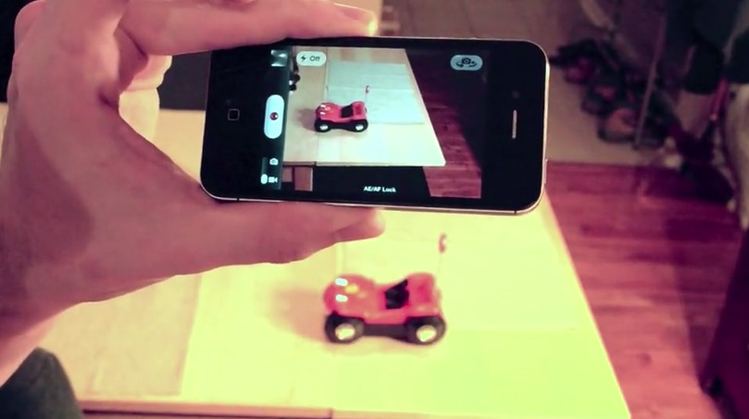
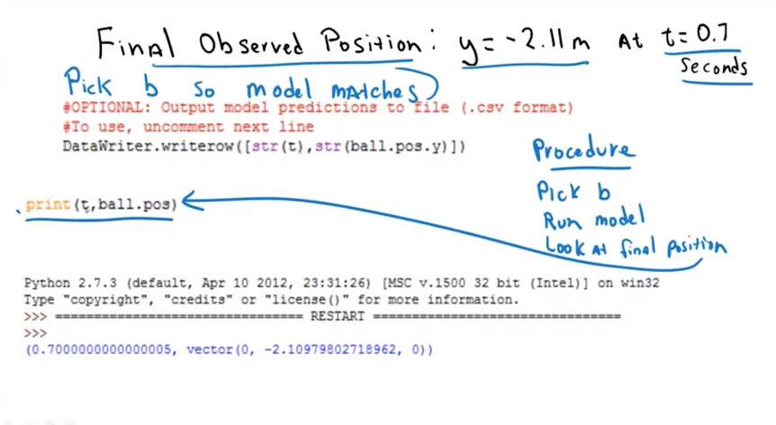
Whiteboard-Style Videos: Hand-animated videos are by far the most laborious—2 hours of work to produce 1 minute of video at a bare minimum
We like the results, though!
(inspiration from Minute Physics)
Live-Action Videos: Some experimental techniques are best presented “live”—less laborious than the whiteboard videos, but not well-suited to diagrams or equations
Screencasted Videos: Khan-Academy-Style videos afford the least visual quality, but the fastest production time

Slide 45
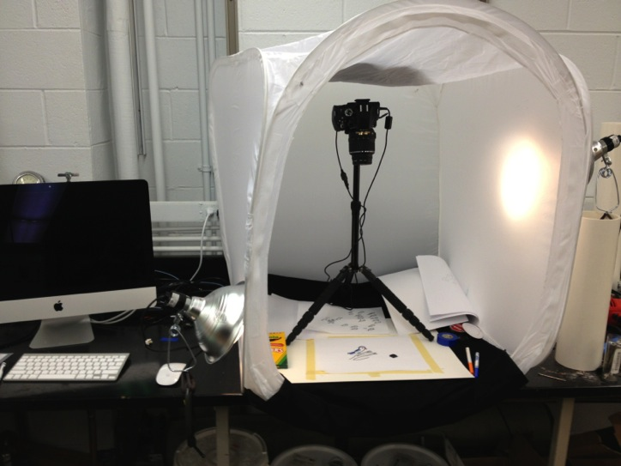
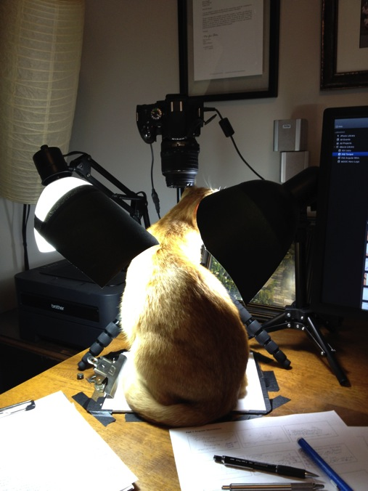
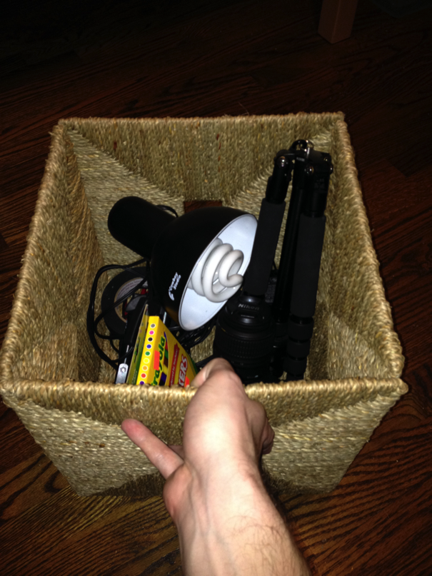

Mobile Animation Studio
Some videos made in the lab…
…others, at animators’
homes
Our animation setup is compact & collapsible. Easy to transport and distribute; convenient for
small dorm rooms, long-distance work, and unpredictable animator schedules

Slide 46
Acknowledgements
Georgia Tech
Scott Douglas, Shih-Yin Lin,
Emily Alicia-Munoz, Ed Greco
Michigan State University
Danny Caballero
Georgia State
John Aiken, Brian Thoms
St. Andrew’s School
John Burk
NC State
Ruth Chabay
Bruce Sherwood
Highpoint
University
Aaron Titus
Hamline
University
Andy Rundquist
Supported by
the Gates Foundation &
NSF DUE-0942076

