Slide 1
Assessment in a
MOOC/Flipped/Blended
Introductory Physics
Course & Lab
Supported by the Gates Foundation & NSF (DUE-0942076)
Notes:
Computational Modeling is using computers to solve problems.
We want to AUGMENT modeling instruction with computational modeling.

Slide 2
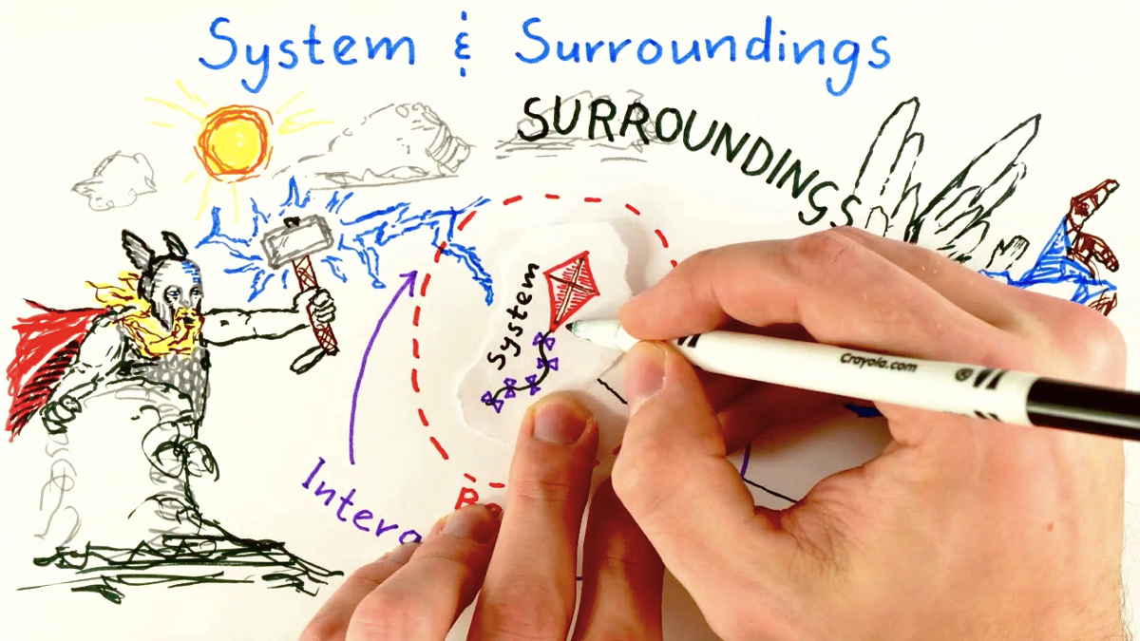
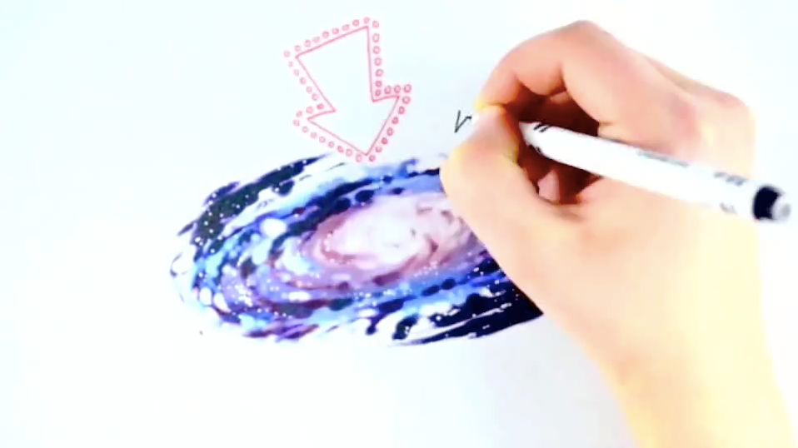
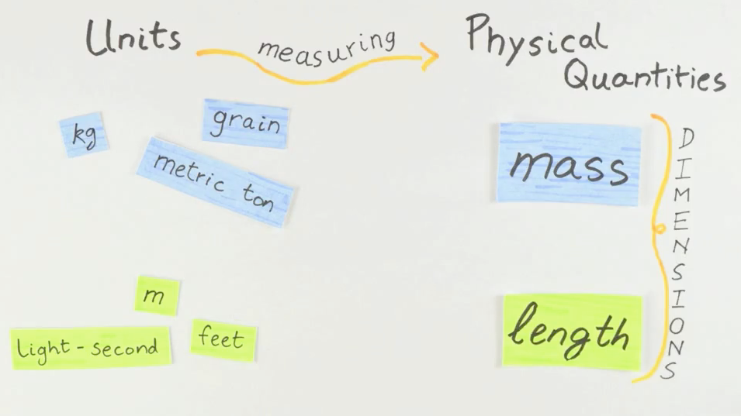
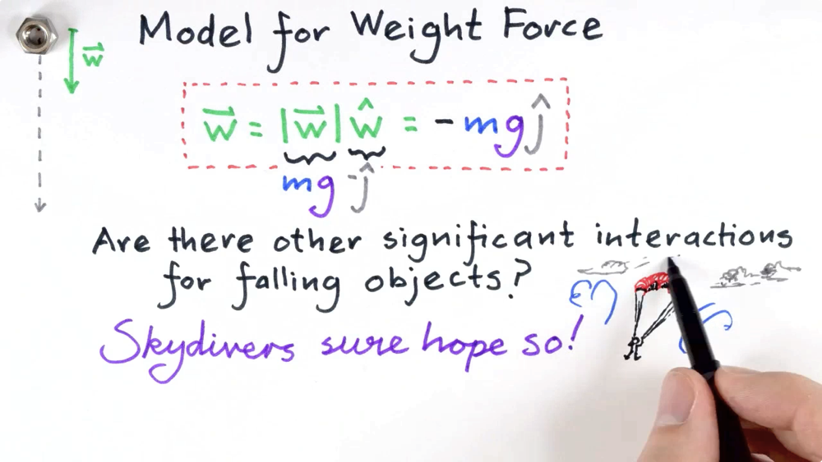
Video Lectures

Slide 3
Rethinking Lecture Content & Delivery (More Examples)

Slide 4
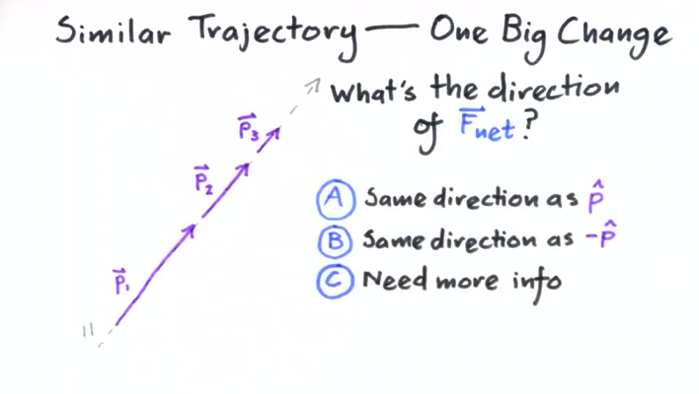
Video Lectures
Our course contains ~70 videos, most around 10 minutes long, many hand-animated
5 animators, 1 full-time graduate student, hundreds of work-hours to produce a one-semester course
We wanted to avoid the more traditional “camera-in-a-lecture-hall” approach
Many videos have clicker questions

Slide 5
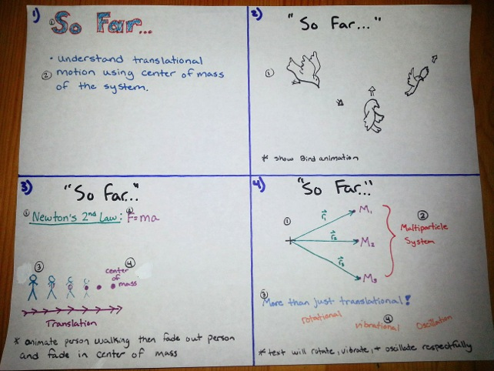
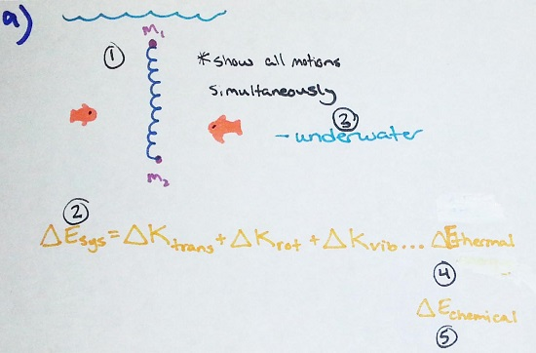
Anatomy of a Storyboard
Script is divided up into “sheets”; each sheet on the storyboard corresponds to 1 piece of paper, and 10s to 1m of video
Each element on each sheet is numbered in the order in which it must be drawn; if you mess up and draw “y” before “x”, you have to start the sheet from the beginning!
Animators will keep the storyboard with them in the studio; it should tell them exactly which pen-stroke is coming up next

Slide 6
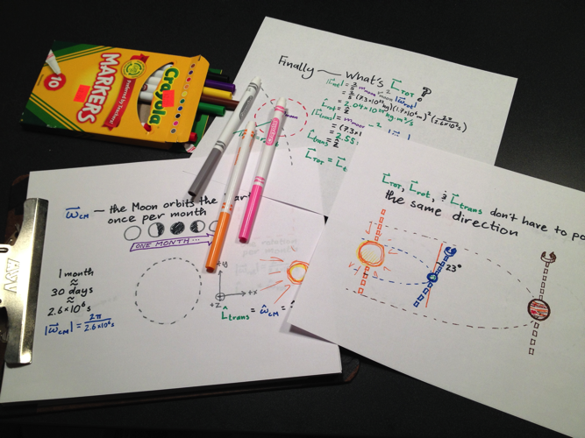
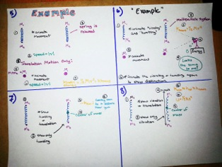
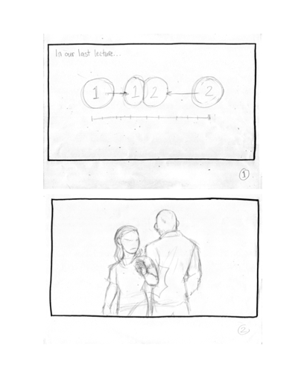
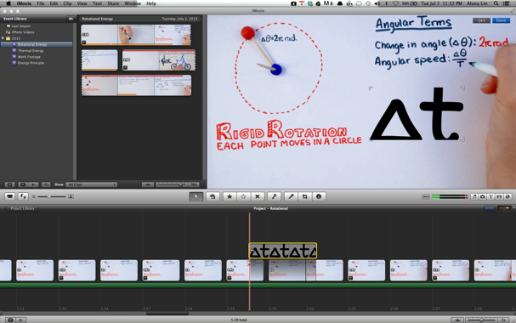
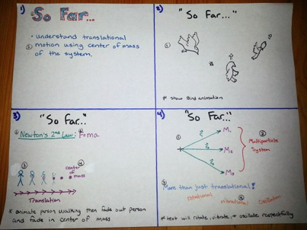
Three Stages of Video Production
Pre-Production:
Video is scripted and storyboarded; storyboard is edited, revised, discarded, restarted from scratch, edited, then finalized (twice)
Post-Production:
Raw footage from production is loaded into video editing software (iMovie or Windows Movie Maker were sufficient for us) and synced with narration audio
Production (Shooting):
Animator warms up the studio lights and puts marker to paper
Each stage takes roughly the same amount of time; plan accordingly!

Slide 7
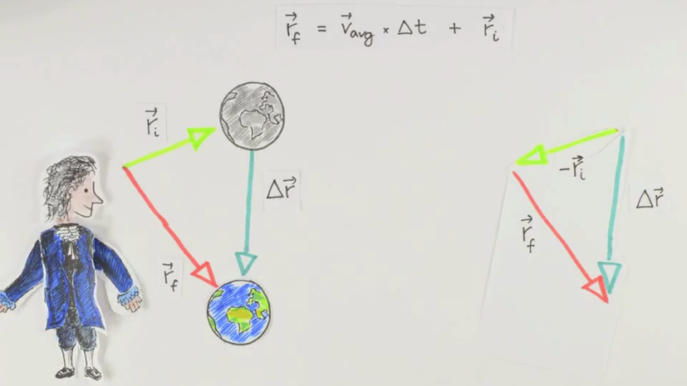
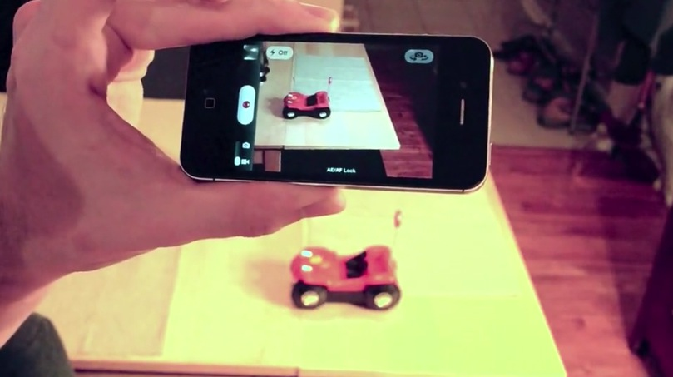
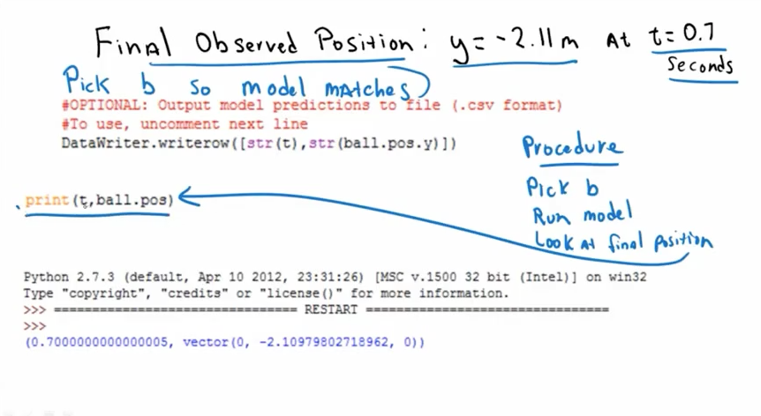
Whiteboard-Style Videos: Hand-animated videos are by far the most laborious—1-2 hours of work to produce 1 minute of video at a bare minimum
We like the results, though!
(inspiration from Minute Physics)
Live-Action Videos: Some experimental techniques are best presented “live”—less laborious than the whiteboard videos, but not well-suited to diagrams or equations
Screencasted Videos: Khan-Academy-Style videos afford the least visual quality, but the fastest production time

Slide 8
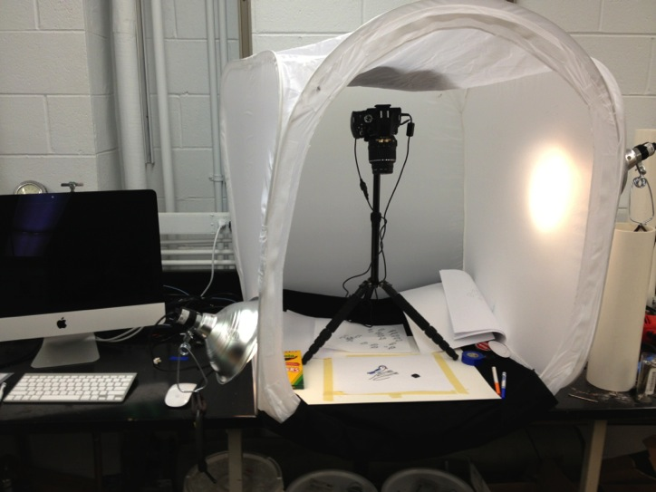
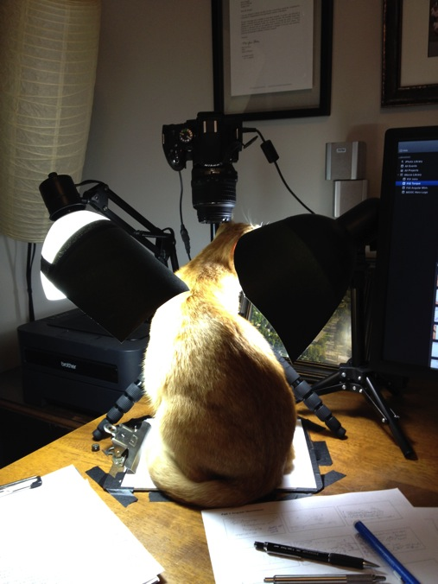
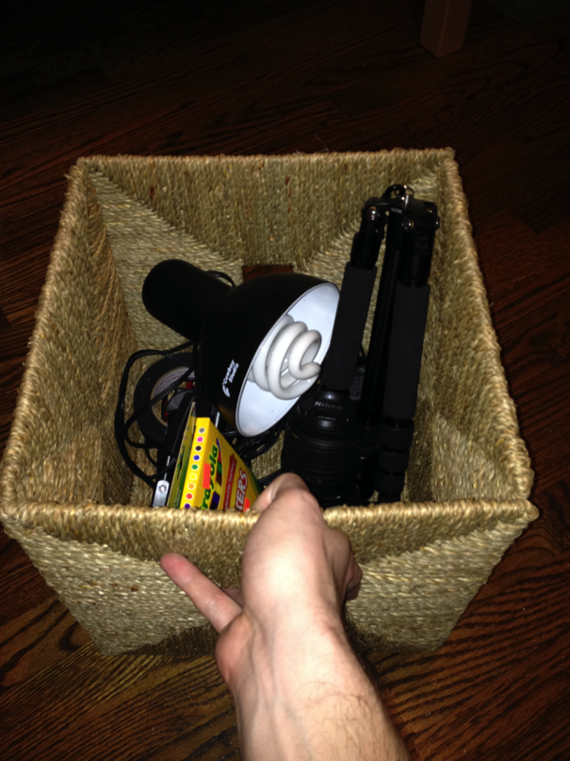
Mobile Animation Studio
Some videos made in the lab…
…others, at animators’
homes
Our animation setup is compact & collapsible. Easy to transport and distribute; convenient for
small dorm rooms, long-distance work, and unpredictable animator schedules

Slide 9
Peer Evaluation

Slide 10
Summative Assessment:
Calibration
A “calibrated” peer grading system adjusts the grades students receive based on the measured expertise of their graders
Basic principle: all students and instructors grade a set of common assignments, students assigned a calibration score based on how well their grades compare with the instructors’
Many variations exist—commercial product CPR™ [1] is popular, Coursera has a system in development [2]; we developed our own software SWAPR for practice & research
[1] Robinson, R. (2001). Calibrated Peer Review™: An Application To Increase Student Reading & Writing Skills. The American Biology Teacher, 63(7), 474–480.
[2] Piech, C., Huang, J., Chen, Z., Do, C., Ng, A., & Koller, D. (2013). Tuned models of peer assessment in MOOCs. arXiv Preprint arXiv:1307.2579.

Slide 11
Summative Assessment:
Calibration in Other Contexts
CPR™ originally designed for creative writing exercises, but has been used for biology essays [3], physics schematics [4], physiology problem-solving exercises [5], and more
Instructors (except [3]) report good similarity between CPR™-generated grades and instructor grades; [3] offers simple changes to improve similarity
Instructors generally agree that calibration is useful
[3] Gaffin, D. D., Chumchal, M. M., & Long, D. A. (2001). An Analysis of Calibrated Peer Review ( CPR ) in a Science Lecture Classroom.
[4] Price, E., Goldberg, F., Patterson, S., & Heft, P. (2013). Supporting scientific writing and evaluation in a conceptual physics course with Calibrated Peer Review, 1513, 318–321.
[5] Pelaez, N. J. (2002). Problem-based writing with peer review improves academic performance in physiology. Advances in Physiology Education, 26(3), 174–184. doi:10.1152/advan.00041.2001

Slide 12
Formative Assessment:
Feedback and Self-Reflection
In peer evaluation (of which grading can be a component), students give verbal or written feedback to each other in pairs or small groups
SWAPR requires students to send anonymous comments to each other for each item on the rubric
Feedback plays an important role generally in fostering understanding, as does self-reflection. It may be that reviewing one’s own assignment is more useful for understanding than is reviewing others’ assignments [6]
SWAPR makes each student review his or her own lab report video
[6] Sadler, P. M., & Good, E. (2006). The impact of self-and peer-grading on student learning.
Educational Assessment, 11(1), 1–31.

Slide 13
Questions: Peer Evaluation
+ How does student grading compare
to instructor grading?
+ How does training affect students’ grading performance?
+ Calibration: Does it help?

Slide 14
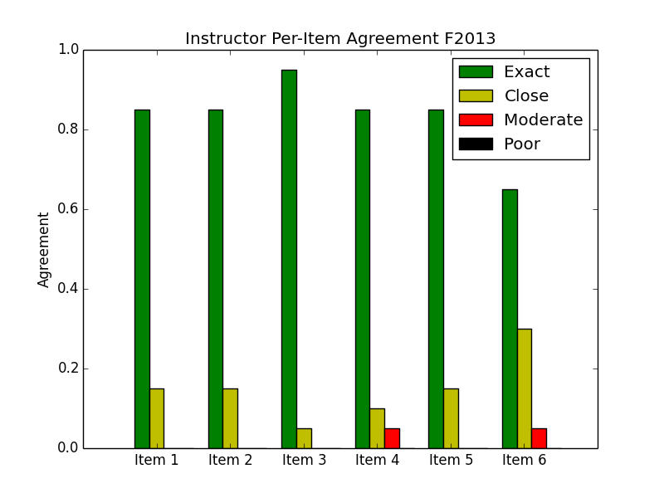
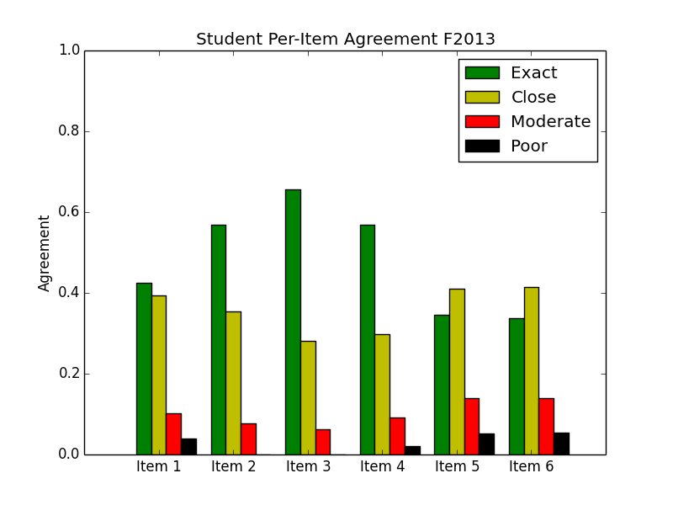
Inter-Rater Agreement
Students were less reliable than instructors when filling out the rubric;
we can improve student reliability by improving the rubric and by offering
extensive in-class coaching and practice.

Slide 15
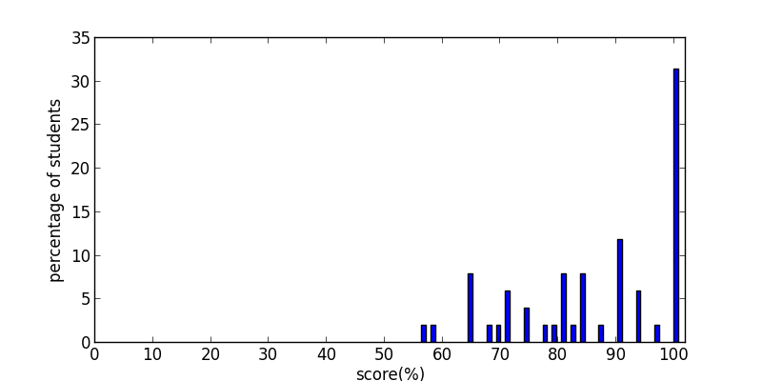
Students overgrade
63% of students
Grade by instructor
Median
29% of students
Notes:
This is data from fall 2013 MOOC, lab 4_calibration 2 video, N=51

Slide 16
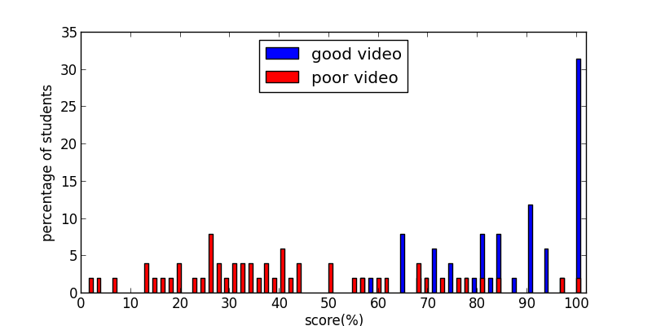
Worse agreement for worse reports
Grade by instructor (poor video)
Grade by instructor (good video)
Notes:
This is fall 2013 mooc, lab 4 videos. (Good video: calibration 2, expert score=11.3 ; Poor video: hidden calibration video, expert score=80.6)
For both videos, N=51

Slide 17
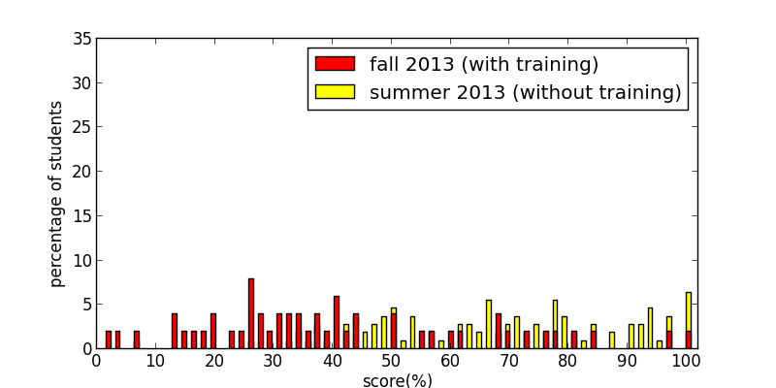
Training helps
Grade by instructor (poor video)
Notes:
This is lab 4 hidden calibration video (N=51 in fall 2013, N=110 in summer 2013)

Slide 18
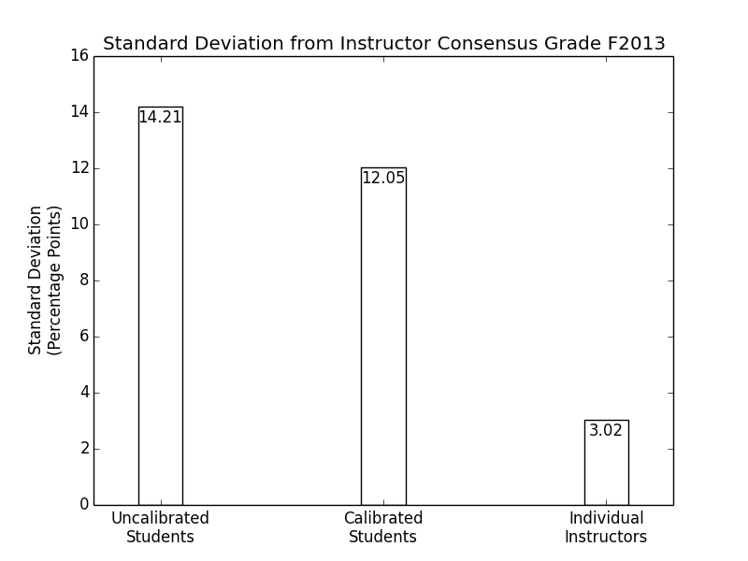
Calibration Helps
Calibrating the students improves the accuracy of their grades by
19% of maximum possible improvement

Slide 19
Evaluation to Grade
Finally: Calculate grades!
Student Responses
Student Responses
Student Responses
Student Weights
Student Offsets
Student Weights
Student Weights
Student Offsets
Student Offsets
Final Grade
4
4
3
5
2
2
2
2
-0.5
+1
0
-0.3
3
3
3
4
1
1
2
2
-1
-1.1
+2
+1
1
2
5
1
0
1
0
0
-2
+3
-0.1
+1
2.7
4.2
4
4.9
Peer 1
Peer 2
Peer 3
Subtract each student’s offsets from their responses, then take a weighted average for each item

Slide 20
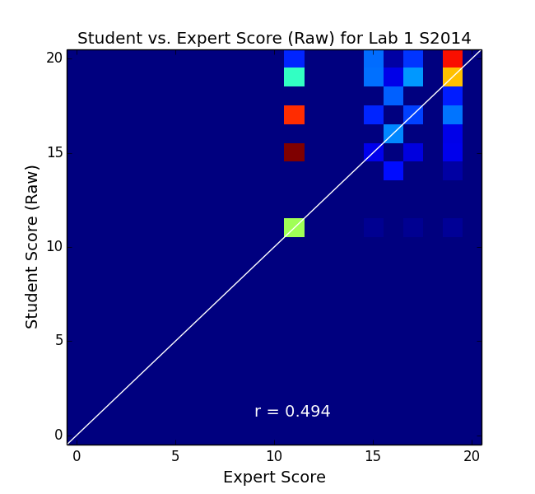
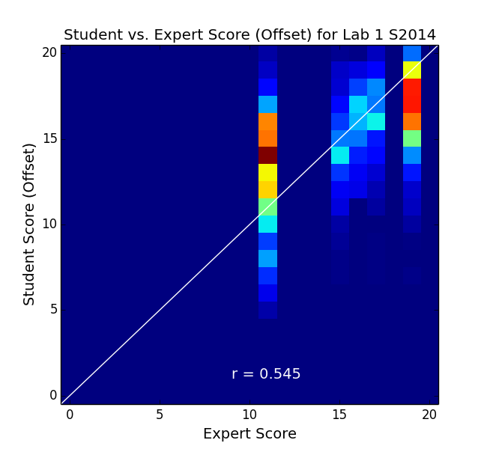
Before Calibration
After Calibration

Slide 21
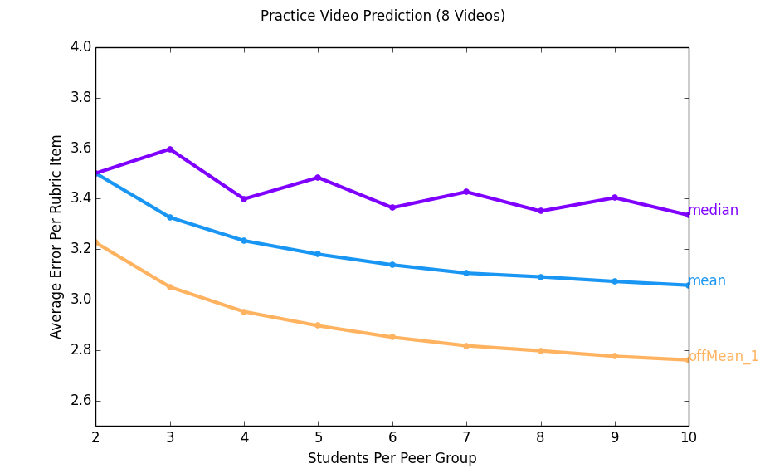
Using an offset + weight calibration scheme,
we get less error than using the mean or median
peer grade

Slide 22
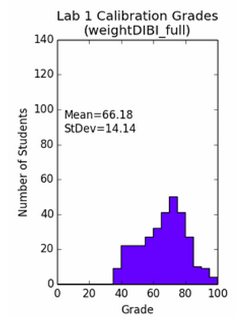
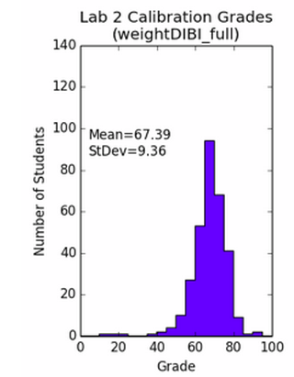
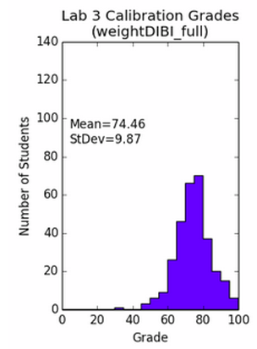
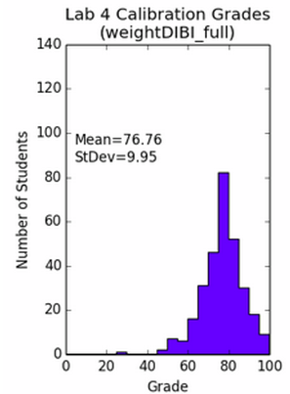
Students Improve Over Time

Slide 23
Video Lecture Usage

Slide 24
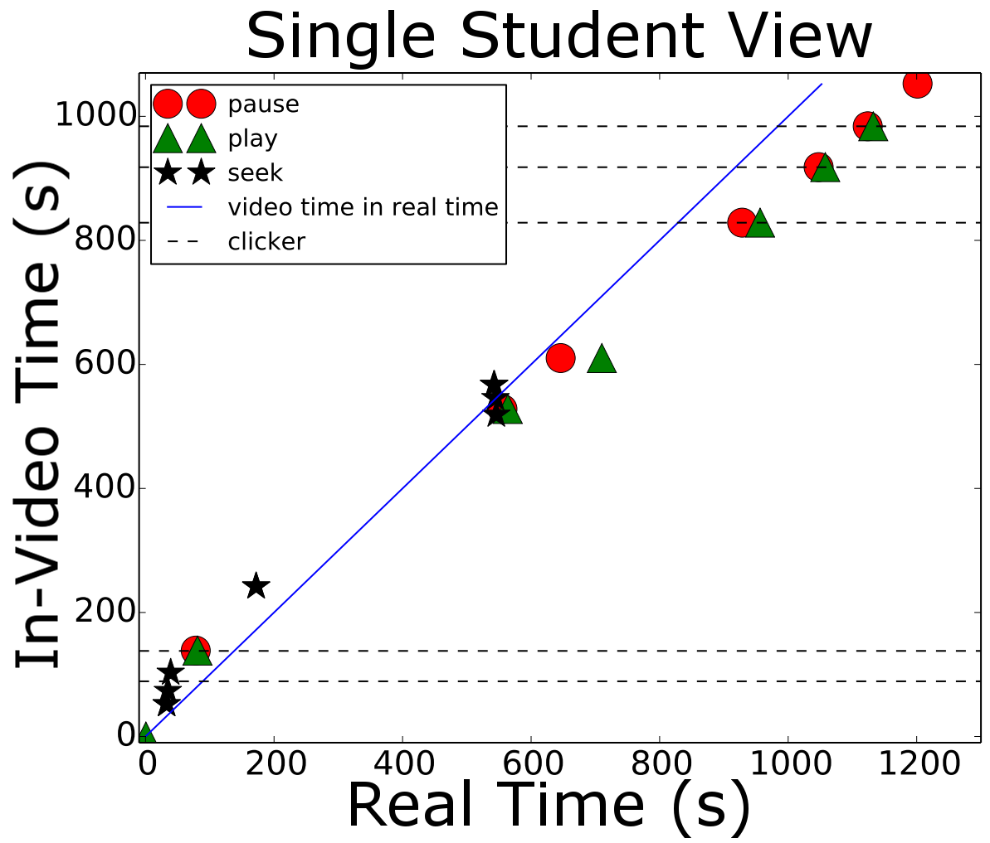

Slide 25
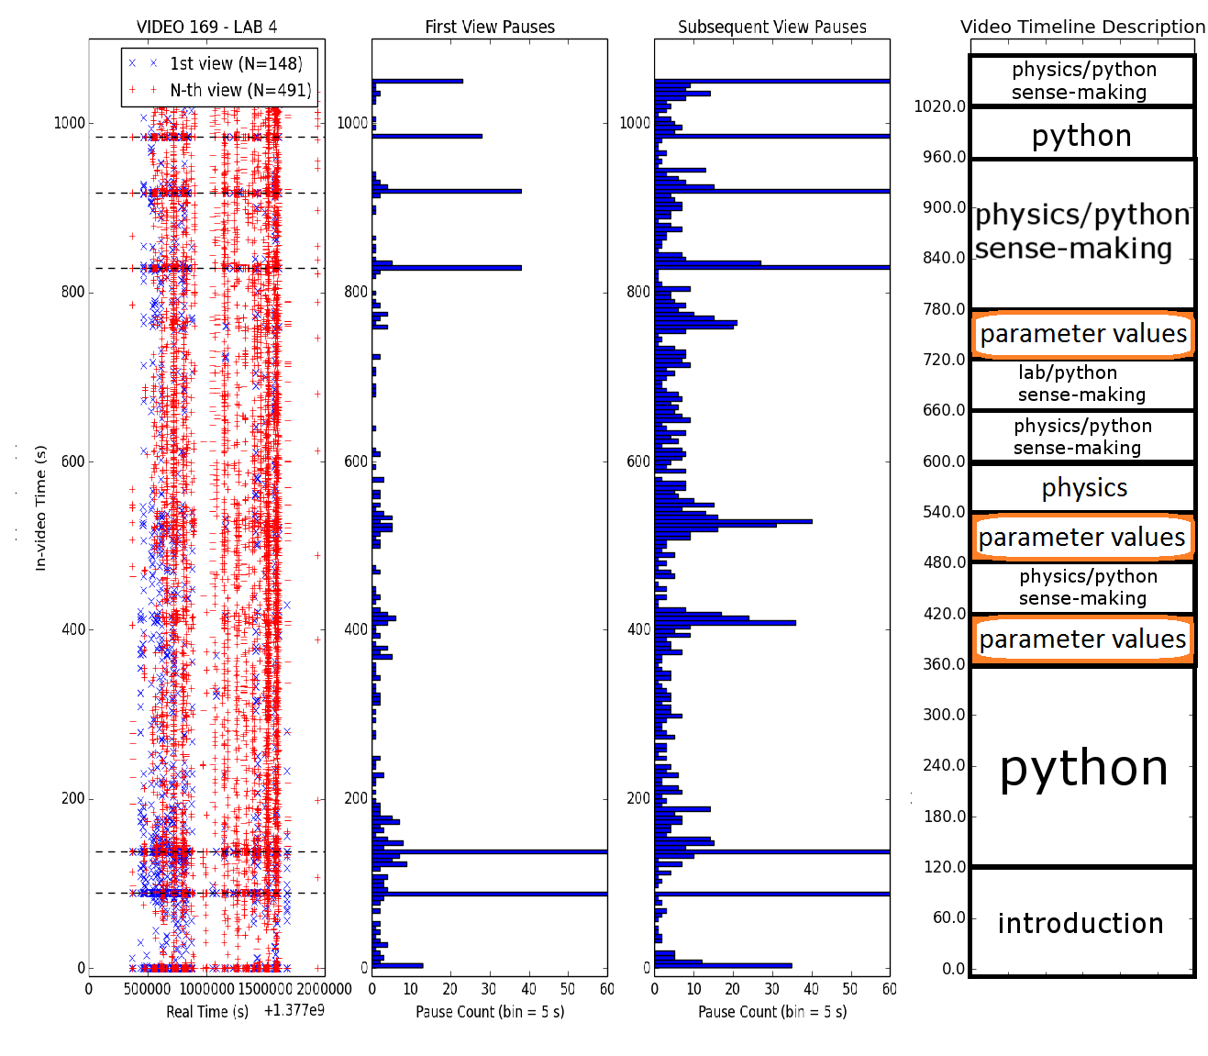

Slide 26
General features
Scatter plot is first two weeks that video is available to students. After first lab due students stop watching this particular video
27% of students terminate video on first viewing at 2nd clicker question, only 15.5% get through entire video
28.5% of subsequent views terminate at the end of the video, 2nd most probable termination point was 2nd clicker question (10%)
The “gap” between the two “columns” of data roughly maps to the weekend

Slide 27
Assessment
+ Standard measures (pre/post concept inventory, demographic survey)
+ Attitudes, expectations (CLASS, E-CLASS)
+ Analysis of student work (Student videos, Exam Questions )
+ Student interviews (Think-aloud)

Slide 28
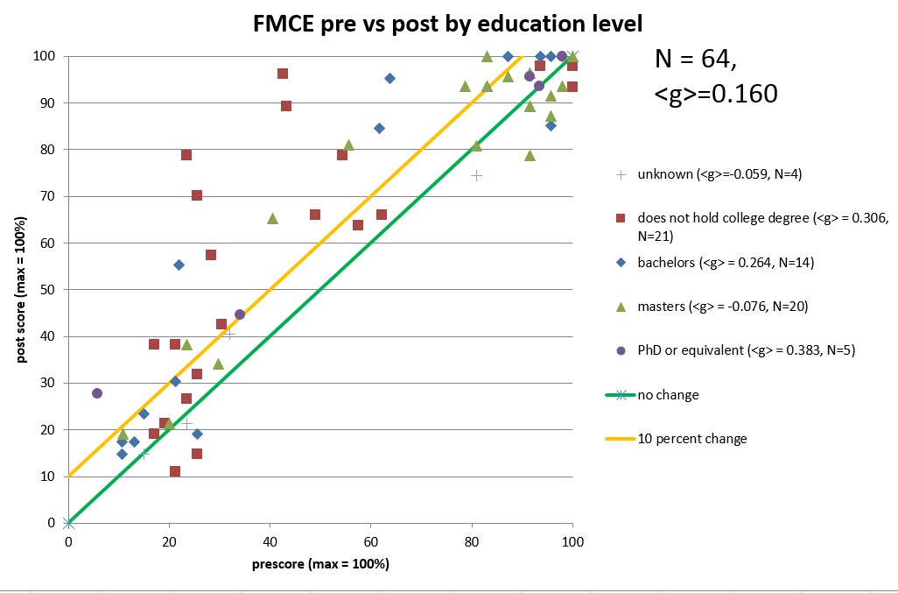
Concept Inventory (Pre/Post)

Slide 29
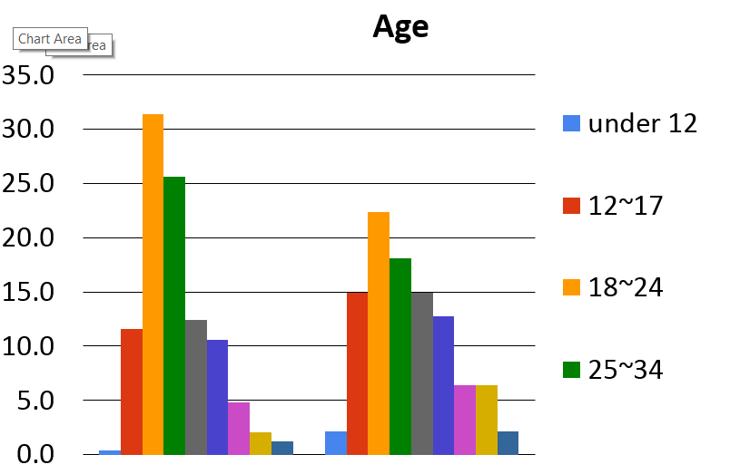
Age Distribution
%
Of
Total
At the Start
End of Course

Slide 30
Assessment
+ Standard measures (pre/post concept inventory, demographic survey)
+ Attitudes, expectations (CLASS, E-CLASS)
+ Analysis of student work (Student videos, Exam Questions )
+ Student interviews (Think-aloud)

Slide 31
Acknowledgements
Georgia Tech
Scott Douglas, Shih-Yin Lin,
Emily Alicia-Munoz, Ed Greco
Michigan State University
Danny Caballero
Georgia State
John Aiken, Brian Thoms
St. Andrew’s School
John Burk
NC State
Ruth Chabay
Bruce Sherwood
Highpoint
University
Aaron Titus
Hamline
University
Andy Rundquist
Supported by
the Gates Foundation &
NSF DUE-0942076

