Slide 1
S2S model initialization and ensemble generation
Frédéric Vitart
European Centre for Medium-Range Weather Forecasts

Slide 2
Model Initialization

Slide 3
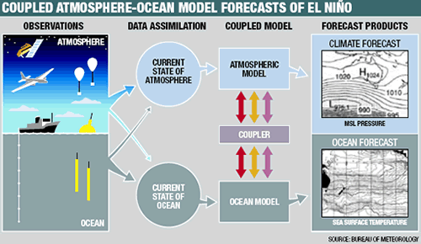
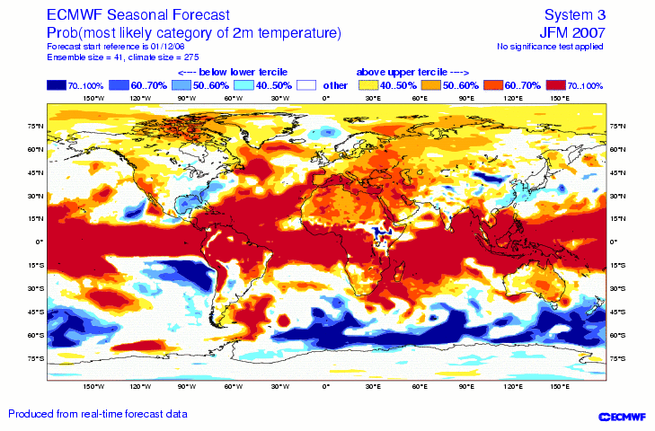
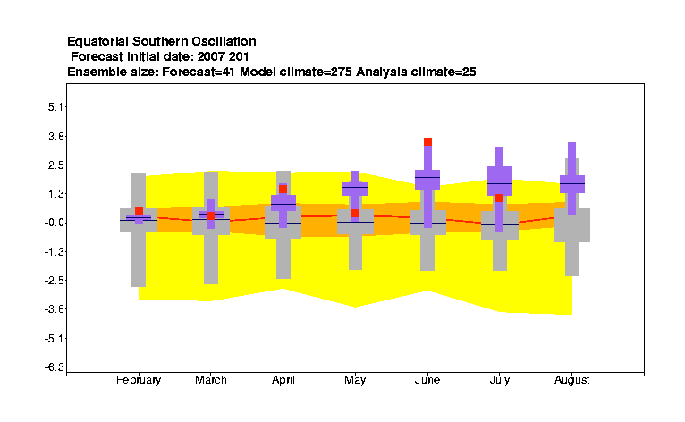

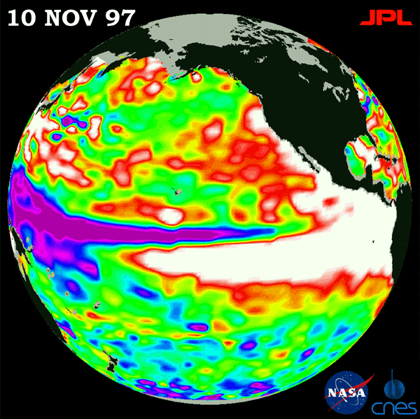
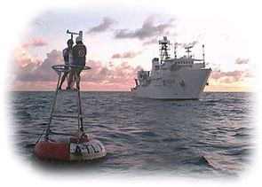
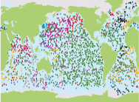
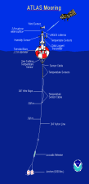
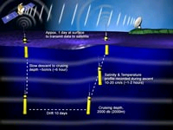
End-To-End forecasting System
COUPLED MODEL
Tailored Forecast PRODUCTS
Atmosphere model
Ocean model
Atmosphere model
ENSEMBLE GENERATION
PROBABILISTIC CALIBRATED FORECAST
OCEAN
Ocean model
Atmosphere model
Ocean model
Initialization
Forward Integration
Forecast Calibration

Slide 4
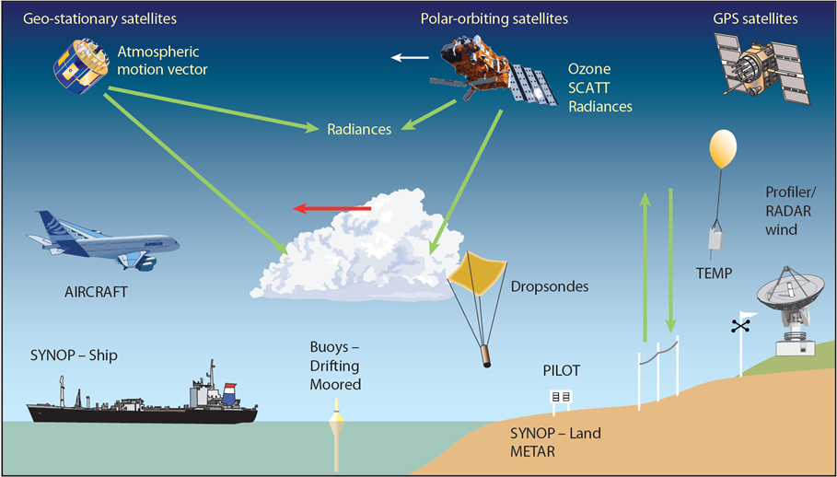
Informations to initialize the atmosphere

Slide 5
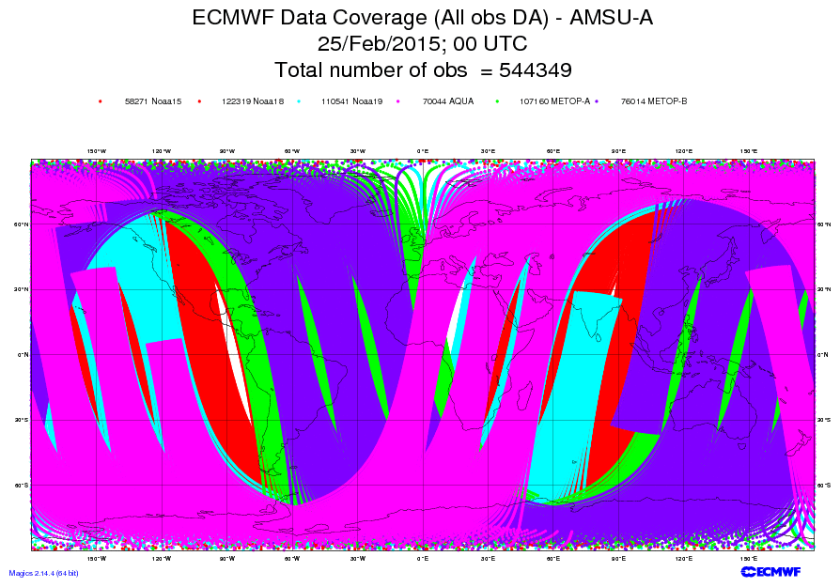
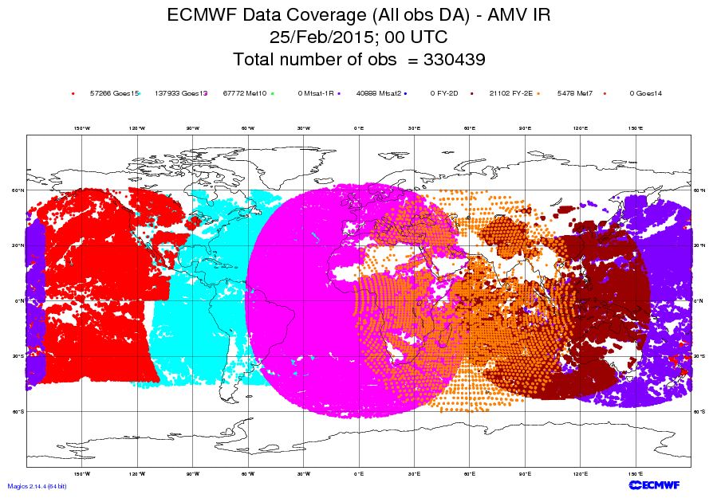
Observations coverage and accuracy
To make accurate forecasts it is important to know the current weather:
  ~ 155M obs (99% from satellites) are received daily;
  ~ 15M obs (96% from satellites) are used every 12 hours.
Notes:
Thanks to the continuous increase in the number of satellite systems, which provide today about 95% of the available observations, the whole globe is now better observed than in the past. Still, land has a larger number of more accurate observations. The ocean, for example, is still very poorly observed. Some regions still have a very limited number of high quality observations. In other words, there are still inhomogeneities in the number and quality of observations.

Slide 6
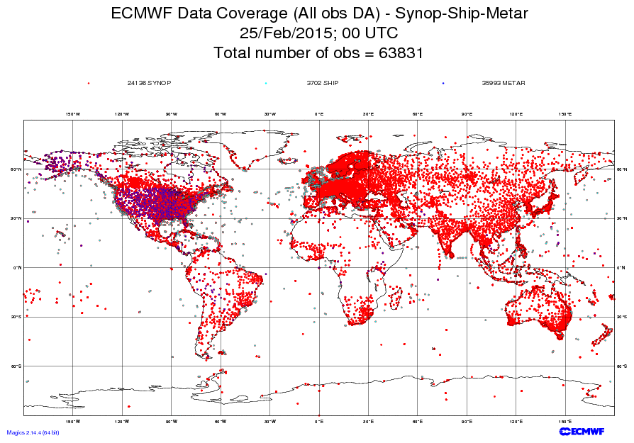
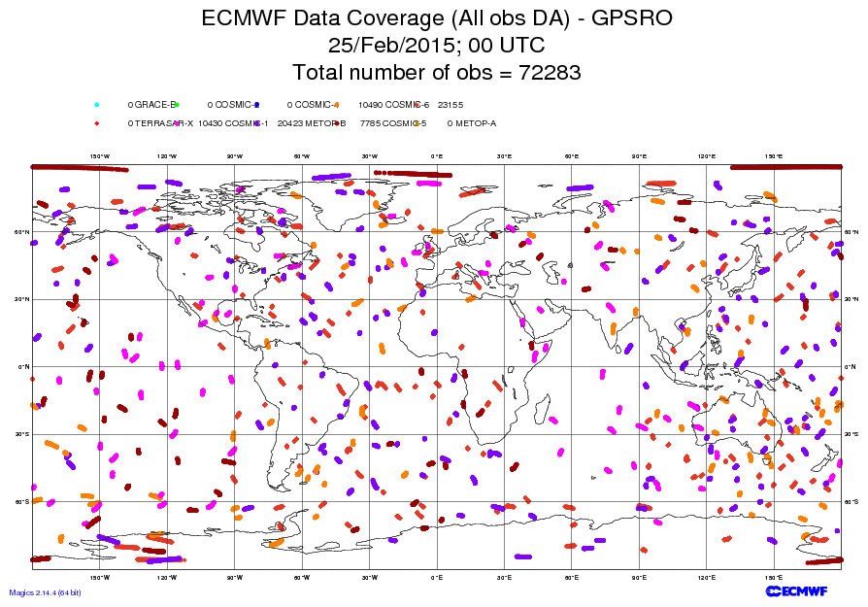
Observations coverage and accuracy
To make accurate forecasts it is important to know the current weather:
  ~ 155M obs (99% from satellites) are received daily;
  ~ 15M obs (96% from satellites) are used every 12 hours.
Notes:
Thanks to the continuous increase in the number of satellite systems, which provide today about 95% of the available observations, the whole globe is now better observed than in the past. Still, land has a larger number of more accurate observations. The ocean, for example, is still very poorly observed. Some regions still have a very limited number of high quality observations. In other words, there are still inhomogeneities in the number and quality of observations.

Slide 7
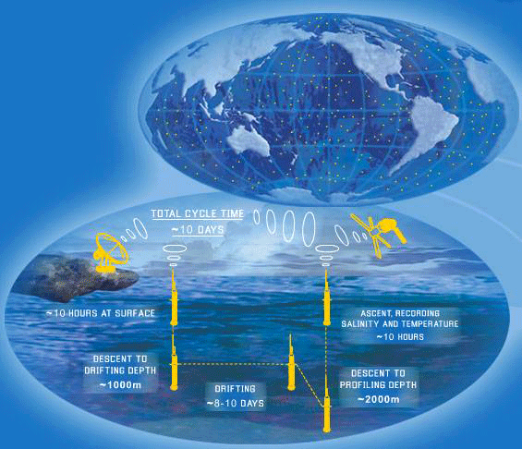
Information to initialize the ocean
Ocean model Plus:
  SST
  Atmospheric fluxes from atmospheric reanalysis
  Subsurface ocean information
Time evolution of the Ocean Observing System
1982
1993
2001
XBT’s 60’s Satellite SST Moorings/Altimeter ARGO
Notes:
Traditionally, ocean measurements (in-situ T and sometimes S) were only available form scientific cruises (CTDs) and Ships of Opportunity (XBT’s, T only).
Satellite and Ocean observations: The electromagnetic radiation does not penetrate into the ocean, so satellites can not be used to measure the ocean vertical thermal structure. They are essential for SST though.
Altimeter derived sea-level variations as a proxy for thermocline variations in well stratified regions.
The equatorial mooring arrays (TAO/TRITON in the Pacific, PIRATA in the Atlantic and RAMA in the Indian ocean) provide continous timeseries of temperature, salinity and currents (among others). The TAO moorings starting around 1993.
Argo has been a real revolution in the ocean observing system: for the first time, measurements of temperature and salinity of the upper 2000m of the ocean, uniformly distributed around the globe, are available in real time. The Argo program started around 2000, and was mature by 2005.

Slide 8
Data coverage for Nov 2005
Ocean Observing System
Data coverage for June 1982
Changing observing system is a challenge for consistent reanalysis
Today’s Observations will be used in years to come
  ▲Moorings: SubsurfaceTemperature
  ◊ ARGO floats: Subsurface Temperature and Salinity
  + XBT : Subsurface Temperature
Notes:
Which means that the observation coverage is not homogeneous in time.
Changes in the changing system can create spurious variability, if not treated with care
Notice the different spatial sampling of the ocean before and after Argo.

Slide 9
1. Satellite data used at ECMWF
70
60
50
40
30
20
10
0
Notes:
One of the key factors that has been contributing to advances in NWP have been the increased number and quality of satellite data. Thanks to advances in data-assimilation, these observations can be used to estimate the initial state in a very efficient way. Since 2010, ~ 300 million satellite observations from ~ 50 instruments are received daily (top). At ECMWF, ~ 10% of the available observations (~30 of the received ~310 million) are used daily (bottom).

Slide 10
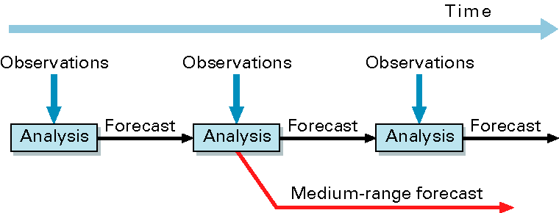
Obs are assimilated to estimate the initial state
Observations are used to correct errors in the short forecast from the previous analysis time
Every 12 hours ~ 15M observations are assimilated to correct the 100M variables that define the model’s virtual atmosphere
The assimilation relies on the quality of the model
Notes:
How do we construct initial conditions (ICs)? Observations are used to correct errors in the short forecast from the previous analysis time. Every 12 hours, about 15M observations are assimilated to correct the ~10⁸ variables that define the model’s atmosphere. At ECMWF, the assimilation is performed using a 4-dimensional approach, which merges a first guess field (generated by integrating the model equations) and the observations, at the right time. In terms of computer time, the T1279 4DVAR takes about 5 times for computer power as the 10-day T1279 forecast.

Slide 11
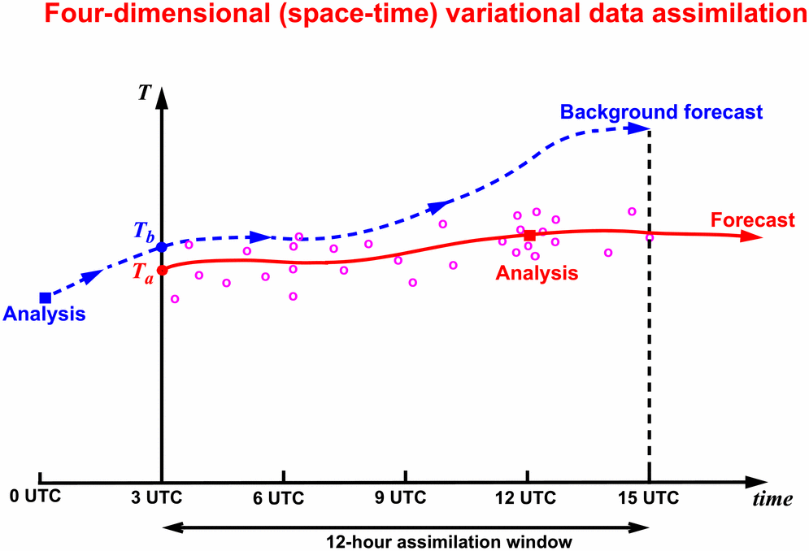
The ECMWF 4D-Var data-assimilation system
The ECMWF 4-dimensional data-assimilation system determines a correction to the background initial condition (blue line) that would lead to a forecast trajectory (red line) that passes closer to the observations (red circles).
Notes:
Before introducing the EDA, let’s very briefly remind what we mean with ‘data assimilation’. We mean a complex procedure to marge a first-guess forecast and observations to estimate the state of the atmosphere, expressed in terms of the model state variables (i.e. in model space). At ECMWF, a 4-dimensional variational assimilation system is used, with a 12 hour window. The high-resolution 4D-Var (hereafter called simply 4DVAR) has the following resolution:
3 outer loops at T_{L}1279L137
3 inner loops at T_{L}159L137 (70 iter), T_{L}255L137 (25-30 iter) and T_{L}255L137 resolution (25-30 iter)
The Ensemble of Data Assimilations (hereafter EDA) include 25 members of 4D-Var run at a lower resolution:
2 outer loops at T_{L}399L137
2 inner loops at T_{L}95L137 (50 iter) and T_{L}159L137 (25-30 iter)
In each 4D-Var cycle, the minimisation finish when DFS increase per iteration is less than 5%. Minimum 10 iterations, maximum 50 for 2nd/3rd minimization.
At the end of this lecture, in the ‘extra material’ section, you will find 4 slides that briefly summarize the key concepts behind the ECMWF 4-dimensional variational system.

Slide 12
The Assimilation corrects the ocean mean state
Mean Assimation Temperature Increment
Equatorial Pacific
(x)
Data assimilation corrects the slope and mean depth of the equatorial thermocline
z
Free model
Data Assimilation

Slide 13
Initialization shock
Initialization shock: accelerated development of model errors at the beginning of the forecasts which can be due to:
Inconsistency between model atmospheric initial conditions and model physics. Use of same model for data assimilation and model integrations reduces this problem, but often sub-seasonal and seasonal re-forecasts are initialized from the reanalysis from a different operational centre (e.g. ERA).
Usually atmosphere and ocean are initialized separately and may not be in close balance at the start of the model integrations
Possible solutions:
- Nudging technique: run the model over the past weeks/months with dynamical parameters relaxed towards analysis/re-analysis. This will ensure initial conditions to be more consistent with model physics
- Coupled data assimilation: This strategy can reduce the initialization shock, since the atmosphere and ocean models will be in closer balance at the start of the integrations

Slide 14
What about Full Coupled Initialization?
Advantages:
  Hopefully more balanced ocean-atmosphere i.c and perturbations. Important for tropical convection
  Framework to treat model error during initialization and fc
  Consistency across time scales (seamlessness):
    currently, weather forecasts up to 10 days use “extreme flux correction”, since SST is prescribed. For longer lead times a free coupled model is used. More gradual transition?
Current Approaches
  Weakly Coupled Data assimilation: FG with coupled model, separate DA of ocean and atmos.
  Example is NCEP with CFSR, and ECMWF-ESA CERA project
  Strongly Coupled Data assimilation: Coupled FG, Coupled Covariances. Usually EnKF
Challenges:
  Different time scales of ocean atmosphere . Long window weak constrain?
  Cross-covariances. Ensemble methodology more natural?

Slide 15
The ENS re-forecast suite to estimate the M-climate
…28 6 13 20 27 March …
51
T639
L91
51
T319
L91
2014
5
5
2013
5
5
5
5
5
5
5
5
Initial conditions:
ERA Interim+
ORAS4 ocean Ics+
Soil reanalysis
Perturbations:
SVs+EDA(2015)+SPPT+SKEB
5
5
2012
5
5
5
5
20y
5
5
5
5
5
5
2011
5
5
5
5
5
5
5
5
…..
5
5
1994
5
5
5
5
5
5
5
5

Slide 16
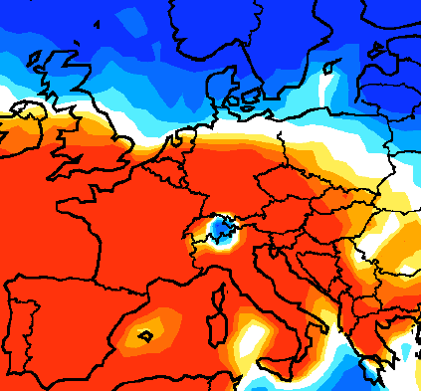
Forecast of week 1 Start: 11-05-2006
Probability of T_{2m} to be in lowest tercile
0
100 %

Slide 17
Forecast of week 1 Start: 11-05-2006
Probability of T_{2m} to be in lowest tercile
0
100 %

Slide 18
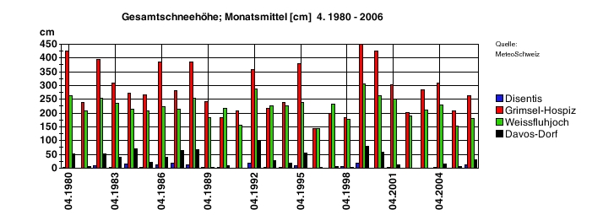
Re-forecast and real-time initial conditions need to be consistent!
Forecast of week 1
Start: 11-05-2006
Snow ANALYSIS 11 MAY
Observations
Probability of T_{2m} to be in lowest tercile
0
100 %

Slide 19
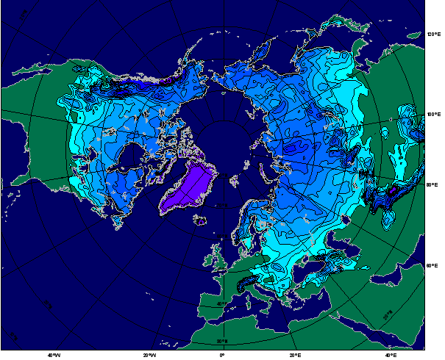
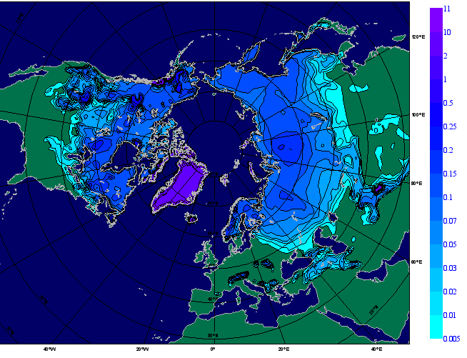
A new snow evolution from ERA-Interim surface-only offline-runs
New OSM-EI
EI
ERA-Interim snow mass before 2003 (here shown for 1st of January 1989) is artificially smooth as a result of the relaxation to a climatology. Orographic areas are more marked in the new ICs field. Snow line is quite comparable (except for Himalayas)
From Gianpaolo Balsamo

Slide 20
Surface Temperature Climatology – Day 12-18 Start dates: 1/5/1989-2008
New soil analysis – EI soil analysis
Strategy at ECMWF: “on the fly re-forecasts” initialized from Era Interim for upper level fields and offline soil re-analysis.

Slide 21
Surface Temperature Anomalies
01/05/2011- Day 5-11
Old Soil Initial Conditions
New Soil Initial Conditions
Verification Synop data

Slide 22
Ensemble generation

Slide 23
Since 1983, most producing centres have developed sub-seasonal forecasts
 | Time-range | Resol. | Ens. Size | Freq. | Hcsts | Hcst length | Hcst Freq | Hcst Size
ECMWF | D 0-32 | T639/319L91 | 51 | 2/week | On the fly | Past 20y | 2/weekly | 11
UKMO | D 0-60 | N216L85 | 4 | daily | On the fly | 1989-2003 | 4/month | 3
NCEP | D 0-44 | N126L64 | 4 | 4/daily | Fix | 1999-2010 | 4/daily | 1
EC | D 0-35 | 0.6x0.6L40 | 21 | weekly | On the fly | Past 15y | weekly | 4
CAWCR | D 0-60 | T47L17 | 33 | weekly | Fix | 1981-2013 | 6/month | 33
JMA | D 0-34 | T159L60 | 50 | weekly | Fix | 1979-2009 | 3/month | 5
KMA | D 0-60 | N216L85 | 4 | daily | On the fly | 1996-2009 | 4/month | 3
CMA | D 0-45 | T106L40 | 4 | daily | Fix | 1992-now | daily | 4
Met.Fr | D 0-60 | T127L31 | 51 | monthly | Fix | 1981-2005 | monthly | 11
CNR | D 0-32 | 0.75x0.56 L54 | 40 | weekly | Fix | 1981-2010 | 6/month | 1
HMCR | D 0-63 | 1.1x1.4 L28 | 20 | weekly | Fix | 1981-2010 | weekly | 10

Slide 24
Initial perturbations

Slide 25
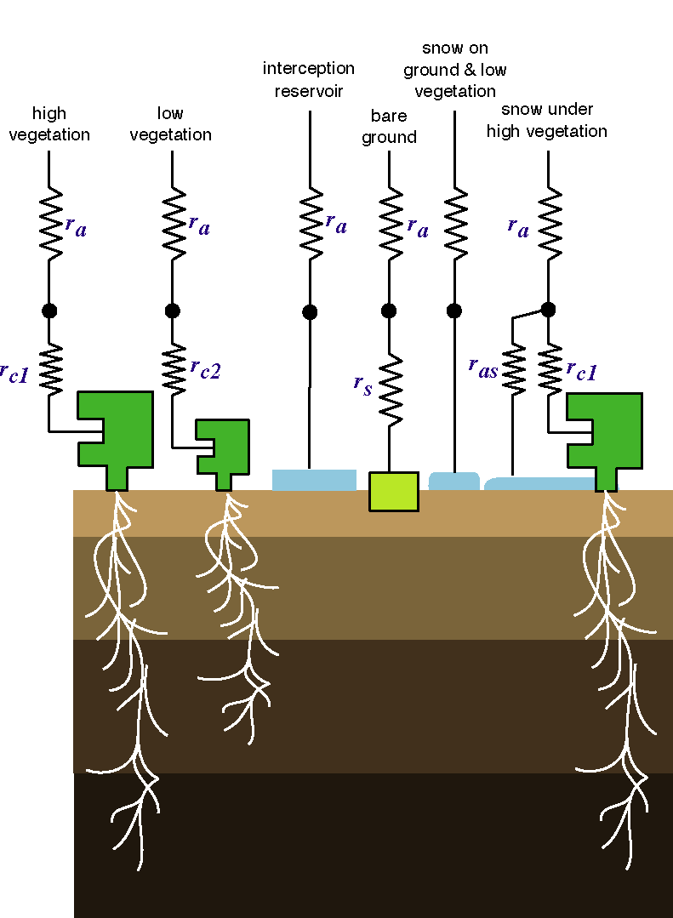
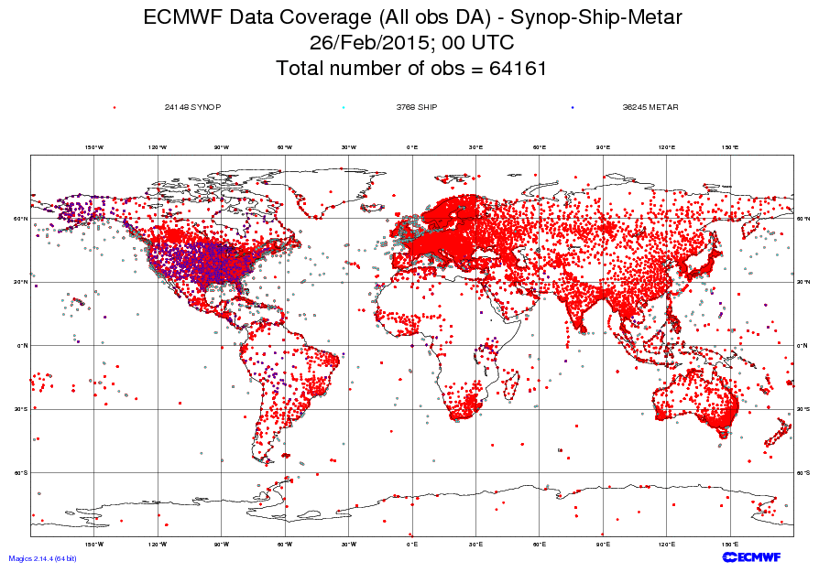
Why do forecasts fail?
Forecasts can fail because:
The initial conditions are not accurate enough, e.g. due to poor coverage and/or observation errors, or errors in the assimilation (initial uncertainties).
The model used to assimilate the data and to make the forecast describes only in an approximate way the true atmospheric phenomena (model uncertainties).
t=T2
t=T1
t=0
Notes:
The combination of initial and model uncertainties leads to wrong forecasts. With ‘model’ we mean not only the representation of physical processes in our model of the atmosphere/land/ocean (the Integrated Forecasting System, IFS), but also assumptions made in data assimilation to determine the initial conditions (ICs), and in any algorithm used to relate the ‘real’ and the ‘model’ phase spaces. Distinguishing which source is dominant is not possible, especially since modern data-assimilation systems rely strongly on the model to assimilate the observations. Models are used to relate the model and the observation phase spaces (to transform from one set of state variables to the other); initial conditions are estimated by merging, in an optimal way, first guess estimates (provided by a model forecast) with observations.

Slide 26
1. Ensemble prediction
Ensemble prediction aims to estimate the probability density function of forecast states, taking into account all possible sources of forecast error:
Observation errors and imperfect boundary conditions
Data assimilation assumptions
Model errors
Temperature
Temperature
fc_{j}
fc₀
PDF(t)
reality
PDF(0)
Forecast time
Notes:
We have seen in the previous lectures that ensemble prediction aims to estimate the probability density function of forecast states, taking into account all possible sources of forecast error:
Model errors (e.g. due to a lack of resolution, simplified parameterization of physical processes, arbitrariness of closure assumptions, the effect of unresolved processes)
Observation errors (observations have a finite precision, point observations may not be very representative of what happens inside a model grid box)
Imperfect boundary conditions (e.g. albedo, roughness length, soil moisture, snow cover, vegetation properties, sea surface temperature)
Data assimilation assumptions (e.g. relative weights given to observations, statistics).
There is not a unique way to achieve this.

Slide 27
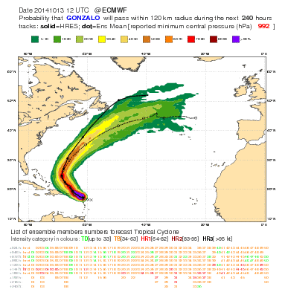
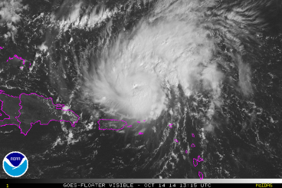
Track dispersion & predictability: Gonzalo (Oct 2014)
Gonzalo (Oct 2014) - Dispersion of ENS tracks in the 10d forecast issued on 2014.10.13@12 was relatively small for the whole 10 day range, indicating more confidence on direction of travel.
Notes:
The second case is Hurricane Gonzalo (Oct 2014), which hit Cuba and then move north-eastward in the Atlantic. In this case the tracks’ dispersion is smaller than for the case of Sandy, indicating that this was a more predictable case, with a smaller uncertainty on the path that the actual system would follow.

Slide 28
How to create initial perturbations?
Several methods:
- Lag approach: run a model every day (example ECMWF S1)

Slide 29
Burst ensemble vs lag approach
Burst approach: 1 start date, large ensemble size
CGCM
51 runs
1 start date
8 Jan 2015
Lag ensemble approach: multiple start date, small ensemble size
5 Jan
20155
6 Jan
20155
7 Jan
20155
8 Jan
2015

Slide 30
Burst ensemble vs lag approach
Burst approach
Advantage: Uses Freshest initial conditions
More control on the ensemble generation
Disadvantage: Too costly to run daily
“flip-flop” forecasts
Lag approach
Advantage: Forecasts can be updates every day
Smooth evolution of the forecasts
Disadvantage: less skilful because it uses “old” initial conditions

Slide 31
What should an ensemble prediction simulate?
Two schools of thought:
Monte Carlo approach: sample all sources of forecast error, perturb any input variable and any model parameter that is not perfectly known. Take into consideration as many sources as possible of forecast error.
Reduced sampling: sample leading sources of forecast error, prioritize. Rank sources, prioritize, optimize sampling: growing components will dominate forecast error growth.
There is a strong constraint: limited resources
(man and computer power)!
Notes:
Generally speaking, we could identify two main schools of thought:
A pure ‘Monte Carlo’ one: sample all sources of forecast error. Rationale: perturb any input variable (observations, boundary fields, …) and any parameter that is not perfectly known. Take into consideration as many sources as possible of forecast error
A ‘reduced sampling’ one: sample leading sources of forecast error (prioritize). Rationale: due to the complexity and high dimensionality of the system properly sampling the leading sources of errors is crucial. Rank sources, prioritize, optimize sampling: growing components will dominate forecast error growth.

Slide 32
How should initial uncertainties be defined?
The initial perturbations’ components pointing along the directions of maximum growth amplify most.
If we knew the directions of maximum growth we could estimate the potential maximum forecast error.
t=T2
t=T1
t=0
Notes:
How should we simulate initial uncertainties? Earlier (1980s) work suggested that random perturbations would not lead to ensemble divergence (i.e. the ensemble forecasts would be very close at forecast times). Following work by Lorenz and Farrell, we decided to perturb the initial conditions along the phase-space directions characterized by the fastest amplification rates. As a consequence, the initial PDF is stretched principally along directions of maximum growth. Initial (analysis) error components pointing along a direction of maximum growth amplifies more than a component along another direction (Buizza et al 1997), and thus dominates forecast error growth.

Slide 33
Selective sampling: singular vectors (ECMWF)
A perturbation time evolution is linearly approximated:
The singular vectors, i.e. the perturbations with the fastest finite-time growth:
are computed by solving:
time T
Notes:
At ECMWF, attention initially focused on the initial uncertainties, and a method was developed to compute perturbations with maximum growth measured in terms of total energy. The adjoint of the tangent forward propagator with respect to the total-energy norm was defined, and the singular vectors, i.e. the fastest growing perturbations, were computed by solving an eigenvalue problem. SVs are still used in the operational ENS.

Slide 34
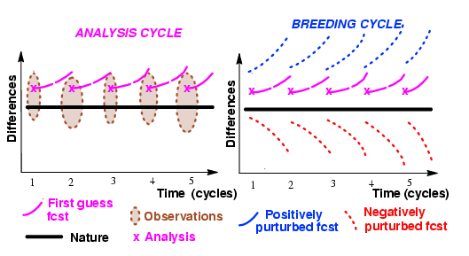
Selective sampling: breeding vectors (NCEP)
At NCEP a different strategy based on perturbations growing fastest in the analysis cycles (bred vectors, BVs) was followed
Each BV was computed by a cycle of (a) adding a random perturbation, (b) evolving and (c) rescaling it, and then repeat steps (b-c).
Notes:
At NCEP also attention initially focused on the initial uncertainties. A different strategy based on perturbations growing fastest in the analysis cycles (bred vectors, BVs) was followed (as we will discuss later, please note that today NCEP uses the Ensemble Transformed with Rescaling, ETR, method, a refinement of their original scheme). The breeding cycle was designed to mimic the analysis cycle: each BV was computed by a cycle of (a) adding a random perturbation, (b) evolving and (c) rescaling it, and then repeat steps (b-c).

Slide 35
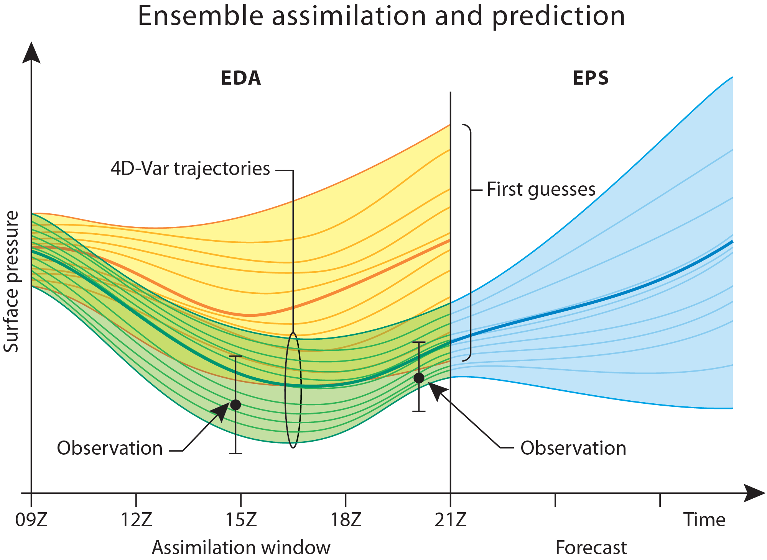
Notes:
How does EDA address these requirements? Should address them all.

Slide 36
ECMWF Ocean ensemble generation
. 5 ocean analyses/re-analyses are produced by perturbing randomly surface winds used to force the ocean model
. Random SST perturbations are added a t=0. They are randomly selected from a large number of pre-computed differences between 2 SST products. The perturbations are applied up to 60 metres.
Plans to use weakly coupled DA

Slide 37




Ensemble reliability
In a reliable ensemble, ensemble spread is a predictor of ensemble error
i.e. averaged over many ensemble forecasts,
$$x_{j}$$
Ensemble member
$$\overline{x}$$
Ensemble mean
$$σ\left(x\right)$$
Observation
$$e\left(\overline{x}\right)$$
Notes:
A reliable ensemble implies that the observation be indistinct from the ensemble members,
i.e. in a single ensemble forecast the observation may appear like an outlier, but averaged over MANY ensemble forecasts,
the root mean square error of the ensemble mean should be very similar to the ensemble spread (square root of the mean of the ensemble variances).

Slide 38



Ensemble reliability
In an under-dispersive ensemble,
$$e\left(\overline{x}\right)≫σ\left(x\right)$$
and ensemble spread does not provide a good estimate of error.
Ensemble member
$$x_{j}$$
$$\overline{x}$$
Ensemble mean
$$σ\left(x\right)$$
Observation
$$e\left(\overline{x}\right)$$
What happens when the ensemble includes no representation of model error?
Notes:
When the ensemble is persistently under-dispersive, the observation is persistently identifiable as an outlier.
Then (even averaged over many ensemble forecasts), the RMS error of the ensemble mean is larger than the ensemble spread.
And the ensemble spread cannot be relied upon to provide a good prediction of the ensemble error.

Slide 39
Model error: where does it come from?
Processes represented in the model:
Notes:
Model error arises due to uncertainty and inaccuracy in the representation of atmospheric processes, because a numerical prediction can only describe in an approximate way the true atmospheric phenomena:
Inaccuracy due to the inherent need to truncate computations: to discretize what are in reality continuous multi-scale processes; and
Uncertainty due to parameterisations of sub-grid-scale processes: simplified representations of processes that are often not well understood/constrained and are important to the large-scale flow.
The schematic illustrates the sub-grid processes represented in the IFS, each of which is associated with some uncertainty and therefore acts a source of model error.

Slide 40
Model error: where does it come from?
Any other sources: processes not captured by the underlying model?
Atmosphere exhibits upscale propagation of kinetic energy (KE)
    at ALL scales: no concept of “resolved” and “unresolved” scales
    How can the model represent upscale KE transfer from unresolved to resolved scales?
    To represent model errors:
    Use a different physic parameterization for each ensemble member (problem is that ensemble members will have different climates)
    Multi-model ensemble
    Stochastic schemes (e.g. ECMWF SPPT + SKEB)
Notes:
As well as uncertainty associated with attempted representations of processes in the model, there may be other sources of error due to processes that are missing from the current model.
One such process is the upscale transfer of energy from sub-grid scales to resolved scales – upscale energy transfer is observed to occur in the real atmosphere at all scales. Analysis of model outputs suggests that models fail to capture the upscale transfer from even close to the grid-scale; and certainly from sub-grid-scales.
The process that enables upscale transfer of energy is not well understood and proposed methods for the transfer assume stochastic projections of energy from the small-scales onto the larger scales. Such parametrisations are not routinely included in deterministic forecasts (e.g. the IFS HRES forecast), but are well suited to ensemble forecasts.

Slide 41
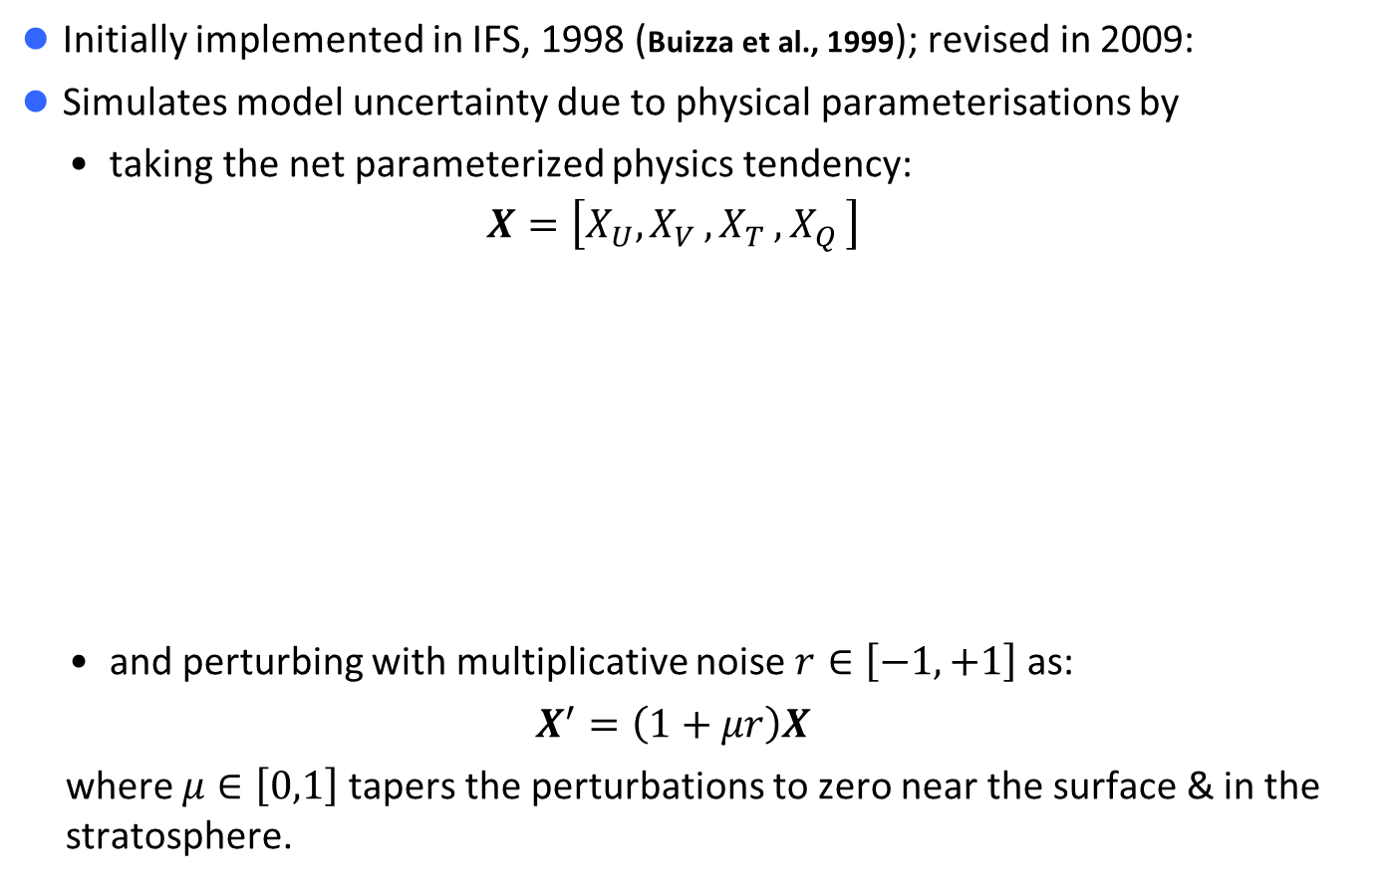
SPPT scheme
Initially implemented in IFS, 1998 (Buizza et al., 1999); revised in 2009:
Simulates model uncertainty due to physical parameterisations by
    taking the net parameterized physics tendency:
    $$X=\left[X_{U}{,X}_{V}{,X}_{T}{,X}_{Q}\right]$$
    and perturbing with multiplicative noise $r∈\left[−1,+1\right]$ as:
    $$X^{′}=\left(1+μr\right)X$$
  where $μ∈\left[0,1\right]$ tapers the perturbations to zero near the surface & in the stratosphere.
coming from | radiation | schemes
 | gravity wave drag
 | vertical mixing
 | convection
 | cloud physics
Shutts et al. (2011, ECMWF Newsletter); Palmer et al., (2009, ECMWF Tech. Memo.)
Notes:
Stochastically Perturbed Physics Tendencies (SPPT) scheme:
attempts to simulate model error due to uncertainties in the physics parametrisation schemes;
computes the net tendency from the physics parametrisations for each prognostic model variable;
modifies the net physics tendency with “multiplicative noise”:
from a 2D random pattern that covers the model domain (e.g. the globe), with numbers that range between +/-1;
2D noise field applied (multiplicatively) at every model level, modified by a factor (mu) that tapers the noise smoothly to zero in the boundary layer and in the stratosphere;
the tapered random number is added to the value 1, such that the net physics tendency is modified by a factor that ranges between ~0 and ~2, i.e. the tendency can be reduced to (almost) zero or increased to (almost) double its original value, but the SIGN of the net tendency is never changed by the perturbation.

Slide 42
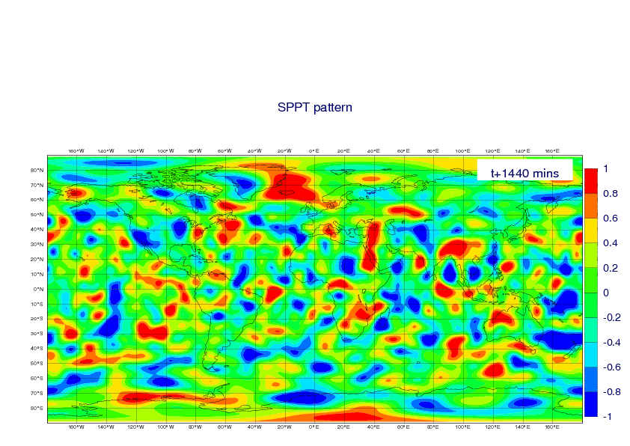
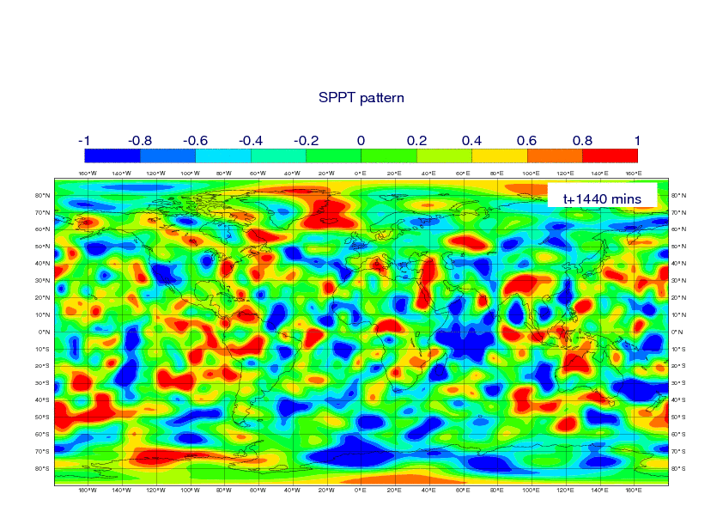
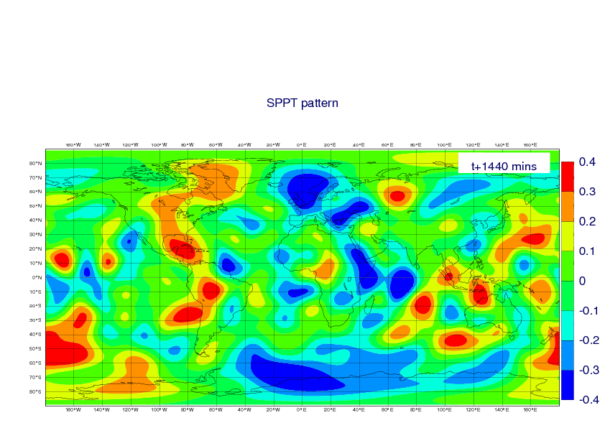
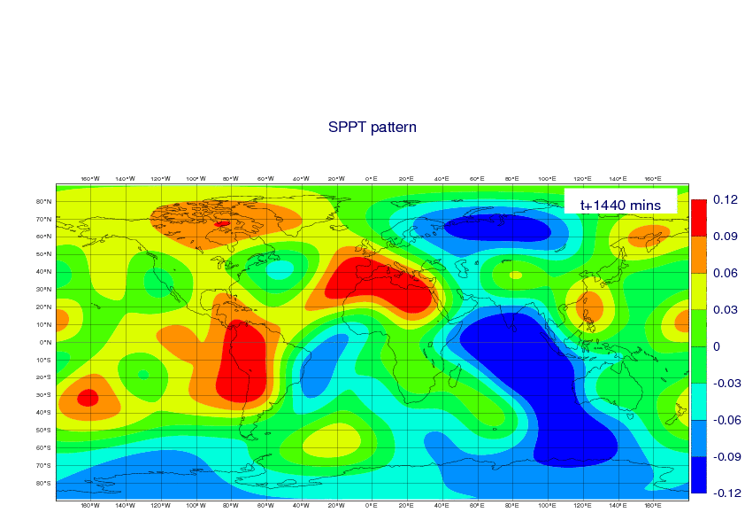
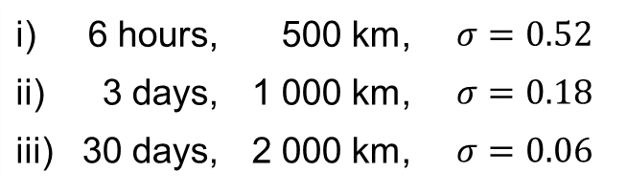
SPPT pattern
3 correlation scales:
i) | 6 hours, | 500 km,
ii) | 3 days, | 1 000 km,
iii) | 30 days, | 2 000 km,

Slide 43
SPPT pattern

Slide 44
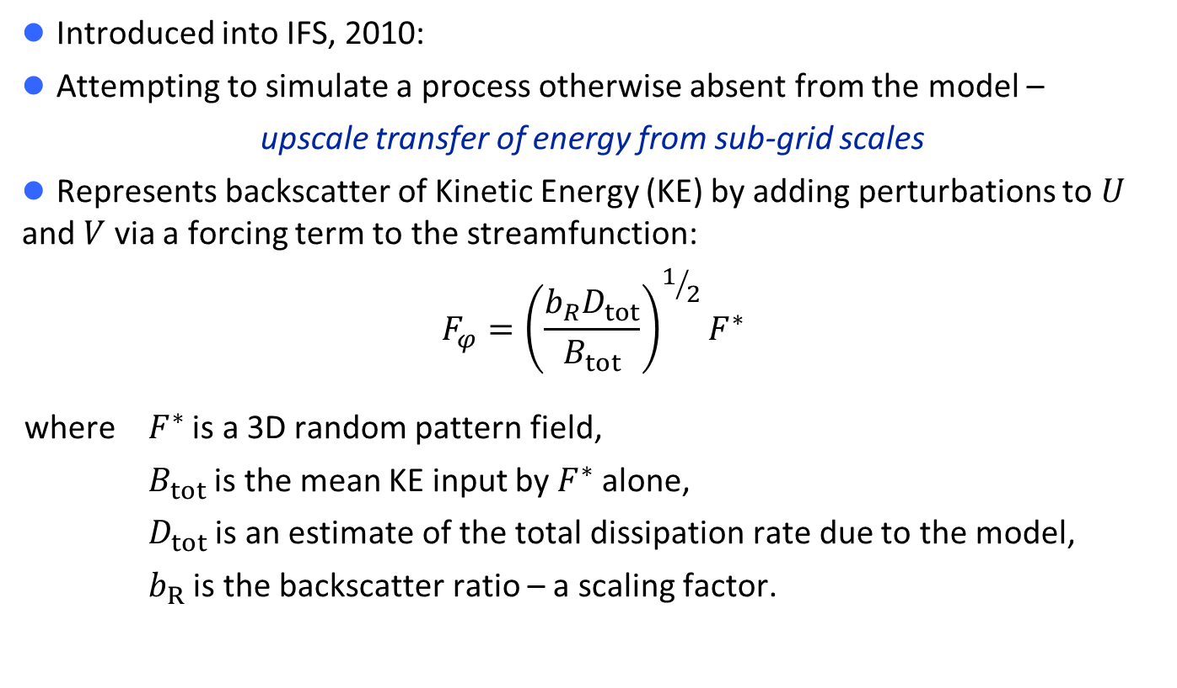
SKEB scheme
Introduced into IFS, 2010:
Attempting to simulate a process otherwise absent from the model –
upscale transfer of energy from sub-grid scales
Represents backscatter of Kinetic Energy (KE) by adding perturbations to $U$ and $V$ via a forcing term to the streamfunction:
$$F_{φ}={\left(\frac{b_{R}D_{tot}}{B_{tot}}\right)}^{1/2}F^{∗}$$
  where $F^{∗}$ is a 3D random pattern field,
    $B_{tot}$ is the mean KE input by $F^{∗}$ alone,
    $D_{tot}$ is an estimate of the total dissipation rate due to the model,
    $b_{R}$ is the backscatter ratio – a scaling factor.
Shutts et al. (2011, ECMWF Newsletter); Palmer et al., (2009, ECMWF Tech. Memo.);
Shutts (2005, QJRMS); Berner et al. (2009, JAS)

Slide 45
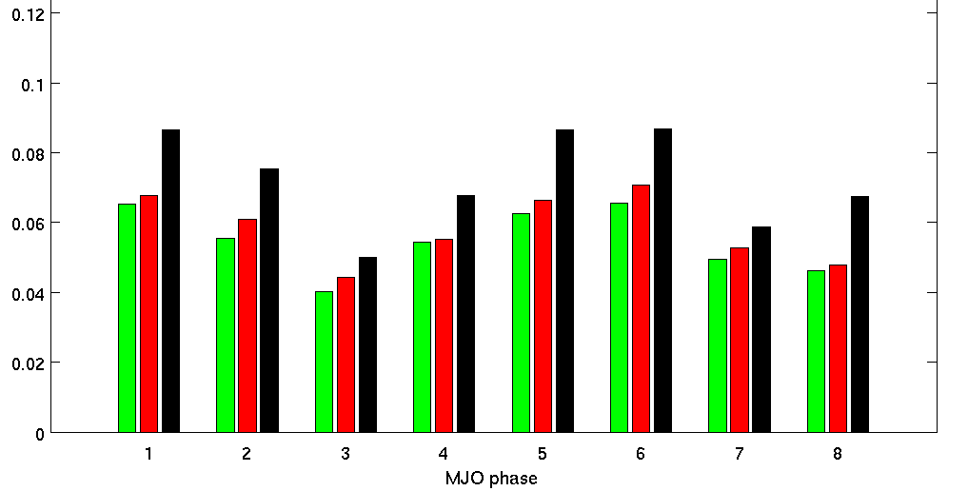
Impact of SPPT and SKEB in S4: Madden Julian Oscillation
Increased frequency of MJO events in most phases
Wheeler and Hendon Index:
projection of daily data on 2 dominant combined EOFs of OLR, u200 and u850 over 15°N-15°S
From Antje Weisheimer

Slide 46
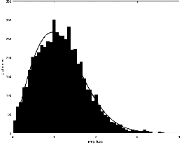
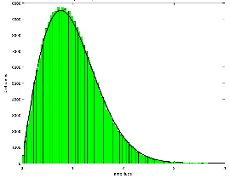
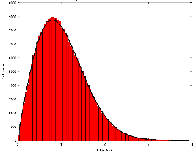
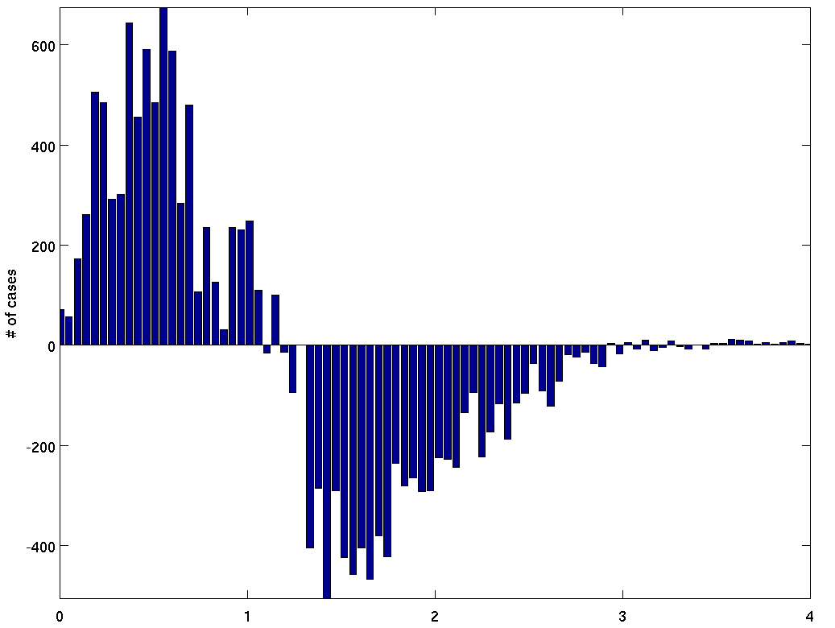
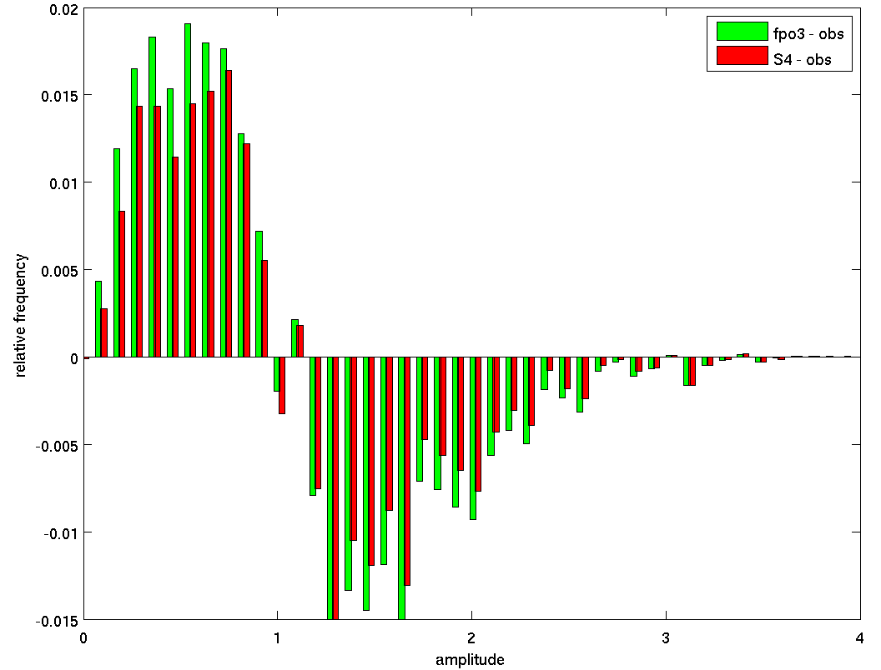
Impact of SPPT & SKEB in S4: Increased amplitude of MJO events
ERA-I
stochphysOFF
System 4
number of days
amplitude
amplitude
amplitude
stochphysOFF – System 4
stochphysOFF – ERA
System 4 – ERA
number of days
number of days
amplitude
amplitude
From Antje Weisheimer

Slide 47
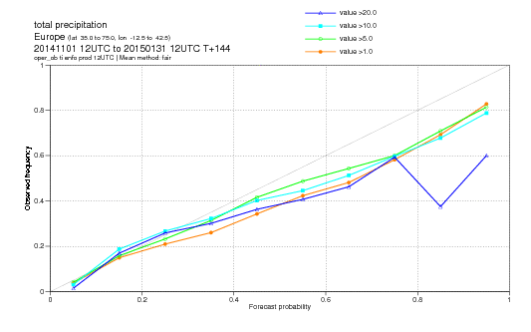
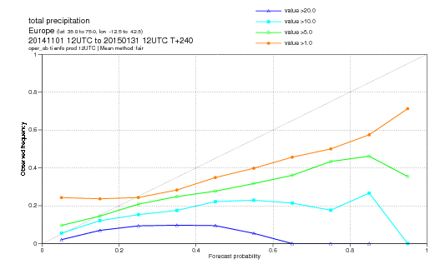
In a reliable ensemble, <fc-prob>~<obs-prob>
One way to check the ensemble reliability is to assess whether the average forecast and observed probabilities of a certain event are similar.
These plots compare the two probabilities at t+144h and t+240h for the event ‘24h precipitation in excess of 1/5/10/20 mm’ over Europe for ND14J15 (verified against observations).
T+144h
T+240h
Notes:
A necessary property that an ensemble-based, probabilistic forecast must have is ‘reliability’. There are different ways to measure whether a probabilistic forecast is reliable:
In a probabilistic forecast based on ensembles, on average, the range spanned by the ensemble members includes the verification;
Small spread indicate high predictability (i.e. small forecast errors);
A probabilistic forecast is reliable if, on average, when the forecast probability is P%, the predicted even occurs P% of the times.
This figure illustrates point (iii). It shows the ND14J15 average reliability diagram for the probabilistic prediction of 24h precipitation in excess of 1/5/10/20 mm/d over Europe, verified against synop stations, at two forecast times, 6 and 10 days.
The figures show that the reliability is much higher in the 6-day forecast, and that at both forecast times it is lower for the higher threshold (20 mm/d).

Slide 48
Spread too small for MJO prediction?
Bivariate RMS error
Ensemble mean/reanalysis
Ensemble Spread
Climatology
Notes:
Slide 19: MJO skill scores. The left panel shows the bivariate correlation and the right panel shows the bivariate RMS error (black lines).

Slide 49
Conclusions
A very large number of observations are used to initialize atmosphere and ocean
Initial shock is an important issue when starting a forecast. Coupled data assimilation/nudging techniques may help reduce initial shocks.
Re-forecast and real-time initial conditions need to be as consistent as possible
Various strategies for ensemble generation: burst vs lag ensemble. Not clear which one is optimal.
Ensemble generation includes perturbation in the initial conditions + perturbations in the model physics. Optimized for medium-range forecasts but not necessarily for extended-range forecasts.

Slide 50
2016 atmos resolution upgrade: 41r1 → 41r2
from linear (L) grid to cubic octahedral (Co) grid
Grid res | HRES | ENS LegA LegB/45d | 4DVAR Inner Loops 1st 2nd 3rd | EDA loops Outer 1st 2nd
128 km
64 km
32 km
16 km
9 km
TL159
TL159
TL255
TL255
TL255
TL191
TL191
TL319
TL319
TL399
TL399
TL639
TCo319
TL1279
TCo639
TCo639
TCo1279
Ocean model in ENS (NEMO): from 1.0º /42 lev to 0.25º /75 lev in late 2016

